Slide 1
The inter-net
Rocky K. C. Chang 13 Sept. 2010

Slide 2
Some history may help

Slide 3
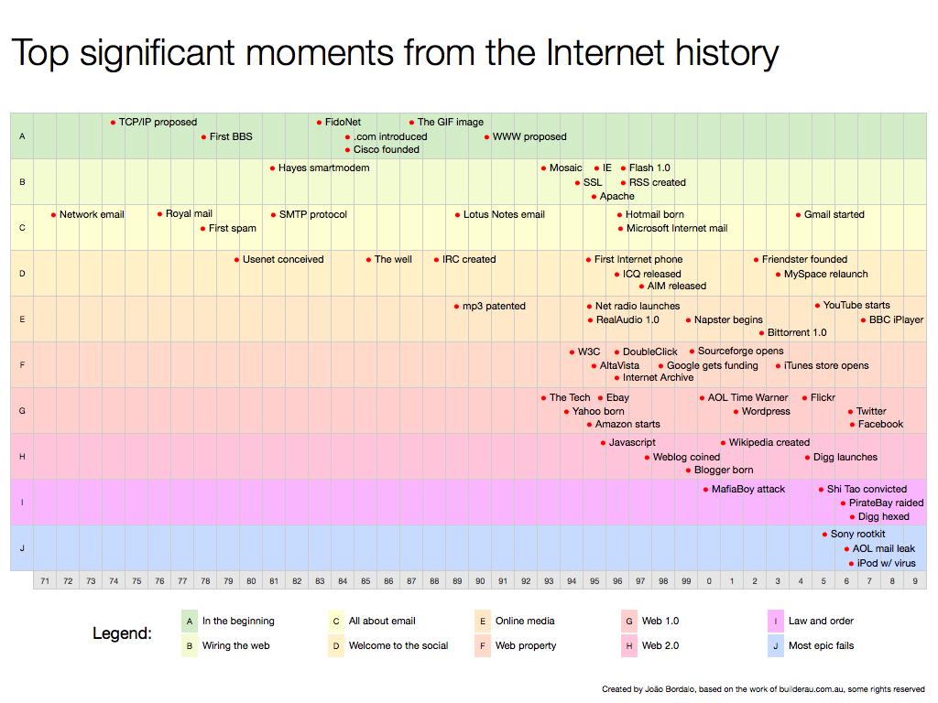
A view (http://joaobordalo.com/files/topInternetHistory.png)

Slide 4
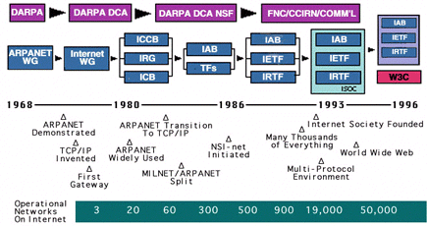
Another view
http://www.isoc.org/internet/history/brief.shtml#Timeline

Slide 5
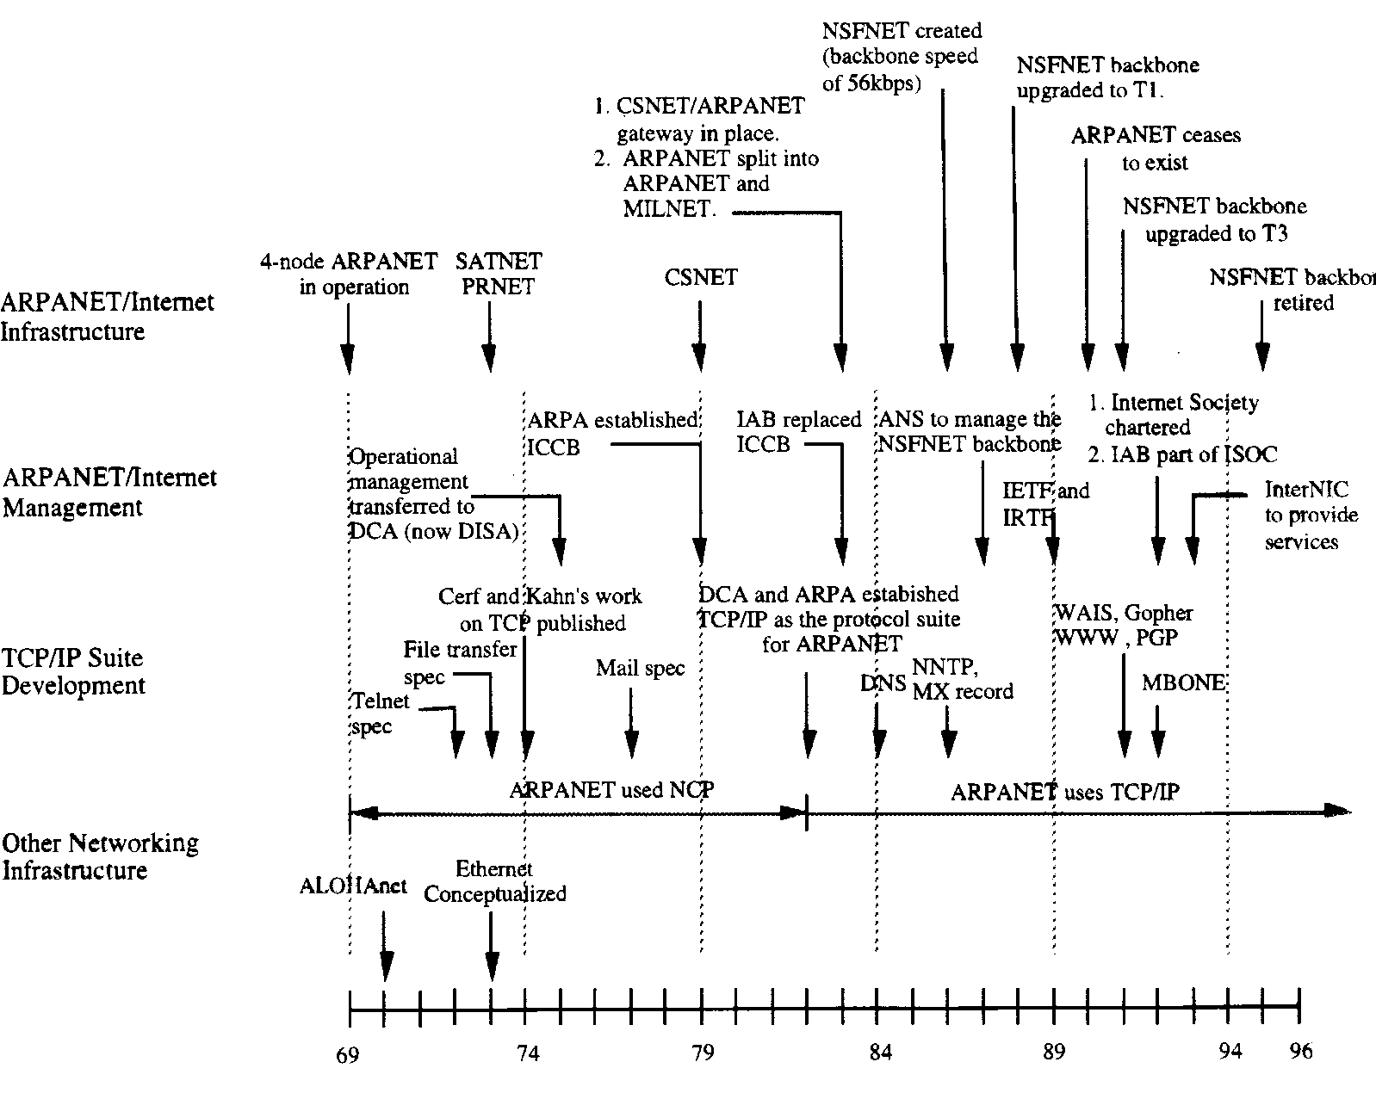
Some milestones

Slide 6
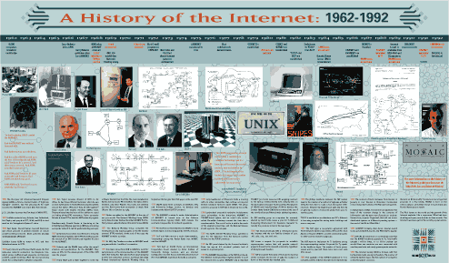
http://www.computerhistory.org/internet_history/

Slide 7
Fathers of the Internet
Vinton Cerf
Bob Kahn
INTERNET PIONEERS CERF AND KAHN TO RECEIVE ACM TURING AWARD Team Developed Architecture for Computers to Communicate
(http://campus.acm.org/public/pressroom/press_releases/2_2005/turing_2_14_2005.cfm)
Leonard Kleinrock (http://www.cs.ucla.edu/~lk/LK/Inet/birth.html)

Slide 8
Recent developments

Slide 9
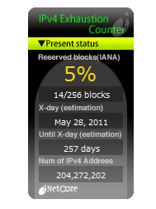
Running out of IPv4 addresses
http://www.potaroo.net/tools/ipv4/index.html

Slide 10
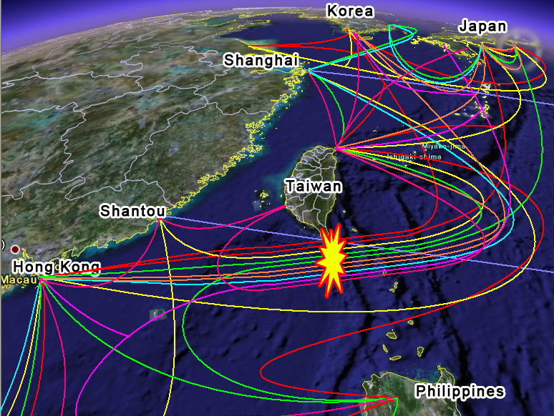
Providing reliable service

Slide 11
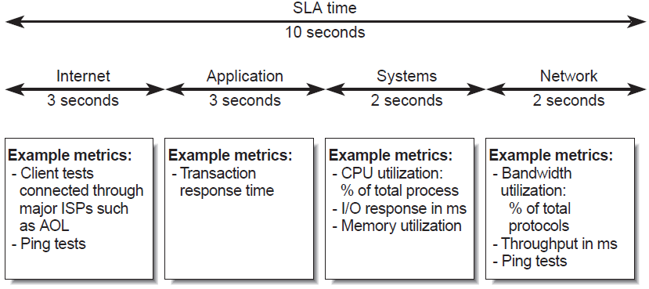
Providing quality service
http://www.sun.com/blueprints/0402/sla.pdf

Slide 12
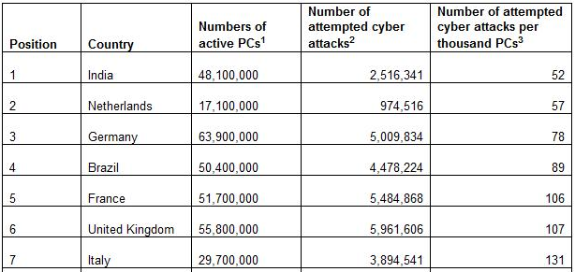
Providing secure services
“India tops list of most cyber secure nations”
http://www.techdigest.tv/2010/07/secureworks_wor.html

Slide 13
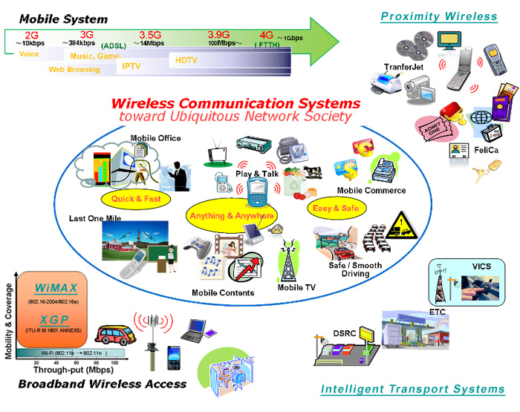
Ubiquitous access
http://www.arib.or.jp/english/html/wireless/

Slide 14
TCP/IP

Slide 15
From ARPANET to Internet
Internet is a network of networks (network integration).
Started off as an experimental packet-switched network
Packet switching (vs. circuit switching and message switching)
4-node ARPANET
BBN Technologies
Create a logical network on top of different physical networks.

Slide 16
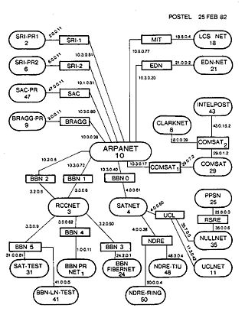
http://en.wikipedia.org/wiki/History_of_the_Internet

Slide 17
The TCP/IP protocol suites
Internet protocol suite, or TCP/IP protocol suite
TCP/IP becomes the de facto standard for open system networking less than ten years ago (replaced the OSI protocol).
No one owns the TCP/IP technology
The Internet Architecture Board (IAB) (www.iab.org)
The Internet Engineering Task Force (IETF) (www.ietf.org)
The Internet Corporation for Assigned Names and Numbers (ICANN) (www.icann.org)

Slide 18

Who is this?
http://www.zazzle.com/al_gore_i_invented_the_internet_flyer-244389381295438644

Slide 19
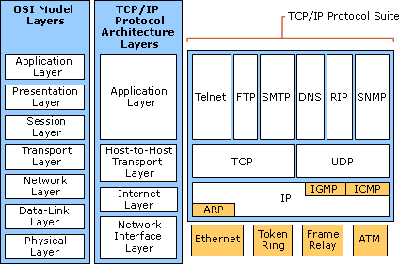
OSI vs TCP/IP
http://technet.microsoft.com/en-us/library/cc786128(WS.10).aspx

Slide 20
ICANN - Internet Corporation for Assigned Names and Numbers
… dedicated to keeping the Internet secure, stable and interoperable. It promotes competition and develops policy on the Internet’s unique identifiers.
The Internet Assigned Numbers Authority (IANA)
Regional Internet registries
AfriNIC
ARIN
APNIC
LACNIC
RIPE NCC

Slide 21
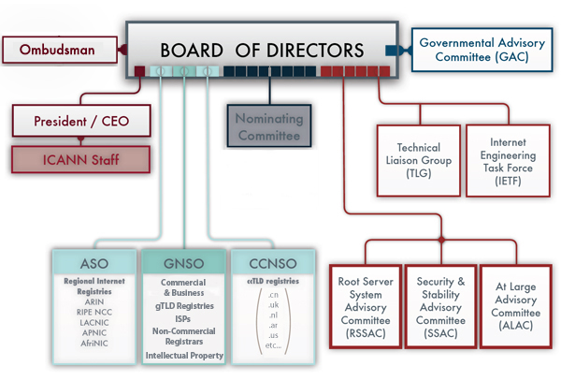
http://www.icann.org/en/about/

Slide 22
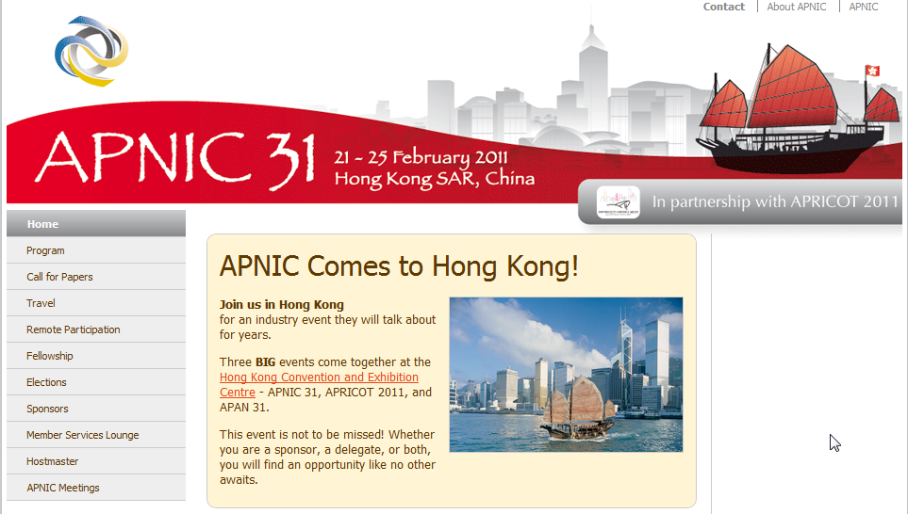
APNIC/APRICOT 2011

Slide 23
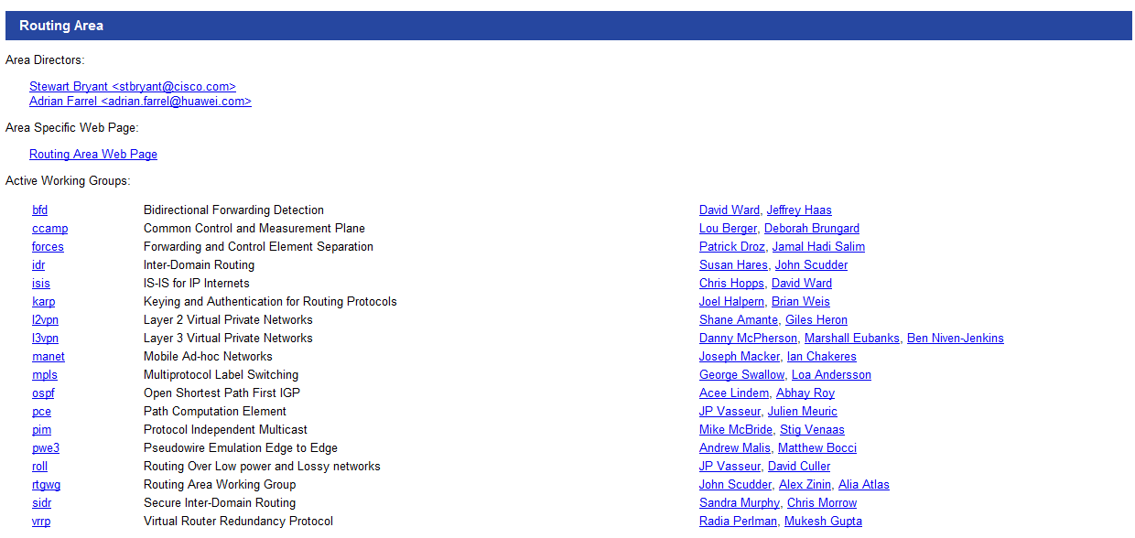
IETF

Slide 24
The model
A four-layer model (hour-glass)
The hour-glass model is everywhere.
Application
FTP
HTTP
NV
TFTP
Transport
TCP
UDP
Network
IP
Data-link
…
NET
1
NET
2
NET
n

Slide 25
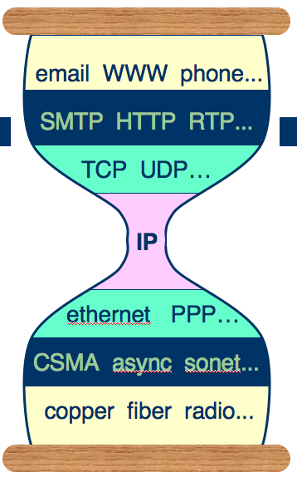
The hour-glass model
http://www.artofteachingscience.org/?p=291

Slide 26
The protocol suite

Slide 27
Conclusions
History of the Internet
Recent developments of the Internet
Management and engineering sides of the Internet
The TCP/IP protocol suites

Slide 28
Acknowledgements
Thanks to all the sources where the diagrams were extracted from.

