Slide 1
Congestion Control in Internet
Dr. Rocky K. C. Chang October 25, 2010

Slide 2
The network congestion problem
Problem: How to effectively and fairly allocate network resources among a collection of competing users?
Congestion is the state of sustained network overload.
Limited link bandwidth, buffer space at routers, and processing speed.
Congestion collapse (or Internet meltdown)
A state where any increase in the offered load leads to a decrease in the useful work.
E.g., small packets and ICMP source quench (RFC 896)

Slide 3
The network congestion problem

Slide 4
Myths about congestion control #1
Congestion will be resolved when memory becomes cheap enough to allow infinitely large memories.
Too much memory is more harmful.
Create very long delay => timed out and retransmissions
Packets are dropped after consuming precious network resources.

Slide 5
Myths about congestion control #2
Congestion will be resolved when high-speed links become available.
Introducing high-speed links without proper congestion control can lead to reduced performance.
Took 7 hours instead of 5 minutes
S
D
Upgrade from 19.2 kb/s to 1 Mb/s

Slide 6
Myths about congestion control #3
Congestion will be resolved when the speed of processor is improved.
Similar to myth #2 that introducing a high-speed processor may increase a mismatch.
Even if all links are upgraded to the same speed, mismatch still occurs.

Slide 7
Congestion ctl vs resource allocation
Congestion control and resource allocation are two sides of the same coin.
If actively allocate resources, then congestion can be avoided.
If no resource allocation, then congestion control is needed to allocate resources when congestion occurs.

Slide 8
Resource allocation
Imply some form of resource reservation and states in the routers.
Reservation-based:
The end host asks the network for a certain amount of capacity at the time a flow is established.
The flow would not be admitted if the request cannot be entertained (admission control).
A reservation-based system always implies a router-centric resource allocation mechanism.
E.g., ATM, RSVP for IP networks (Intserv)

Slide 9
Congestion control (the best effort service)
Since the states are kept in the end hosts, congestion control mechanism are implemented there.
End-to-end congestion control
Need indicators for congestion: explicit (ECN bit) or implicit (packet losses)
Feedback-based: Sending rate depends on the feedback signal (ACKs).
Assistance from routers, who know better?
Window-based (or credit-based) vs rate-based

Slide 10
Congestion control (the best effort service)

Slide 11
Other important issues
Fairness (of using the network resources)
Between TCP flows (cooperative users) and nonTCP flows (usually noncooperative users)
Between TCP flows (one with a longer RTT)
Between TCP implementations
NonTCP flows may be TCP-friendly if
“their long-term throughput does not exceed the throughput of a conformant TCP under the same conditions.”
Indices and algorithms for fairness, e.g., Jain’s index and max-min algorithms.

Slide 12
Fairness measures

Slide 13
What are needed?
An end-to-end congestion control protocol
Assistance from the routers
Indicate congestion explicitly
Scheduling discipline (e.g., FCFS, fair queuing) for controlling the bandwidth allocation for different flows.
Buffer management (e.g., shared buffer pool, per-flow allocation) for determining how the buffer space is shared between different flows.
Queue management (e.g., drop tail, RED) for controlling the length of queue by selecting which packets to drop.

Slide 14
Resource management in routers

Slide 15
Congestion control in TCP
TCP interprets packet losses as a sign of congestion rather than corrupted packets.
TCP needs to create packet losses to find the available bandwidth of the connection.
Signs: timing out or receiving duplicate ACKs
TCP (1) recovers lost data, and (2) performs congestion and flow control.
Doing (1) without (2) causes “congestion collapse.”
A congestion collapse occurred in Oct., 1985.

Slide 16
Congestion control in TCP
TCP uses the sliding window protocol to handle congestion control and flow control.
TCP uses +ve acknowledgments to self-clock its data transmission.
The rate of data transmission depends on the rate of acknowledgment received by the sender.
Four algorithms (RFC 2581):
Slow start and congestion avoidance
Fast retransmit and fast recovery

Slide 17
Slow start and congestion avoidance
Slow start is used to start up the self-clocking process.
There are no ACKs at the start up of a TCP connection.
The connection has no information about the network congestion.
The congestion avoidance algorithm
This algorithm is used when the sending rate is close to the full capacity of the network.
Some knowledge about the network congestion is assumed.

Slide 18
Slow start and congestion avoidance
Sender-side congestion window and a slow start threshold
Congestion window
The congestion window is imposed by the sender for congestion control purpose (size = cwnd).
The receiver’s advertised window (size = rwnd) is imposed by the receiver for flow control purpose.
The sender window = min{cwnd, rwnd}
Slow start threshold (ssthresh)
A cutoff point between slow start and congestion avoidance phases
Additive increase/multiplicative decrease

Slide 19
Slow start and congestion avoidance
Slow start algorithm is used when cwnd < ssthresh.
Congestion avoidance algorithm is used when cwnd > ssthresh.
Either can be used when cwnd = ssthresh.
Initial values:
cwnd should be set to at most 2MSS bytes.
ssthresh is set to rwnd in some implementations.

Slide 20
Slow start and congestion avoidance
20
15
10
5
Congestion due to timeout
0 5 10 15 20 25

Slide 21
Slow start algorithm
Problem: When a TCP connection just starts up, it lacks ACKs to self-clock its data transmission.
Put it another way, how to start the self-clocking process?
This issue also concerns a long idle TCP connection.
Two approaches:
Send as many segments as possible (uncooperative and selfish) or
Start with one or two segments (cooperative).

Slide 22
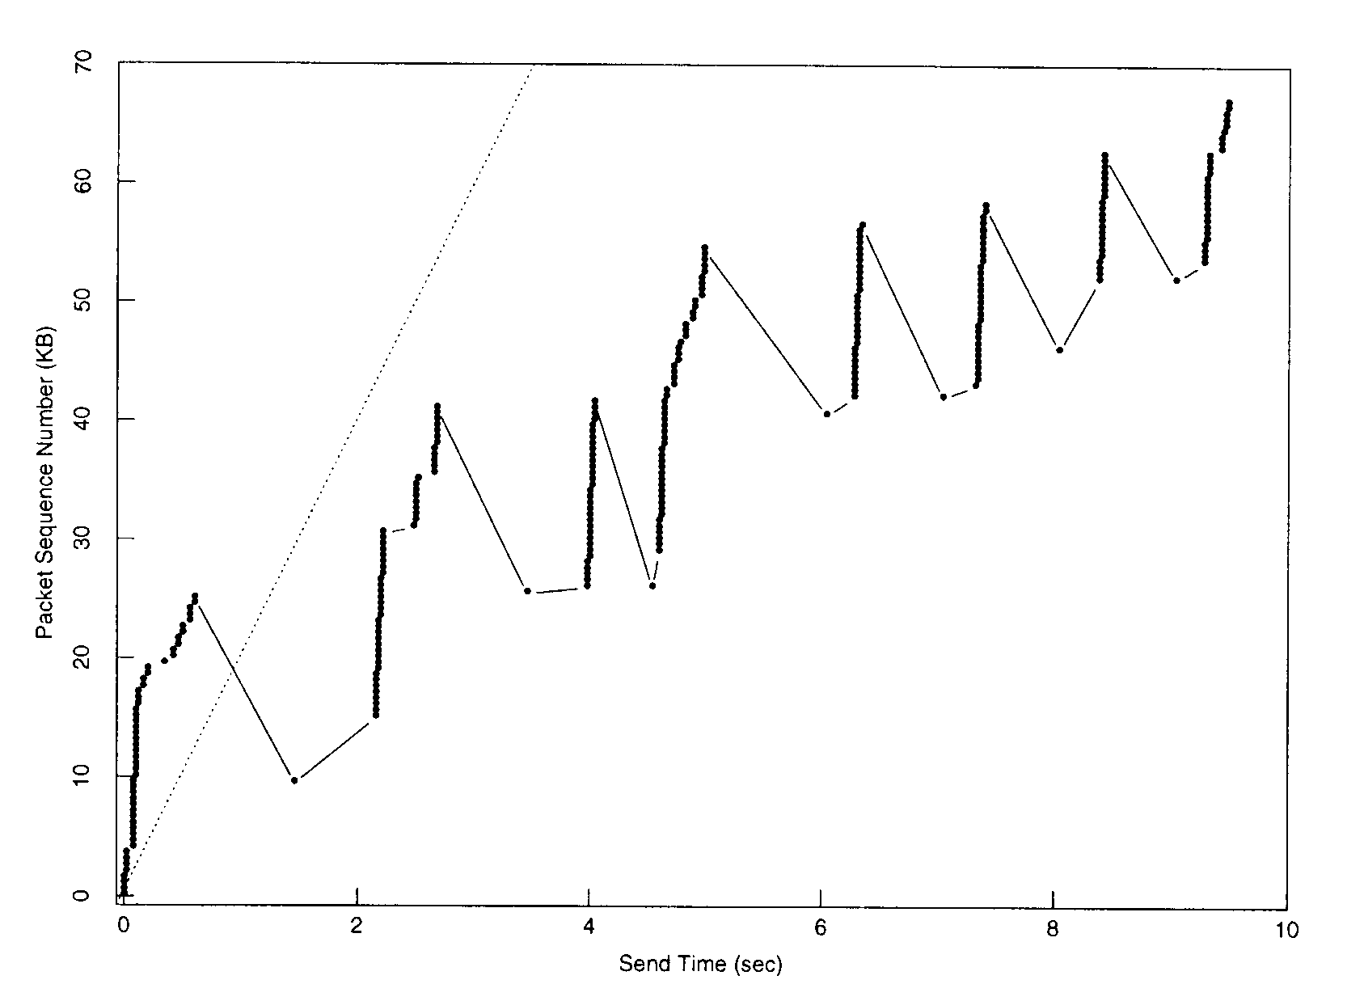
Startup of TCP without slow start

Slide 23
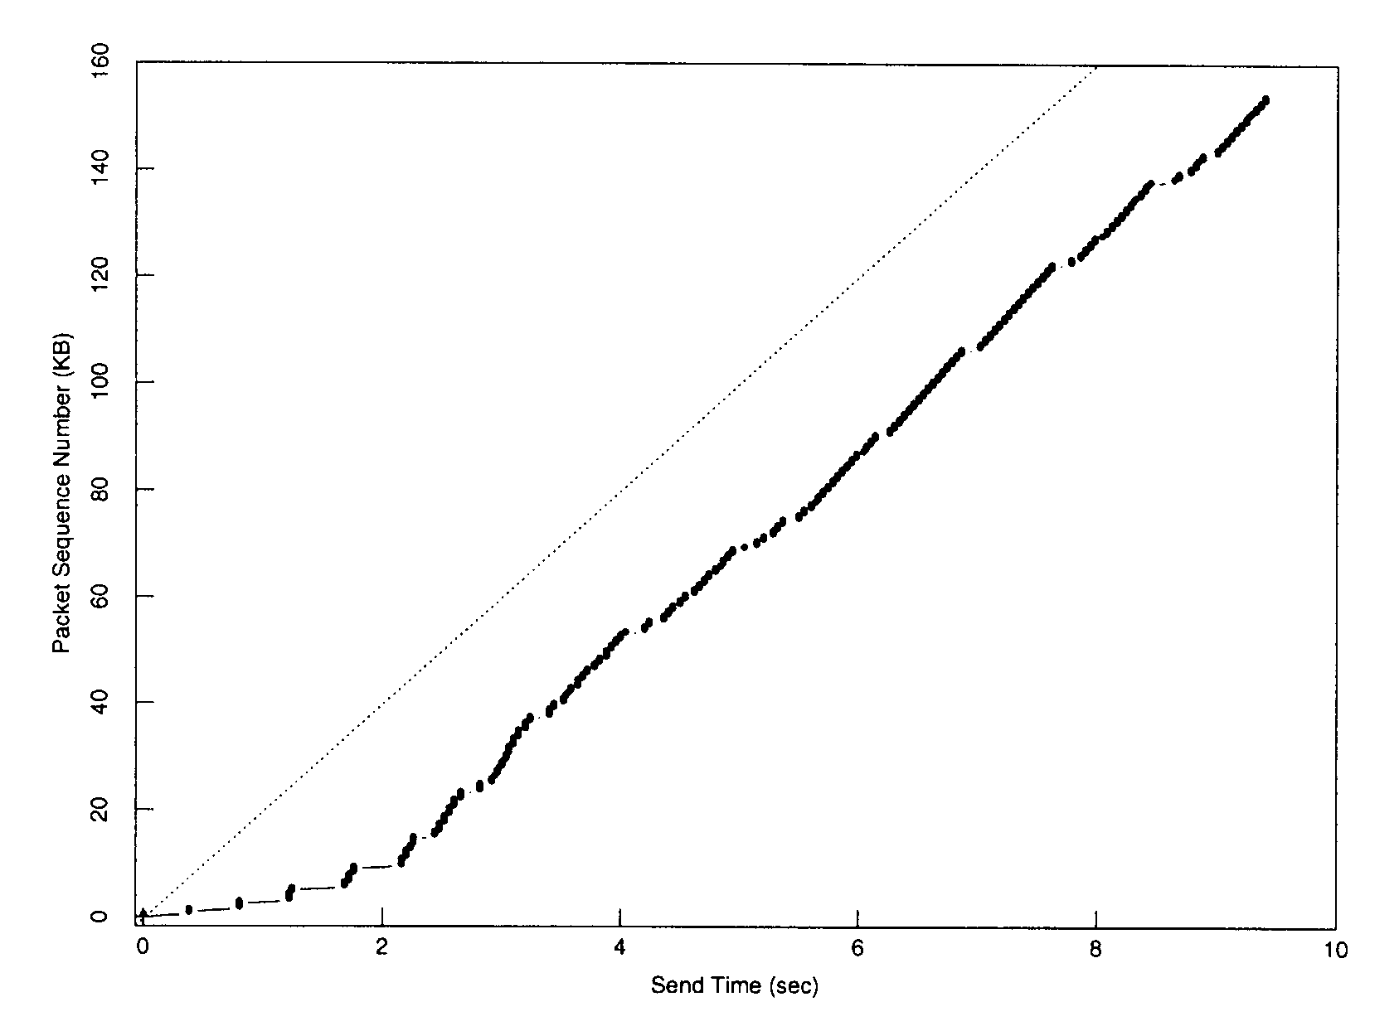
Startup of TCP with slow start

Slide 24
Slow start algorithm
Multiplicative increase in cwnd:
TCP increments cwnd by at most MSS bytes for each ACK received that acknowledged new data.
It is desirable to get out of the slow start phase as soon as possible.
Slow start ends when
cwnd exceeds ssthresh (entering congestion avoidance phase) or when
congestion is observed (drop the window and start slow-start again).

Slide 25
Slow start algorithm
Source
Destination
…

Slide 26
Congestion avoidance algorithm
Additive increase in cwnd:
The idea is to increase the cwnd by one MSS-sized segment when a full window of segments is acknowledged.
In actual implementation, when a nonduplicate ACK arrives, cwnd += MSS×(MSS/cwnd)*
When the receiver acknowledges every segment, * proves slightly more aggressive than 1 segment per RTT.
When the receiver acknowledges every other segment, * is less aggressive.
Congestion avoidance continues until congestion occurs.

Slide 27
Congestion avoidance algorithm
Source
Destination
…

Slide 28
When congestion occurs
When a TCP sender detects congestion from timeout,
The value of ssthresh is set to no more than
max{Flightsize / 2, 2MSS}
Flightsize is the amount of data that has been sent but not yet acknowledged.
In some implementation, cwnd is mistakenly used instead of Flightsize.
The value of cwnd is set to no more than 1 MSS bytes, regardless of the initial setting.
Retransmit the lost segment and start the slow start algorithm again.

Slide 29
Fast retransmit and recovery
The main idea of quickly detecting a lost segment is to count the number of duplicate ACKs received.
If only a small number of duplicate ACKs is received, the missing segment could still be in the network.
If a large number of duplicate ACKs is received, the likelihood that the missing segment is lost is high.
Use the 3rd duplicate ACK (a total of 4 identical ACKs) to signal that the missing segment is considered lost.

Slide 30
Fast retransmit and recovery
The fast retransmit and fast recovery algorithms are usually implemented together:
When the third duplicate ACK is received,
Set ssthresh to no more than max{Flightsize / 2, 2MSS}.
Retransmit the missing segment.
Set cwnd = ssthresh + 3. The “3” accounts for the number of segments that are received (inflating the congestion window).
Each time an additional duplicate ACK arrives, increment cwnd by 1 MSS (and send a new segment if possible).

Slide 31
Fast retransmit and recovery
When receiving an ACK that acknowledges new data (cumulative acknowledgment of the missing segment and others), set cwnd = ssthresh.
These two algorithms may not recover very efficiently from multiple losses in a single flight of packets.

Slide 32
Retransmission ambiguity
Problem: When retransmission occurs, how would the sender know whether the received ACK is for the original segment or the retransmitted segment?
The answer to the question above affects the timeout estimate.
One simple solution is to exclude the RTT measurements for retransmitted segments.
Does this solution work?

Slide 33
Karn’s algorithm
When a timeout or retransmission occurs,
Do not update the RTT estimator when the ACK for the retransmitted segment arrives.
Moreover, set RTO = γ RTO, γ > 1 (backoff RTO).
Calculate a new RTO when an ACK is received for a segment that was not retransmitted.

Slide 34
Buffer management
Determine how the router’s buffer space is shared between different flows, in particular for the same output interface.
Determine the number of queues.
One queue (shared buffer pool)
Per-flow queues (per-flow allocation)
Per-class queues (aggregated-flow allocation)

Slide 35
Packet scheduling
Control the bandwidth allocation by serving a certain number of packets from each flow in a given time interval.
First-come-first-served (FCFS)
Implemented a first-in-first-out (FIFO) queue.
Simple to implement: a multiplexer and a FIFO queue.
Disadvantages:
Impact all flows equally.
Benefit UDP flows over TCP flows.
A bursty flow consumes all resources.

Slide 36
Priority-based scheduling
A possible solution: strict priority queueing
Need a packet classifier, multiple queues, and a simple scheduler.
Can suffocate the lower-priority classes of traffic.

Slide 37
Fair queueing
Maintain a separate queue for each class of flows and router services these queues in a round-robin manner.
Need a packet classifier, multiple queues, and a scheduler.
Bit-by-bit round-robin (generalized processor sharing)
Packet-by-packet round-robin
Schedule the next packet that should finish transmission before others.

Slide 38
Fair queueing

Slide 39
Queue management
Control the length of the queue by determining when to drop packets and which packets to drop.
Queue management mechanisms are orthogonal and complementary to both packet scheduling and buffer management.
A single FIFO queue: FCFS schedule and a drop tail queue management
Dropping packet early enough spares buffer and packet scheduling.

Slide 40
Queue management for congestion recovery
Queue management in reaction to congestion
Tail drop policy
Packets arriving at a full queue will be dropped.
Disadvantages:
Delayed reaction to congestion
A global synchronization for TCP flows.
Reduced link utilization
Lockout (flow segregation) phenomenon

Slide 41
Queue management for congestion recovery

Slide 42
Queue management for congestion recovery
The global synchronization can be avoided by a random drop mechanism.
When a queue is full, randomly drop a packet from the queue.
The flow with most packets in the queue will most likely be dropped.
However, this scheme does not address the delayed reaction to congestion.
Active queue management (AQM): proactively drop packets to avoid congestion

Slide 43
Queue managem’t for congestion avoidance
The AQM approach also needs not use packet loss as an indication for congestion.
Instead, an AQM router may mark (instead of drop) a packet by setting a Congestion Notification bit in the IP header.
It continues to forward the marked packet.
The receiver will then set an ECN-Echo flag in the TCP header of the next TCP ACK to the sender.
The sender halves cwnd and reduces ssthresh.

Slide 44
Random early drop (RED) gateway
RED proactively controls the average queue length by “frequently” dropping/marking packets.
The RED gateway has two separate algorithms:
One for computing average queue size that determines the degree of burstiness allowed in the queue.
Another for computing packet-marking probability that determines how frequently the router marks packets.

Slide 45
Computing average queue size (from [7])

Slide 46
Computing packet-marking prob. (from [7])
P(drop)
1.0
MaxP
A
vgLen
MinThreshold
MaxThreshold

Slide 47
Advantages of RED
Avoid a global synchronization.
Eliminate the bias against bursty traffic (as in the tail drop policy).
Maintain upper bounds on router queue size even in the presence of noncooperative flows.
Penalize aggressive flows.
Reduce the number of packet drops.
Provide lower-delay interactive service.

Slide 48
Source-based congestion avoidance
Unlike the two earlier approaches, this approach relies on only sources to avoid congestion.
The main idea is for end nodes to watch for some sign from the network for congestion,
e.g., there is a measurable increase in the RTT samples or
the measured sending rate is flattened.
TCP Vegas belongs to this type of congestion control.

Slide 49
Summary
Controlling network congestion is crucial to the stability and usability of the Internet.
The congestion control problem will not go away when there are more resources in the network.
Due to the best-effort model, Internet congestion control is traditionally performed end-to-end.
With noncooperative flows, routers adopt fair queueing and other queue management schemes to ensure fairness.
Routers today also employ AQM to improve the end-to-end congestion control, fairness, and performance.

Slide 50
References
John Nagle, “Congestion control in IP/TCP Internetworks,” RFC 896, 1984.
Van Jacobson, “Congestion avoidance and control,” Proc. SIGCOMM, vol. 18, no. 4, Aug. 1988.
Raj Jain, “Congestion control in computer networks: issues and trends,” IEEE Network, pp. 24-30, May 1990.
P. Gevros et al, “Congestion control mechanisms and the best effort service model,” IEEE Network, pp. 16-26, May/June 2001.

Slide 51
References
S. Floyd, “A report on recent developments in TCP control congestion control,” IEEE Commun. Mag., Apr. 2001.
C. Semeria, “Supporting differentiated service classes: queue scheduling disciplines,” http://www.juniper.net/solutions/literature/white_papers/200019.pdf
Larry Peterson and Bruce Davie, Computer Networks: A Systems Approach, Second Edition, Morgan Kaufmann, 2000.

