Slide 1
Layer two and below
Rocky K. C. Chang 13 September 2010

Slide 2
The services at layers 1-2
The lowest two layers:
Provide a virtual link for (unreliable) packets to above
Datalink layer
Datalink layer
Provide a virtual (unreliable) bit pipe to above
Physical layer
Physical layer

Slide 3
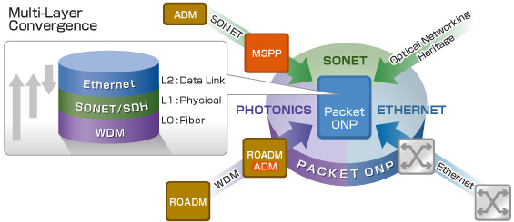
An example (from Fujitsu)
http://www.fujitsu.com/global/services/telecom/solution/photonics/mlcs/

Slide 4
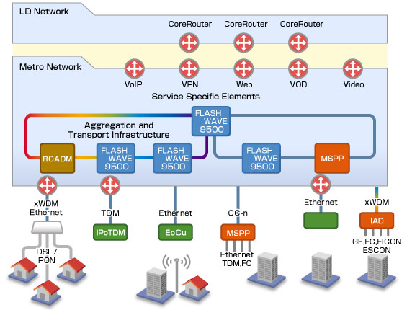
An example (cont’d)

Slide 5
Another example (from BT’s 21CN)
PSTN
Copper
PSTN
DPCN
KStream
DSL
ATM
Inter-node transmission provided by SDH/PDH platforms
CWSS
IP
Fibre
DWSS
Mesh -SDH
MSH -SDH
ASDH
PDH
End
User
~5k
nodes
~2k
nodes
~1k
nodes
~400
nodes
~100
nodes
~15
nodes

Slide 6
Another example (cont’d)
PSTN Migration
Converged Core
Class 5
Call Server
Copper
DSL
WWW
Fibre &
Copper
IP-MPLS-WDM
Agg Box
Content
ISP
End
User
~5k
nodes
~100
nodes

Slide 7
Hosts and routers
Switches and routers (highly specialized hardware)
Hosts (general-purpose computers)
Network adaptors and device drivers
Unparalleled performance improvement of memory latency and processor speed

Slide 8
A simplified architecture
CPU
Cache
Network
(T
o network)
adaptor
Memory
I/O bus

Slide 9
Network links
A network link is a physical medium carrying signals in the form of electromagnetic waves.
Point-to-point vs broadcast (or shared medium)
Wired (copper, optical fiber, OC-N) vs wireless (licensed or unlicensed)
Broadband vs narrowband (link capacity/ bandwidth)
Symmetric or asymmetric
Long haul (satellite, submarine cables) or short haul
Error rates

Slide 10
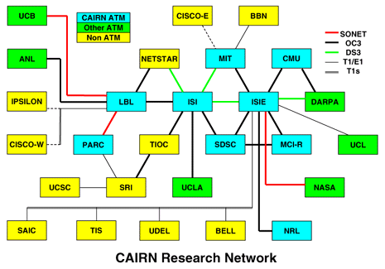
http://www.ece.udel.edu/~mills/dartnet.html

Slide 11
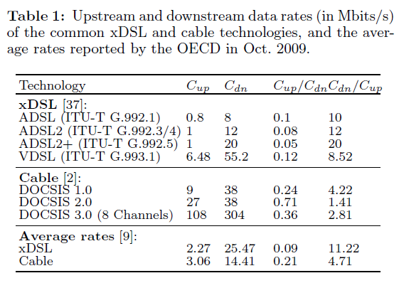

Slide 12
The five problems
Bit synchronization (need additional encoding data, such as from Manchester encoding, to delineate bits)
Frame synchronization (need additional protocols to delineate frames)
Error detection (need additional algorithms to detect errors, if occurred)
Reliable link service (need additional schemes to recover from errors)
Multiple access control problem (for shared media only; need additional protocols to share the medium)

Slide 13
Problem 1: Bit synchronization (BS)
Problem: How does a receiver synchronize with a sender, so that bits can be decoded correctly from the signals?
Solution: requires encoding (e.g., Solutions: NRZ, NRZI, Manchester, and 4B/5B).
Signalling component
Signal
Node
Adaptor
Adaptor
Node
Bits

Slide 14
Problem 2: Frame synchronization
Problem: Given that a receiver can synchronize bits sent by a sender, how does the receiver recognize bits belonging to the same frame?
Signalling component
Signal
Node
Adaptor
Adaptor
Node
Bits
Frames

Slide 15
Several solutions
Byte-oriented protocols (e.g. PPP)
Data unit in terms of bytes (ASCII, EBCDIC)
Sentinel approach vs. byte counting approach
Bit-oriented protocols (e.g. HDLC, Ethernet)
Sentinel approach
PPP’s approach:
Flag 7E
Addr FF
Control 03
Flag 7E
Protocol
Information
CRC
Protocol 0021
IP datagram

Slide 16
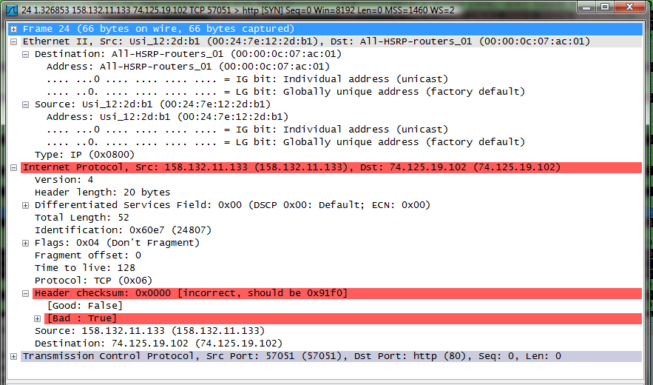
Example: Ethernet

Slide 17
Problem 3: Error detection
Transmission errors do occur, with different probabilities in different media.
Two general approaches:
Error correction code (forward error correction)
Error detection code + an error correction mechanism when errors are detected.
Insert redundancy for error correction or detection.
Common error detection methods:
Cyclic redundancy check (CRC)
Checksum

Slide 18
Examples
Error detection codes are usually inserted in more than one layer, e.g.
HTTP
TCP (16-bit checksum for the TCP header and data)
IPv4 (16-bit checksum for the IP header)
PPP/Ethernet (CRC-16, CRC-32 for the whole frame)
Why don’t we just have CRCs on the data-link layer?

Slide 19
Problem 4: Reliable link service
Recovering from transmission errors.
Solutions: error correction codes, retransmissions
Retransmissions based on positive/negative acknowledgements.
Automatic repeat request (ARQ): stop-and-wait, go-back-N, and selective repeat

Slide 20
Problem 5: Multiple access control problem
Coordinate the access to the channel from different users.
Solutions:
ALOHA protocols
Carrier sense MAC protocols (Ethernet, 802.11)
Collision-free protocols (polling, token ring, reservation)
Subchannels (frequencies, time, code)

Slide 21
Ethernet

Slide 22
Physical connectivity
Components:
Cable (passive)
Transceivers (transmitter + receiver)
Adaptor (active). Each adaptor card is uniquely identified by a 48-bit (physical or MAC) address, e.g., 00:40:26:5A:67:88.
Design principles:
Cost-effective resource sharing
Reliability
Inexpensive

Slide 23
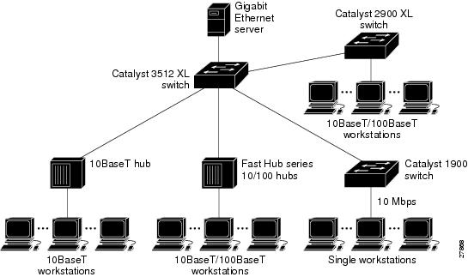
http://www.cisco.com/en/US/docs/switches/lan/catalyst2900xl_3500xl/release12.0_5_xp/swcfg/kiintro.html

Slide 24
Switched Ethernets
Both DIX and IEEE 802.3 Ethernets do not require switching elements.
Hosts are connected to a cable (10base2/5/T) through network adaptors.
Several segments may be connected (horizontally) to another segment (vertically) through hubs, which serve as repeaters.
Switched Ethernets
10G Ethernets, Optical Ethernets, Wireless Ethernets, Metro Ethernets, Carrier Ethernets

Slide 25
Ethernet frames
DIX Ethernet frame structure:
IEEE 802.3 Ethernet frame structure:
7-byte preamble
1-byte start frame delimiter
6-byte dest address
6-byte src address
2-byte type
Data
4-byte
CRC
type 0800
IP datagram
802.3 MAC
802.2 LLC
802.2 SNAP
Preamble
dest address
src address
DSAP AA
SSAP AA
cntl 03
org code 00
type
4-byte
CRC
len
Data

Slide 26
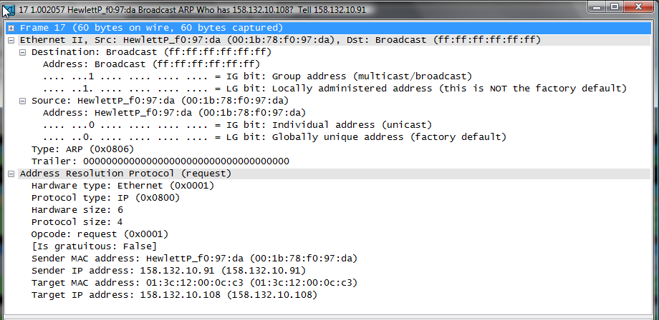
An example

Slide 27
Ethernet’s MAC protocol
Types of MAC addresses:
Unicast address: hardwired into ROM
Broadcast address: all 1 bits
Multicast address: First bit set to 1 and configurable.
Promiscuous mode
CSMA/CD (carrier sense multiple access with collision detection)
Each adaptor is able to distinguish a busy link from an idle link.
Each adaptor is able to detect “frame collisions,” if occurred, as it transmits.

Slide 28
Summary
The services at the first two layers
The five main problems at the data link layers
Solutions to the problems
The Ethernet

Slide 29
Acknowledgements
Thanks to all the sources where the diagrams were extracted from.

