Slide 1
An overview
Rocky K. C. Chang 13 Sept. 2010

Slide 2
The web

Slide 3
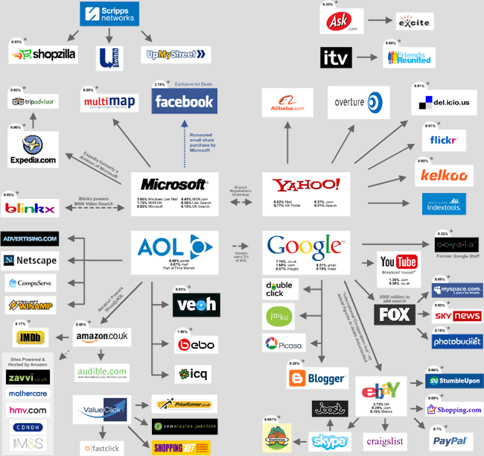

Slide 4
The web
Web browser in a host
Finding resources (web, search facilities)
DNS: resolving names to IP addresses
HTTP
TCP/IP in the host
Ethernet
Switches
Routers
TCP/IP in the server
HTTP
…

Slide 5
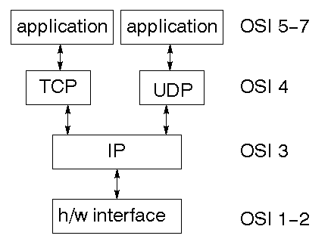
Two layers
http://www.codeproject.com/KB/IP/serversocket.aspx

Slide 6
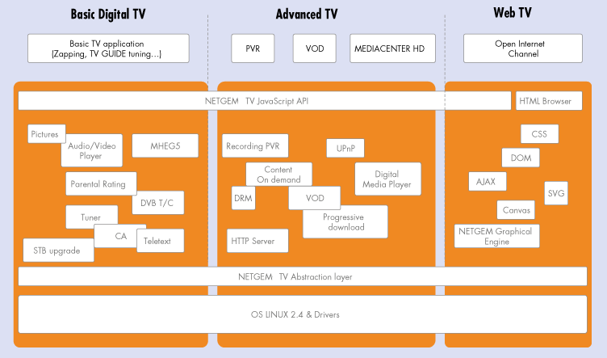
The web services (http://www.netgem.com/solutions-architecture.php)

Slide 7
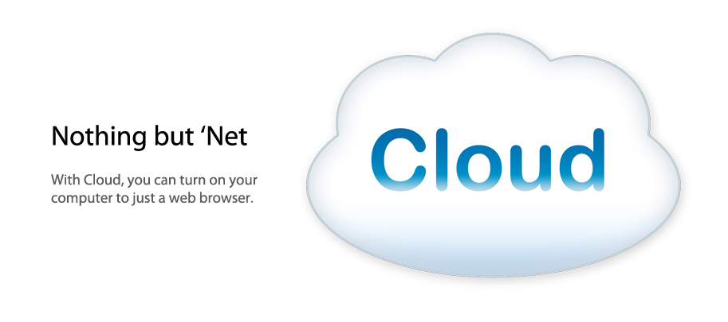
Cloud computing
http://www.thinkgos.com/index.html

Slide 8
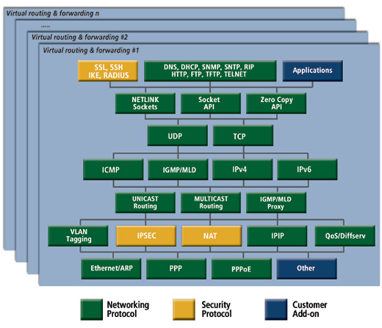
The network
http://www.ghs.com/products/comm_tcp-ip.html

Slide 9
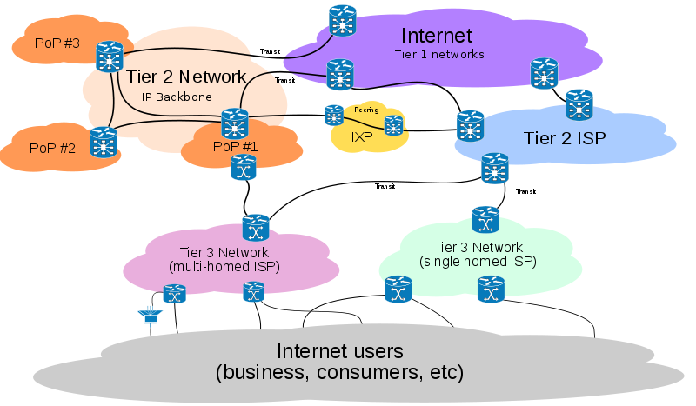
The network
http://en.wikipedia.org/wiki/File:Internet_Connectivity_Distribution_%26_Core.svg

Slide 10
The networking problem

Slide 11

The main problem
Given some form of “addresses”, how can we send packets of information to another user?
http://email.indiatimes.com/

Slide 12
The main problem
“Addresses”
“We” and “users”
One or more users?
“Packets of information”
Sent and received?

Slide 13
Other important problems
Reliability
Effective sharing of resources
Fair sharing of resources
Providing different types of services
Security
Ease in configuration
Free
…

Slide 14
Layering
A layer is an abstraction.
Layering simplifies the task.
Layering based on functionalities or implementations?
Layering requires specified interactions between layers.
Layering does not imply good performance.
Layers are not independent in terms of performance.

Slide 15
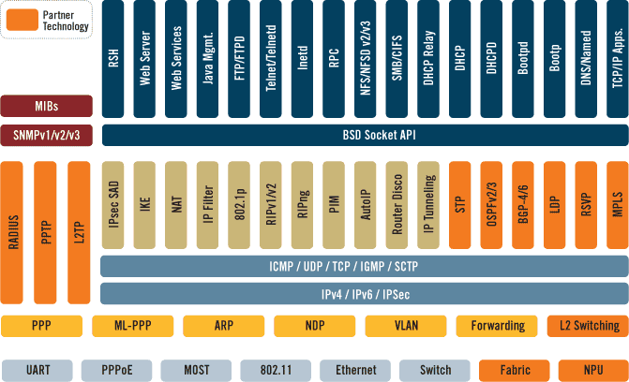
A layering example
http://www.qnx.com/popups/imageview.html?group=screenshot&key=protocol_support

Slide 16
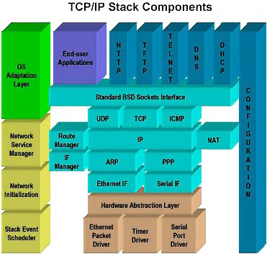
Another layering example
http://www.cuberoot.biz/products/docs/CR48_Product_sheet.htm

Slide 17
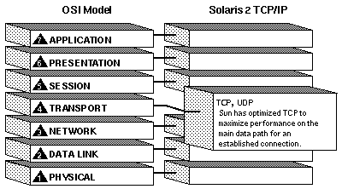
A simpler one
http://www.civis.net/Documentations/Reseaux/SUN/solaris/networking/tcpip.html

Slide 18
Protocols

Slide 19
Services and protocols
Service: an act of helpful activity
Protocol:
the customs and regulations dealing with diplomatic formality, precedence, and etiquette.
an original draft, minute, or record from which a document, esp. a treaty, is prepared.
A formal description of message formats and the rules two computers must follow to exchange those messages.

Slide 20
Protocols
Each protocol defines two interfaces:
Service interface: the operations that local objects can perform on the protocol.
Peer interface: the form and meaning of messages exchanged between protocol peers to implement the communication service.

Slide 21
Protocols
Services
Services
Message format and interpretation
Protocol entity
Protocol entity
Services
Services
Message format and interpretation
Protocol entity
Protocol entity

Slide 22
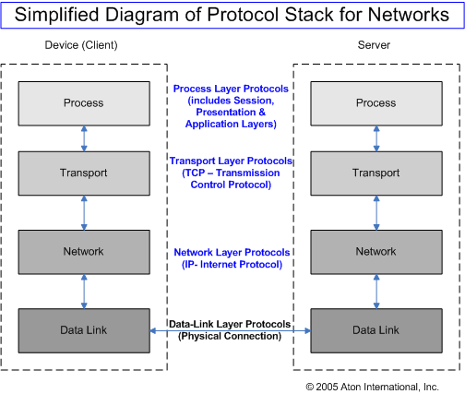
An example: A 4-layer protocol stack
http://www.aton.com/about/media-room/extras/troubleshooting-connections/

Slide 23
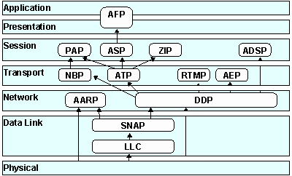
An example: AppleTalk
http://www.protocols.com/pbook/appletalk.htm

Slide 24
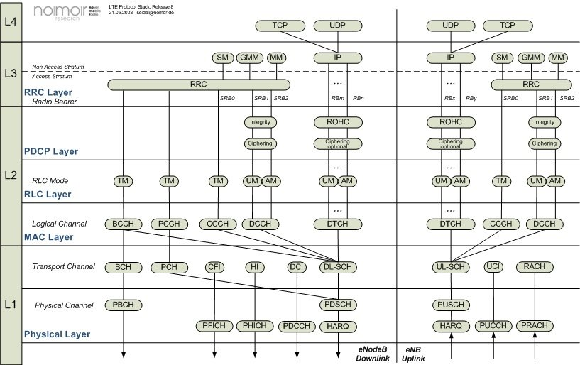
An example: A LTE protocol stack
http://www.nomor.de/

Slide 25
Protocol messages
A header and a payload
The header contains sufficient information for implementing the intended services.
The header is an overhead to the payload.
The payload generally contains a header from another protocol.
Protocol encapsulation

Slide 26
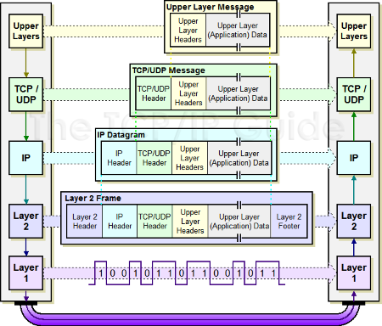
The TCP/IP messages
http://blogs.techrepublic.com.com/networking/?p=668

Slide 27
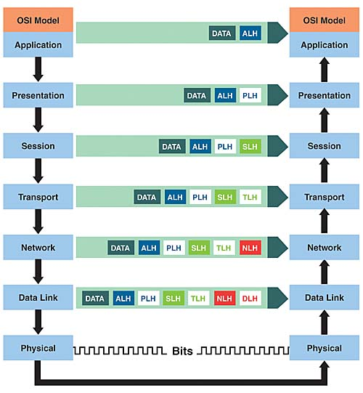
The OSI messages
http://news.idg.no/cw/art.cfm?id=BE0E53AA-1A64-6A71-CEEB6F625C36306D

Slide 28
Conclusions
Web is a driving force for turning the Internet into a “playground” for many.
Two major layers: applications and networks
Other courses devoted to web technologies and development
This course is about the network layer.
Important concepts: layering, protocols, services, protocol messages, and their inter-relationship.

Slide 29
Acknowledgements
Thanks to all the sources where the diagrams were extracted from.

