Slide 1
Basics of Wireless Communications
Analog vs. Digital transmission
Frequency, Spectrum, Bandwidth
Modulation Techniques
Multiplexing Techniques
Medium Access Control (MAC)
Notes:
Application developers do not have to know the internal working of wireless networks to be successful, but having knowledge of how they work is very helpful.
Understand why certain wireless technologies behave the way they do;
Understand which application design architectures should be based.

Slide 2
Networking Layers
Notes:
Application developers do not have to know the internal working of wireless networks to be successful, but having knowledge of how they work is very helpful.
Understand why certain wireless technologies behave the way they do;
Understand which application design architectures should be based.

Slide 3
Analog vs. digital data
Data can be digital or analog
Digital data appears as a sequence of bits, each of it taking on one of two discrete values: the binary 0 and the binary 1.
e.g., text
Analog data is characterized by a continuous value range at some interval.
e.g., human speech.

Slide 4
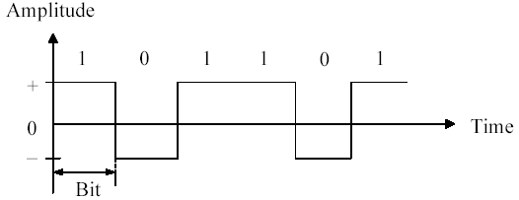
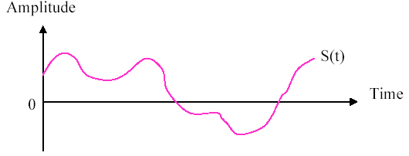
Analog vs. digital signal
Signals can also be digital or analog:
Digital signal - signal strength (voltage pulses) maintains a constant level for some period of time and then changes to another constant level
Analog signal - signal strength varies in a smooth (continuously varying) fashion over time

Slide 5
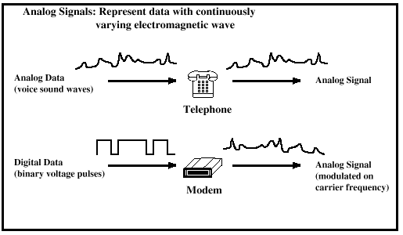
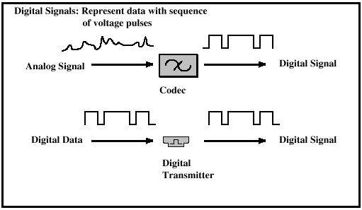
Analog vs. digital signal
Both analog and digital data can be propagated by analog and digital signals

Slide 6
Analog vs. digital signal
Digital signal
generally cheaper than analog signaling
less susceptible to noise interference
allow better utilization of the bandwidth
suffer more from attenuation, which endangers integrity of data
repeaters can be used to recover the signal and retransmit for longer distance (in wired networks)

Slide 7
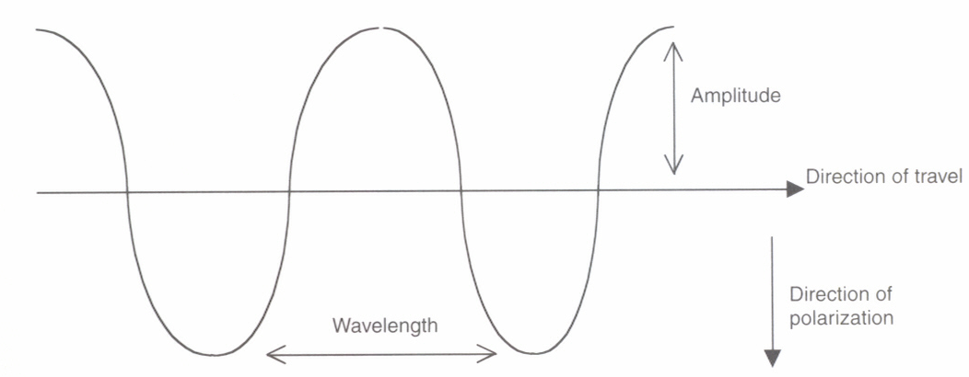
Frequency
An electromagnetic wave is characterized by:
Amplitude (A) - maximum strength of the signal over time; typically measured in volts
Frequency (f ) - rate at which the signal repeats, measured by cycles per second (called Hertz (Hz))
Phase (φ) - denotes the relative position in time within a single cycle of a signal
Wavelength (λ) - distance occupied by a single cycle of the signal - the distance between two points of corresponding phase of two consecutive cycles

Slide 8
Frequency
The higher the frequency, the shorter the wavelength.
In vacuum, all electromagnetic waves transmit at the same constant speed C (speed of light: C ≅ 3x10⁸m/s), independent of their frequencies: C = λf
The higher the frequency, the higher the bit rate.
More changes can be expressed
e.g., under low frequency, only several bits can be encoded, but under high frequency, sometimes can encode up to 40 bits.
The higher the frequency, the smaller the components become (e.g., antennas)
Today’s cellular phone are so small because they operate at frequencies high enough to allow components inside to be made small enough

Slide 9
Modulation
An electromagnetic wave does not carry any information in its pure form. In order to represent data, one or more of its parameters A, f, and φ need to be varied over time.
This is called modulation: signals are manipulated to carry information, or data is superimposed onto the carrier signal
Conventional standard modulation methods are:
Amplitude modulation – varying A,
Frequency modulation – varying f,
Phase modulation – varying φ

Slide 10
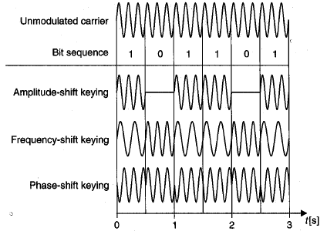
Modulation

Slide 11
Spectrum, Bandwidth
The original carrier signal consists of only a single frequency but, when modulating data onto it, the modulated carrier signal can be spread over a range of several frequencies.
Spectrum - range of frequencies adopted by a modulated carrier signal [f_{min}, f_{max}].
Bandwidth - width of the spectrum, or the difference between the highest and lowest frequencies available in a band (f_{min}− f_{max})

Slide 12
Channel capacity
The following two terms have benn used interchangeably for describing the information transmission capability of a network.
Bandwidth : range of signal frequencies that can be supported
Used in analog networks - unit is Hz, KHz, MHz and GHz
e.g. telephone lines carrying analog signals have a bandwidth from 300 Hz to 3.4 KHz
Data rate : number of bits that be transmitted in a unit of time
Used in digital networks - unit is bps, Kbps, Mbps, and Gbps
e.g. digital voice signal passes at a speed of 64Kbps; optical fiber can carry digital signals at a speed of 20 Gbps.

Slide 13
Channel capacity
The greater the bandwidth, the higher the information-carrying capacity (transmission rate, or data rate)
Any digital waveform has infinite bandwidth, but it is the transmission system that limits the bandwidth that can be transmitted
For any given medium, the greater the bandwidth transmitted, the greater the cost
On the other hand, limiting the bandwidth creates distortions

Slide 14
Channel capacity
Narrowband (or Voiceband)
Used for regular telephone communications
Transmission rate < 100 kilobits per second
Mediumband
Used for long-distance data transmission or to connect mainframe and midrange computers
Transmission rate 100 kb to 1 megabit per second
Broadband
For high-speed data and high-quality audio and video
Transmission rate 1 megabit per second to 100 megabits per second

Slide 15
Electromagnetic spectrum
Wireless networks may use different bands in the electromagnetic spectrum
Each band consists of a range of frequencies
Majority of wireless networks use the bands of radio waves and microwaves
Some use Infrared (e.g., for household devices)
The spectrum is a continuum; the boundaries between different bands don’t exist naturally, but were invented by scientists trying to classify them

Slide 16
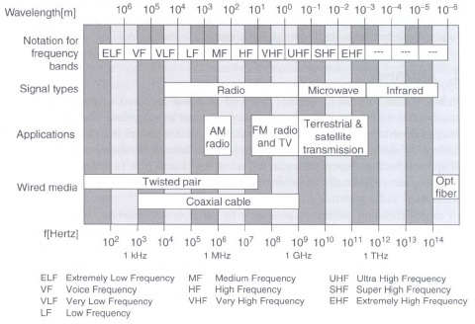
Electromagnetic spectrum
Signals for wireless communications are classified into radio, microwave, infrared

Slide 17
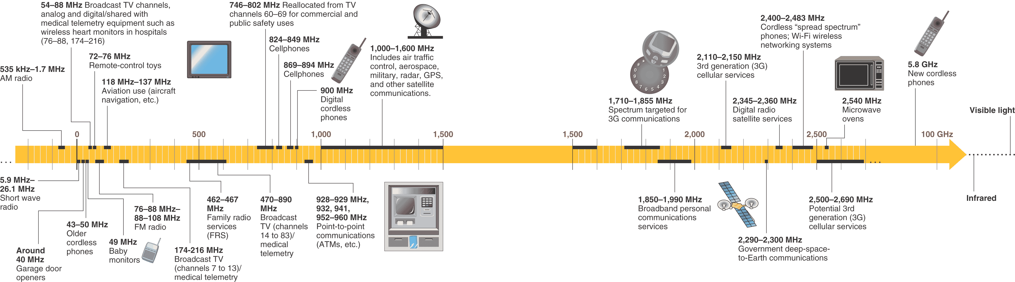
Electromagnetic spectrum

Slide 18
Frequency bands for wireless communications
Radio frequency range
30 MHz to 1 GHz
Suitable for omnidirectional applications
Microwave frequency range
1 GHz to 40 GHz
Higher-frequency bands are suitable for point-to-point transmission
Used for satellite / radar communications
Also used for heating
Infrared frequency range
Roughly, 3x10¹¹ to 2x10¹⁴ Hz
Useful in local point-to-point / multipoint applications within confined areas
Remote control, optical networks
These bands are relevant to telecommunications (ELF – EHF) and fixed by ITU – Int’l Telecom Union.

Slide 19
Modulation in wireless networks
Special transmission techniques are used in wireless communications.
e.g., WLANs, mobile phone networks, digital radio system DAB (Digital Audio Broadcast), etc.
Unlike in narrowband technology (data is transmitted on designated carrier frequency), here multiple frequencies are used.
Different techniques are available, differing in efficiency, power requirements, and complexity.
Spread spectrum
Orthogonal Frequency Division Multiplexing (OFDM)
Notes:
Why do we need new techniques?
For saving precious bandwidth by improving bandwidth utilization
For reducing interferences

Slide 20
Spread spectrum
Distribute a signal over a wide range of frequencies for transmission
Two variations exist:
DSSS (Direct Sequence Spread Spectrum)
FHSS (Frequency Hopping Spread Spectrum)

Slide 21
DSSS
Each bit in original signal is represented by multiple bits in the transmitted signal
Spreading code is used to mix with each message bit before it is transmitted – the effect is spreading the signal across a wider frequency band.
Spread is in direct proportion to number of bits used
The same code is used to decode these encoded bits.
One technique combines digital data stream with the spreading code bit stream using exclusive-OR

Slide 22
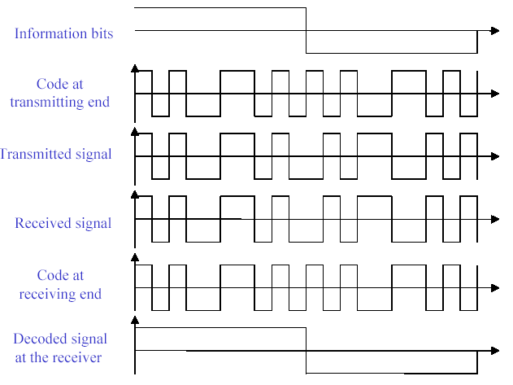
DSSS
0 1
user data
XOR
Code bit
sequence
=
resulting
signal

Slide 23
FHSS
Signal is broadcast over seemingly random series of radio frequencies
A number of channels are allocated for the FH signal
Width of each channel corresponds to bandwidth of input signal
Signal hops from frequency to frequency at fixed intervals
Transmitter operates in one channel at a time
Bits are transmitted using some encoding scheme
At each successive interval, a new carrier frequency is selected
Receiver, hopping between frequencies in synchronization with transmitter, picks up message

Slide 24
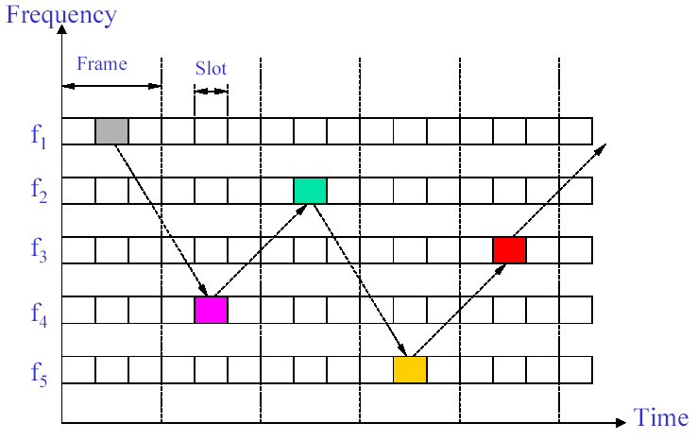
FHSS

Slide 25
FHSS
t_{b}
user data
0
1
0
1
1
t
f
t_{d}
f₃
slow
hopping
(3 bits/hop)
f₂
f₁
t_{d}
t
f
f₃
fast
hopping
(3 hops/bit)
f₂
f₁
t
t_{b}: bit period t_{d}: dwell time

Slide 26
Features of spread spectrum
Allow multiple users to use the same frequency band
Easily detected by receivers that know the parameters (patterns) of the signal being broadcast.
To everyone else the spread-spectrum signal looks like background noise
Higher reliability and security
Used in most mobile data transmission systems, including Bluetooth, 3G cellular networks, and WLAN

Slide 27
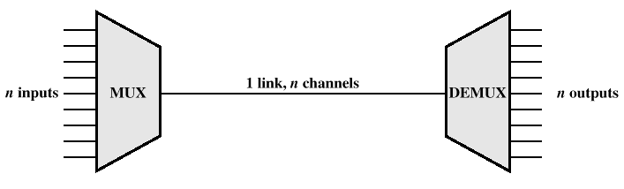
Multiplexing
Multiplexing - carrying multiple users’ signals over a single medium
Capacity of transmission medium usually exceeds capacity required for transmission of a single user – how to make more efficient use of transmission medium
The medium is always shared in wireless communication – how to ensure low interference.
Divide medium into several channels that can be used independently of each other without interferences.

Slide 28
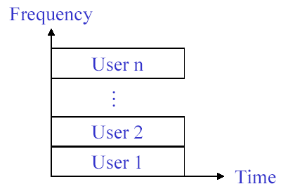
Multiplexing techniques
Frequency-division multiplexing (FDM)
Takes advantage of the fact that the useful bandwidth of the medium exceeds the required bandwidth of a given signal
Advantages:
no dynamic coordination necessary
works also for analog signals
Disadvantages:
waste of bandwidth if the traffic is distributed unevenly
inflexible

Slide 29
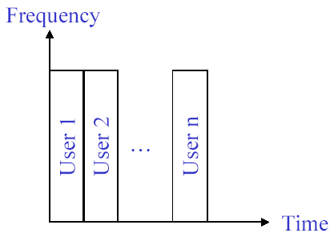
Multiplexing techniques
Time-division multiplexing (TDM)
Takes advantage of the fact that the achievable bit rate of the medium exceeds the required data rate of a digital signal
Advantages:
only one carrier in the medium at any time
high throughput even for many users
Disadvantages:
Precise coordination and synchronization necessary

Slide 30
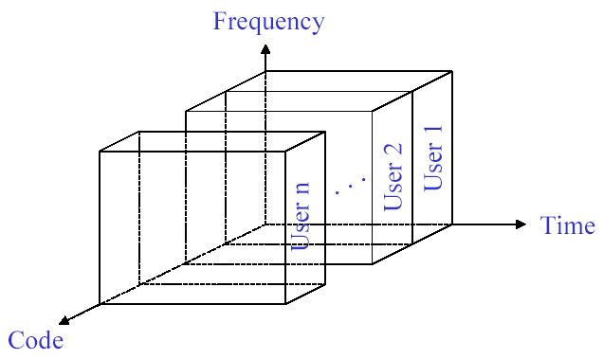
Multiplexing techniques
Code-division multiplexing (CDM)
Takes advantage of the fact that multiple channels can take place using the same frequency at the same time, if we separate the channels by assigning them their own ‘code’
Implemented using spread spectrum technology - DSSS
Advantages:
Bandwidth efficient
Good protection against interference and tapping
Disadvantages:
More complex signal regeneration
Precise power control needed

Slide 31
CDM examples
Sender A
sends Ad = 1, Code Ac = 010011 (Let “0“= -1, “1“= +1, Ak = -1 +1 -1 -1 +1 +1)
sending signal As = Ad * Ak = (+1) * (-1, +1, -1, -1, +1, +1)
= (-1, +1, -1, -1, +1, +1)
Sender B
sends Bd = 0, Code Bc = 110101 (Let “0“= -1, “1“= +1, Bk = +1 +1 -1 +1 -1 +1)
sending signal Bs = Bd * Bk = (-1) * (+1, +1, -1, +1, -1, +1)
= (-1, -1, +1, -1, +1, -1)
Both signals superimpose in space
interference neglected (noise etc.)
As + Bs = (-2, 0, 0, -2, +2, 0)
Receiver wants to receive signal from sender A
apply code Ac bitwise (inner product)
Ae = (-2, 0, 0, -2, +2, 0) • Ak = 2 + 0 + 0 + 2 + 2 + 0 = 6
result greater than 0, therefore, original bit was “1“
receiving B
Be = (-2, 0, 0, -2, +2, 0) • Bk = -2 + 0 + 0 - 2 - 2 + 0 = -6, i.e. “0“

Slide 32
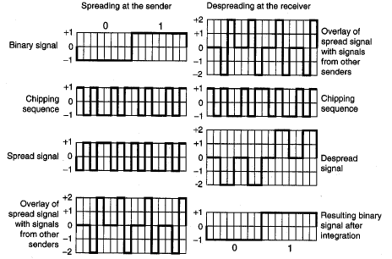
CDM examples

Slide 33
Multiplexing techniques
Space-division multiplexing (SDM)
Allow the establishment of several channels in the same frequency range for simultaneous use, assuming that they are sufficiently separated in space.
Define frequency reuse distance (e.g., Cell structure, where signals are attenuated as farther away they travel from the source). or
Propagate signals as highly directed beams (e.g., Segment space into sectors, use directed antennas)

Slide 34
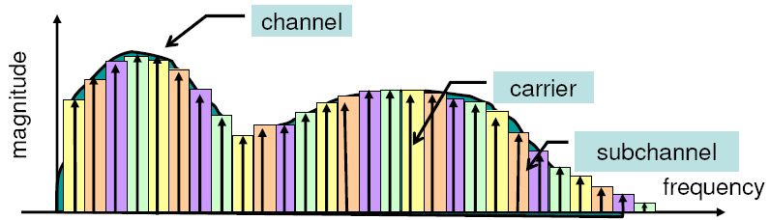
OFDM
Transmits data over parallel frequencies
A special method of implementing MCM (multi-carrier modulation)
Channel bandwidth is divided into multiple sub-carrier frequencies called tones (sub-channels)
Fast serial data stream is converted into slow parallel streams (longer symbol durations), and then distributed over different sub-carriers for transmission.

Slide 35
Channel impulse
response
Channel
transfer function
Time
Frequency
1 Channel (serial)
Signal is
“broadband”
Frequency
2 Channels
Frequency
8 Channels
Frequency
Channels are
“narrowband”

Slide 36
OFDM
Same as in traditional FDM, sub-carriers are spaced apart, but in OFDM they can be overlapped to be independent & unrelated, hence orthogonal.
Spectrum of normal time
domain sequence
Spectrum of classical
FDM
Spectrum of OFDM

Slide 37
Ch.1
Ch.2
Ch.3
Ch.4
Ch.5
Ch.6
Ch.7
Ch.8
Ch.9
Ch.10
Conventional multicarrier techniques
frequency
Ch.2
Ch.4
Ch.6
Ch.8
Ch.10
Ch.1
Ch.3
Ch.5
Ch.7
Ch.9
Saving of bandwidth
50% bandwidth saving
Orthogonal multicarrier techniques
frequency

Slide 38
OFDM
Used by IEEE 802.11a/g & 802.16
Advantages:
Protecting signal from interference
High spectrum efficiency – more data can travel over a smaller amount of bandwidth

Slide 39
Multiple access methods
Multiplexing is about how to share the medium by dividing the medium into multiple channels
But how to use multiplexing ?
This is by multiple access methods :
Segmenting available spectrum into frequencies,
planning frequency for reuse,
allocating time slots, or
defining spreading codes, etc..

Slide 40
Multiple access methods
FDMA (Frequency Division Multiple Access)
Based on FDM – Allocate frequencies to channels or define a frequency hopping pattern
E.g., used for simultaneous communication between base station and mobile unit (uplink and downlink)
TDMA (Time Division Multiple Access)
Based on TDM – Allocate time slots for channels in a fixed pattern;
CDMA (Code Division Multiple Access)
Based on CDM – Assign codes to allow for separation of different users in code space;
Power control (the problem of “near and far terminals”).
SDMA (Space Division Multiple Access)
Based on SDM

Slide 41
Multiple access methods

Slide 42
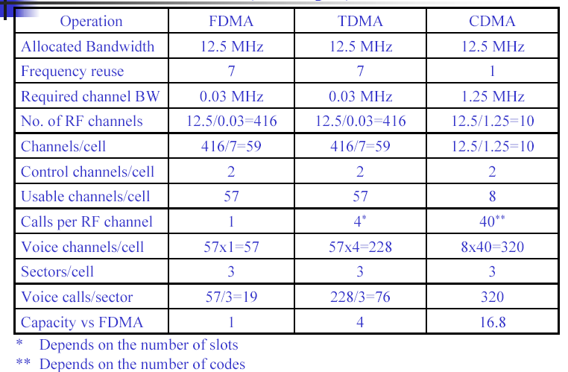
Comparison of FDMA, TDMA, CDMA (example: Cellular system)
f₃
f₅
f₂
f₄
f₆
f₅
f₁
f₄
f₃
f₇
f₁
f₂

Slide 43
Call Admission Control
Given the number of channels available, the network needs to determine whether a newly arrived transmission request should be admitted.
This is especially important for calls in cellular phone networks - the Call Admission Control (CAC) problem
The number of channels allocated to each BS is limited
Maximized channel utilization while guaranteeing QoS

Slide 44
Call Admission Control
CAC is a process for managing the arriving traffic (at the call, session, or connection level) based on some predefined criteria
When necessary, some call requests need to be blocked
New call blocking
Handoff call blocking
Example: TDMA network

Slide 45
Number of channels per cell=20.
The network consists of 3 cells.
At instant (t0), number of users Ni(t0) (i=1,2,3) is equal to (18, 17, 19)
At instant (t1), a new user arrived at cell 3. Then Ni(t2) will be (18, 17,20).
At instant (t₂), one of the 17
active users in cell 2 is leaving cell 2
heading cell 3.
This user has to be handed over
to cell 3, but cell 3 is fully loaded.
Result: This user will be rejected
by cell 3 and the call will be dropped.
Conclusion:
Admitting the new user in cell 2 at
instant (t₁) was not a good decision.
The Guard Channel Scheme
Parameter to consider: new and handoff call arrival rates and mean call residency time

Slide 46
Call Admission Control
Naïve solution: for no hand-off drops, reserve bandwidth in all cells a mobile/connection might pass through
Problem: bandwidth quickly consumed and new connection blocking probability increases
Proposed solution: a cell estimates aggregate bandwidth for hand-offs from adjacent cells, to be reserved and used solely for hand-offs, not new connection requests
Predictive: estimate directions and hand-off times of ongoing connections in each cell
Adaptive: dynamically adjust amount of reserved bandwidth to account for estimation inaccuracies and varying traffic/mobility conditions

Slide 47
Medium Access Control (MAC)
Multiplexing allows terminals to share medium, assuming each terminal can be assigned a separate channel in the medium for transmission (e.g. by CAC).
But in some networks, channels are accessed by terminals on demand - there is no admission control and no dedicated channel for each terminal. Then terminals need to compete for the use of channels and collision may occur.
MAC protocols are used to regulate multiple terminals for randomly access to the shared medium.
Need to resolve collisions - can be centralized and distributed
Needed for wireless networks that are designed to carry data: IEEE 802.11 Wireless LANs, ad hoc networks, bluetooth, ….

Slide 48
Medium Access Control (MAC)
MAC in wireless networks is more difficult than in wired network
Signal strength decreases proportional to square of distance, so no use for sender to apply CS
Collisions happen at receivers, so no use for sender to apply CD
Protocols (centralized vs distributed; schedule-based vs. conflict-based)
ALOHA,
CSMA/CA (Carrier Sense MA with Collision Avoidance),
MACA (MA with Collision Avoidance),
DAMA (Demand Assignment MA – for Satellites),
…

Slide 49
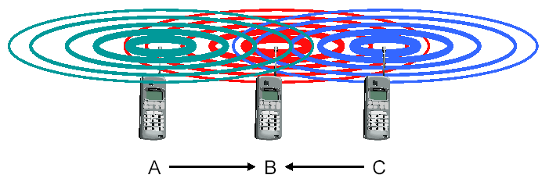
Medium Access Control (MAC)
Hidden terminal problem
A sends to B, C cannot receive A
C wants to send to B, C senses a “free” medium (CS fails)
Collision at B, A cannot receive the collision (CD fails)
A is “hidden” for C -> cause collisions

Slide 50
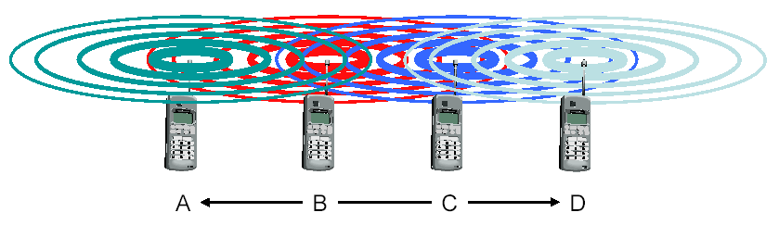
Medium Access Control (MAC)
Exposed terminal problem
B sends to A, C wants to send to D
C has to wait, CS signals a medium in use
Since A is outside radio range of C, waiting is not necessary
C is “exposed” to B –> unnecessary blocking

Slide 51
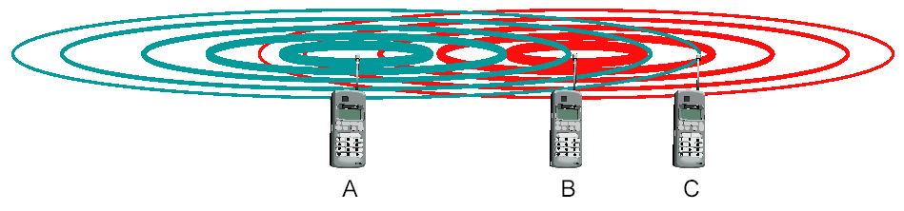
Medium Access Control (MAC)
Near and far terminal problem
The signal of terminal B hides A’s signal
C cannot receive A as B can keep occupying the channel
This is also a severe problem for CDMA networks - precise power control is needed

Slide 52
Medium Access Control (MAC)
Example: MACA (Multiple Access with Collision Avoidance)
Use short signaling packets for collision avoidance;
Request (or Ready) to send (RTS): sender requests the right to send from a receiver with a short RTS packet before it sends a data packet;
Clear to send (CTS): receiver grants the right to send as soon as it is ready to receive
Signaling packets contain:
Sender address
Receiver address
Packet size

Slide 53
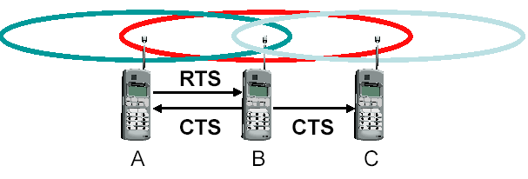
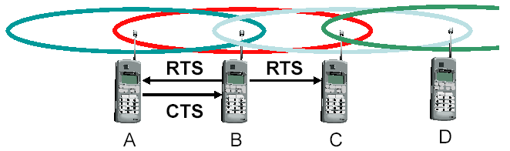
Medium Access Control (MAC)
MACA avoids hidden terminal problem
A and C want to send to B
A sends RTS first
C waits until receiving CTS from B
MACA avoids exposed terminal problem
B wants to send to A and C wants to send to D
Now C does not have to wait as it cannot receive CTS from A

Slide 54
Research on MAC
Energy efficiency
Improving throughput (channel utilization)
Improving fairness
…

