Slide 1
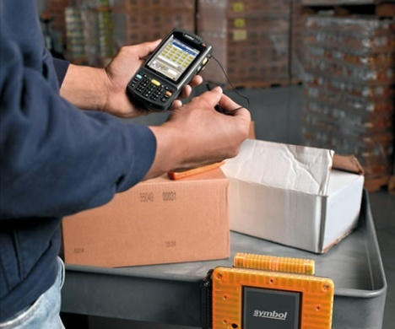
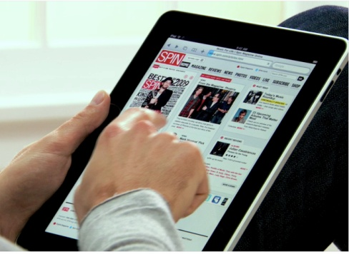
Mobile Computing Models

Slide 2
Outline
Mobile computing models and Application architectures
Popular mobile computing models
Mobile client-server computing
Mobile Peer-to-Peer computing
Mobile Agents
Mobile Internet Architectures
Mobile devices

Slide 3
Mobile computing models
A mobile computing model specifies a computing paradigm for designing and organizing mobile applications.
Divide the mobile computing system into a collection of components
Specify how to use these components and their relationships to design mobile computing applications
Examples:
Client-Server model: clients, servers, requests and results;
Mobile P2P model: peers, neighbors, sharing & cooperation;
Mobile Agent model: agents, hosts, communication &
coordination;

Slide 4
Application architectures
Based on a mobile computing model, a mobile application architecture defines how the model can be realized / implemented
Specify the division of functionalities among the components in the model
Describe the mechanisms for implementing each participating component

Slide 5
Model vs. Architecture
Model is defined from the software designer’s viewpoint
It is precise enough about the system organization and performance but not too explicit about mechanisms and implementation details
Application architecture is defined from the programmer’s viewpoint
It provides details about mechanisms and implementations

Slide 6
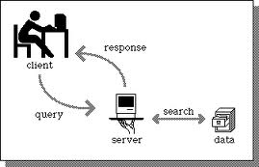
Example: C/S model
A network computing model in which each computer or process on the network is either a client or a server
Clients: asking for services, e.g., email
Servers: providing services
Communication networks: connecting client and server
Client-Server computing optimizes computing resources

Slide 7
Example: C/S application architectures
Thin Client (Wireless Internet ):
Mostly for online access to Web content
Server side plays the main functional role
Limited user interface and capabilities on client side;
Smart Client :
Allows for working in ‘occasionally connected’ environment with offline access to important data and re-synchronization upon reconnection
Both server and client sides have good capabilities
Client side incorporates mobile database technology for persistent data storage

Slide 8
Mobile Internet Architectures

Slide 9
Mobile Internet
Thin Client
Also called as Wireless internet applications
Same architecture as wired Internet applications
Business and enterprise data are stored on the servers
Client side is a mobile device with internet browser called microbrowsers (due to their limited size and functionality). No other software is required on the client device
Smart Client
Enables user to access data when disconnected from the network.
Instead of a microbrowser, application software is developed on the client device, so it is mobile and can be used even when the connection is unavailable.
By deploying applications to the device itself, we have capability to give client application some “smarts” or business logic.

Slide 10
Mobile Internet
Sender
Mobile messaging
Client and server applications are loosely coupled through the exchange of self-describing messages
Messaging can mean email, paging, SMS, voice, data, text etc
Store and forward delivery of data - sender and receiver are not necessary on-line at the same time
Messages are stored when the connection is not available and forwarded when it becomes available
Can be used itself as a stand-alone application architecture, or in conjunction with wireless Internet or smart client as an enhancement.
Messages
MOM
Receiver

Slide 11
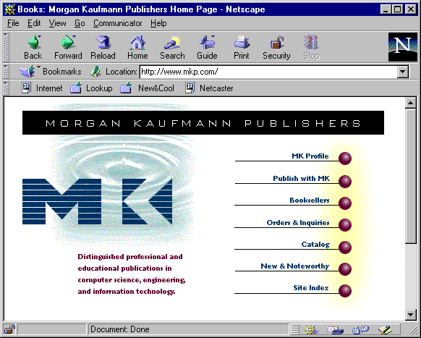
Three-tier client/server
Client
Tier-1
Web
browser
Web
server
Tier-2
Common
gateway
interchange
Application logic
Tier-3
Databases and DBMS

Slide 12

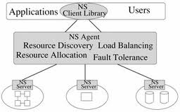
Extended C/S models
Place some application logic in a middle component, called agent /proxy, between client and server.
Agents can help perform some processing and/or mask out mobile computing limitations
More flexible with thin client and smart client: application logic can be changed readily

Slide 13
Extended C/S model
Agents can also be associated with client side or server side.
Client-side agent functionalities
Perform some pre-fetching and compression operation.
Cache data for satisfying client’s request during disconnection.
Server-side agent functionalities
Messaging and queuing.
Optimize transmission over wireless link
Offload some processing from client
Handle disconnection of client

Slide 14
Extended C/S model
Agent types
Shared client: multiple clients can share the same agent
Client-specific: each client has one agent
Service-specific: each service of the client is associated with an agent (e.g., web browsing, database access)
Agent can be at a fixed location or can move with the client

Slide 15
Extended C/S architectures
Two common architectures based on the extended C/S model
CAS model (Client/Agent/Server)
CIS model (Client/Intercept/Server)

Slide 16
Client/Agent/Server architecture
Application Client
Agent
Application Server
Mobile Host
Wireless / Wireline
Agent proxy: a surrogate of the client on the wired network side
Communications between client and server pass through agent
Continuously maintains the client’s presence on the fixed network
To the server, the agent looks like the mobile client, so standard C/S interaction occurs between agent and server
Different protocol can be used for interactions between mobile client and agent

Slide 17
Client/Intercept/Server architecture
Client-side
Intercept
Agent
Server-side
Intercept
Agent
Application
Client
Application
Server
Mobile Host
Wireless / Wireline
Pair of agents - one stays on client side and the other on fixed network.
Agents are transparent to both client and server – no limit on functionality or interoperability of the client.
Two agents cooperate to facilitate highly effective data reduction and protocol optimization, and application-specific optimization

Slide 18
CAS vs. CIS
Advantages of CAS
Complex client requests can be managed by agent with only the final result transmitted to the client
Server can also offload some activities to agent (e.g., compression)
Agent can cache some results to improve performance
Disadvantages of CAS
Changes are needed in client code to communicate with agent
In normal operation, system overhead will increase.

Slide 19
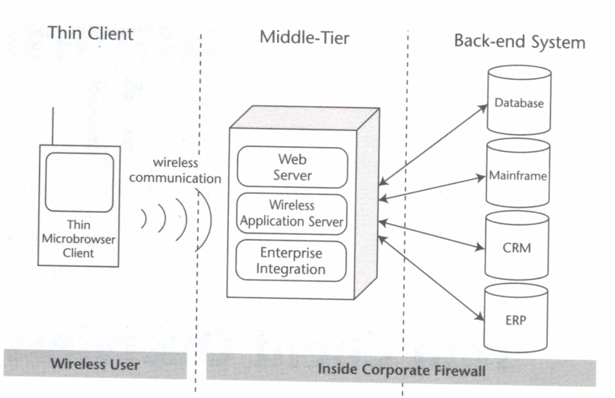
Thin Client architecture

Slide 20
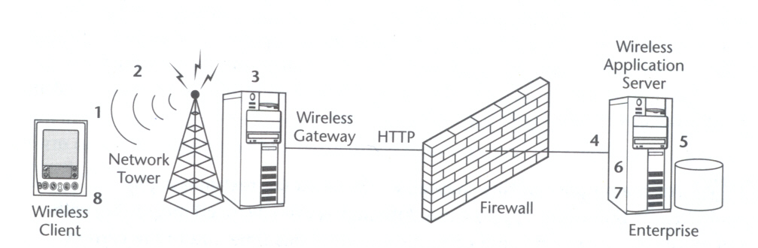
Processing a wireless request
Establish a wireless session
Submit a request
Translate a request
Receive a request
Identify the wireless client
Process the request
Transform content for device
Return the content
When the wireless network is not IP based, the base station contains a gateway which translates the request and send it as HTTP to the web server.

Slide 21
Wireless gateway
Gateway serves as the link between wireless and wired world
Usually hosted by wireless network provider (e.g., in a BS)
Provided functions
Protocol gateway
e.g., wireless protocol ↔ IP, WAP ↔ HTTP, HTML ↔ WML etc.
Optimized communication streams
WAP push messaging
Enhanced security
WAP gateway is a commonly used wireless gateway

Slide 22
Servers
Web server
Listens to the incoming HTTP request and sends response back to the client.
Format data to be returned to client.
Wireless application server
Usually located within the enterprise
Provide core infrastructure to build wireless Internet applications, and is the engine driving the architecture
Including features like
device & browser identification,
content transformation,
session management,
enterprise data management.
Two leading specifications
J2EE
Microsoft .NET Framework

Slide 23
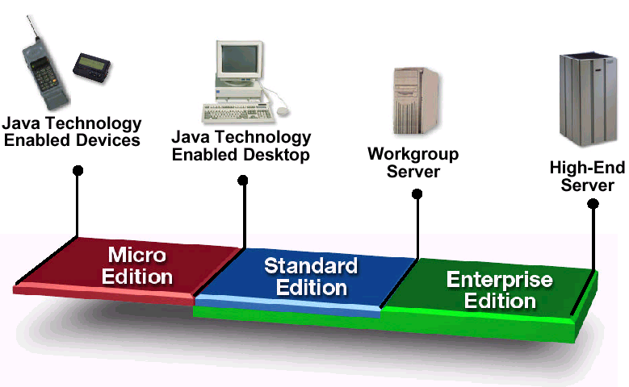
J2EE
The Java 2 platform includes J2SE, J2EE, and J2ME.
Small & memory
Constrained devices
Standard desktop &
Workstation Applications
Heavy duty server
systems
JVM
Java programming language
Core & optional packages

Slide 24
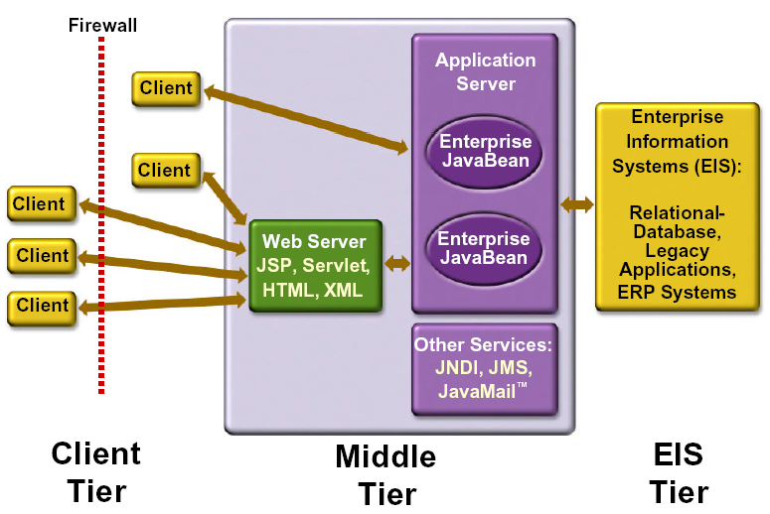
J2EE
Defines a standard for building multi-tier enterprise applications.
Three-tiered architecture:
extend the standard two-tiered client and server model by placing a multithreaded application server between the client application and back-end storage

Slide 25
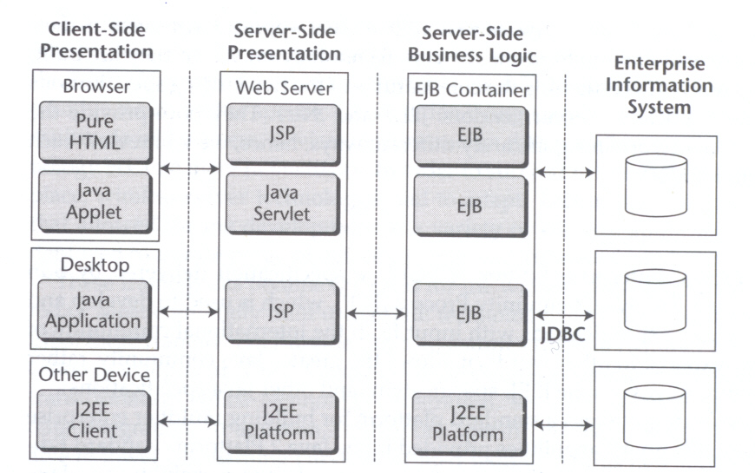
J2EE
Four main technologies: Applets, Java servlets/JSP, EJB, JDBC.

Slide 26
J2EE Components
Application clients and applets
components that run on the client
Web server (Servlets, Java Server Pages (JSP))
Web components that run on the server
Java classes extending network server functionality
Coordinating the interaction between the user and EJB and produce forms and information for returning results to the user
Dynamic generation of contents
Enterprise Java Bean (EJB)
Business components that run on the server
Packaging business logics and apply them to backend EIS
J2EE Connectors
Connect and access backend EIS
Relational databases, JDBC, SQL

Slide 27
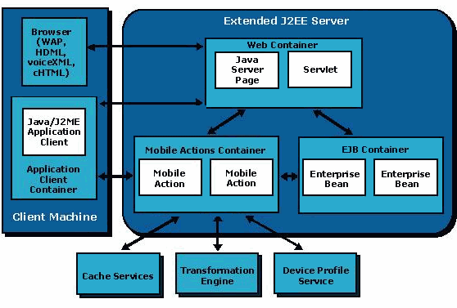
J2EE extensions for mobile application development

Slide 28
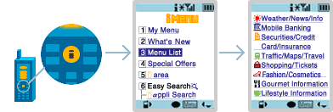
Wireless Internet Standards
WAP:
Standard wireless Internet application protocol
i-mode from NTT DoCoMo (Japan):
Proprietary product based on wireless internet.
Only available in Japan
Various services available : News, Weather, Banking, Ticket booking, On-line ordering, Game, Wallpaper, Music….

Slide 29
WAP overview
A standard for the delivery and presentation of Internet content to mobile devices.
WAP forum was founded in 1997 by Ericsson, Motorola, Nokia and Openwave System.
http://www.wapforum.org (now called Open Mobile Alliance)
Released the first version of WAP (WAP 1.0) in 1998.
Released the second version of WAP (WAP 2.0) in 2000.
Now more than 300 corporations have joined the forum, making WAP the de facto standard for wireless Internet applications.
90% of mobile phones will be WAP-enabled

Slide 30
WAP - Motivations
HTTP/HTML: not designed for mobile applications
HTTP 1.0 characteristics
designed for large bandwidth, low delay
stateless, client/server, request/response communication
connection oriented, one connection per request
TCP 3-way handshake, DNS lookup overheads
big protocol headers, uncompressed content transfer
primitive caching (often disabled, dynamic objects)
security problems (using SSL/TLS with proxies)
HTML characteristics
designed for computers with “high” performance, color high-resolution display, mouse, hard disk
typically, web pages optimized for design, not for communication; ignore end-system characteristics
Need support for mobile, wireless Internet

Slide 31
WAP - Motivations
Enhanced browsers
client-aware support for mobility
Proxies
Client proxy: pre-fetching, caching, off-line use
Network proxy: adaptive content transformation for connections
Client and network proxy
Enhanced servers
server-aware support for mobility
serve the content in multiple ways, depending on client capabilities
New protocols/languages
WAP/WML

Slide 32
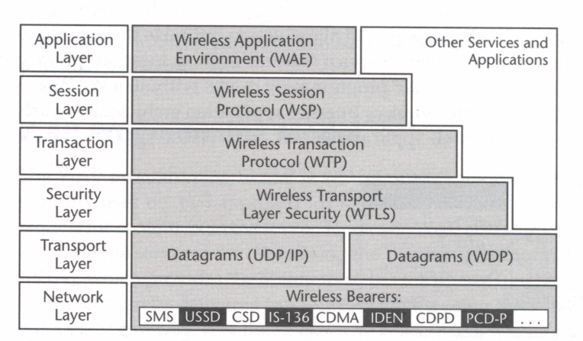
WAP components
WAP defines its own protocol stack, optimized for wireless communications

Slide 33
WAP protocol stack
WAP1.x: proprietary protocols in pre-3G wireless networks.
WAE (Wireless Application Environment) <-> Browser & HTML
WSP (Wireless Session Protocol) <-> HTTP
WTP (Wireless Transaction Protocol) <-> TCP/IP
WTLS (Wireless Transport Layer Security) <-> TLS/SSL
WDP (Wireless Datagram Protocol) <-> UDP
WAP2.x : 2.5G and 3G, using standard Internet protocols.
WML2 based on XHTML
WP-HTTP (Wireless Profiled HTTP)
TLS (Wireless Profiled Transport Layer Security)
WP-TCP (Wireless Profiled TCP)
Other WAP2.x Services
WAP Push
User Agent Profile
External Functionality Interface (EFI)
Wireless Telephony Application (WTA)
Persistent storage interface
Data synchronization
Multimedia Messaging Service (MMS)

Slide 34
WAP programming model
Similar to Internet programming model
Uses both Pull and Push approaches to obtain the content
Two models
Using a WAP gateway (also called WAP proxy)
Without a WAP gateway

Slide 35
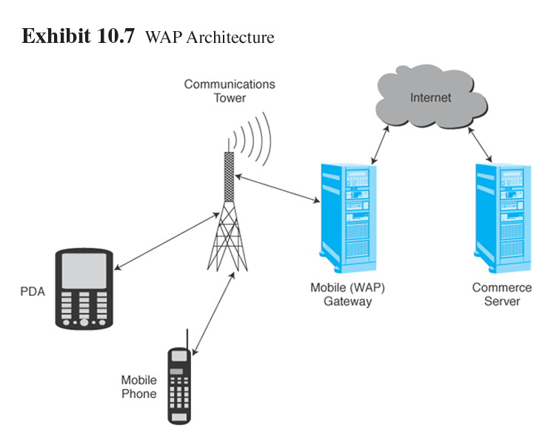
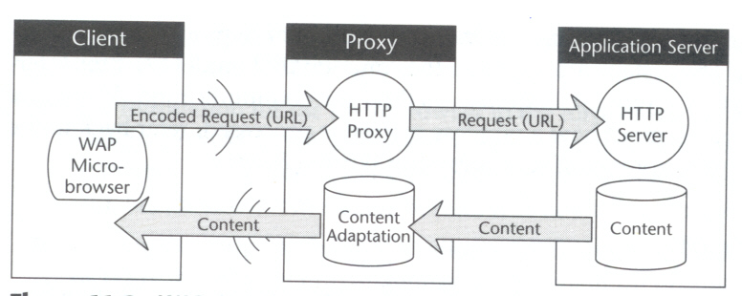
Using a wireless gateway

Slide 36
Using a wireless gateway
Client
Web Server
WAP Gateway
WML
CGI
Scripts
etc.
WML Encoder
WML-Script
WSP/WTP
HTTP
WML Decks
with WML-Script
WMLScript
Compiler
WTAI
Protocol Adapters
Content
Etc.
Gateway’s functions:
Translating requests/results between protocols: WAP <-> TCP/IP/HTTP
Encoding/Decoding web content
Implementing “push” functionality using WTA (Wireless Telephony Application Specification) - Information “pushed” to WAP devices

Slide 37
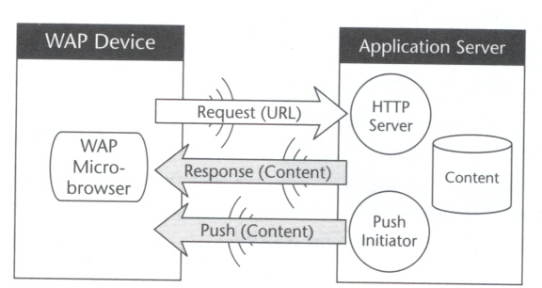
Without wireless gateway
WAP2.x no longer requires a WAP gateway
Allows HTTP communication between the client and the original server - No need for conversion
But you can still benefit from using a gateway, if you want to optimize communication and facilitate other wireless services, such as location, privacy, WAP push.

Slide 38
WAP vs. HTML5?
What is HTML5?

Slide 39
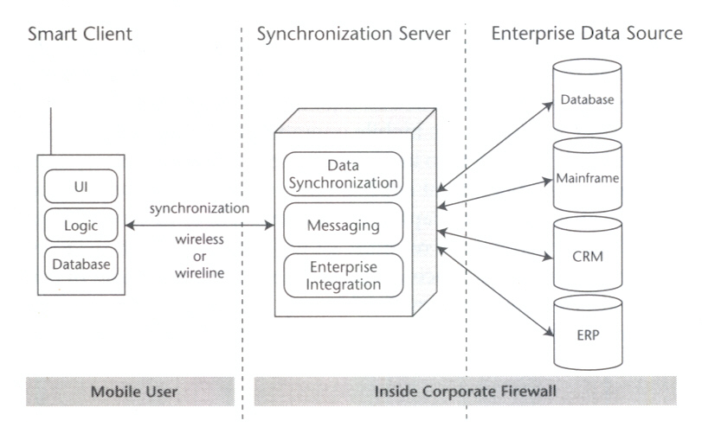
Smart Client architecture

Slide 40
Smart Client
Execute application logic and messaging, either a native executable or a Java application
Provide UI: the interface to the end user
can have rich and sophisticated user interface.
programmed with development tools
usability!
Have persistent data storage: client-side data
Communicate to the enterprise system’s synchronization or messaging layer either wirelessly or over wireline connection.

Slide 41
Data synchronization
Backup of data from mobile devices
Update data on mobile devices
Propagation of updates between desktop and mobile devices
Transaction Processing (e.g., email, data collection)

Slide 42

Data synchronization
Synchronization software:
ensure consistency among different copies of the same data on clients and the server.
In most cases, synchronization is executed on the server but client side still needs to know certain synchronization knowledge
location of the synchronization server,
data to be synchronized etc
Most vendors provide a synchronization client module:
Microsoft’s ActiveSync
Apple’s iTunes
BlackBerry’s Desktop Software

Slide 43
Synchronization server
Receives data from the client application and communicates to the enterprise data source.
Ensuring the minimal amount of data transferred.
Data can be exchanged in a variety of formats (vCard, vCal, various XML-based formats (XML, SyncML))
Integration with back-end data source is often done using JDBC or ODBC.
Synchronization logic:
Executes protocols which can simply take the updates and apply them to data store, or perform more complex actions, e.g., detecting & resolving conflicts.
SyncML Initiative
Support for disconnected operations –we will talk about this later

Slide 44
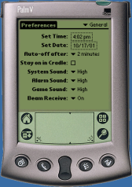
Why is synchronization difficult?
Synchronization logic can be very complex
Can be difficult to map fields from various sources
Tree structures are tricky to synchronize (categories, directory, keywords)
Allowing many-to-many synchronization is hard to do efficiently

Slide 45
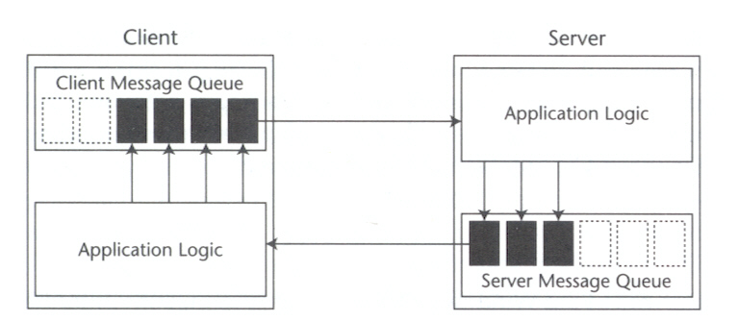
Mobile Messaging architecture

Slide 46
Mobile messaging
Messaging client
Store-and-Forward:
When connection is unavailable, message can be stored in an outgoing queue.
Sends automatically when the connection was established to the server.
Messaging server
Communicates with messaging client and to the enterprise system.
MOM (message oriented middleware).
Many of the systems were built on JMS (java message service).
Enterprise data source
Messaging server can interact with variety of back end systems like databases, business applications and other messaging systems.

Slide 47
Syn vs. Asyn. messaging
Synchronous messaging: blocking
Sender and receiver of the message must be ready at the same time.
May lead to poor user experience.
“Only 20% of inter-application communication is synchronous, 80% is asynchronous”

Slide 48
Syn. vs. Asyn. messaging
Asynchronous Messaging: nonblocking
Sender only initiates the operation and doesn’t need to wait for response before continue working.
When response appears, sender receives the message and respond appropriately.
User can continue to perform other tasks while waiting for a response.
Even if the message takes time to complete, user may not notice the delay at all.

Slide 49
Push vs. Pull messaging
Pull messaging
Client periodically polls the server to check if there is a new message for it. If yes, it will retrieve the message and react accordingly.
Can be used to enhance smart client applications
e.g., to check whether new set of data is available on the server

Slide 50
Push vs. Pull messaging
Push messaging
Used to notify the mobile user when specific event occurs in the enterprise.
Push information to the mobile user without user interaction – user should not be required to request the information manually.
In practice, however, often the client has to do some form of check to see if new data is present.
HDML notification and WAP Push

Slide 51
User-to-User vs. Application-to-Application messaging
U2U: messages sent from one user to another
Email, paging / SMS, instant messaging (IM)
Graphics and formatted text sent by EMS (enhanced message service)
Multimedia content sent by MMS (media message service)

Slide 52
U2U vs. A2A messaging
A2A: In many cases user interaction is not needed for messaging. Applications communicate data directly with each other.
Rather than using standard client software, A2A messaging is incorporated in custom applications.
Client must be able to both send and receive messages
When receiving message, client needs to relay the information appropriately to user or application
Notifying user directly
Updating a set of data in client data store

Slide 53
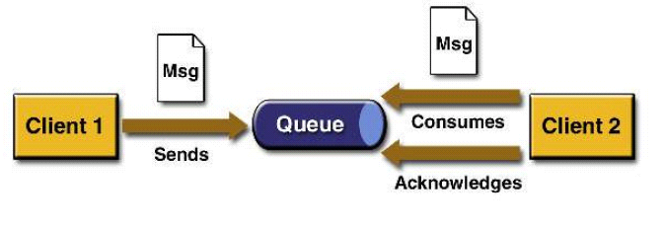
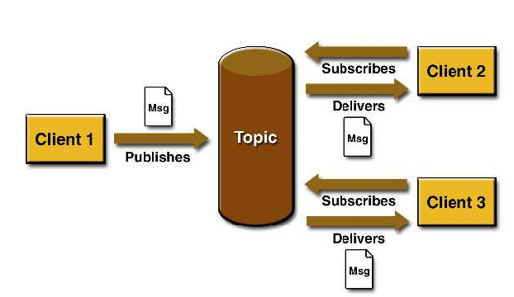
Point-to-Point messaging vs. Pub/Sub messaging

Slide 54
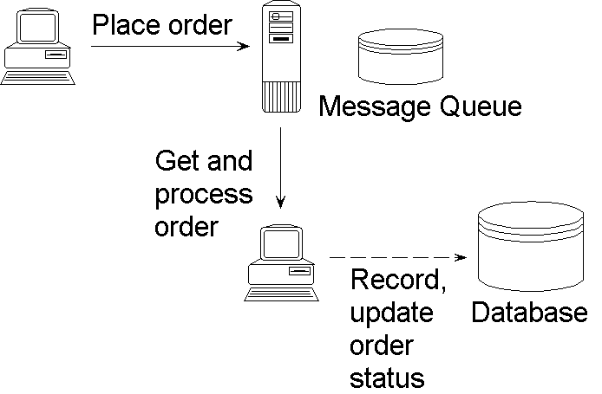
Point-to-Point messaging

Slide 55

Pub/Sub messaging
publish (“AAPL”, 29.2);
publish(“AAPL”, 29.3);
publish (“SUN”, 43.0);
publish(“SUN”, 42.7);
subscribe (“AAPL”);
subscribe (“SUN”);
subscribe (“AAPL”);
subscribe (“SUN”);
subscribe (“AAPL”);

Slide 56
Email
The killer application of messaging - billions of messages are sent everyday.
Email client can be either stand alone or browser based, and has to communicate with an email server to send and receive messages.
Most widely used servers
SMTP (Simple Mail Transfer Protocol) server used to send messages
POP (Post Office Protocol) server used to store incoming mail.
IMAP (Internet Message Access Protocol) is an alternative to POP which allows users to access email from multiple machines.
JavaMail API: its implementation provides access to mail services using POP3, IMAP, and SMTP.

Slide 57
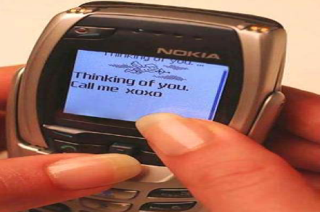
Short Message Service(SMS)
Introduced in Europe in 1991, supported on digital wireless networks such as GSM, CDMA, etc.
Used to send and receive short text messages (160 characters) - eliminates the need of pager
SMS messages can be received during voice call.
Many applications: both consumer-oriented and corporate applications
Personal communications
Information services: stock, weather, sports, etc.
Advertising
Location tracking; Remote monitoring
Benefits:
Guaranteed message delivery using store and forward.
Low cost
Revenue source for service providers (~200 billion messages/yr; ~$16 billion annual revenue).

Slide 58
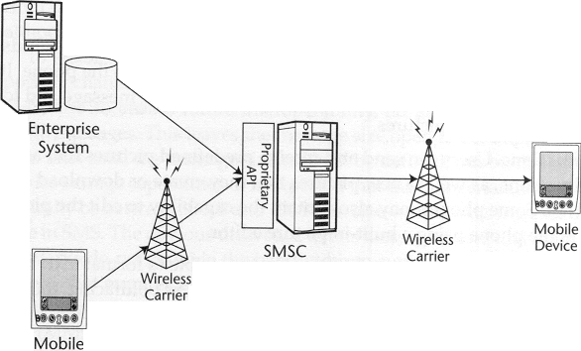
SMS architecture

Slide 59
E
D
MS1
MS2
MSC1 + VLR
MSC2 + VLR
SMSgwy + SMSC
C
HLR
Submit SM
Forward MT SM
Ack
Ack
Send routing info
Routing info
Forward MT SM
Nack (MS2 switched off)
Report SM waiting
Ack
MS2 switched on
Report ready for SM
Ack
Alert SMSC
Ack
Forward MT SM
Deliver SM
Ack
Ack

Slide 60
SMS architecture
Messages sent from a mobile phone are taken care by carrier through the SMSC to the destination device
Messages from other sources will not be taken care by the carriers but need the help of the SMSC for delivering the message
May need to know SMSC’s APIs
Standard protocol used to communicate with SMSCs include TAP (Telocator Alphsnumeric Protocol) and SMPP (Short Message Point to Point).

Slide 61
SMS architecture
Another possible way to send SMS is to use email interface (SMTP).
Many carriers make SMTP access available to their systems, allowing SMS messages to be sent using an email interface (e.g., Java Mail).
Send email message to destination user’s telephone number and carrier domain (8005551234@mobile.att.met).
Message is routed through SMTP server to SMSC, then delivered to mobile over wireless network.
JavaMail API provides a generic model of an email system, and Sun Microsystems’ reference implementation of JavaMail supports the three most popular email protocols – SMTP, POP3, and IMAP

Slide 62
Multimedia Message Service (MMS)
More data format, including voice, audio and video clips and presentation information.
Standardized by OMA (Open Mobile Alliance) for message encapsulation and application protocols, and 3GPP (3rd Generation Partnership Project) for network architecture and general functions
1st generation MMS size is 30 KB to 100 KB, requiring 2.5 G wireless network with minimum bandwidth of 14.4 Kbps.

Slide 63
MMS features
Messages are laid out as slide shows, containing at least one slide divided into two sections (one for text and another for multimedia).
Actual contents are separate files sent along with the slides, incorporated to the slide show using SMIL (Synchronized Multimedia Integration Language).
SMIL (from W3C) is based on XML, and used to control the presentation of multimedia elements

Slide 64
MMS architecture
Similar to SMS in delivery - use MMSCs (similar to SMSCs), which use a store-and-automatic forward mechanism.
Supports for email addressing so messages can be sent to an email address from the MMS client.
Each vendor’s MMSC has its own APIs. But unlike SMSCs, MMSCs are not expected to provide an SMTP interface.
Transport of MMS is accomplished using WAP transport, making MMS bearer independent and possible to use WAP push to deliver messages.

Slide 65
Instant Messaging (IM)
IM is the next killer application for wireless industry - fastest growing communications function on the Internet
Over 130,000,000 worldwide users
3,000,000 new users every month
1,000,000,000 instant messages are sent every day !
Provides capabilities similar to paging, SMS, and email with additional feature “Presence"
Mobile IM enables users everywhere to communicate with one another, regardless of their type of connectivity.
Several mobile IM products are available from Microsoft, Yahoo, ...
True mobile IM requires interoperability between IM services.
Wireless Viliage (OMA): A joint effort (Nokia, Motorola, and Ericsson) to create standards of IM for handset makers and carriers to follow.

Slide 66
Push messaging
Urgent messages (notifications & alerts) are sent to mobile users through wireless devices which contains URL link called actionable alerts.
Receiver performs the action based on the information.
WAP push is the industry standard (by WAP Forum) for pushing content to WAP-enabled devices.
Allows multiple gateway vendors, microbrowser providers, and wireless carriers to communicate using the same protocol.

Slide 67
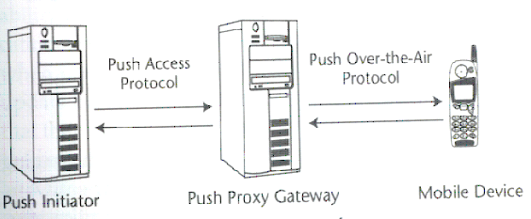
WAP Push architecture

Slide 68
WAP Push: how it works
Push Initiator (PI)
An application that pushes the content (in XML format) and delivery instructions to the PPG.
PI must have two sets of information about the destination, domain name of the PPG and client address.
Runs on standard web server and communicates with PPG using PAP (Push Access Protocol, currently runs on top of HTTP)
WAP client
Typically a wireless device that contains a WAP microbrowser capable of receiving WAP push content.

Slide 69
WAP Push: how it works
Push Proxy Gateway (PPG)
Mainly responsible of delivering push content to the WAP client.
Store the message when they can’t be delivered immediately to the client.
Maintains the status of each message, allowing PI to cancel, replace and request status of the message.
Uses OTA (Push Over The Air) protocol to deliver push content to WAP client over wireless network.
OTA runs on top of HTTP or WSP (wireless session protocol)
Can respond to PI using “result notification” (an XML document), indicating whether message delivery was successful or not.
Successful delivery occurs only when the WAP device has taken the responsibility for the pushed content.

Slide 70
WAP Push operations
WAP push specification adds three MIME types for delivery from PI to WAP client.
Service indication (SI)
Provides the ability to send notification directly to the end users.
Contains information directly in the message or in URI form.
Service loading (SL)
Often behind the scene - without requiring user interaction.
Contains URI that points to content to be loaded into the browser’s cache to make interaction efficient
Indicate whether the content should be executed immediately or placed in the cache memory.
Cache operation (CO)
Removes objects from the client’s cache.
SI and CO are optional.

Slide 71
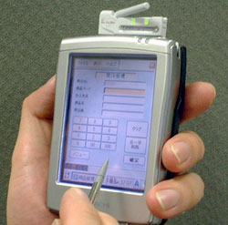
Mobile Device Platforms

Slide 72
Mobile device platforms
In addition to wireless networks, mobile devices is another important underlying technology for mobile computing.
Mobile device platform includes device hardware itself and the software platform: OS and program development kit.
We are seeing increasing device capabilities and functionalities
More memory, more processing power, more battery life, larger and richer screens, better bandwidths.
Except input – which has remained largely unchanged

Slide 73
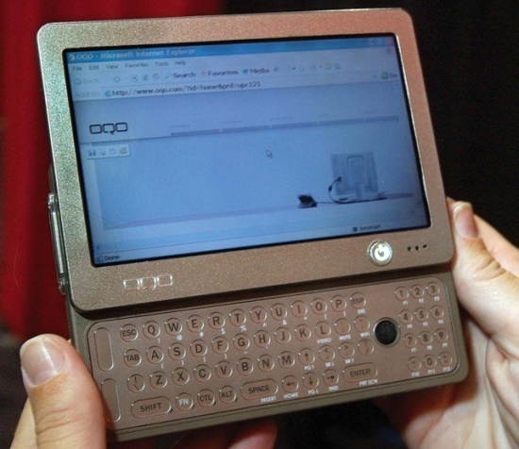
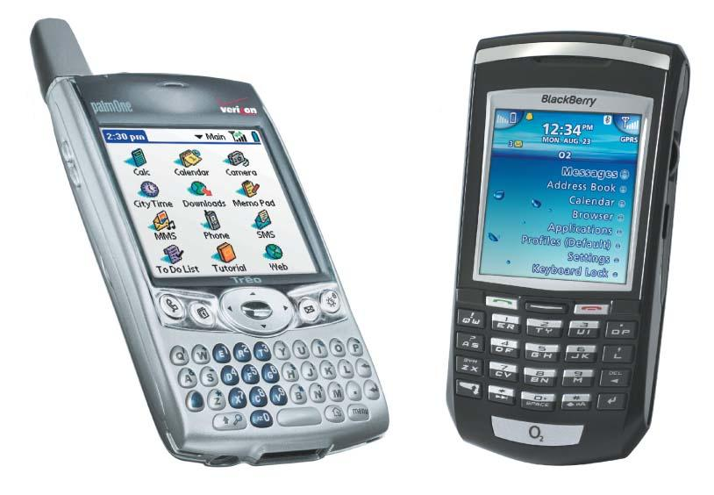
Mobile devices
Pagers
Cellular phones
Portable media players
Personal digital assistants (PDAs)
Tablet PCs
Laptop computers
Mobile Internet devices (MIDs)
Notes:
There are many mobile computing devices on the market:
Paging devices provide you with limited communication capabilities but are inexpensive options if you want some of the features of mobile computing.
Cell phones feature traditional phone services such as call waiting and voice mail. Many now come with calendars, contact databases, text messaging, and e-mail capabilities.
MP3 players allow you to carry music files and other digital files.
Personal digital assistants (PDAs) are handheld devices that allow you to carry much of the same digital information as desktop systems.
Tablet PCs are larger and more powerful than PDAs and incorporate specialized handwriting-recognition software.
Laptops are expensive and powerful tools for carrying electronic information.

Slide 74
Converged technologies
Smartphones: cell phones with smart add-ons, e.g.:
PDA capability
Fancy color graphics
MP3 player
GPS
PDAs with cell phone capability
Sony Ericsson P800
iPhone
Notes:
A number of devices are being released that attempt to combine a cell phone, an MP3 player, and a PDA into one unit.
These kinds of mobile devices are called “smartphones” and represent a step toward the ideal of “convergence,” being able to have a single compact device that features all of these capabilities.
However, each is making some compromises: there are features available on the best cell phones and PDAs that are missing from the smartphones currently on the market.

Slide 75
OS for mobile devices
To deploy smart client applications, client devices should have a mobile OS.
Provided features
Multitasking
Persistent storage and memory management
Power management
Wireless networking protocols such as Bluetooth, TCP/IP.
Programming languages and development tools
Data synchronization with server-side data sources.
Applications
Device emulators

Slide 76
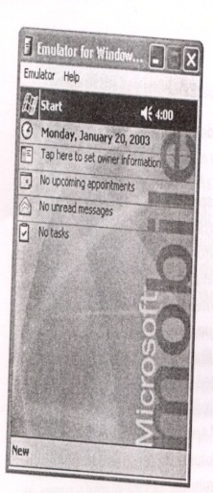
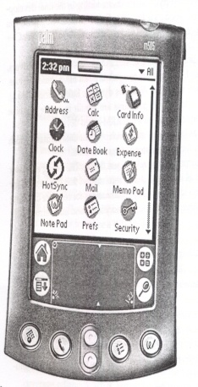
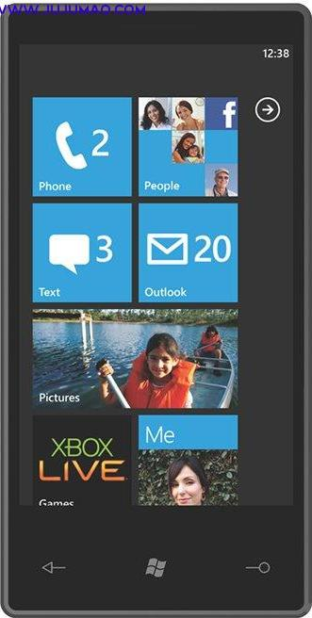
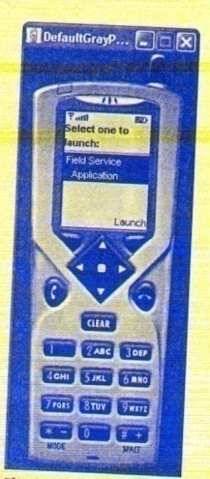
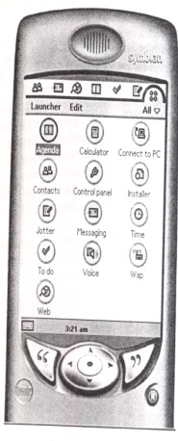
OS for mobile devices
Main OS & platforms
Palm OS
Symbian OS (Nokia)
Window CE / Window CE .NET (Windows Mobile)
Windows Phone 7 (WP7)
Blackberry OS
Linux
Google’s Android
iPhone OS and SDK
J2ME
Windows CE, Palm OS
Symbian OS, J2ME

Slide 77
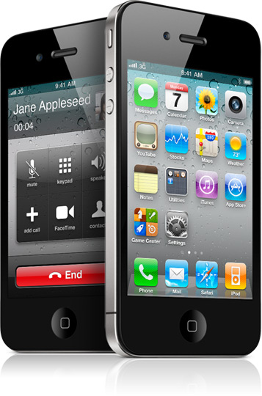
iPhone’s iOS platform
iOS 4.3 (iPhone OS)
Derived from Mac OS X
iOS SDK
Novel Feature
Multi-touch interface
Multi-tasking
Sensors
iOS devices
iPad
iPod Touch
Notes:
77

Slide 78
Google Android
So far, most mobile device platforms are closed systems owned by companies and consortium
High royalty fee, OEM/ODM not happy
Low application development efficiency
Difficult to collaborate and re-use among developers
Android is a software platform and operating system for mobile devices, based on the Linux kernel, developed by Google and later the Open Handset Alliance
The main goal is to make the best possible user experience available on a mobile device - an open platform allows just about anyone who wants the chance to get in on the game.
Andriod’s API is freely available for any programmer to create Android applications

Slide 79

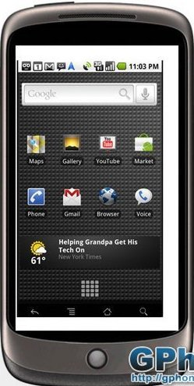
Google Android
Open Handset Alliance:
A consortium established in 2007, led by Google, 48 hardware, software, and telecom companies: Intel, Motorola, T-Mobile, HTC, etc
Develop open standards for mobile devices
Main product: Android Platform (Nov. 2007), available as open source
October 22, 2008: HTC delivered G-Phone - Android capable smartphone
Jan. 5, 2010: Google releases Nexus One

Slide 80
Blackberry OS
Proprietary software platform made by Research In Motion for their BlackBerry line of handhelds.
Provides multi-tasking,
Makes heavy use of specialized input devices, particularly the thumbwheel,
Support a subset of MIDP2.0 and WAP1.2
Allows complete wireless activation and synchronization with Exchange's e-mail, calendar, tasks, notes and contacts,
Third-party developers can write software using these APIs, and proprietary BlackBerry APIs.
Fast Web browsing, Video camera, Youtube,

Slide 81
J2ME
J2ME, now called Java ME, is Sun’s answer to the development of Java services on lightweight, limited computing platforms.
Consumer devices
Embedded systems
Support both connected / disconnected operations
Rich user-network interaction model
Fully programmable
Portable

Slide 82
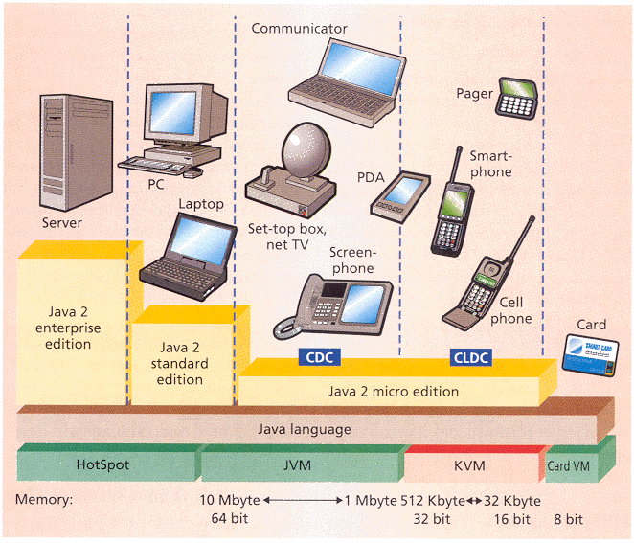
J2ME configurations
J2ME currently is designed to target two types of devices (called configurations)
CDC (Connected Device Configuration) - targeted at shared, fixed (permanently connected) devices
CLDC (Connected Limited Device Configuration) - targeted at mobile, personal devices that have low bandwidth & transient network connections.

Slide 83
J2ME architecture
J2ME consists of
Configuration
JVMs that fit inside the range of consumer devices
A library of Java APIs that are common for each type of devices
Profile
Additional set of Java APIs specialized for a particular kind of devices of that type, e.g., PDA and mobile phone
MIDP (Mobile Information Device Profile) is a particular profile specified for wireless handheld devices.
J2ME
Profile
Profiles
J2ME
Libraries
Java Language
Configuration
Java Virtual Machine
Host Operating System

Slide 84
CLDC/MIDP Wireless Toolkit
CLDC 2.0 specification is available for download free of charge.
Java language and virtual machine features, core libraries, input/output, networking and security are the primary topics addressed by the specification.
SUN provides reference implementation of CLDC on KVM.
MIDP 2.0 specification and implementation are also available for download.

Slide 85
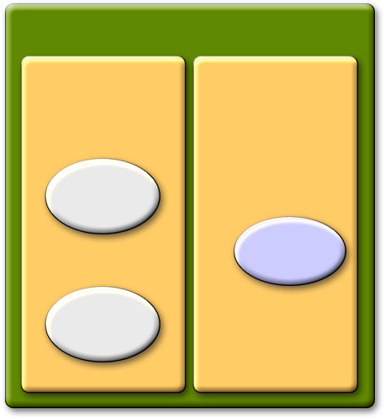
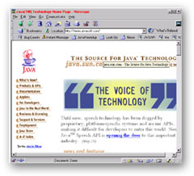
J2ME talks to J2EE
J2EE Application Server
Network
container
EJB
container
HTTP
GSM/GPRS,
WLAN, …
J2ME Servlet
Book
EJB
redirect
HTTP
HTML Servlet
search

Slide 86
J2ME extensions
http://www.jcp.org/en/jsr/all
120, 205: Wireless Messaging API
135: Mobile Media API
169: JDBC Optional Package for CDC/Foundation Profile
82: Java APIs for Bluetooth
179: Location API for J2ME
184: Mobile 3D Graphics API for J2ME
172: J2ME Web Services Specification
177: Security and Trust Services API for J2ME
180: SIP API for J2ME
190: Event Tracking API for J2ME

Slide 87
The trend
Focus shifted from device to OS platforms and application software.
Most mobile devices now have similar design and form factors, so OS platforms and application software become the key for competition in attracting the users.
WMC-2010 in Spain – Nokia, LG, Apple not present, but Google’s Eric Schmidt and Microsoft ‘s Steve Ballmer showed

Slide 88
The Trend
The biggest problem now is the incompatibility among the OS platforms and application software.
Big equipment manufacturers, mobile operators are forming alliance and pushing standards for mobile application software
Alcatel-Lucent (www.alcatel-lucent.com)
Joint Innovation Lab (JIL): formed by China Mobile, Verizon Wireless, Vodafone, Softbank Mobile (http://www.jil.org/)
Wholesale Applications Community: formed by JIL and AT&T, Sprint Nextel, Orange and other mobile operators (www.wholesaleappcommunity.com)

