Slide 1
Overview of Mobile Data Management

Slide 2
Outline
Drives of mobile data management
Objectives of mobile data management
Data management in client/server mobile environments
Data management in ad hoc mobile environments

Slide 3
Drives of mobile data management
With increasing wireless connectivity and popularity of portable devices, mobile users are enabled to access and share on-line data and related services.
Mobile users can also carry extracts of corporate databases with them to have continuous access.
Sales force automation – especially in pharmaceutical industry, consumer goods, parts, etc.
Financial consulting and planning
Insurance and claim processing
Real estate / Property management – maintenance and building contracting
Mobile e-commerce

Slide 4
Objectives of mobile data management
Reducing the number of data transmitted over wireless networks.
Reducing the response time of accessing data via wireless networks.
Providing data caching on mobile hosts.
Maintaining consistency of data and transactions.

Slide 5
Data management in Client /Server mobile environments
A reference model of mobie databases

Slide 6
Data management in Client /Server mobile environments
Components of mobile a database
Communication
Link
Corporate
Server
Corporate
DB
Laptop
Mobile DBMS
Corporate
DBMS
Mobile DB
Mobile DBMS
PDA
Mobile DB

Slide 7
Mobile databases
Mobility and wireless have big impact on deign of DBMS!
Models
One server or many servers
Shared data, with full or partial replication
Some local data on client side, mostly subsets of global data
Both client side and server side computing
Execution of transactions on multiple nodes – mobile and fixed
Requirements: access to accurate & up-to-date information with constraints
Some applications can tolerate bounded inconsistency: e.g., sacrificing strict “ACID” requirements and allowing “weaker” consistent models.
Long disconnection should not constraint availability

Slide 8
Mobile database design
Data modeling and design
Modeling clients and related data that can change locations
Modeling and handling fast changing data.
Even distribution of data among servers – design of server databases with partitioning and replication
Handling intermittent connectivity
Constraint: only client can, whenever needed, establish communication with server but not vice versa.
Replication
Synchronization of replicas
Update Installation and propagation

Slide 9
Mobile database design
Fault tolerance and recovery
Handling various failures, including site, media, communication, and transaction failures
e.g., transaction failure is common during handoff.
Planned and unplanned failures should be treated differently
In most cases, when failures occur, data recovery is needed
Shadows
Checkpoints
Logs

Slide 10
Mobile database: data management
Mobile transaction management
Concurrency and Integrity constraint enforcement
Recovery of mobile transactions
Wireless data dissemination (broadcast)
Mobile data caching / replication management
Disconnected operations
Mobile query processing
Energy efficient query processing, e.g., data shipping vs. query shipping
Location dependent query processing – must reflect the constantly-changing location of client
Querying moving objects – keep tracking moving objects

Slide 11
Mobile transactions
Transaction: a set of operations that translate a database from one consistent state to another consistent state
Transaction operations
Serialization of concurrent execution
Transaction commit
Transaction and database recovery
Transaction properties:
ACID (Atomicity, Consistency, Isolation, and Durability)
Too rigid and difficult to enforce for mobile transactions.
Begin_transaction ()
Execution of transaction program
If (reach_final_state) then
Commit_Work(final_state)
Else
Rollback_Work(initial_state)

Slide 12
Mobile transactions
Execution scenario:
User issues transactions from his/her MU and the final results comes back to the same MU.
The user transaction may not be completely executed at the MU so it is fragmented and distributed among database servers for execution.
This creates a distributed mobile execution

Slide 13
Mobile transactions
Flexibility need be introduced.
E.g., using workflow concept, part of the transaction can be executed and committed independent to its other parts
New models and solutions are needed.
Kangaroo Transactions: the management of transactions move with MU.
A Kangaroo Transaction (KT) is created at MU
On each hop to a new BS, A Jump Transaction (JT) is created at the BS - JT consists of a set of Local Transactions (LTs) and Global Transactions (GTs)
Each BS manages mobile transactions and the movement of the MU.
Mobile transaction’s execution is coordinated by the BS the MU is currently associated with.
When MU hops from one cell to another, coordination of the mobile transaction moves to the new BS.
Maintains a linked list of all BSs that have been coordinators of the KT

Slide 14
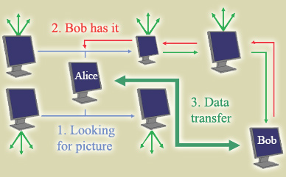
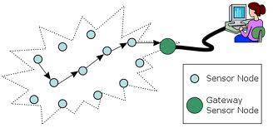

Data management in ad hoc mobile environments
With no dedicated routers, nodes become much more prone to get disconnected from network
Data availability degrade significantly
Query & data delivery becomes much more difficult & costly (energy)

Slide 15
Caching & Replication
Same goal as in C/S model: improve data availability and reduce delay
But, replication is very hard to achieve now
Disconnection makes it difficult to guarantee consistency in a timely and efficient manner, as we rely purely on the mobile nodes, no wired nodes
As nodes are disconnected more often, data at each node diverges further and further from others
Soon, the database is inconsistent and there is no obvious way to repair it
Cooperative caching provides an effective way.

Slide 16
Caching in ad hoc networks
Caching
Cache popular data on the querying node
Reduce traffic overhead and query delay
Cooperative Caching
Data source asks a collection of caching nodes for help
Nodes cooperate to cache popular data
Coordination and sharing of cached data
Advantages
Further explore the potential of caching – nodes collaborate to serve queries without having to frequently send request to data source
Shorter delay and less communication overhead

Slide 17


Data dissemination in ad hoc networks
Data collection and dissemination
From / to a certain node
From / to a certain group of nodes
From / to a certain area
Data delivery in
Mobile ad hoc networks
Sensor networks
Vehicular networks
Ad hoc routing
Delay-tolerant
Y
Z
S
E
B
F
C
M
L
J
A
G
H
D
K
I
N

Slide 18
Query processing in WSN
Network is abstracted as a database
represents sensors and sensor data in a database
Control of sensors and extracting data occurs through special SQL-like queries
Examples:
TinyDB (UC Berkley),
Cougar (Cornell),
Sensors
SELECT Nodeid, Light
FROM Sensors
WHERE Light > 400
EPOCH DURATION 1s
Epoch | Nodeid | Light | Temp | Accel | Sound
0 | 1 | 455 | x | x | x
0 | 2 | 389 | x | x | x
1 | 1 | 422 | x | x | x
1 | 2 | 405 | x | x | x

Slide 19
Query processing in WSN
Network is abstracted as a database
represents sensors and sensor data in a database
Control of sensors and extracting data occurs through special SQL-like queries
Examples:
TinyDB (UC Berkley),
Cougar (Cornell),
Sensors
SELECT Nodeid, Light
FROM Sensors
WHERE Light > 400
EPOCH DURATION 1s
Epoch | Nodeid | Light | Temp | Accel | Sound
0 | 1 | 455 | x | x | x
0 | 2 | 389 | x | x | x
1 | 1 | 422 | x | x | x
1 | 2 | 405 | x | x | x

Slide 20
Query processing in WSN
Users specify the data they want
Simple, SQL-like queries
Challenge is to how to provide:
expressive & easy-to-use interface
high-level operators
well-defined interactions
“transparent optimizations” that many programmers would miss
Sensor-net specific techniques
Power-efficient execution of queries

Slide 21
Data aggregation in WSN
Exploit query semantics to improve efficiency
Data coming from multiple sensor nodes are aggregated when they reach a common routing or relaying node on their way to the sink, if they have about the same attributes of the phenomenon being sensed
Provide energy savings by allowing in-network aggregation of redundant information and reducing transmissions
Source 1
Source 2
2
Data
Aggregation
1
A
B
1+2
Sink

Slide 22
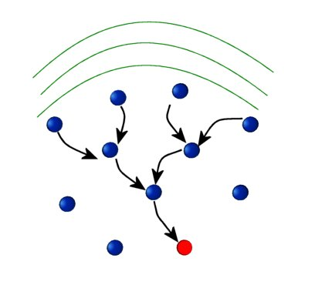
Data aggregation in WSN
In this view, routing structure in a sensor network can be considered as a form of reverse multicast tree
Optimal aggregation is NP-hard in general
Equivalent to forming a minimum Steiner tree.
Optimum no. Of transmission = no. of edges in the minimum Steiner tree
*A minimum-weight tree connecting a designated set of vertices, called terminals, in a weighted graph. The tree may include non-terminals, which are called Steiner vertices”

Slide 23
Data aggregation in WSN
Aggregation techniques (sub-optimal)
Center at Nearest Source (CNSDC): All sources send the information first to the source nearest to the sink, which acts as the aggregator.
Shortest Path Tree (SPTDC): Opportunistically merge the shortest paths from each source wherever they overlap.
Greedy Incremental Tree (GITDC): Start with path from sink to nearest source. Successively add next nearest source to the existing tree.

