Slide 1
Data Dissemination over Wireless Internet

Slide 2

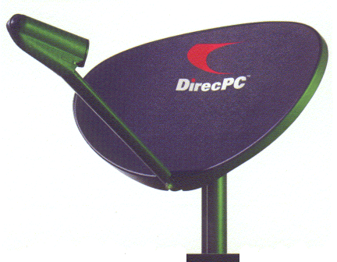
Wireless data dissemination
Application distribution service
Information feeds:
Stock quotes and sport tickets, electronic newsletters, mailing lists, traffic and weather information systems, cable TV on the Internet.
Commercial products:
AirMedia’s Live Internet broadcast network,
Hughes Network Systems’ DirectPC

Slide 3
Wireless data dissemination
Abstraction model
Server
Base station
Clients
Wireless channels
Uplink channels for sending data query requests
Downlink channel to receive data from BS

Slide 4
Wireless data dissemination
Goals:
Reduce access delay
Wireless networks have less bandwidth and long delay
Minimizing energy consumption at client
MUs have limited energy power
Maximize capacity of servers

Slide 5
Wireless data dissemination
Two basic approaches for data dissemination
Pull-based mechanisms (on-demand mode) - Client actively pulls data from the server
music album server, ring tones server, video clips server, or bank account activity server
Push-based mechanisms (publish-subscribe mode) - Server actively pushes data to client - as per the subscription for a push service by a client
advertisers or generators of traffic congestion, weather reports, stock quotes, and news reports
Hybrid mechanisms (hybrid mode)

Slide 6
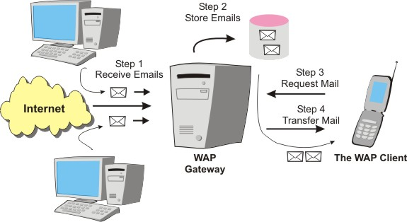
Pull-based mechanisms
client
client
client
client
server
client
client
help
client

Slide 7
Pull-based mechanisms
Pull is the best option when the server has very little contention and is able to respond to many device requests within expected time intervals
No unsolicited or irrelevant data arrives at the device
Relevant data disseminated only when user asks for it

Slide 8
Pulling bandwidth
Bandwidth used for the uplink channel depends upon the number of pull requests
Assume uplink bandwidth of 19.2 kbps and server accepts 384 kbps, only 20 pull requests can be used at 19.2 kbps
If number of pull requests is larger, uplink channel bandwidth lowered to 9.8 kbps or 4.8 kbps
Similarly, server adapts to the bandwidth required for serving requests (downlink) in case the server is unable to deliver response in a reasonable period
Pull threshold limits the number of pull requests in a given period of time
Controls the number of server interruptions

Slide 9

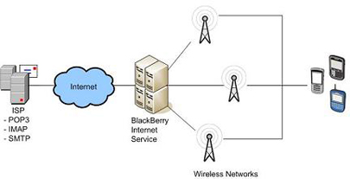
Push-based mechanisms
client
client
client
server
client
client
Whew!
client

Slide 10
Push-based mechanisms
Push is suitable when information is transmitted to a large number of clients with overlapping interests.
The server saves several bandwidth and is prevented from being overwhelmed by client requests.
Push is scalable: performance does not depend on the number of clients. Pull cannot scale beyond the capacity of the server or the network.
In push, access is sequential, so access latency degrades with the volume of data.

Slide 11
Push algorithms
Select a structure of data records to be pushed
an adaptable mechanism that permits data items to be pushed uniformly or non-uniformly after structuring them according to their relative importance
Push the data at selected time intervals
pushing at periodic intervals provides the devices that were disconnected at the time of previous push with a chance to get the data when it is pushed again
Allocate bandwidths for downlink (for pushes)
Usually higher bandwidth is allocated to data records with higher number of subscribers or higher access probabilities
Stop pushes when device is handed over to another BS

Slide 12
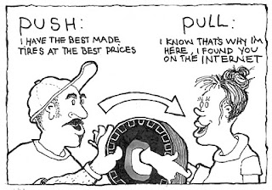

Hybrid mechanisms
client
client
client
help
client
server
client
client
Whew!
client

Slide 13
Hybrid mechanisms
Two channels between devices and server
Front channel for push and Back channel for pull
Bandwidth is shared and adapted between the two channels
Bandwidth adapted in downlink and uplink channels depend upon the number of active devices receiving data from the server and the number of devices requesting data pulls from the server

Slide 14

Wireless data broadcast

Slide 15
Wireless data broadcast
Server continuously broadcast a set of most frequently accessed data on some fixed radio frequency channel.
Mobile users receive broadcast data packets from the server by tuning their mobile units to this broadcast frequency, listen and download the desired data to local cache.
Server determines, according to users’ demands or their interests, what data should be broadcast and its schedule on the channel.
A broadcast program consists of a set of data items, ordered in time of broadcast
The program can also use index or some other method to inform users when their interested data are available, so as to save battery consumption on mobile units.

Slide 16
Wireless data broadcast
service provider
Mobile users
A
MU
B
A
Data
Distribution
Medium
A
B
MU
A
Server
A
B
.
.
.
A
B
A
MU
Broadcast Program
optimized for expected
access pattern
of all users
≠
individual access
pattern of one user

Slide 17
Pure vs. On-demand broadcast
Pure broadcast
MUs do not send any query but listen passively to the channel for interesting data items – e.g., stock quote
On-demand broadcast
MUs send queries, and the result to a query is broadcast together with results from other queries on the same channel.
MU must filter out the designated result.

Slide 18

Models for wireless broadcast
2
3
1
4
server
5
6
Schedule of data blocks to be transmitted

Slide 19
Models for wireless broadcast
Assume that records to be broadcast are stored on a hypothetical circular disk - the disk revolves and the angle changes from 0° to 360°
The entire N bits in n records get pushed through a hypothetical reading-head over the disk.
The head continuously reads each bit of a record just beneath it and broadcasts it instantaneously on the wireless network
During next revolution each bit in the records positioned from 0° to 360°broadcast once again in the same sequence as in earlier revolution
In case a device misses a record in first revolution, it can cache the same in next or any of the successive revolutions

Slide 20
Models for wireless broadcast
T_{s} = time taken for one revolution of the disk
Time interval between successive broadcasts of each bit in each record
Ts = N × ts
t_{s} = time interval between successive bits transmitted
Time interval between transmission of successive bits
ts = (Ts/N) [= reciprocal of bandwidth]
Due to sequential access of broadcast data items, increasing number of broadcast items causes mobile users to wait for longer time before receiving desired data items.

Slide 21
Access Time
The main purpose of broadcast is to push records of greater interest with greater frequency in order to reduce access time or average access latency
t_{access} = the time interval between request from device and reception of interested data item from broadcasting or data pushing or responding system
t_{access} is dependent on the number (n) and size (N) of the records to be broadcast
the greater the n and N, the greater will be t_{access}

Slide 22
Tuning Time
MU should be activated for listening and caching only when it is going to receive the elected data records or buckets of interest
MU does not have sufficient energy to continuously cache the broadcast records and hoard them in memory
MU dissipates more power if it gets each pushed item and caches it
Tuning means that MU gets ready for caching at those instants and intervals when a desired record of interest is broadcast
t_{tune} = time MU spent on listening actively to the channel
Since MU must scan the channel for interested data item, its power consumption can be considered as directly proportional to t_{tune}

Slide 23
Access Time & Tuning Time
Do they have any correlation?

Slide 24
Broadcast disks
Recall that broadcast-disk programs consists of a set of data items on the disk, ordered in time of broadcast.
Item-based broadcast program is expensive to generate, especially when there are many items
For better performance we can collect items of similar access probability into partitions.
Each partition is viewed as an individual disk.
Broadcast disks - Put items into different disks with different spinning speed.
Broadcasting hot partitions more often translates into a disk spinning with faster speed.
Multiplex multiple disks onto the same broadcast channel.

Slide 25
Broadcast disk models
A broadcast file is similar to a disk file but located on the air – so it is also called broadcast disk - file on the air
Several disk models
Flat Disk Model
Circular Multi-disk Model
Multi-disk Model with repetition rate proportional to priority
Skewed disk model

Slide 26


Broadcast disk models
Flat Disk Model
Data records, R0, R1, R2, R3, R0, R1, R2, R3, are transmitted in a single broadcast cycle
All record blocks have an equal priority level (round-robin)
Server broadcasts the data as per cyclic requests (subscriptions) without taking into account the number of devices that subscribe to a particular record

Slide 27
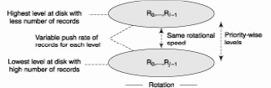
Broadcast disk models
Circular Multi-disk Model
Each block of records is pushed with a repetition rate proportional to its hierarchical level

Slide 28
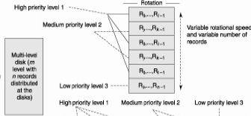

Broadcast disk models
Multi-disk Model with repetition rate proportional to priority
The transmission rate at each level is same but the repetition rate of a record is proportional to the record’s priority level
Popular records are assigned to multiple levels.
Priority of a record can be as per the number of users subscribing to it
3 priority levels

Slide 29
Broadcast disk models
Skewed disk model
Block of records are repeated as per their priorities for pushing
Priority of a record can be set as per number of its subscribers
Unlike the multi-disk model, the skewed-disk model entails consecutive repeated transmissions of a record block, followed by consecutive repeated transmissions of another record block, and so on

Slide 30


Broadcast disk models
Skewed disk model
High priority record blocks pushed more often than the low priority ones because these are repeated one after one more often

Slide 31
Objectives of broadcast disk program
Allow mobile users to access broadcast data with optimal access time and power consumption.
Determine how to organize the data items (e.g., in priority order) and schedule the time of broadcast (e.g., how often).
Determine how MUs should retrieve and process the broadcast data items on air.

Slide 32
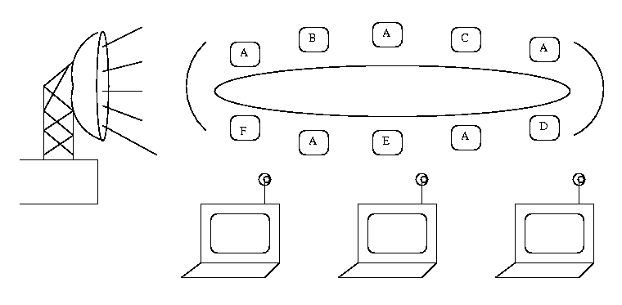
Broadcast disk program
Schedule of periodic broadcast of one or more disks
Disks are of different sizes and can be broadcast at different speed
Broadcast frequency of each item depends on its access pattern
Disk1
A
Disk2
B
C
A B A C

Slide 33
Broadcast disk program
Disk parameters:
first, the number of disks (i.e., different frequencies);
then, for each disk, the number of data items to be stored and the relative frequency of broadcast
Scheduling Problem:
Given a list of data items ordered by their expected access probabilities and a specification of the disk parameters, design an algorithm that assigns data items to disks and determines the interleaving of disks.
The algorithm produces a periodic broadcast program with fixed inter-arrival times per data item.

Slide 34
Broadcast disk program
An example:
Order pages from "hottest" to coldest (page is record of data with same format and length)
Partition pages into tracks ("disks") — pages in a track have similar access probabilities
Determine relative frequencies of the disks (e.g., rel_freq (1) = 3, rel_freq (2) = 2)
Split each disk into "chunks"
maxchunks = LCM(relative frequencies)
numchunks(J) = maxchunks / relativefreq(J)
Broadcast program is then:
for I = 0 to maxchunks - 1
for J = 1 to numdisks
Broadcast( C(J, I mod numchunks(J) )

Slide 35
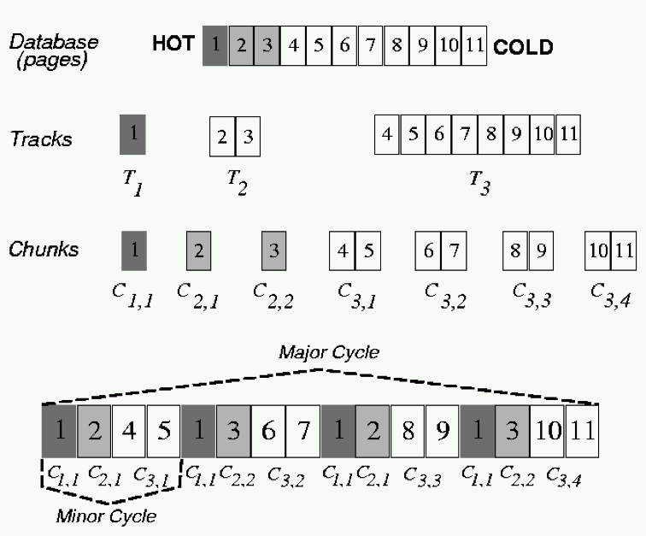
Broadcast disk program
An example:
rel_freq (1) = 4
rel_freq (2) = 2
rel_freq (2) = 1

Slide 36
Selective tuning
Clients may actively listen to thousands of data records on the broadcast just to pick up one of them to use.
Selective tuning is the process by which MU selects only the required data records, tunes to them, and caches them
MU activates only when the data arrives, saving power consumption
How to enable selective tuning?
Place a structure and overhead over the broadcast data
In addition to data, each broadcast cycle broadcasts a directory or index which is the overhead prefixed by server before the data
A disadvantage of selective tuning is that it extends the broadcast cycle and hence increases t_{access}

Slide 37
Selective tuning
An example:
n records R0 to Rn–1 interleaved and broadcast as in a multi-disk model
Only the records Ri' and Rj' are of interest and required by applications on a device
The broadcast disk broadcasts Ri ' and Rj ' thrice and once, respectively, as the subscription probability of Ri ' is three times that of Rj ‘
The record Ri' is partitioned into k buckets, bi0 to bik–1
The record Rj' is partitioned into k‘ buckets, bj0 to bj k'–1. Each bucket has equal length lb, which means equal number of bits and the devices takes identical time lb × ts to cache each bucket data. [ts the time interval between successive bits]
In addition to data, each broadcast cycle broadcasts a directory, or index which is the overhead prefixed by server before the data
Device selects only the buckets of Ri’ and Rj ' which are of interest and receives the signals only during first, second, or third instances of Ri ' or during instances of Rj' , that is, during the intervals Ti0,… ,Ti k–1, Tj0, … ,Tjk'–1 of broadcasting of bi0 … bi k–1, bj0 … bj k'–1, respectively
In the remaining intervals, where either the other records which are not of interest are being broadcast or when record of interest is already cached in an earlier broadcast cycle, the device remains idle.
During this period it does not dissipate power and hence saves energy

Slide 38
Directory method
Broadcasting a directory as overhead at the beginning of each broadcast cycle
A directory specifies when a specific record or data item appears in data being broadcasted, consisting of start sign, pointers to records, and end sign
If interval between the start of the broadcast cycles is T_{B}, then directory broadcasts at each successive intervals of T_{B}
A device has to wait for directory before it can get tuned to its interested data and then start caching it
Recall that tuning time t_{tune} is the time taken by the device for selection of desirable records.

Slide 39
Index-based method
Indexing is another method for selective tuning, used to guide the MU in the listening process
Index can be broadcast interleavingly with data records.
Index only contains key names so is relatively small.
A traditional database index maps a key to where the key value is stored in memory; Here, an index for broadcast maps a key to the time when the key value is broadcast “on air”.
When client is looking for information, it tunes to the channel to locate the index for the broadcast cycle – gets broadcast time of the data and sleep until it arrive.
inx
inx
inx
inx
inx
inx
inx
inx
inx
inx

Slide 40
Index and offset
At each location (data record), an offset value may also be specified
An index maps to the absolute location of from the beginning of a broadcast cycle, while an offset maps to the beginning of the next index
Offset is used by the MU along with the present location to calculate the wait period for tuning to the next record

Slide 41
(1, m) indexing
Broadcast the index every fraction 1/m of the broadcast data items.
An index transmits m times during each period of the broadcast.
All data items have an offset to the beginning of the next indexed data item.
To access a record, a client tunes into the current data item on the channel, uses the offset to tune in again when the index appears.
From the index, it determines the required data item.

Slide 42
(1, m) indexing
An algorithm is used to adapt a value of m such that it minimizes the access latency in a given wireless environment
Index format is adapted to with a suitable m chosen as per the wireless environment, so as to decrease the probability of missing the index
If m is chosen small then the power dissipated by device is less but the data access latency increases
The value of m therefore needs to be optimized by employing an algorithm

Slide 43
Distributed indexing
Improves over the (1, m) method
instead of replicating the whole index (large overhead), each index segment describes only the offset of data items which immediately follow
Each index I is partitioned into two parts I' and I″
I″ consists of unrepeated k levels (subindexes), which do not repeat and I′ consists of top j repeated levels (subindexes)

