Slide 1
Disconnected Operations
What is disconnected operation?
Why support for disconnected operation?
Approaches
Bayou
Coda
Notes:
Application developers do not have to know the internal working of wireless networks to be successful, but having knowledge of how they work is very helpful.
Understand why certain wireless technologies behave the way they do;
Understand which application design architectures should be based.

Slide 2
What is disconnected operation?
Disconnected operation
A mode of operation that enables a client to continue accessing critical data maintained at the server during temporary interruption of network connection
Weakly connected operation
Network condition is poor ( radio signal is in lower level, connectivity is intermittent, channel noise)
Disconnected operation is the extreme of weakly-connected operation
Disconnection can be involuntary or voluntary

Slide 3
Why support for disconnected operation?
Provide data availability under mobile circumstance
User mobility
Unpredictable network conditions
Client’s choice:
Extends battery life by avoiding wireless transmission and reception
Reduces network charges (high rate)
Allows radio silence - a vital capability in military applications.

Slide 4
Approaches
Objectives
Ensure data availability even under disconnection
Tradeoff between consistency of data and autonomy of client
Solutions
Standard file systems (e.g., NFS) are very inefficient, almost unusable
Approaches to achieving data availability
Caching, prefetching, hoarding
Solutions need to ensure certain degree of data consistency
Update conflict detection / resolution
Data reintegration
Weak consistency
Cost of enforcing data consistency is high

Slide 5
Caching
Places a copy of file on client to avoid requesting over network
Useful for both weak connection and disconnection
Invalid copy may still be of limited value during disconnection (better than nothing?)
Issues
What to cache? (Files, objects, pages?)
When to cache? (Cache all newly obtained items?)
How to cache?
Simple LRU or other metrics
Semantic caching
Predictive caching

Slide 6
Prefetching
Anticipatory caching
Cache items that may be useful in future, but not currently needed, utilizing the otherwise idle processing power or bandwidth
Issues
What to fetch? (Files, objects, pages?)
When to fetch?
When no one uses the request channel
When the broadcast item is interesting
How to fetch?
Compute for the need and use the up-link channel to send request
Monitor broadcast channel and download the item

Slide 7
Hoarding
Pre-fetching to prepare for disconnection
Issues
What to hoard? (Files, objects, pages?)
When to hoard?
When planned disconnection is coming
With sufficient important data accumulated and high chance of disconnection
How to hoard?
User-provided information (useful for client-initiated disconnection)
Access pattern-based (past history)
Inter-file relationships

Slide 8
States of a client
Three modes
Connected (Normal)
server is available, request can be satisfied from either local cache or server
Disconnected (Off)
all request must be satisfied from local cache
Reintegration (Recover)
update related info, deal with conflict etc.
States of a client
hoarding
strong
connection
weak
connection
disconnection
write
disconnected
connection
disconnection
emulating

Slide 9
Consistency
Main problem with strong consistency
Strong consistency requires atomic updates
Invalidation of caches through a server
Difficult to achieve in mobile environments - mobile computer may not be connected to network
Alternative: weak consistency
Tolerate occasional inconsistencies
Apply conflict resolution strategies subsequently
Use version numbering, time-stamps (content independent)
Use dependency graphs (content dependent)

Slide 10
Transparency of replication
Transparent replication:
Allow systems that were developed to run on a central server to operate unchanged on top of a strongly-consistent replicated data storage (as seen in Oceanstore)
Non-transparent replication:
Allow systems to be developed assuming a relaxed consistency model – applications are involved in conflict detection and resolution.
Hence applications need to be modified (e.g. Bayou, Coda file system etc.
Conflicts between application users are not easily handled transparently.
Applications know best on how to resolve conflicts

Slide 11
Non-transparent replication
The challenge is providing the right interface to support cooperation between applications and their data managers

Slide 12
Bayou
Bayou is a system developed at PARC in the mid-90’s, as the first coherent attempt to fully address the problem of disconnected operation
But first, why did they call it “Bayou”?
A body of water, such as a creek or small river, that is a tributary of a larger body of water.
A sluggish stream that meanders through lowlands, marshes, or plantation grounds.
Possible explanations
Bayous are ubiquitous, and Bayou supports ubiquitous computing
Bayou provides “fluid” replication
Allows operation when you are “bayou self”
Pronounced Bi-U, which makes it Ubi spelled backwards

Slide 13
Bayou
Bayou is a replicated, weakly consistent storage system designed for a mobile computing environment.
To maximize availability, users can read and write any accessible replica. (read-any/write-any)
Bayou introduced an novel application-specific conflict detection and resolution method
Two major design issues
Resolve conflicts: How?
Guarantee consistency: How?
The Case for Non-transparent Replication: Examples from Bayou Douglas B. Terry, Karin Petersen, Mike J. Spreitzer, and Marvin M. Theimer. IEEE Data Engineering, December 1998
Managing Update Conflicts in Bayou, a Weakly Connected Replicated Storage System Douglas B. Terry, Marvin M. Theimer, Karin Petersen, Alan J. Demers, Mike J. Spreitzer and Carl H. Hauser. In ACM Symposium on Operating Systems Principles (SOSP ’95)

Slide 14
Conflict detection and resolution
Supporting application-specific conflict detection and resolution is a major emphasis in the Bayou design.
Why application-specific?
Only the application knows how to resolve conflicts, so let it specify its notion of a conflict along with its resolution policy
Application can do record-level conflict detection, not just file-level conflict detection
Split of responsibility:
Replication system: propagates updates
Application: resolves conflict

Slide 15
Motivating scenario: Shared calendar
e.g., Sharing calendar for meeting room scheduling
users can reserve room, at most one person (group) can reserve the room for any given period of time.
Want to allow updates offline, but then conflicts can’t be prevented
Let application itself speak and suggest
Calendar example: resolution can be easily done at record-level

Slide 16
Motivating scenario: Shared calendar
Observing updates at a coarse granularity (e.g., lock at the whole-file level) Conflict!
Observing updates at a fine granularity (record ) No Conflict
Neither of these conclusions are warranted.
In fact, for this application, a conflict occurs when two meetings scheduled for the same room overlap in time.
Reserve same room at same time: conflict
Reserve different rooms at same time: no conflict
Reserve same room at different times: no conflict
Only the application would know this!
So, application-specific!

Slide 17
Application-specific conflict detection and resolution
A Bayou Write not only is the typical file / database system Write (update), but also includes two mechanisms for automatic conflict detection and resolution that are intended to support arbitrary applications:
Dependency checks
information that lets each server receiving the Write decide if there is a conflict.
Merge Procedure (Mergeproc)
Fix measure that server should take while encountering the conflict for this write based on app’s semantics

Slide 18
Application-specific conflict detection and resolution
Dependency Checks
In Bayou, application-specific conflict detection is accomplished through the use of dependency checks.
Each Write operation includes a dependency check consisting of an application-supplied query and its expected result. It works as follows:
run the query at a server against its current copy of the data,
check if the returned result matches the expected result
if the check fails, then the requested update is not performed and the server invokes a procedure to resolve the detected conflict

Slide 19
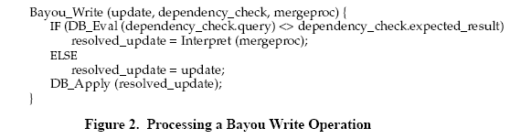
Application-specific conflict detection and resolution
Use the meeting scheduling appplication as example
SQL-like query

Slide 20
Application-specific conflict detection and resolution
Merge Procedure (Mergeproc)
Once a conflict is detected, a merge procedure is run by the server in an attempt to resolve the conflict.
In practice, the merge procedures are written by application programmers in the form of templates that are instantiated with the appropriate details filled in for each Write.
The users of applications do not have to know about merge procedures

Slide 21
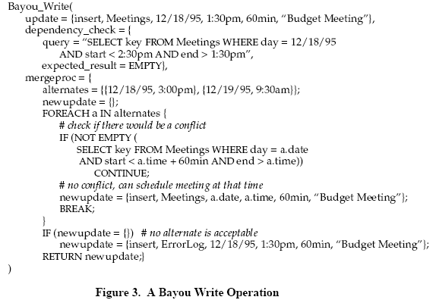
Application-specific conflict detection and resolution

Slide 22
Example of Bayou Write mechanisms
3-tuple: <update> <dependency check> <mergeproc>
Update:
<insert, HL, 02/02/2009, 3:00pm, 1 hr, “Curriculum Meeting”>
Dependency check:
<Is there an entry in the database on 02/02/2009 at 3:00pm for 1
hr? expected answer is empty>
Mergeproc:
<Try 02/22/2009 at 4:15pm for 45min; if successful write that
tuple>
A different merge procedure could search for the next available time slot to schedule the meeting, which is an option a user might choose if any time would be satisfactory.
Another is to allow the conflicts; sometimes users like conflicts

Slide 23
User-specified resolution strategies
Classes take priority over meetings
Faculty reservations are bumped by admin reservations
Move meetings to bigger room, if available
Point:
Conflicts are detected at very fine granularity
Resolution can be policy-driven

Slide 24
Consistency in Bayou
Eventual consistency
All servers receive all Writes via the pair-wise anti-entropy process
Two servers holding the same set of writes will have the same data contents.
Two important features of Bayou design allow servers to achieve eventual consistency.
First, Writes are performed at all servers, in the same, well-defined order.
Second, the conflict detection and merge procedures are deterministic so that servers resolve same conflicts in same manner.

Slide 25
Anti-entropy protocol
The protocol used among servers in Bayou for propogating Writes (updates) is called anti-entropy protocol
Anti-entropy refers to a model of information propagation
A server P picks another server Q at random to exchange updates
Three approaches:
P only pushes its own updates to Q
P only pulls in new updates from Q
P and Q send updates to each other
This anti-entropy model guarantees that once a write reaching one of the servers, finally it will reach all of the other servers
Write is propagated pair-wise between servers
All replicas receive all updates

Slide 26
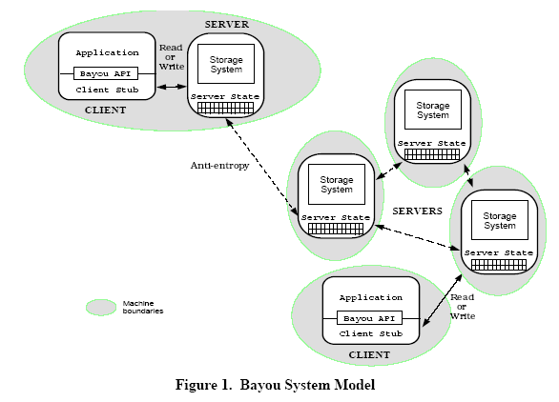
Anti-entropy protocol

Slide 27
Ordering of updates
Maintain ordered list of writes at each node
This will be referred to as the write log
Each write in the log has a unique Write ID:
<local-time-stamp, originating-node-ID>
The local-time-stamp is assigned by the server that accepted the write from front end (referred to as the accepting server)
<701, A>:
Node A asks for meeting M1 to occur at 10 AM, else 11 AM in MC 316
<770, B>:
Node B asks for meeting M2 to occur at 10 AM, else 11 AM in MC 316

Slide 28
Ordering of updates
Let’s agree to sort by write ID (e.g., <701, A> <770, B>)
As writes operations spread from node to node, nodes may initially apply updates in different orders
The dependency check and merge procedures do not necessarily take care of this
Want writes for a particular data to be performed in the same order at all replicas
Each newly seen write merged into write log
Log replayed
may cause calendar displayed to user to change!
i.e., all entries are tentative, nothing stable unless an entry is committed.
How do we get commits?

Slide 29
Criteria for committing Writes
For log entry X to be committed, everyone must agree on:
Total order of all previous committed entries
Fact that X is next in total order
Fact that all uncommitted entries are “after” X

Slide 30
How Bayou agrees on total order
Write in Bayou has 2 states
- “committed”
- “tentative”
When a Write is accepted by a Bayou server from a client, it is initially deemed tentative
Later the tentative will become committed
Must be able to undo writes; Why?
Servers may receive Writes from clients and other servers in an order that differs from the required execution order;
Servers immediately apply all known Writes to their replicas.

Slide 31
How Bayou agrees on total order
Rolling back updates
Keep log of updates
Order by some timestamp
When a new update comes in, place it in the correct order and reapply log of updates
Need to establish when you can truncate the log
Requires old updates to be “committed”, new ones tentative

Slide 32
How Bayou agrees on total order
Method to achieve well-defined order:
Divide the servers into 2 roles
“Primary “
Be responsible for committing write
Set order in which data committed and propagate final committed order to secondary
(via anti-entropy)
“Secondary”
Accept write from user and propagate to Primary (using anti-entropy protocol )

Slide 33
Coda
A distributed file system developed at CMU that can survive network disconnection
Designed on experience with using AFS:
Network disconnection does occur quite often
Client suffer a lot when network is down
CODA extends AFS by
Providing constant availability through replication
Introducing a disconnected mode for portable computers
Most lasting contribution
A good mobile file system to use

Slide 34
Distributed file systems
File
abstraction of permanent storage (e.g., disk), storing data, program, directories, etc
File system
responsible for organization, storage, retrieval, naming, sharing, and protection of files.
Distributed file system: file system implemented and used on a distributed system.
Files are stored at different nodes over the network and may be replicated.
Users can access and share the files from different sites

Slide 35
Client module
Client module hides low-level constructs of file system and directory services, making the access procedure transparent to user programs.
User program should only access network files using normal file names and operations (read, write, rename, etc.)
Client can improve file access performance by caching frequently used files in local memory / storage.
Caching should be handled by the client module and transparent to user.
mobile client
application
cache
server

Slide 36
Caching at client
The following protocols may be used:
Write-through
An update changes local copy, also sent to server for action with similar write message
Delayed write
Update local copy and batch updates before sending them to server for action
Write-on-close
Update local copy and send final copy on closing of the file
Mutual-exclusive write
Lock the file for writing at a coordinating manager (which can be distributed)
In a mobile environment, additional complexities need to be considered:
Weak connection: write-through and mutual-exclusive write are impractical
Disconnection: even delayed write may not work
File hoarding / prefectching and reintegration

Slide 37
Andrew file system
AFS is a Unix-based distributed file system, runnable on Mach as well, and is compatible with NFS
AFS adopts the upload/download model instead of merely performing remote accesses.
The whole file is transferred to and cached in client sites
Observations based on real measurements on Unix-based systems;
Most files are smaller than 10k bytes
Most files are of a shot live.
Reads are about 6 times more common than writes.
Sequential access is common, but random access is rate.
Most files are accessed by one user, and for shared files, often only a single writer.
Files are references in bursts. A file recently updated is likely to be accessed in neat future, in a LRU manner.

Slide 38
Andrew file system
AFS caches a file at client upon opening the file, together with a callback promise token (2 states: valid or cancelled).
Server promises to notify client whenever it receives a new version of the file from any other client.
It will send a callback to client
Client invalidates the cached copy, by setting the promise state to canceled.
Relieves the server from having to answer a call from the client every time the file is opened
Significant reduction of server workload

Slide 39
Andrew file system
On read/write, operation is done on local cached copy at client
AFS performs write-on-close
Upon a close operation, the file is sent back to server for update, retained at client if necessary
AFS provides approximated Unix semantics, close to session semantics, by using callback promise.
Server is not updated until file is closed
Client is not updated until it reopens the file
Does not handle concurrent updates
Only final file closing operation can retain all updates it makes

Slide 40
Andrew file system
If two users on two different workstations modify the same file at the same time, the users closing the file last will overwrite the changes made by the other user
First client
F’
F” overwrites F’
F
F’
F”
Time
F”
Second Client

Slide 41
Andrew file system
When client crashes and recovers, it will check with server about validity of its cached files, using modification timestamp.
To guard against missing callbacks due to message loss, callback promises must be renewed every few minutes from client.
AFS servers are stateful.

Slide 42
Andrew file system

Slide 43
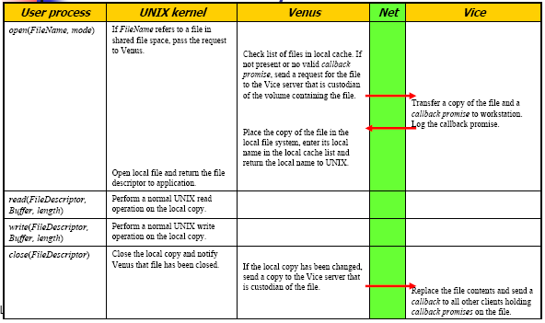
Andrew file system

Slide 44
Extension in Coda
In a mobile environment, weak network connection poses a major hurdle and design of propose mechanism is needed:
Connection may fail intermittently, leading to high communication cost
Clients may become disconnected from the network
Coda is an extension of Andrew
Its ordinary operation just stays the same as that of AFS
Whole file catching: original design purpose is reducing traffic, but also appropriate for disconnection
Cache invalidation: server’s callback promise
Use optimistic replication: does not prevent inconsistency from happening but to detect it

Slide 45
Extension in Coda
What makes Coda different is the disconnected mode
Original design goal of Coda is to be resilient to network failures
Extensive use of caching is employed
Supporting disconnected operation and mobility was an side effect

Slide 46
Coda
Cache whole file at client whenever possible (makes more sense to cache whole file to prepare for disconnection)
Callback based caching (i.e. invalidation)
Automate the portable computer model
Figure out which files one needs to use at home, make changes, copy back modified files next morning (auto-syn feature)
Use server replication to improve scalability
A client reads a file from any server but writes to all servers when file is closed (read-one write-all)

Slide 47
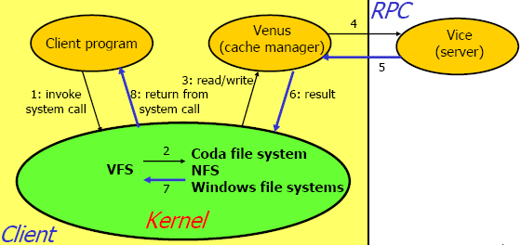
Coda operation

Slide 48
Coda operations
Each client chooses a preferred server which holds all callbacks and answers all read requests from the client
Can also choose the server randomly on each access
To serve a read, just try the local cache first
If it is a cache miss, requests the preferred server for file and status.
To server a write, a two-phased non-blocking protocol is executed:
Updated file and status are sent to all servers
Server receiving updates will install update and reply
Client send consolidated server replies in an update sent to all servers to bring them up-to-date together (this phase could be executed asynchronously or lazily to improve efficiency)

Slide 49
Cache consistency
Callbacks are used to maintain consistency
When a file is accessed, a local copy is made at client and a callback is registered with server
If someone else modifies the file, client will get a call back from server to invalidate it.
Cache invalidation is used instead of cache update
It is inefficient to bring in new version of file (may be large)
Re-fetch the file only when the file is needed

Slide 50
Handling disconnected operation
Problem: how to extend caching well to cope with disconnection?
Updates to the server are synchronous. If disconnection, it usually leads to timeout and failure in normal distributed file systems
While disconnected, it is impossible to bring in new files or updates from server

Slide 51
Upon disconnection
Handle updates:
Coda switches to the disconnected mode, which is transparent to user
Venus emulates the server, and logs updates locally in the Client Modification Log (CML) without existence of server.
Handle missing files:
Coda uses hoarding to let users keep important files in their hoard database
e.g., you hoard calendar and appointment list in a PDA; web pages for disconnected access in browser; files in a laptop that you think will be useful
Venus generates temporary file ids and service requests to hoarded files.

Slide 52
Upon reconnection
Enters the data reintegration state - Venus integrates locally changed files to servers
Coda supports a weaker semantics than session semantics
Does not prevent inconsistent updates but guarantees that inconsistent updates will always be detected
Handles only write-write conflicts
Apply user conflict resolution

Slide 53
Data reintegration
CML is sent to server for consistency checking
If consistent, server installs updates in 4 steps
Initiate a distributed update transaction (with one of the server as coordinator) and locks all objects in the log
Validate updates on each object and if valid, execute operation
Real data for update are then transferred through back-fetching from client
Commit the transaction and release all locks
If inconsistent, a conflict occurs and must be resolved.

Slide 54
Data reintegration
If another client has modified the same file, there is a conflict (write/write conflict)
Principles adopted in Coda:
No update should be lost without explicit user approval.
Conflicts are application-specific concept
Final decision should be made by human users
Conflict resolution in Coda:
Coda uses last storeid to indicate the last update to an object
Conflict resolution can be based on concurrent versioning systems (using version number, timestamp, version vector).
Usually, resolution can be done automatically (e.g., each user updates different part of a file) through the use of Application-specific Resolver (ASP)
Sometimes, human intervention is need

