Slide 1
Location-dependent Query Processing
Location-dependent applications
Location-dependent queries
Mobile positioning techniques
Location-dependent databases
Data representation
Indexing and retrieval
Query processing
Notes:
Application developers do not have to know the internal working of wireless networks to be successful, but having knowledge of how they work is very helpful.
Understand why certain wireless technologies behave the way they do;
Understand which application design architectures should be based.

Slide 2
Location-dependent applications
Traffic Monitoring
How many cars are in the downtown area?
Send an alert if a non-friendly vehicle enters a restricted region
Report any congestion in the road network
Once an accident is discovered, immediately send alarm to the nearest police and ambulance cars
Make sure that there are no two aircrafts with nearby paths
Location-based Object Finder / Advertisement
Where is my nearest Gas station?
What are the fast food restaurants within 3 miles from my location?
Am I near to a restaurant while any of my friends are there
Send E-coupons to all customers within 3 miles of my stores
Where is Bus 973 now? How long do I have to wait for its arrival?

Slide 3
Location-dependent applications
Location-dependent applications have three key elements
Location-dependent queries:
Results depend on the location of the queries or the objects being queried for.
Locations:
Obtained by using mobile positioning technologies.
Maintained by spatial databases.
Location-dependent database:
Representation, storage, and retrieval of location-dependent data
Processing of location-dependent queries

Slide 4
Location dependant query
Query whose result depends on the geographical location of the origin of the query
Moving query
Example: What is the distance of Hung Hom station from here?
Query whose result depends on the geographical location of the object being queried for
Moving object
Example: Where is the Taxi with plate no. 12345678?
User continuously asks the same question - every time the answer is different but correct.
How about query whose context is related to locations?
Find out the top 5 roads in KLW that have the most traffic between 7:00-8:00pm

Slide 5


Location-dependent queries
Moving query on stationary objects
Find the nearest gas station(s) within 1 miles of moving red car

Slide 6
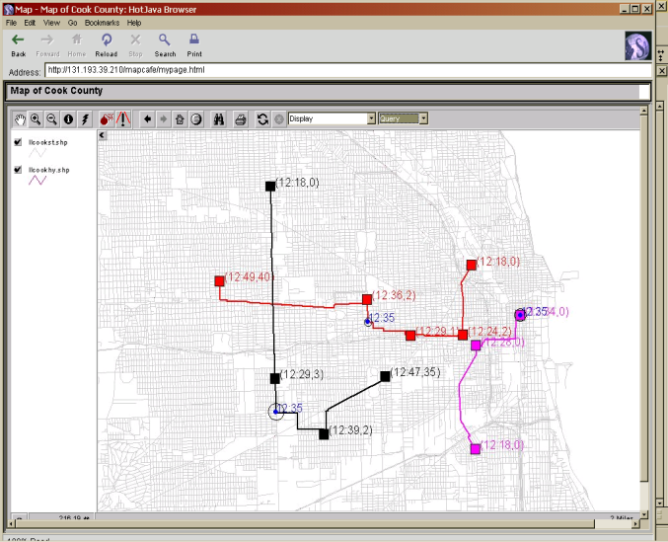
Location-dependent queries
Stationary query on moving objects
Continuously find all vehicles within 1 miles of my house
My
House

Slide 7
Location-dependent queries
Moving query on moving objects
Continuously find all police cars within 3 miles of the moving red car

Slide 8
Mobile positioning techniques
Requirement of location-dependent queries:
Continuous monitoring of location of the origin of the query, or of the object being queried for – need mobile positioning technologies.
Objective of all positioning technologies is to capture the location of a mobile device and convert it into a meaningful X, Y, Z coordinate
Many technologies are available, deciding which one to use depends on the combination of accuracy and cost.
When the accuracy increases, so does the cost
Cost is usually shared between the mobile user and wireless carrier

Slide 9
Mobile positioning techniques

Slide 10
Location representation
2 models
Geometric model
specify a location as an n-dimension coordinate
Symbolic model
logical, real-world entities describing the location space
e.g., Restaurant A
(250,3000)
{ Mall }
Spatial data: data representing / associated with locations
Space: defined by a set of locations

Slide 11
Location-dependent databases
Processing of location-dependent queries
Representation, Indexing and retrieval of location-dependent, spatial, and mobile data
Built-in Approach
Layered Approach
GIS Interface
Spatio-temporal
GIS
DBMS
ST Query Processing
DBMS
Indexing
ST-Index
Index

Slide 12
Location-dependent data
Data whose value is functionally dependent on location.
e.g., city tax, regional weather, hotel rent
In database, multiple correct values exist - needs location binding or location mapping function
Report the trucks in my area
SELECT O.ID
FROM Object O
WHERE O.type = “truck”
INSIDE Area My-area

Slide 13
Spatial data
Data about space or entities occupying space.
Target at representing the geometry of spatial features of the entity, e.g., the location of a road, its orientation.
Attribute data represents other information about the spatial features, which are merely regular database data, e.g., the name of a road, its speed limit.
Spatial objects can be of
zero dimension (a point),
one dimension (a line),
two dimensions (an area)
and so on

Slide 14
Spatial data representation
Spatial features can be discrete or continuous.
Discrete features do not exist between observations but are individually distinguishable, e.g., road and land use.
Continuous features exist between observations, e.g., elevation, rainfall on land.
Spatial features can be modeled using vector data model or raster data model.
Vector data model: using points (and their x- and y-coordinates) as basis to model lines, areas and so on.
Raster data model: using grid to represent spatial feature. Each cell contains a value about the feature at that location.
Generalized raster model is called tessellation model, in which the elements can be of arbitrary shapes.

Slide 15
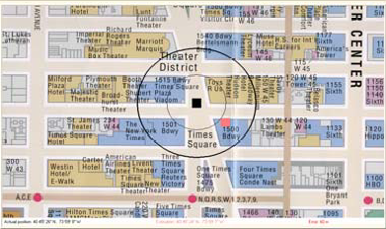
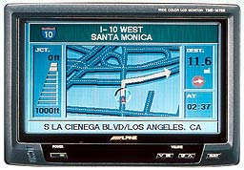
Spatial data representation
Geographical Information System (GIS) is the computer-based system to manipulate spatial data
A mapping software that translates the low-level position information from the locating infrastructure into meaningful location.
building addresses, street layouts, population densities, plethora of other information.

Slide 16
Spatial queries
In standard databases, the comparison operator is based on logical and relational operators only.
Spatial queries include new operators:
Containment: whether a point or an area is contained in another area.
Overlap: whether two areas overlap in some part.
Neighbor: whether two entities are close to each other.
General spatial relationship: e.g., whether a point is to left of a box.
Spatial join: joining two relations containing spatial objects, e.g.
select L.name
from Legco L, Company C
where L.district.area() > 20 and within(C.location, L.district);
General spatial queries include range query for objects within a certain area, nearest neighbor (object that is nearest to another object), k-nearest neighbors.

Slide 17
Location-dependent vs Spatial queries
Location-dependent queries are supported by spatial databases and subsume spatial queries.
Similarity to spatial queries:
Operate on spatial data, i.e. data associated with space occupied by object.
Expressed with spatial query operators, e.g., contains, contained in, intersects, neighboring, north of.
Relying on spatial select and spatial join.
Based on spatial data structures for storage and indexing.
More than spatial queries:
Client may move in location-dependent queries - location of client may be part of the query itself, and result may depend on direction of movement.
Data may not directly contain location information, but may have multiple values corresponding to different locations.
Requires dynamic spatial data processing.
Sometimes temporal features are also implied (e.g. gas stations in the next 20 minutes).

Slide 18
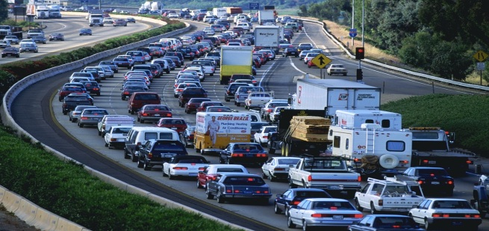

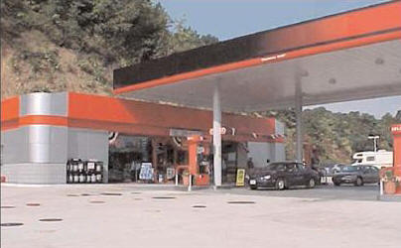
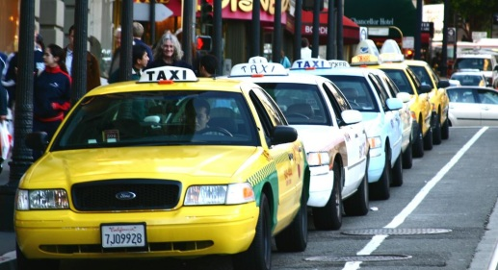
Variety of location-dependent queries
Continuously report the number of cars in the freeway
Type: Range query
Time: Present
Duration: Continuous
Query: Stationary
Object: Moving
What are my nearest McDonalds for the next hour?
Type: Nearest-Neighbor query
Time: Future
Duration: Continuous
Query: Moving
Object: Stationary
Send E-coupons to all cars that I am their nearest gas station
Type: Reverse NN query
Time: Present
Duration: Snapshot
Query: Stationary
Object: Moving
What was the closest dist. between Taxi A & me yesterday?
Type: Closest-point query
Time: Past
Duration: Snapshot
Query: Moving
Object: Moving

Slide 19
Indexing
Data are stored within a relational database as tuples and tables.
To answer queries, indexes are built to allow efficient retrieval of data satisfying querying conditions ( especially for relational joins).
Allow direct access to tuples satisfying the condition.
Most indexes are built based on hashed table (for point query) and B-tree or B⁺-tree (for range query).
In practice, B⁺-trees are used more often, since they allow sequential access to range data by chaining together leaf nodes.

Slide 20
Indexing spatial data
In a spatial database, spatial objects can be stored in their primitive forms
e.g., a polygon is represented by the points defining the lines enclosing it or by the polyline.
Again, indexes must be built to allow effective processing of additional spatial query types.
Partition the set of objects into subsets according to their locations
Examples include R-tree, R*-tree, R⁺-tree.
B-tree is based on ordering on a one-dimension key attribute.
Spatial data (e.g. an area) is of two dimensions - R-tree etc. generalize the B-tree and B⁺-tree into their two dimensional equivalence.

Slide 21
R-Tree
R-tree is the 2D extension of B⁺-tree.
In range query, how do you get a set of points or a set of areas contained within a certain bounding box?
A minimum bounding box (mbb) is the smallest rectangular region that just completely covers the area.
It is easily computed by taking x₁ and x₂ to be the minimum and maximum value of x-coordinate of all points in the area, and y₁ and y₂ to be the minimum and maximum value of y-coordinate.
It is not difficult to get a set of points within an area, by generating a range query on the x- and y-coordinate of the corner points of the bounding box (point query).
select p.x, p.y from allPoints p
where x1 <= p.x and p.x <= x2 and y1 <= p.y and p.y <= y2;

Slide 22
R-Tree
In R-Tree, objects (points or rectangles) are clustered into a group, represented by the mbb of the group and is considered a node.
Nodes are considered again as objects for clustering into next level, until the root is reached.
Note that now the mbb of interior nodes could overlap.
For point search, check the mbb of each branch.
If the mbb of a branch contains the point, search recursively down the sub-branches of the branch.
For range search, check the mbb of each branch.
If the mbb of a branch intersects with the query rectangle, search recursively down the sub-branches of the branch.
Insertion with R-tree is complicated.
R*-tree performs some optimizations to R-tree for insertion.

Slide 23
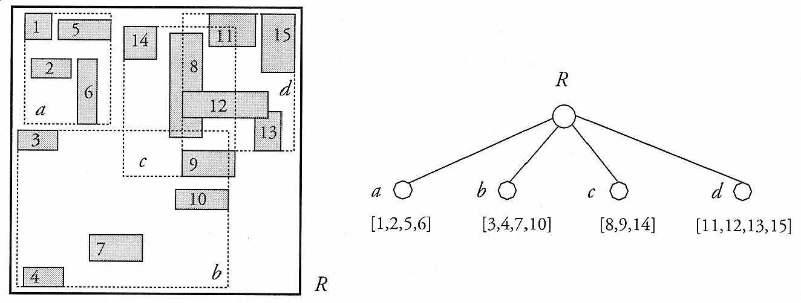
R-Tree
An example of an R-tree.
How to search for A?
A

Slide 24
R⁺-Tree
Searching in R-tree could be expensive, since multiple branches need to be explored if the mbb of a branch overlaps with the query.
R⁺-tree is designed to ensure that the mbb for branches at the same level do not overlap.
The tradeoff is that the object may have to be duplicated.
Searching in R⁺-tree is similar to searching in quadtree.
Compared with R-tree, the storage overhead for R⁺-tree is higher, insertion is more complicated, but searching is much faster.

Slide 25
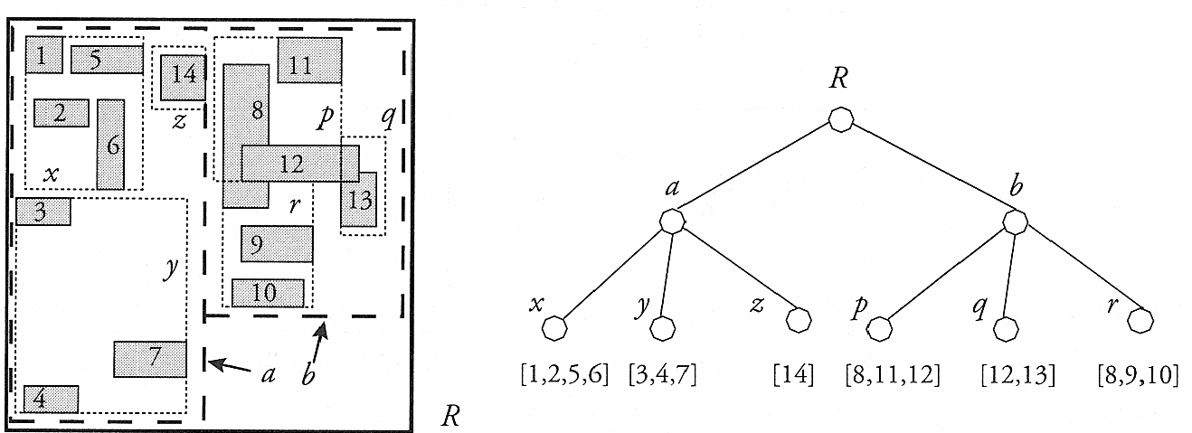
R⁺-Tree
An example of an R⁺-tree.
Here objects 8 and 12 are duplicated.

Slide 26
Indexing moving object
Moving object database - spatial database storing locations of moving objects.
E.g. You may want to get the nearest taxi (or the nearest green taxi if you are in Northern N.T.). Database must store the current location of all taxis, since a similar query can be issued at different location.
Cost of insertion of an object in spatial database is very high. Worse yet, this needs to be done often for a moving object.
Research is done to search for fast methods to insert and query moving objects, with effective indexing.
We can trade off precision with update efficiency: update important objects more often but others less often.

Slide 27
Indexing time dimension
Querying Along the Spatial-Temporal Dimension
What was the location of a certain object from 7:00 AM to 10:00 AM yesterday?
Find all objects that were in a certain area at 7:00 AM yesterday
Find all objects that were close to each other from 7:00 AM to 8:00 AM yesterday
Historical trajectories are represented by their three-dimensional Minimum Bounding Rectangle (MBR)
Time
3D-R-tree is used to index the MBRs
Technique simple and easy to implement
Does not scale well
Does not provide efficient query support

Slide 28
Indexing time dimension
Multi-version indexing structures: maintain an R-tree for each time instance
R-tree nodes that are not changed across consecutive time instances are linked together
Timestamp 0
Timestamp 1
3D- R-tree
A multi-version R-tree can be combined with a 3D-R-tree to support interval queries

Slide 29
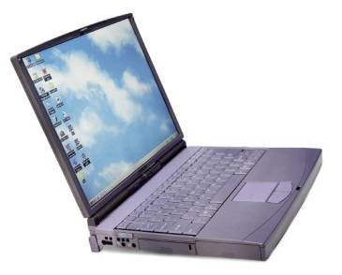
Continuous query
Query the present – time is always NOW
Find the number of objects in a certain area
What is the current location of a certain object?
Traditional (Snapshot) queries
Answer
Data
Query
Continuous queries
Answer
Query
Data
Query
Changing Data

Slide 30
Continuous query
Straightforward Approach
Abstract the continuous queries to a series of snapshot queries evaluated periodically
Result Validation
Valid time (t) and Valid region (r)
Result Caching
Consecutive evaluations of a continuous query yield similar results
Upon evaluation, retrieve more data that can be used later
Result Prediction
Based on future trajectory movement, answer can be pre-computed in advance
Incremental Evaluation
Query is evaluated only once, then only updates of the ansqer are evaluated – add or delete objects

Slide 31
Current status of research
50+ spatial index structure
30+ spatio-temporal indexing structure
Wide variety of spatio-temporal query processing techniques

Slide 32
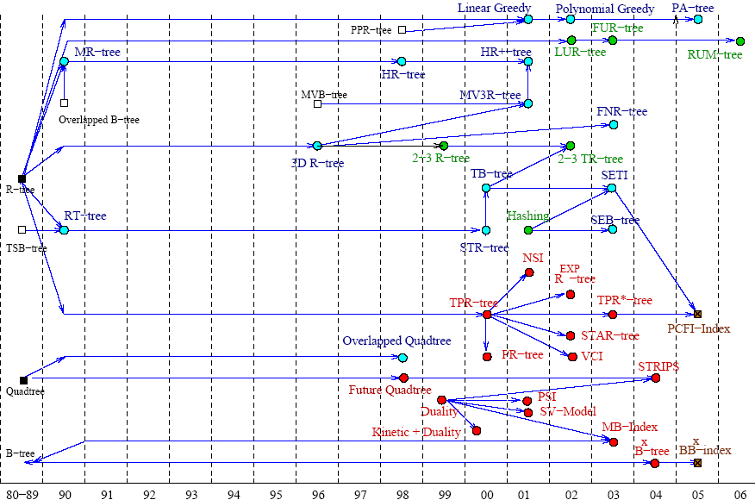
Spatio-temporal access methods
R^{PPF}-tree
Red: Future
Blue: Past
Green: Present
Brown: All

Slide 33
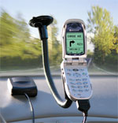

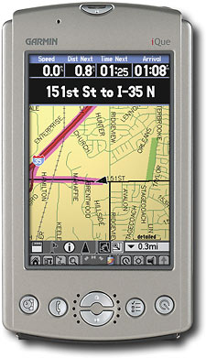
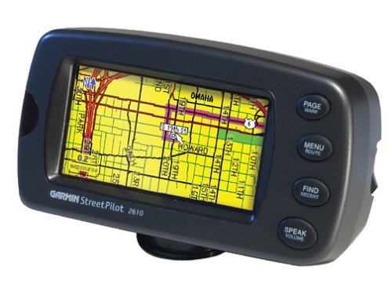

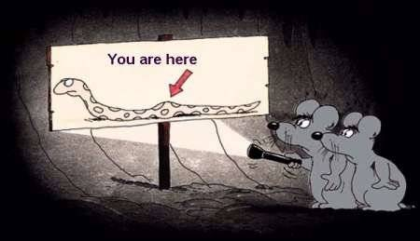
Open Research Issues Location Privacy
YOU ARE TRACKED…!!!!
“New technologies can pinpoint your location at any time and place. They promise safety and convenience but threaten privacy and security”

Slide 34
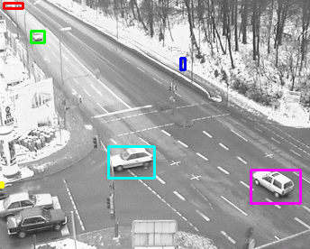

Open Research Issues Spatio-temporal data mining
Mining the history ➔ Predicting the future
Online outlier detection for moving objects
Suspicious movement in video surveillance
Analysis of tsunami, hurricanes, or earthquakes
Phenomena detection and tracking

