Slide 1
🌱 SUSTAINABLE CIRCULAR FASHION
EcoThread
Sustainable Circular Fashion & Dignified NGO Clothing Redistribution Platform
Connecting mindful donors, real-time logistics, hospital-grade QC grading, and an Amazon-style tokenized beneficiary store.
70.73 lakh t
USD 3.5 bn
100%
SDG 12 · 1 · 13
UN Global Goals Framework
Tax-exempt under Section 80G
Textile waste per year in India (PIB)
Recycling market by 2030 (Ministry of Textiles)

Slide 2
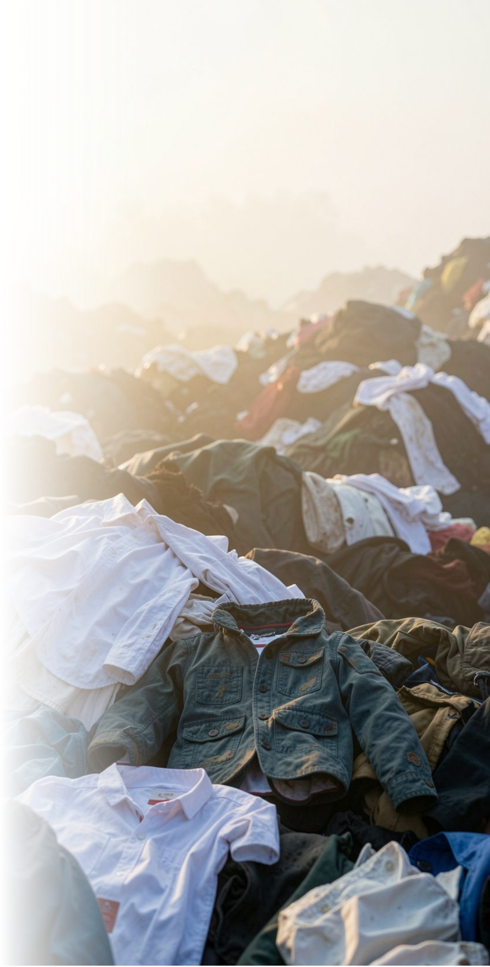
THE CRISIS IN NUMBERS · PEER-REVIEWED RESEARCH
Textile Landfill Saturation & Clothing Poverty
70.73 lakh tonnes
42% / 58%
India generates about 70.73 lakh tonnes of textile waste annually (Ministry of Textiles, PIB).
Pre-consumer manufacturing waste (42%) and post-consumer disposal (58%) make up India’s textile waste (PIB, Ministry of Textiles).
>70% recovered
Broken pipelines
More than 70% of total textile waste is recovered, and around 95% of pre-consumer textile waste (PIB Rajya Sabha response).
Zero donor transparency & sanitation: conventional charity bins suffer 60%+ sorting rejection, unhygienic storage, high logistics costs, and fail to issue verifiable 80G tax receipts.
Sources: PIB, Ministry of Textiles report on textile recycling · PIB Rajya Sabha response on textile-waste management · Ministry of Textiles Annual Report 2023-24.

Slide 3

END-TO-END CIRCULAR LIFECYCLE
One operating loop moves garments from doorstep to dignified choice.
01
02
03
Doorstep Pickup
Route Dispatch
QC & Sanitization
Donor selects slot, bag count, garment types; fleet manifests auto-sync.
Driver navigates pincode cluster; verifies bags and weights on doorstep.
3-stage UV-C sterilization; scientific grading: Grade A, B, or Downcycling.
04
05
Beneficiary Store
80G Tax Exemption
Amazon-style catalog; beneficiaries checkout with seasonal NGO welfare credits.
Instant downloadable OpenPDF certificate; dynamic cryptographic verification.

Slide 4
ENTERPRISE GRADE FOUNDATION
Modular architecture keeps the operating loop auditable and extensible.
Frontend · SPA
Backend · REST API
Persistence & Cloud
React 19 & Vite · lightning sub-second HMR; Tailwind CSS · responsive modern UI; Lucide React icon system; Axios · JWT request/response interceptors; Canvas Confetti · celebration micro-interactions.
Spring Boot 3.3.5 · Java 21 (LTS); Spring Security 6 · stateless JWT authentication; Spring Data JPA · Hibernate ORM; OpenPDF engine · dynamic 80G Tax Certificates; SpringDoc OpenAPI 3.0 · Swagger UI.
Dual Profiles · In-Memory H2 for dev, PostgreSQL for prod; Derby SQL Relational Driver support; stateless session management; CORS security · granular origins; clean separation · Model, DTO, Repo & Service.

Slide 5

ROLE-BASED GOVERNANCE
Each participant gets a clear workflow, with trust visible at every handoff.
DONOR PORTAL · AARAV SHARMA
Doorstep pickup calendar · interactive CO₂ & water impact calculator · reschedule and cancellation controls · official Section 80G Tax PDF.
BENEFICIARY STORE · PRIYA KUMARI
150 seasonal monthly NGO credits · demographic and size filters · hospital-grade sanitization logs · zero-cost checkout and real-time delivery tracking.
LOGISTICS FLEET · RAMESH KUMAR
Pincode cluster route optimization · doorstep bag count and weight validation · seal barcode scanning · manifest transitions to hub arrival.
WAREHOUSE QC ADMIN · NEHA · MANAGER
Scientific 3-stage QC grading · seasonal credit quota allocations (+50/+100) · order fulfillment dispatch · real-time ESG circularity audit and CSV export.

Slide 6
CIRCULAR QUALITY CONTROL
Scientific sorting protects dignity and keeps more material in circulation.
Grade A
Grade B
Downcycle
Prime condition
Minor wear
Frayed / unusable
Online Beneficiary Store Catalog
Gently used or like-new apparel. Zero tears, missing buttons, or stains. 3-step UV-C medical sterilization and fabric press. Published instantly for zero-cost credit claims.
Bulk NGO Relief & Slum Drives
Structurally sound with cosmetic fading. Minor mending by NGO refurbishment crew. Weather-proof 25kg bulk bales dispatched to flood and winter disaster relief centers.
Industrial Fiber Shredding Partners
Unwearable garments, scraps, and torn knits sorted by synthetic versus organic cotton fibers, then downcycled into automotive sound insulation and carpet padding.

Slide 7

MEASURABLE COMPLIANCE & SCIENTIFIC CITATIONS
Impact is calculated per verified garment, then made legally useful.
Indian government impact metrics
Section 80G engine
>70% of total textile waste recovered · ~95% of pre-consumer textile waste recovered · USD 3.5 billion recycling market projected by 2030 · ~1 lakh green jobs (Ministry of Textiles report, PIB)
Automated OpenPDF streaming: high-resolution, print-ready branded certificates on pickup completion; statutory basis: OpenPDF Java Engine. Statutory NGO exemption registration: Reg # NGO-80G/CSR/2026/88421 · Tax ID AAATE1234F-80G-01; statutory basis: Income Tax Act 1961, Section 80G (Govt. of India). Public cryptographic registry: instant QR/REST validation for income tax authorities at /api/invoices/verify/{number}; statutory basis: EcoThread Cryptographic Verification Protocol. Corporate CSR ESG audit CSV: audited water, carbon, and garment data downloadable for annual CSR filings; statutory basis: Ministry of Corporate Affairs (MCA) CSR Rules 2014.
Sources: PIB, Ministry of Textiles report on textile recycling · PIB Rajya Sabha response on textile-waste management · Ministry of Textiles Annual Report 2023-24.

Slide 8
WHY ECOTHREAD WINS
EcoThread turns four broken handoffs into one trusted platform.
Dimension | Legacy model | EcoThread
Beneficiary experience | Chaotic bins, undignified handouts, size mismatch | Amazon-style store, seasonal credit budget, dignity of choice
Hygiene & quality | Unsanitized garments mixed with damaged rags | 3-tier hospital-grade UV-C sterilization, size classification, digital sanitization log
Donor incentive | Manual paper receipts, zero proof of impact | Automated Section 80G PDF plus live water and carbon dashboard
Logistics fleet | Ad-hoc collections with high fuel waste | Pincode cluster scheduling, doorstep weight verification, seal tracking

Slide 9
FUTURE HORIZONS
The roadmap compounds platform control into enterprise-scale circularity.
01
02
03
Phase 1 · Completed
Phase 2 · Next Quarter
Phase 3 · Enterprise Scale
Core Platform & Compliance
Computer Vision & AI Grading
Nationwide Brand Partnerships
Doorstep pickup scheduler and cancellation · Amazon-style beneficiary store · logistics route dispatch and verification · OpenPDF Section 80G tax engine.
Mobile camera inspection for tears and stains · fabric composition recognition · dynamic route traveling salesperson algorithm · native PWA driver manifest caching.
Retail drop-off QR integration · direct CSR impact dashboards · blockchain tokenized garment traceability · textile mill fiber downcycling B2B supply.

Slide 10
RESEARCH CREDIBILITY & BIBLIOGRAPHY
Institutional sources anchor the metrics, formulas, and compliance layer.
Institutional source | Role in EcoThread
Ministry of Textiles, Government of India Textile waste and recycling report, Press Information Bureau (PIB) | Source for 70.73 lakh tonnes annual textile waste, the 42% pre-consumer and 58% post-consumer split, over 70% total waste recovery, around 95% pre-consumer recovery, and the USD 3.5 billion recycling market by 2030 with about one lakh green jobs.
PIB, Rajya Sabha response Textile-waste management and government initiatives | Policy and recovery context for the textile-waste figures and government initiatives supporting the recycling pathway.
Ministry of Textiles Annual Report 2023-24 | Sector context for Indian textile production, waste, and recovery framing.
Ministry of Finance & Ministry of Corporate Affairs, Govt of India Income Tax Act 1961, Section 80G & Companies Act, CSR Rules 2014 | Statutory basis for non-cash clothing in-kind donation valuation, 80G tax certificates, and mandatory ESG audit trails.

