Slide 1
AETHERLEARN AI EDUCATION SUITE
Student Performance Analytics & Learning Platform
Continuous 200-Mark Assessment • Student & Mentor Portals • GCP Cloud Storage & NPTEL Ecosystem
Comprehensive Industrial Project Presentation | Real Application Live Screenshots

Slide 2
PROBLEM & MOTIVATION
Educational Challenges & Problem Statement
01. Opaque Single-Test Grading Systems
Traditional academic portals evaluate students strictly on final exams, failing to capture sessional tests, practical coding projects, lab documentation, and oral viva.
02. Static One-Size-Fits-All Learning
Conventional LMS platforms provide identical course paths regardless of student neural efficiency, stress indicators, or individual skill gaps.
03. Disconnected Cloud & Open Course Ecosystems
NPTEL/Swayam courses and cloud file storage engines operate in separate silos, requiring manual data synchronization and untracked asset storage.

Slide 3
OUR SOLUTION
The AetherLearn Platform Architecture & Solution
200-Mark Continuous Assessment
Evaluates Major Exams (70), Minor Exams (30), Projects (50), Reports (30), and Viva (20) with transparent grade tracking on both Student & Mentor portals.
Adaptive AI Tutor & PYQ Engine
Powered by Gemini 3.6 Flash LLM and PyMuPDF/PaddleOCR for multi-turn academic dialogues and automated Past-Year Question paper analysis.
Cloud Storage & NPTEL Ecosystem
Direct integration with GCP Bucket (`studentperformance-498100-storage`) and official NPTEL Swayam course portal linking for IIT courses.

Slide 4
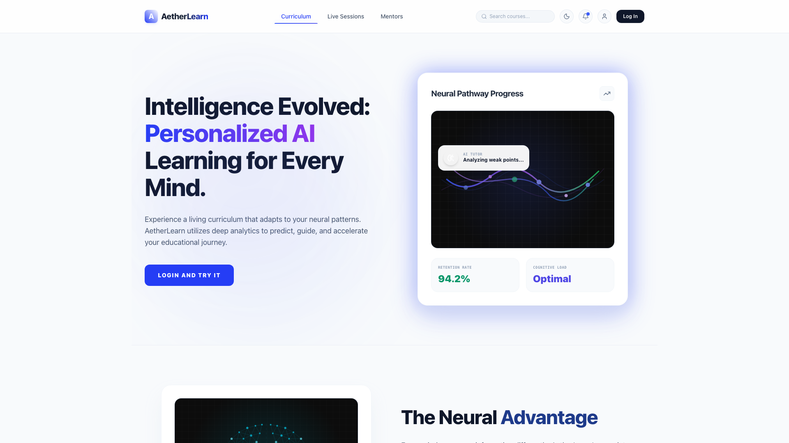
LIVE DEMO: PLATFORM LANDING
Landing Page & Curriculum Portal
Key Feature Highlights
• AetherLearn Suite: Clean dark/light theme engine with particle background.
• Curriculum Exploration: View neural computing, machine learning, and AI modules.
• Quick Access: Seamless sign-in portal and active course enrollment.

Slide 5
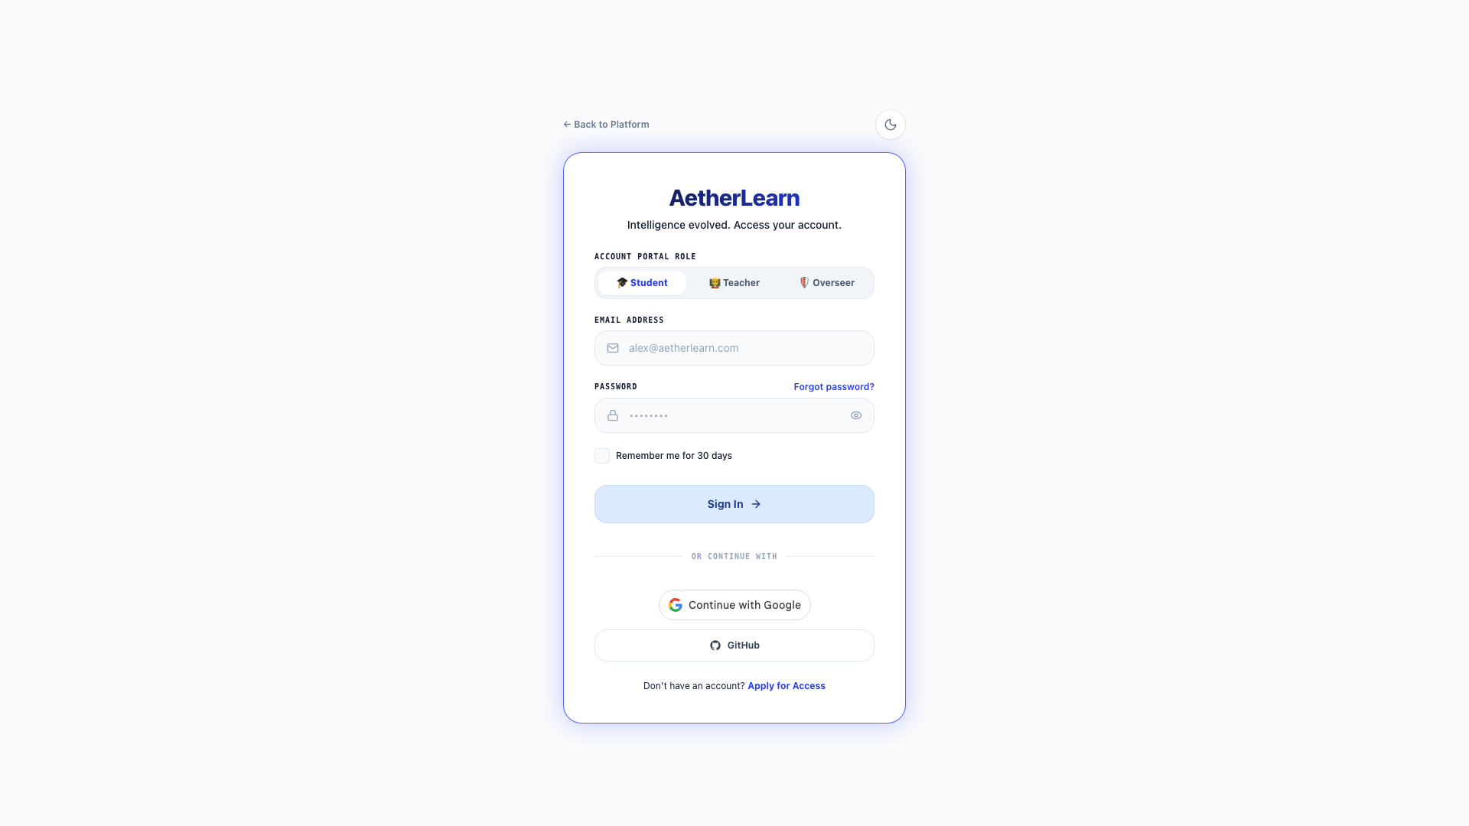
LIVE DEMO: LOGIN & AUTH
Role-Based Authentication & Google OAuth
Key Feature Highlights
• Multi-Role Switcher: Dedicated login modes for Students and Teachers/Mentors.
• Google OAuth Integration: Single sign-on authentication via Google Accounts.
• Auto-Account Provisioning: Dynamic role assignment and session management.

Slide 6
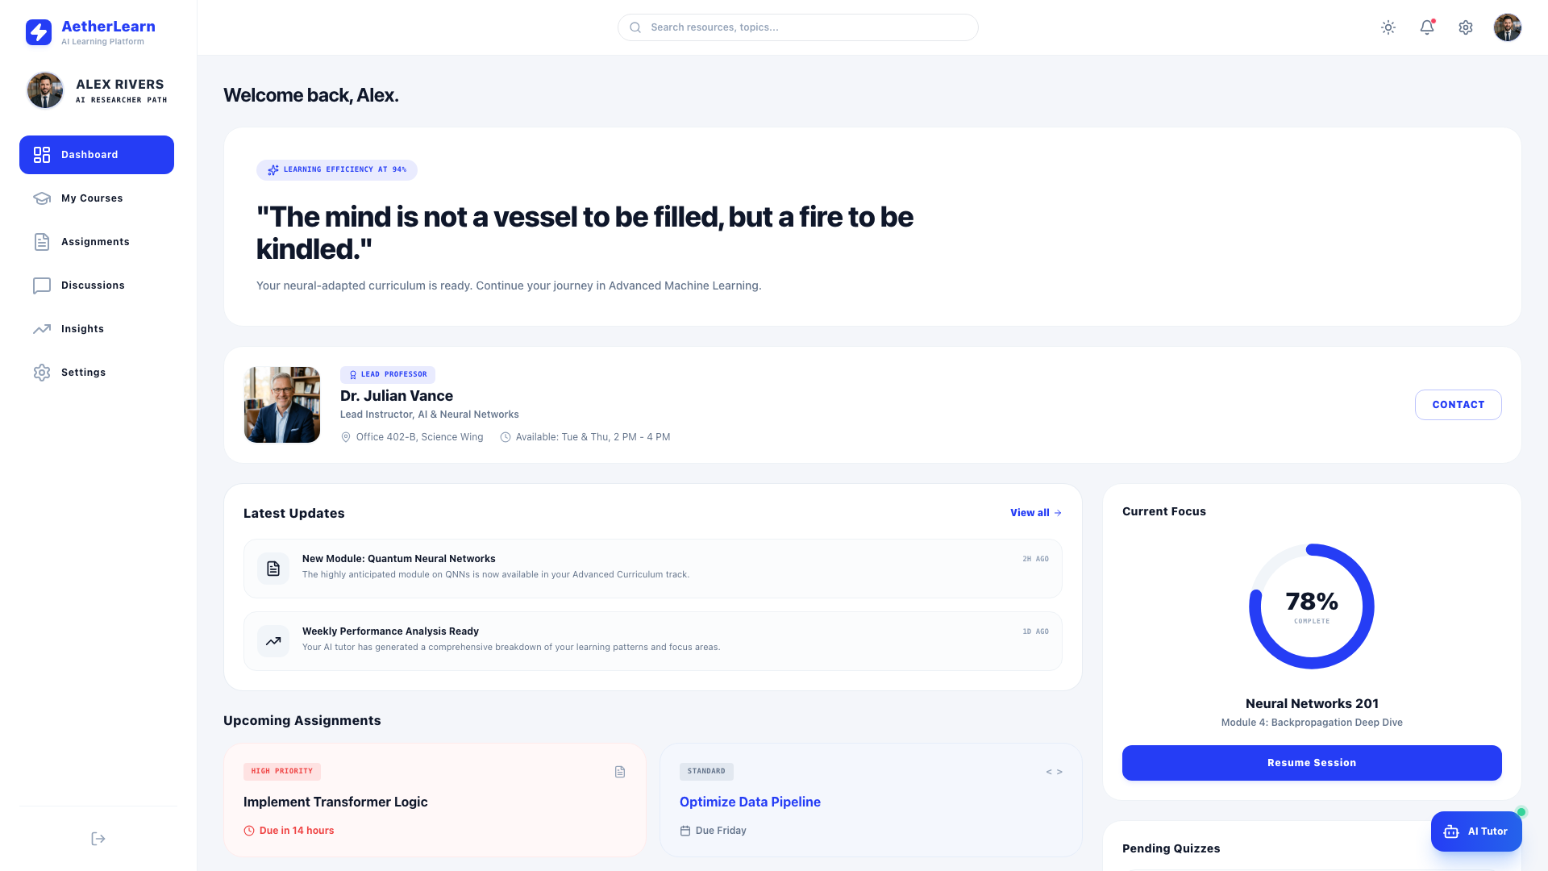
LIVE DEMO: STUDENT PORTAL
Student Dashboard & 200-Mark Evaluation Matrix
Key Feature Highlights
• 200-Mark Assessment Scheme: Major (70), Minor (30), Project (50), Report (30), Viva (20).
• Dynamic Profile Greetings: Dynamic user initials and synchronized name tags.
• Neural Efficiency Index: Real-time efficiency metrics (94%) and active study modules.

Slide 7
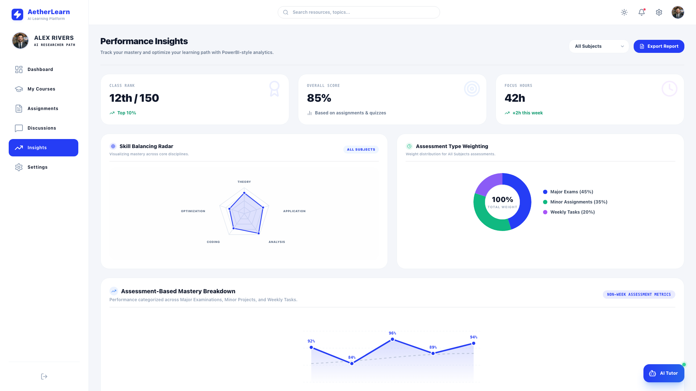
LIVE DEMO: STUDENT INSIGHTS
Performance Analytics & Assessment Insights
Key Feature Highlights
• Non-Week Category Breakdown: Major Exams (92%), Minor Projects (84%), Weekly Tasks (96%).
• Interactive SVG Curves: Visual mastery curves comparing target vs actual progress.
• Doughnut Weight Charts: Multi-dimensional assessment category distribution.

Slide 8
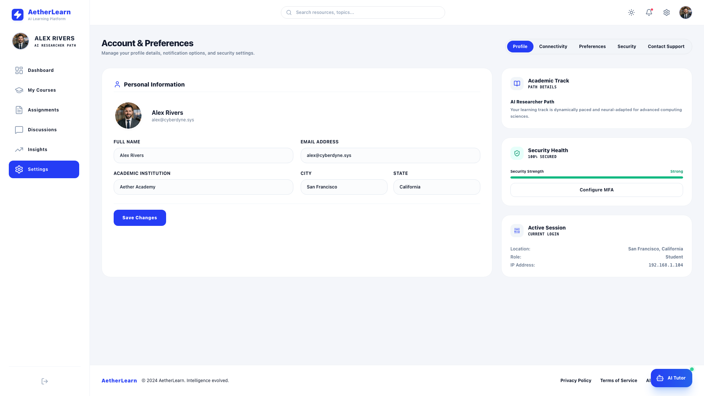
LIVE DEMO: PROFILE SETTINGS
Student Profile & Connectivity Settings
Key Feature Highlights
• Personal Info Sync: Dynamic profile updates for Telegram, Gmail, and Phone.
• Institutional Integrations: Connect LMS credentials with Google Cloud Storage.
• Theme Preference: Synchronized light/dark mode preference persistent in browser.

Slide 9
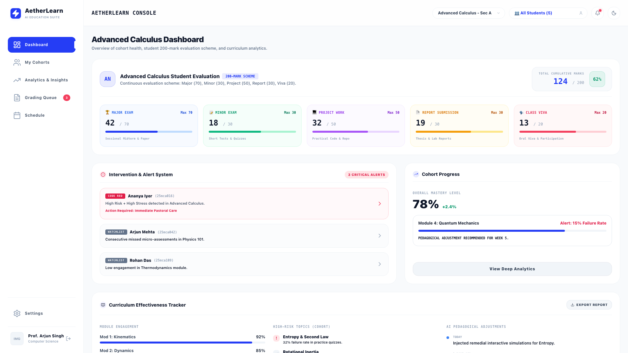
LIVE DEMO: TEACHER PORTAL
Educator Console & Cohort Health Overview
Key Feature Highlights
• Cohort Management: Track course mastery, alert rates, and student counts.
• Intervention & Alert System: Code Red risk alerts for low engagement/high stress.
• Grading Queue: Review, grade, and provide feedback on student project submissions.

Slide 10
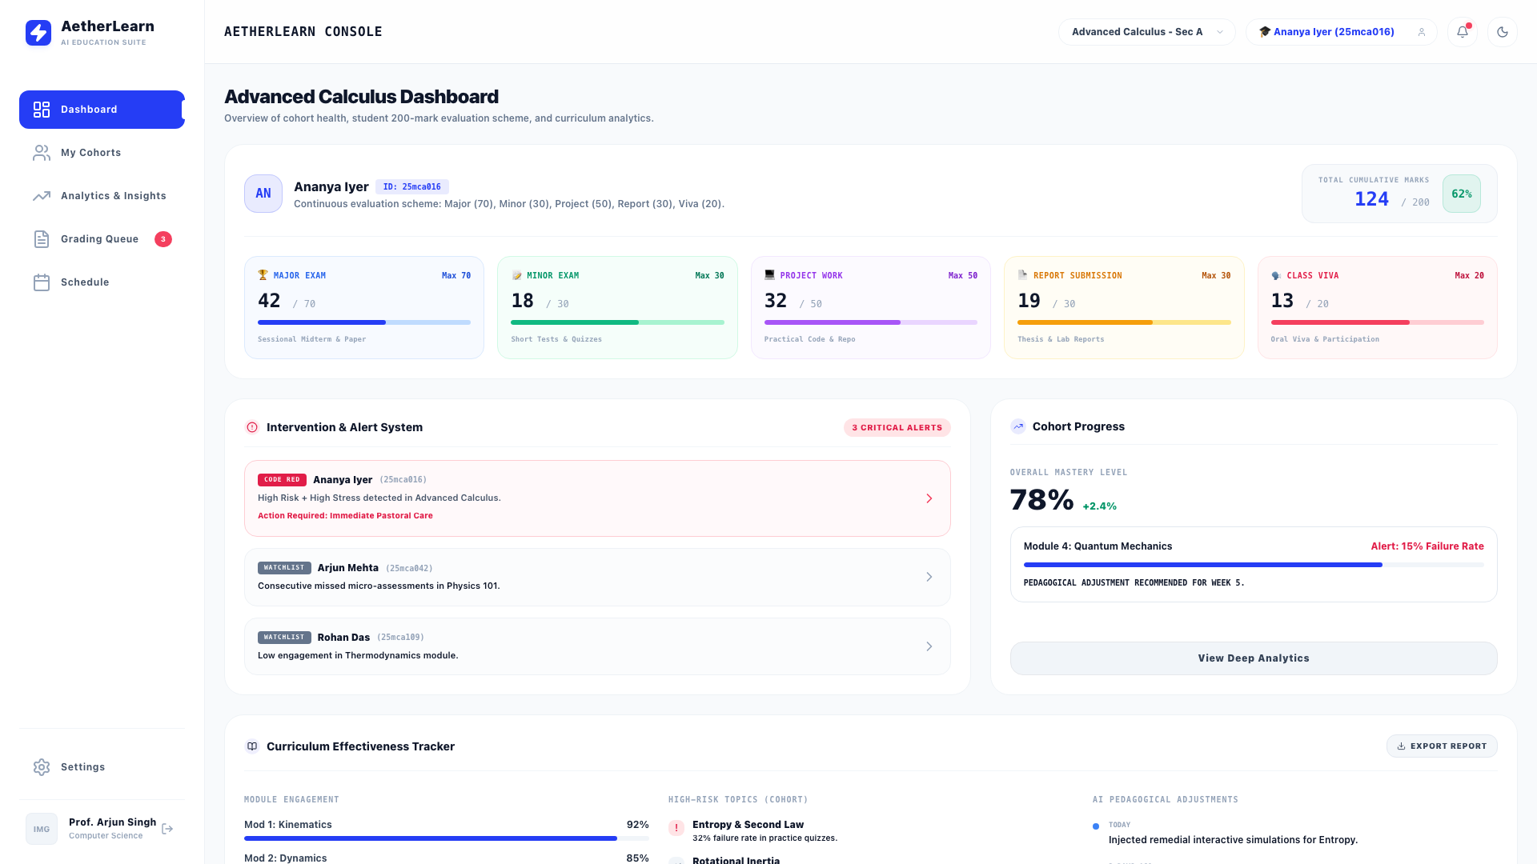
LIVE DEMO: TEACHER GRADING
Mentor Student Selection & 200-Mark Grading
Key Feature Highlights
• Dual Header Selectors: Select course and individual student from header bar.
• Individual 200-Mark Matrix: View student score out of 200 (e.g. 124 / 200 - 62%).
• Granular Component Progress: Visual progress bars for Major, Minor, Project, Report, and Viva.

Slide 11
SYSTEM DESIGN
Technical Architecture & Cloud Integration
Frontend Layer
React 18 + Vite + Vanilla CSS Keyframe Animations (`animate-float-slow`, `animate-login-card`, `animate-dropdown-pop`).
Backend REST API
FastAPI + Python 3.14 + SQLAlchemy ORM + Pydantic v2 data models + HTTP Session Security.
Google Cloud Storage
GCP Project `studentperformance-498100` + Bucket `studentperformance-498100-storage` for resume and media asset storage.
AI & Analytics Engine
Gemini 3.6 Flash LLM + PyMuPDF + PaddleOCR for document parsing and past-year question paper solving.

Slide 12
CONCLUSION
Summary, Impact & Project Roadmap
Key Achievements
✓ Multi-Role Console for Students, Educators, and Overseers.
✓ Continuous 200-Mark Assessment Matrix on Student & Mentor Portals.
✓ GCP Cloud Storage & NPTEL Swayam Course Integration.
✓ Live Gemini 3.6 Flash AI Tutoring & PYQ Question Breakdown.
Future Evolution Roadmap
➔ Native Mobile App (React Native / iOS & Android).
➔ Automated Voice Viva Assistant using Gemini Live WebSockets API.
➔ Blockchain-verified Micro-Credentials & Skill Badges.
➔ Predictive Dropout Risk Intervention via BigQuery ML.

