Slide 1

TECH 4U

Slide 2
“The Key to success is getting people to do the right thing at the right time.”

Slide 3
E-Learning History
The Testing Machine
Computer Based Training
E-Learning as a term
Mobile Learning
1924
1954
1960
1966
1999
2000
2010
Computer Aided instruction
The first LMS and SCORM
The teaching Machine

Slide 4
INTRODUCTION
Our website is one of the best E-Learning website ever created. Developed using popular framework react js.the It has got hundreds of courses on various Technical subjects, and it can access by millions of learners every month.
This platform provides different animation videos for makes learning interesting.
4

Slide 5
INTRODUCTION
This website can be accessed through any platform
(Mobile, PC, Tablets).
It gives additional functionality secure online payment and evaluating each users through quizzes at the end of the course .
We providing the website with clean and classic design
5

Slide 6

OBJECTIVES
To provide latest courses with effective contents.
Meet the learning style or needs of students through
various instructors.
Improve the efficiency and effectiveness with best contents
Improve user-accessibility and time flexibility to engage learners in the learning process.

Slide 7
Cost effective courses.
Look and feel is Amazing for better E-learning Experiences.
Designing e-learning Courses For Different Generations.
Measurable learning outcomes like Quizzes.
Adaptive learner models to accommodate different learner needs.
Establish a timeframe and goals.

Slide 8
Anyone can provide the various courses to teach
the people in all over all the world.
Enhance the quality of learning and teaching through experienced and skilled instructors

Slide 9
ADVANTAGES OF OUR WEBSITE
Easy To Sign in.
Easy to Join a Course.
Easy to Make your Profile by Clicking My profile.
Easy to understand and face to face interactions are available.
In all courses Certificate is Provided.
Easy to maintain your account.
All security is provided.
Easy to Make payments.

Slide 10

Features
Developed using html,css,and react js.
Complete Responsive design.
Each courses contain a valuable related resources and contain requirements to get jobs related to that particular course in famous companies.
Helps to evaluate learners by themself using quizzes at the end of course
.

Slide 11
Features/Functionalities
STRIPE Payment Platform is available for easy and secure payment.
Sorting option is provided for the various courses
There is free courses and paid courses are available. For the paid courses cost are very less.
CART feature is added for calculating the amount for courses purchased.
We provide a Preview videos for each courses, only after purchasing the course all the contents will unlock automatically.

Slide 12
CART
CART is used for adding courses to the cart for calculating the total amount purchased.
Quizzes
Quizzes are added last in the course for understanding the learner how much he/she is understanded, and we are giving certificate after the competion of quiz, (For getting the certificate he/she want to get 50% of mark in Quiz).

Slide 13
Future Ideas
EMI Features will be provided.
Donation Features will added (The funds will be used for the students).
Discounts will be added during festival seasons.
Scratch card feature will be added (The winner will get paid courses for free).
After end of every course, survey are provided.

Slide 14
Future Ideas
After the completion the course to provide a each users a survey
and evaluate each of them and give them future instructions and resources for future planning.
Face to face interaction with the instructors after the completion of course.
The user who get 100% points at the end of the quiz provide 10 tokens.
Refer and earn option will be added with proper security.

Slide 15
Future ideas
Evaluate the instructors on the basis of their various certificates.
The instructors will be given income according to the active users ,user rating, user feedback.
Course of the instructors with active users awarded a special badge it will be given at the top of them courses.

Slide 16
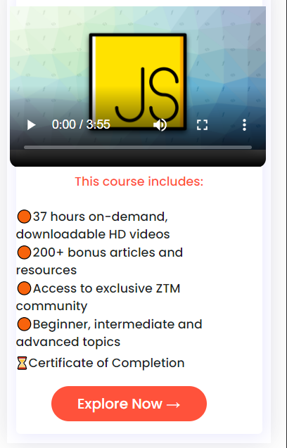
Mobile View
Our Website View on Mobile Phones.

Slide 17
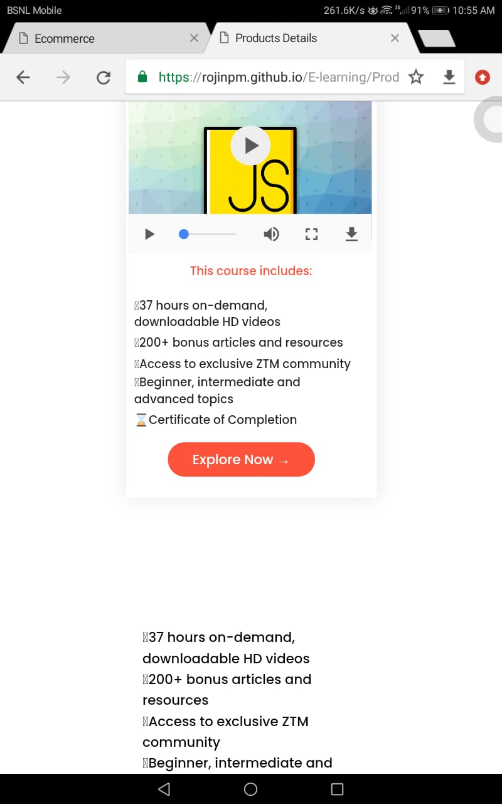
Tablet View
Our Website View on Tablets.

Slide 18
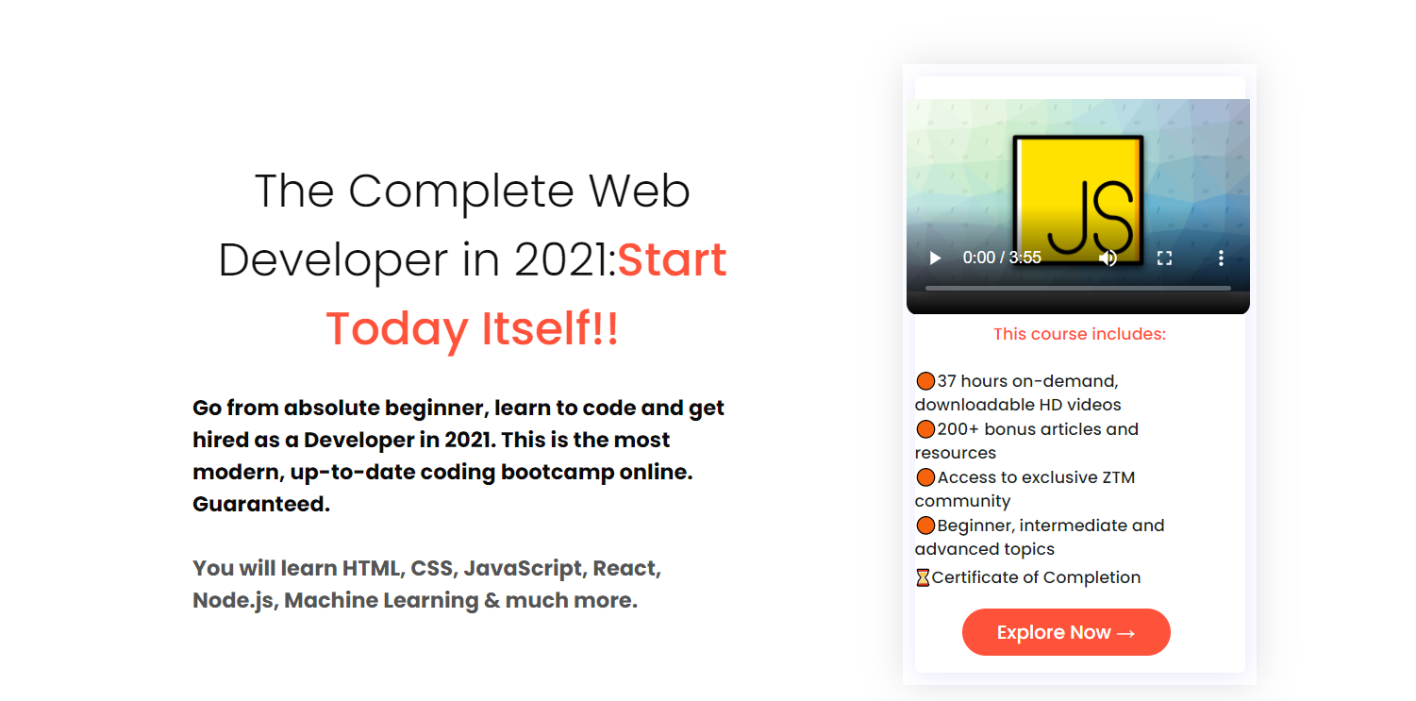
Desktop View
Our Website View on Desktop.

Slide 19


Roadmap
Future Ideas
Signin to our Website
Watch Entertainment Study Materials.
Certificate of Completion
Future Resources
1
3
5
2
4
6
Join a course
Attend Quiz
Feedback Survey

Slide 20
Our Process is Easy
Join your favourate Courses.
Join a course with your id and start Learning. There is study Material and Video Tutorial For Studying.
And online Quiz.
Face to Face interaction are also Available. You can use the helpline to communicate with our team for any doubt.
03
Sign in
Sign in with your Email id and use your password to login to our website.
Certificate of Completion And take a Survey for Feedback
In the Last session of the Course we have a Quiz. Attend the Quiz and If you got 50% of Mark. We will Provide Certificate.
And take a survey.
01
02

Slide 21
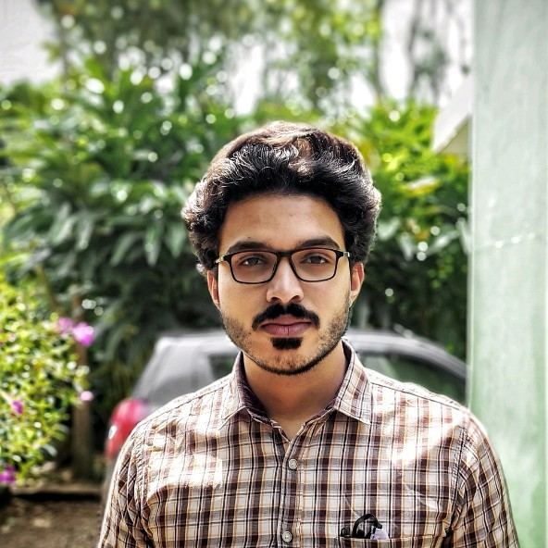
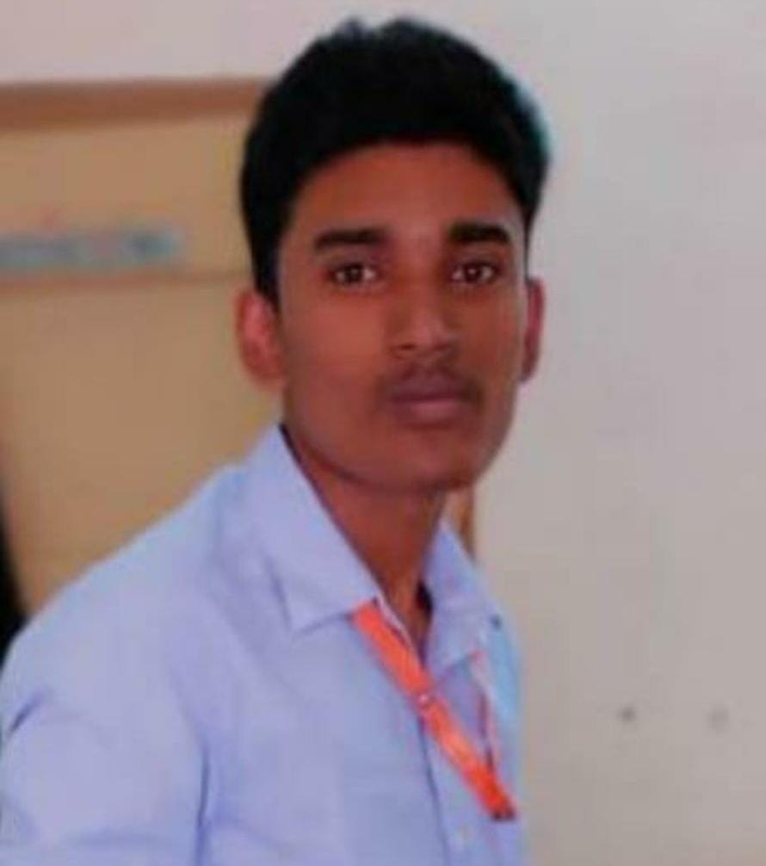

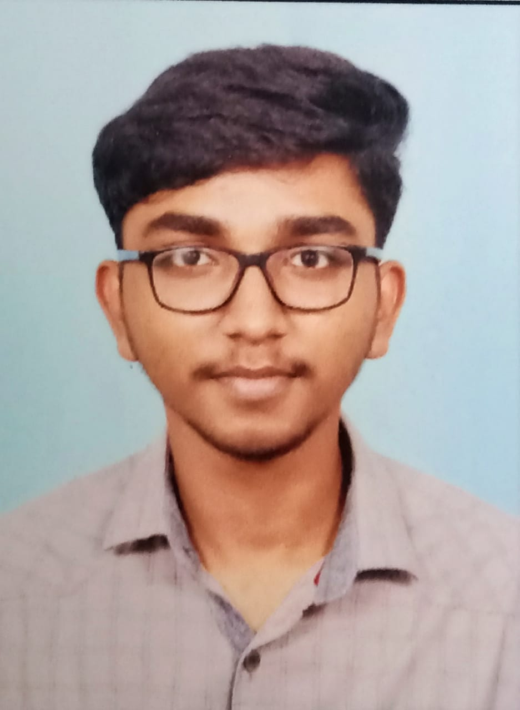
Team Presentation
Sanu K Joseph BSC CS
Sahyajyothi Arts and Science College Kumily.
Rojin PM MCA Student (S3)
Amal Jyothi College of Engineering
Rohith Santhosh MCA Student (S3)
Amal Jyothi College of Engineering
Alfred Koshy MCA Student (S3)
Amal Jyothi College of Engineering

Slide 22

Thank You

