Slide 1

Covid-19 India Data Analysis Project
Prepared By:
Aditya Pawar
Nooman Khan
Rahul Kumar
Manish Singh Rawat

Slide 2
INTRODUCTION

Slide 3
Top 3 Affected State
STATE | TOTAL_CASES | TOTAL_RECOVER | TOTAL_DEATH
MH | 6611078 | 6450585 | 140216
KL | 4968657 | 4857181 | 31681
KA | 2988333 | 2941578 | 38082

Slide 4
Top 3 Safe State
STATE | TOTAL_CASES | TOTAL_RECOVER | TOTAL_DEATH
DN | 10681 | 10644 | 4
LD | 10365 | 10270 | 51
AN | 7651 | 7518 | 129

Slide 5
Lakshadweep Status
STATE | POPULATION | TOTAL_TEST | TOTAL_CASES | TOTAL_RECOVER | TOTAL_DEATH
LD | 64473 | 263541 | 10365 | 10270 | 51

Slide 6
Monthly Status

Slide 7
First Wave vs Second Wave
STATUS | CASES | RECOVERED | DEATH | RECOVER % | DEATH %
FIRST WAVE | 11112057 | 10784568 | 157194 | 97.05 | 1.41
SECOND WAVE | 23189169 | 22888062 | 301384 | 98.70 | 1.30

Slide 8
Before Vaccine vs After Vaccine
STATUS | BEFORE VACCINATED | AFTER VACCINATED
CASES | 10572677 | 23726897
RECOVER PERCENTAGE | 96.57663806 | 98.89669096

Slide 9
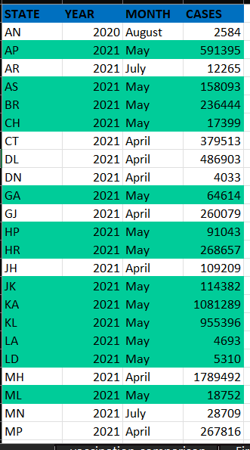
State with Highest Cases Month
Out of 38 States and union territories,24 have the worst scenario on May 21

Slide 10
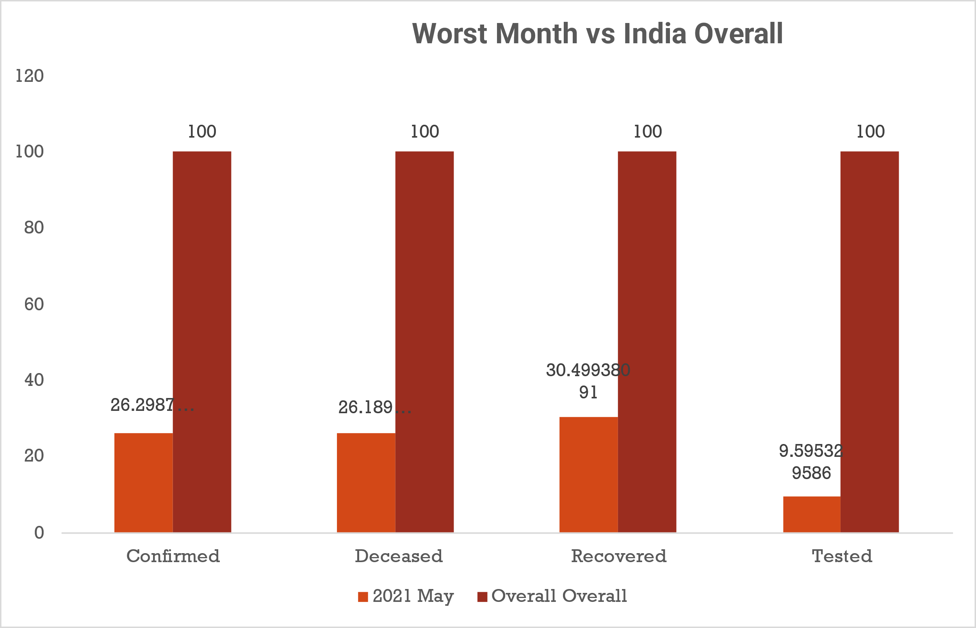

Slide 11
Category Wise Death
CATEGORY | DEATH
Category A | 165583
Category B | 148011
Category C | 21024
Category D | 16281
Category E | 26009
Category A: 0.05 ≤ tr ≤ 0.1
Category B: 0.1 < tr ≤ 0.3
Category C: 0.3 < tr ≤ 0.5
Category D: 0.5 < tr ≤ 0.75
Category E: 0.75 < tr ≤ 1.0
testing ratio(tr) = (number of tests done) / (population)

Slide 12
Percentage of death in Each Category
Category | Percentage Of Death
Category A | 43.93%
Category B | 39.27%
Category C | 5.58%
Category D | 4.32%
Category E | 6.90%

Slide 13
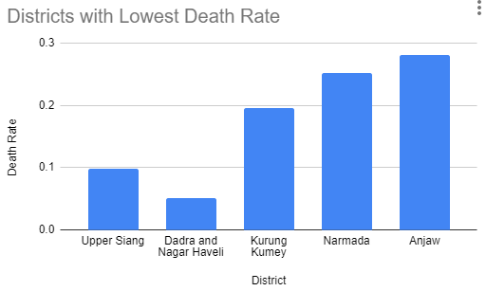

Slide 14
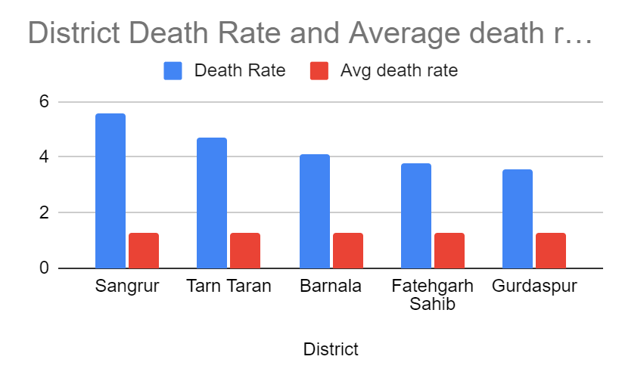
District With Highest Death Percentage

Slide 15
https://data.covid19india.org/v4/min/data.min.json https://data.covid19india.org/v4/min/timeseries.min.json https://mohfw.gov.in/
REFERENCES

Slide 16
Conclusion

Slide 17


Slide 18
Any Question?

