Slide 1
Introduction to Maven 3.x.x

Slide 2
Agenda
What is Maven
How can Maven be helpful for Project Development
Maven Architecture
How to use Maven
Maven Life Cycle

Slide 3
What is Maven
Maven is a build tool that automates everything related to s/w project like
Generating source code
Generating documentation from source code
compiling Source Code
Packaging Source code as jar , war file
Installing packaged code on server, in a repository

Slide 4
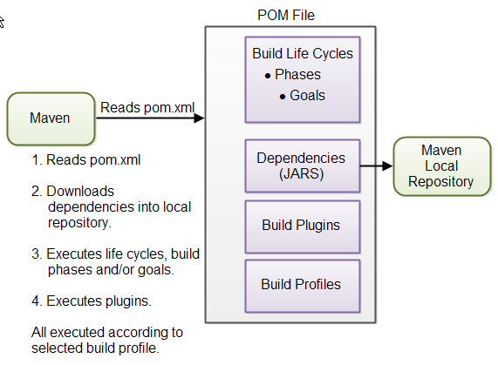
Maven Core Concept
Notes:
POM Files When you execute a Maven command you give Maven a POM file to execute the commands on. Maven will then execute the command on the resources described in the POM.
Build Life Cycles, Phases and Goals The build process in Maven is split up into build life cycles, phases and goals. A build life cycle consists of a sequence of build phases, and each build phase consists of a sequence of goals.
Dependencies and Repositories One of the first goals Maven executes is to check the dependencies needed by your project. Dependencies are external JAR files (Java libraries) that your project uses. If the dependencies are not found in the local Maven repository, Maven downloads them from a central Maven repository and puts them in your local repository
Build Plugins Build plugins are used to insert extra goals into a build phase. If you need to perform a set of actions for your project which are not covered by the standard Maven build phases and goals, you can add a plugin to the POM file
Build Profiles Build profiles are used if you need to build your project in different ways. For instance, you may need to build your project for your local computer, for development and test. And you may need to build it for deployment on your production environment. These two builds may be different. To enable different builds you can add different build profiles to your POM files. When executing Maven you can tell which build profile to use.

Slide 5
Maven Demo
Install Maven→ http://maven.apache.org/download.cgi
Download binary zip file
Set JAVA_HOME Environment variable
SET Path variable to the path of unzipped maven file bin
Open command prompt and type mvn –version
After the command, it must show the version.
Notes:
POM Files When you execute a Maven command you give Maven a POM file to execute the commands on. Maven will then execute the command on the resources described in the POM.
Build Life Cycles, Phases and Goals The build process in Maven is split up into build life cycles, phases and goals. A build life cycle consists of a sequence of build phases, and each build phase consists of a sequence of goals.
Dependencies and Repositories One of the first goals Maven executes is to check the dependencies needed by your project. Dependencies are external JAR files (Java libraries) that your project uses. If the dependencies are not found in the local Maven repository, Maven downloads them from a central Maven repository and puts them in your local repository
Build Plugins Build plugins are used to insert extra goals into a build phase. If you need to perform a set of actions for your project which are not covered by the standard Maven build phases and goals, you can add a plugin to the POM file
Build Profiles Build profiles are used if you need to build your project in different ways. For instance, you may need to build your project for your local computer, for development and test. And you may need to build it for deployment on your production environment. These two builds may be different. To enable different builds you can add different build profiles to your POM files. When executing Maven you can tell which build profile to use.

Slide 6
Maven Lifecycle
Maven has 3 built-in build life cycles. These are:
Default- handles everything related to compiling and packaging your project
Clean-handles everything related to removing temporary files from the output directory, including generated source files, compiled classes, previous JAR files etc
Site-handles everything related to generating documentation for your project
Notes:
You can execute either a whole build life cycle like clean or site, a build phase like install which is part of the default build life cycle, or a build goal like dependency:copy-dependencies. Note: You cannot execute the default life cycle directly. You have to specify a build phase or goal inside the default life cycle.
The default build life cycle consists of 23 phases as it's the main build lifecycle.
On the other hand, clean life cycle consists of 3 phases, while the site lifecycle is made up of 4 phases.

Slide 7
Maven Archetype
To create a maven project use
mvn archetype:generate -DgroupId=MyProject -DartifactId=DemoMavenProject -DarchetypeArtifactId=maven-archetype-quickstart -DinteractiveMode=false
To convert it into eclipse compatible format
Mvn eclipse:eclipse
Notes:
To see a full list of Maven archetypes mvn archetype:generate

Slide 8
Build Phases
Build Phase | Description
Validate | Project is correct, necessary info is available and all dependencies are downloaded
Compile | Compiles source code of project
Test | Runs the test against compiled source code, using suitable UT framework. These tests don’t need to be packaged or deployed
Package | Packs the compiled code in its distributable format (Jar/War)
install | Install the package into the local repository, so as to use in other projects as dependency; locally
Deploy | Copies the final package to remote repository for sharing with other developers
Notes:
When you execute a build phase, all build phases before that build phase in this standard phase sequence are executed. Thus, executing the install build phase really means executing all build phases before the install phase, and then execute the install phase after that.

Slide 9
Maven Plugin(Group of Goals)
<build>
<!-- Source directory configuration -->
<sourceDirectory>src</sourceDirectory>
<plugins>
<!-- Following plugin executes the testng tests -->
<plugin>
<groupId>org.apache.maven.plugins</groupId>
<artifactId>maven-surefire-plugin</artifactId>
<version>2.14.1</version>
<configuration>
<!-- Suite testng xml file to consider for test execution -->
<suiteXmlFiles>
<suiteXmlFile>testng.xml</suiteXmlFile>
<suiteXmlFile>suites-test-testng.xml</suiteXmlFile>
</suiteXmlFiles>
</configuration>
</plugin>
<!-- Compiler plugin configures the java version to be usedfor compiling
the code -->
<plugin>
<artifactId>maven-compiler-plugin</artifactId>
<configuration>
<source>1.6</source>
<target>1.6</target>
</configuration>
</plugin>
</plugins>
</build>

Slide 10
Maven Goals
If you want to know about Goals in each phases you van use the command
mvn help:describe -Dcmd=PHASENAME
Ex: compile is a phase corresponding to this plugin
Org.apache.maven.plugins:maven-compiler-plugin:3.1:compile
Task: find the goals under plugin
Clean, resources,compiler,surefire
Use command
Mvn <pluginName>:help

Slide 11
Basic Maven Coordinates
GroupID, Artifact ID and Version are the required fields wherein
GroupID: unique amongst an organization
ArtifactID: It’s generally the name that the project is known as. Artifact ID separates a project from other.
Version: artifact ID denotes a single project but they cannot delineate which incarnation of that project we are talking about. Whenever code changes, those changes should be versioned, and this element keeps those versions in line
Notes:
To see a full list of Maven archetypes mvn archetype:generate

Slide 12
Maven Java Compiler Version
<properties>
<maven.compiler.target>1.8</maven.compiler.target>
<maven.compiler.source>1.8</maven.compiler.source>
</properties>
Update your project(maven update)

Slide 13
Inheritence in Maven
Packaging must be pom to the parent
<modelVersion>4.0.0</modelVersion>
<groupId>com.example</groupId>
<artifactId>Parent</artifactId>
<version>0.0.1-SNAPSHOT</version>
<packaging>pom</packaging>
In the child pom.xml
<parent>
<groupId>com.example</groupId>
<artifactId>Parent</artifactId>
<version>0.0.1-SNAPSHOT</version>
</parent>
Notes:
While we create child class many properties will get inherited like
groupId,version,description,url,organization,properties,dependencyManagement,dependencies,repositories,
pluginRepositories,build,profiles
Few properties will not get inherited like artifactid,name,prerequisite
To see effective pom: mvn help:effective-pom

Slide 14
Maven Repository
Maven repositories are directories of packaged JAR files with extra meta data. The meta data are POM files describing the projects each packaged JAR file belongs to, including what external dependencies each packaged JAR has. It is this meta data that enables Maven to download dependencies of your dependencies recursively, until the whole tree of dependencies is download and put into your local repository
Maven has three types of repository:
Local repository
Central repository
Remote repository

Slide 15
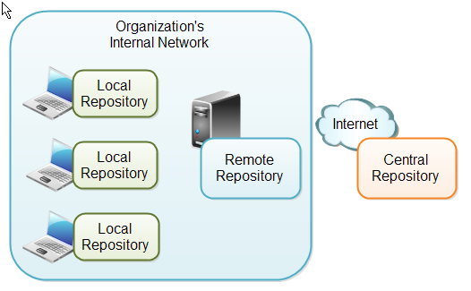
Maven Repository
Notes:
A local repository is a directory on the developer's computer. This repository will contain all the dependencies Maven downloads. The same Maven repository is typically used for several different projects. Thus Maven only needs to download the dependencies once, even if multiple projects depends on them
The central Maven repository is a repository provided by the Maven community. By default Maven looks in this central repository for any dependencies needed but not found in your local repository. Maven then downloads these dependencies into your local repository. You need no special configuration to access the central repository
A remote repository is a repository on a web server from which Maven can download dependencies, just like the central repository. A remote repository can be located anywhere on the internet, or inside a local network.

Slide 16
Maven Dependencies
External Dependencies-An external dependency means, its not located in Maven repositories, It will be located in your local harddisk like the lib directory of webapp.
example: <dependency>
<groupId>mydependency</groupId>
<artifactId>mydependency</artifactId>
<scope>system</scope>
<version>1.0</version>
<systemPath>${basedir}\war\WEB-INF\lib\mydependency.jar</systemPath>
</dependency>

Slide 17
Maven Dependencies
SnapShot Dependencies-A snapshot dependency, is a dependency under development.
You can tell Maven that your project is a snapshot version simply by appending –SNAPSHOT to the version number in the beginning of the POM
<version>1.0-SNAPSHOT</version>
Transitive Dependencies- if your project dependes on a dependency ABC, and ABC depends on XYZ, then XYZ is a transitive dependency for your project.
Exclude Dependency-to exclude a particular dependency, (like a transitive dependency version is not matching with your direct dependency version, we can exclude the dependency)
<dependency><exclusions>
<exclusion> <groupId>com.fasterxml.jackson.core</groupId>
<artifactId>jackson-core</artifactId>
</exclusion> </exclusions>

Slide 18
Publish Jar to Central Maven Repository
Steps to Publish to Central Maven Repository
Create a Sonatype Account and Claim your Namespace
Create and Publish PGP Keys
Prepare Your Project Maven POM File
Configure POM File for Distribution Management
Configure POM File for Nexus Staging Plugin
Configure POM File for Sources
Configure POM File for JavaDoc
Configure POM File for Signing JAR Files
Configure settings.xml
Publish JAR File

