Slide 1

The 8086 Microprocessor Architecture

Slide 2
The 8086 Microprocessor -Introduction
Intel 8086 microprocessor is the enhanced version of Intel 8085 microprocessor and it was designed by Intel in 1976.
It is a 16-bit,N-Channel,HMOS(High Speed Metal Oxide Semiconductor) Microprocessor
It is packaged in a 40-pin IC Package DIP(Dual Inline Package)
It uses 20 address lines and 16 data lines. It can directly address upto 2²⁰ = 1 Mb of memory
8086 is designed to operate in two modes i.e., Minimum and Maximum

Slide 3
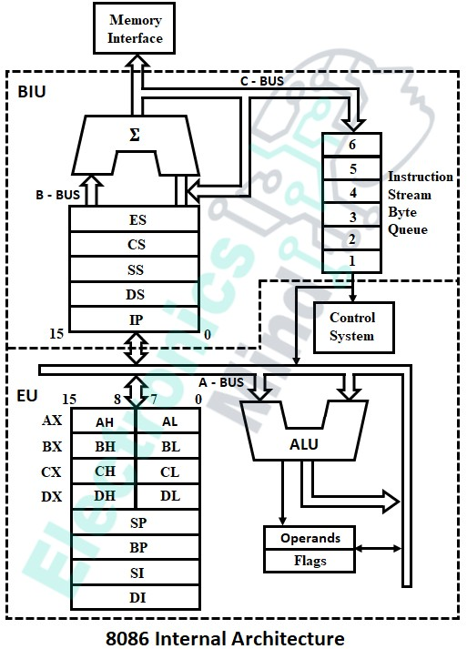
Internal Architecture of 8086 Microprocessor

Slide 4
The architecture of the 8086 microprocessor consists of two independent sections or units
The Bus Interface Unit (BIU)
The Execution Unit (EU).
BIU provides the interface of 8086 to external memory and I/O devices via the System Bus. It performs various machine cycles such as memory read, I/O read etc., to transfer data between memory and I/O devices.
The Execution unit tells the bus interface unit where to fetch instruction or data from. It decodes the instruction and performs arithmetic and logical operations using the ALU.

Slide 5
Bus Interface Unit(BIU)
The BIU performs read and write operations on data in the memory and on the external devices connected to the ports of the microprocessor, and it also sends out addresses.
To perform these operations BIU contains some functional parts
Instruction Queue
Segment Registers
Instruction Pointer

Slide 6
Instruction Queue
The instruction queue holds the six bytes of instruction fetched from the code memory by the BIU that are to be executed by the EU.
The instruction queue contains registers that work on FIFO (first-in-first-out) principle.
Since EU and BIU are independent, whenever the execution unit starts decoding and executing fetched instructions, the BIU fetches additional instructions to the queue from the code memory for execution.
Again when the execution unit starts executing fetched instructions in the queue, again the BIU will add instructions to the queue at the same time.

Slide 7
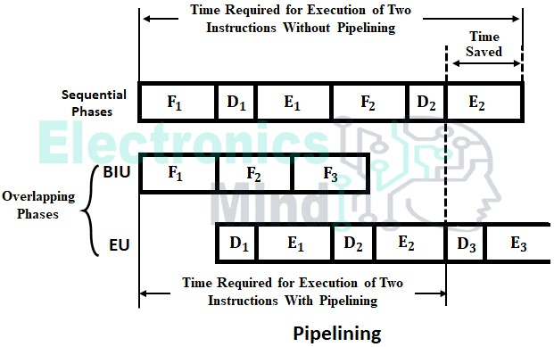
Since the fetching of instructions from the memory and execution of instructions in the queue are done as the same time, both the operations will overlap. The Pipelining which speeds up the execution by reducing CPU waiting state time as illustrated in the below figure.

Slide 8
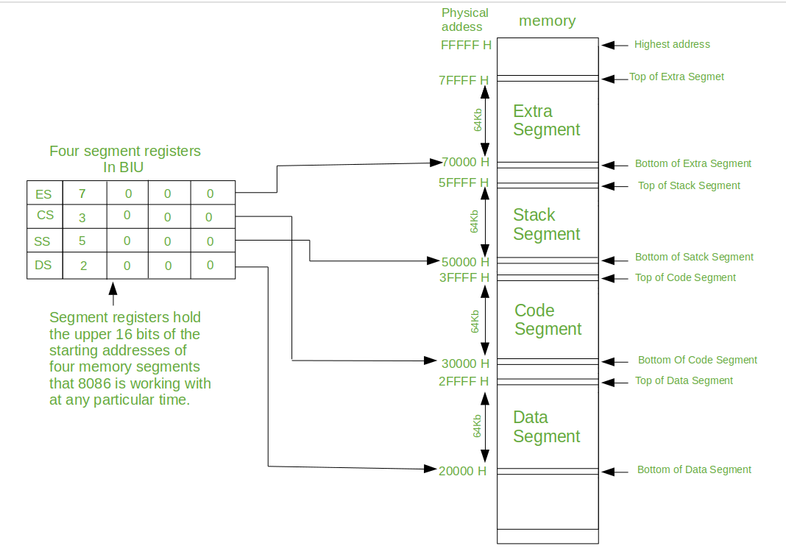

Slide 9
Segment Registers
Each segment is associated with segment registers that are 16 bits wide. The four registers related to four segments are,
Data Segment Register (DS) - It is used to point to the base address of the data register.
Code Segment Register (CS) - It is used to point to the base address of the code register.
Extra Segment Register (ES) - It holds the base address of the extra memory segment.
Stack Segment Register (SS) - It holds the base address of the stack memory segment.

Slide 10
Instruction Pointer(IP)
The instruction pointer is similar to the program counter in 8085 CPU. The IP is updated by BIU so that it contains the offset (distance in byte from base address) of the next instruction. That is IP points to the next instruction to be fetched from the code segment.

Slide 11
Execution Unit (EU)
The execution unit provides effective addresses of memory locations. Then, this address is added to the base address provided by segment registers in the bus interface unit. The execution unit consists of the following parts
Control System : It manages all the operations in the execution unit
Instruction Decoder : It translates or decodes the instructions in the queue for execution
Arithmetic and Logic Unit : Depending upon the given instructions the ALU performs operations like addition, subtraction, AND, OR, NOT, shifting of binary numbers, etc, on the data.

Slide 12

Flag Register : It is a 16-bit register with 16 flip-flops or flags. Out of 16 flags, only 9 are used. In these 9 flags, six flags are used for indicating the status of the result of an operation, and three flags are used to control certain operations in the EU.

Slide 13
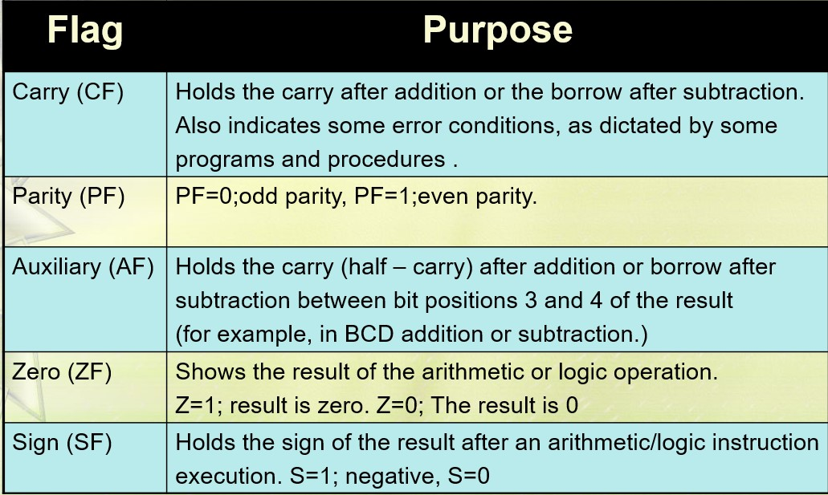

Slide 14
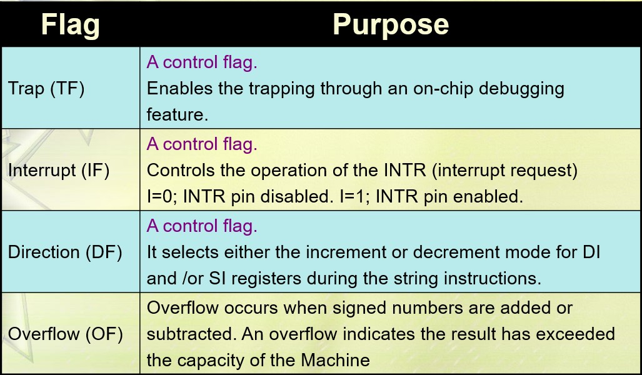

Slide 15
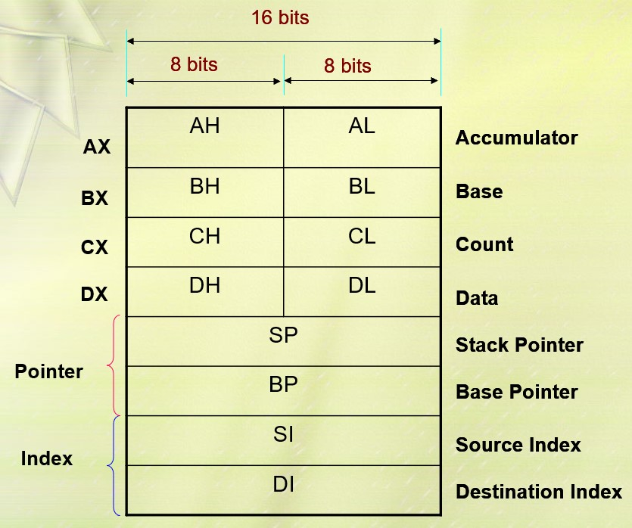
General Purpose Registers : The 8086 contains four 16-bit general-purpose registers (AX, BX, CX, and DX) used to store data, variables, temporary results and can be used as counters. Each register is divided into two 8-bit registers i.e., AX as AH and AL, BX as BH and BL, CX as CH and CL, and DX as DH and DL.

Slide 16
Stack Pointer (SP) : It is a 16-bit register that contains the offset from the start of the stack segment to the stack top.
Base Pointer (BP) : It is Primarily used to access data on the stack and it can be used to access data in other segments
Source Index(SI) : When string operations are performed, the SI register points to memory locations in the data segment which is addressed by the DS register. Thus, SI is associated with the DS in string operations.
Destination Index(DI) : When string operations are performed, the DI register points to memory locations in the data segment which is addressed by the ES register. Thus, DI is associated with the ES in string operations

Slide 17
Since, the two operations i.e., fetching an instruction from code memory by bus interface unit and execution of the instruction by execution unit are performed simultaneously, it is called Parallel processing.
The A-Bus, B-Bus, and C-Bus are the internal buses of the 8086 processor.
The A-Bus is an interface between BIU and EU.
The B-Bus is used to perform instruction fetch, data fetch, address transfer and computations of the effective address of the memory
The C-Bus performs transfer of instructions, addresses and data on the system to the execution unit

Slide 18
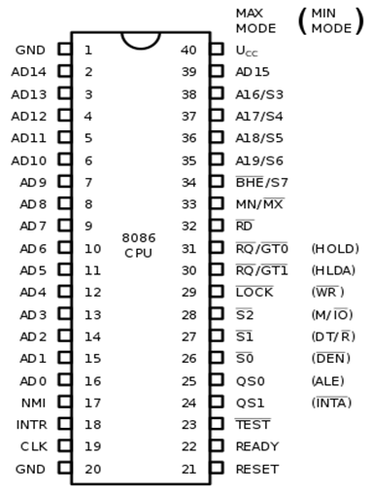
8086 PINS CONFIGURATION

Slide 19
The description of the pins of 8086 is as follows:
AD0-AD15(Address Data Bus): Bidirectional address/data lines. These are low order address bus. They are multiplexed with data. When these lines are used to transmit memory address, the symbol A is used instead of AD, for example A0-A15
A16-A19(Output): High order address lines. These are multiplexed with status signals.
A16/S3, A17/S4: A16 and A17 are multiplexed with segment identifier signals S3 and S4.
A18/S5: A18 is multiplexed with interrupt status S5.
A19/S6: A19 is multiplexed with status signal S6.
BHE/S7 (Output): Bus High Enable/Status. During T1, it is low. It enables the data onto the most significant half of data bus, D8-D15. 8-bit device connected to upper half of the data bus use BHE signal. It is multiplexed with status signal S7. S7 signal is available during T3 and T4.

Slide 20
RD (Read): For read operation. It is an output signal. It is active when LOW.
Ready (Input): The addressed memory or I/O sends acknowledgment through this pin. When HIGH, it denotes that the peripheral is ready to transfer data.
RESET (Input): System reset. The signal is active HIGH.
CLK (input): Clock 5, 8 or 10 MHz.
NTR: Interrupt Request.
NMI (Input): Non-maskable interrupt request.
TEST (Input): Wait for test control. When LOW the microprocessor continues execution otherwise waits.
VCC: Power supply +5V dc.
GND: Ground.

Slide 21
Pin Description for Minimum Mode
INTA (Output): Pin number 24 interrupts acknowledgement. On receiving interrupt signal, the processor issues an interrupt acknowledgment signal. It is active LOW.
ALE (Output): Pin no. 25. Address latch enable. It goes HIGH during T1. The microprocessor 8086 sends this signal to latch the address into the Intel 8282/8283 latch.
DEN (Output): Pin no. 26. Data Enable. When Intel 8287/8286 octal bus transceiver is used this signal. It is active LOW.
DT/R (output): Pin No. 27 data Transmit/Receives. When Intel 8287/8286 octal bus transceiver is used this signal controls the direction of data flow through the transceiver. When it is HIGH, data is sent out. When it is LOW, data is received.
M/IO (Output): Pin no. 28, Memory or I/O access. When this signal is HIGH, the CPU wants to access memory. When this signal is LOW, the CPU wants to access I/O device.
WR (Output): Pin no. 29, Write. When this signal is LOW, the CPU performs memory or I/O write operation.
HLDA (Output): Pin no. 30, Hold Acknowledgment. It is sent by the processor when it receives HOLD signal. It is active HIGH signal. When HOLD is removed HLDA goes LOW.
HOLD (Input): Pin no. 31, Hold. When another device in microcomputer system wants to use the address and data bus, it sends HOLD request to CPU through this pin. It is an active HIGH signal.

Slide 22
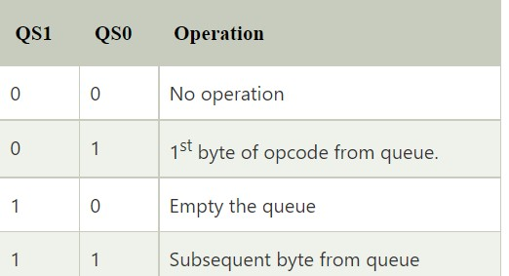
Pin Description for Maximum Mode
In the maximum mode of operation, the pin MN/¯MX is made LOW. It is grounded. The description about the pins from 24 to 31 is as follows:
QS1, QS0 (Output): Pin numbers 24, 25, Instruction Queue Status. Logics are given below:

Slide 23
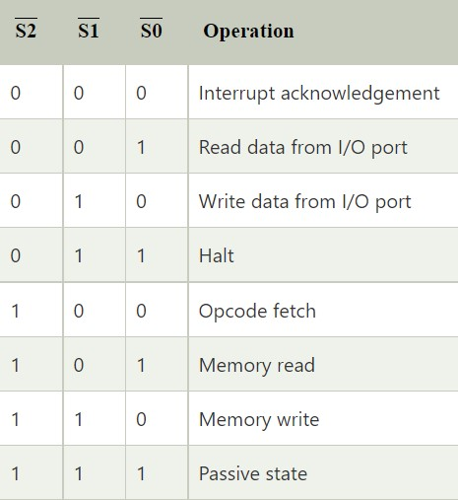
S0, S1, S2 (Output): Pin numbers 26, 27, 28 Status Signals. These signals are connected to the bus controller of Intel 8288. This bus controller generates memory and I/O access control signals. Logics for status signal are given below:

Slide 24
LOCK (Output): Pin no. 29. It is an active LOW signal. When this signal is LOW, all interrupts are masked and no HOLD request is granted. In a multiprocessor system all other processors are informed through this signal that they should not ask the CPU for relinquishing the bus control.
RG/GT1, RQ/GT0 (Bidirectional): Pin numbers 30, 31, Local Bus Priority Control. Other processors ask the CPU by these lines to release the local bus.
In the maximum mode of operation signals WR, ALE, DEN, DT/R etc. are not available directly from the processor. These signals are available from the controller 8288.

Slide 25


