Slide 1
Direct memory access (DMA)

Slide 2
Introduction :
Direct memory access (DMA) is a feature of computer systems and allows certain hardware devices to access main memory independently without using CPU.

Slide 3
How Does Direct Memory Access Work?
DMA adopts a DMA controller. The DMA controller can produce memory addresses and launch memory read or write cycles.
It covers multiple hardware registers that can be read and written by the CPU.

Slide 4
What is a DMA Controller?
The hardware device used for direct memory access is called the DMA controller.
DMA controller is a control unit, which can transfer blocks of data between I/O devices and main memory with minimal intervention from the processor.

Slide 5
DMA Controller in Computer Architecture
DMA controller provides an interface between the bus and the input-output devices.
Although it transfers data without intervention of processor, it is controlled by the processor.

Slide 6
DMA in Computer Architecture
The processor initiates the DMA controller by sending the starting address, Number of words in the data block and direction of transfer of data .i.e. from I/O devices to the memory or from main memory to I/O devices.
More than one external device can be connected to the DMA controller.

Slide 7
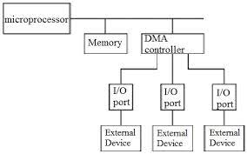
DMA in Computer Architecture

Slide 8
DMA in Computer Architecture
DMA controller contains an address unit, for generating addresses and selecting I/O device for transfer.
It also contains the control unit and data count for keeping counts of the number of blocks transferred and indicating the direction of transfer of data

Slide 9
DMA in Computer Architecture
. When the transfer is completed, DMA informs the processor by raising an interrupt.
The typical block diagram of the DMA controller is shown in the figure below.

Slide 10
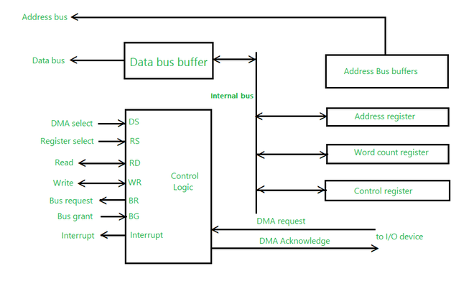

Slide 11
Working of DMA Controller
DMA controller has to share the bus with the processor to make the data transfer.
The device that holds the bus at a given time is called bus master.

Slide 12
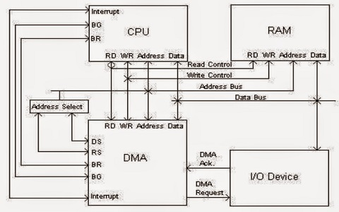

Slide 13
Working of DMA Controller
When a transfer from I/O device to the memory or vice verse has to be made, the processor stops the execution of the current program, increments the program counter, moves data over stack then sends a DMA select signal to DMA controller over the address bus.

Slide 14
Working of DMA Controller
If the DMA controller is free, it requests the control of bus from the processor by raising the bus request signal.
Processor grants the bus to the controller by raising the bus grant signal, now DMA controller is the bus master.

Slide 15
Working of DMA Controller
The processor initiates the DMA controller by sending the memory addresses, number of blocks of data to be transferred and direction of data transfer.
After assigning the data transfer task to the DMA controller, instead of waiting ideally till completion of data transfer, the processor resumes the execution of the program after retrieving instructions from the stack.

Slide 16
Working of DMA Controller
DMA controller now has the full control of buses and can interact directly with memory and I/O devices independent of CPU.
It makes the data transfer according to the control instructions received by the processor.
After completion of data transfer, it disables the bus request signal and CPU disables the bus grant signal thereby moving control of buses to the CPU.

Slide 17
Working of DMA Controller
When an I/O device wants to initiate the transfer then it sends a DMA request signal to the DMA controller, for which the controller acknowledges if it is free.
Then the controller requests the processor for the bus, raising the bus request signal. After receiving the bus grant signal it transfers the data from the device.

Slide 18
Modes of Operation
The DMA transfers the data in three modes which include the following.
a) Burst Mode: In this mode DMA handover the buses to CPU only after completion of whole data transfer.
Meanwhile, if the CPU requires the bus it has to stay ideal and wait for data transfer.

Slide 19
Modes of Operation
b) Cycle Stealing Mode: In this mode, DMA gives control of buses to CPU after transfer of every byte.
It continuously issues a request for bus control, makes the transfer of one byte and returns the bus.
By this CPU doesn’t have to wait for a long time if it needs a bus for higher priority task.

Slide 20


