Slide 1
Pipelining

Slide 2
Pipelining
The term Pipelining refers to a technique of decomposing a sequential process into sub-operations, with each sub-operation being executed in a dedicated segment that operates concurrently with all other segments.

Slide 3
Pipelining
The most important characteristic of a pipeline technique is that several computations can be in progress in distinct segments at the same time.
The overlapping of computation is made possible by associating a register with each segment in the pipeline.
The registers provide isolation between each segment so that each can operate on distinct data simultaneously.

Slide 4
Pipelining
The structure of a pipeline organization can be represented simply by including an input register for each segment followed by a combinational circuit.
Let us consider an example of combined multiplication and addition operation to get a better understanding of the pipeline organization.

Slide 5
Pipelining
The combined multiplication and addition operation is done with a stream of numbers such as:
A_{i}* B_{i} + C_{i} for i = 1, 2, 3, ......., 7
The operation to be performed on the numbers is decomposed into sub-operations with each sub-operation to be implemented in a segment within a pipeline.

Slide 6
Pipelining
he sub-operations performed in each segment of the pipeline are defined as:
R1 ← A_{i}, R2 ← B_{i} Input A_{i} and B_{i}
R3 ← R1 * R2, R4 ← C_{i} Multiply,and input C_{i}
R5 ← R3 + R4 Add C_{i} to product

Slide 7
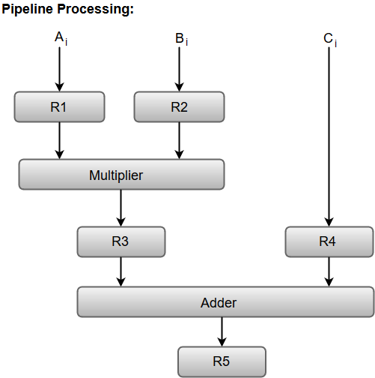

Slide 8
Pipelining
Registers R1, R2, R3, and R4 hold the data and the combinational circuits operate in a particular segment.
The output generated by the combinational circuit in a given segment is applied as an input register of the next segment.
For instance, from the block diagram, we can see that the register R3 is used as one of the input registers for the combinational adder circuit.

Slide 9
Implementation of Pipelining
In general, the pipeline organization is applicable for two areas of computer design which includes:
Arithmetic Pipeline
Instruction Pipeline
RISC Pipeline

Slide 10
Arithmetic Pipeline
Arithmetic Pipelines are mostly used in high-speed computers.
They are used to implement floating-point operations, multiplication of fixed-point numbers, and similar computations encountered in scientific problems.

Slide 11
Arithmetic Pipeline
To understand the concepts of arithmetic pipeline in a more convenient way, let us consider an example of a pipeline unit for floating-point addition and subtraction.

Slide 12
Arithmetic Pipeline
The inputs to the floating-point adder pipeline are two normalized floating-point binary numbers defined as:
X = A * 2ª = 0.9504 * 10³
Y = B * 2^{b} = 0.8200 * 10²
Where A and B are two fractions that represent the mantissa and a and b are the exponents.

Slide 13
Arithmetic Pipeline
The combined operation of floating-point addition and subtraction is divided into four segments.
Each segment contains the corresponding sub operation to be performed in the given pipeline.

Slide 14
Arithmetic Pipeline
The sub operations that are shown in the four segments are:
Compare the exponents by subtraction.
Align the mantissas.
Add or subtract the mantissas.
Normalize the result.

Slide 15
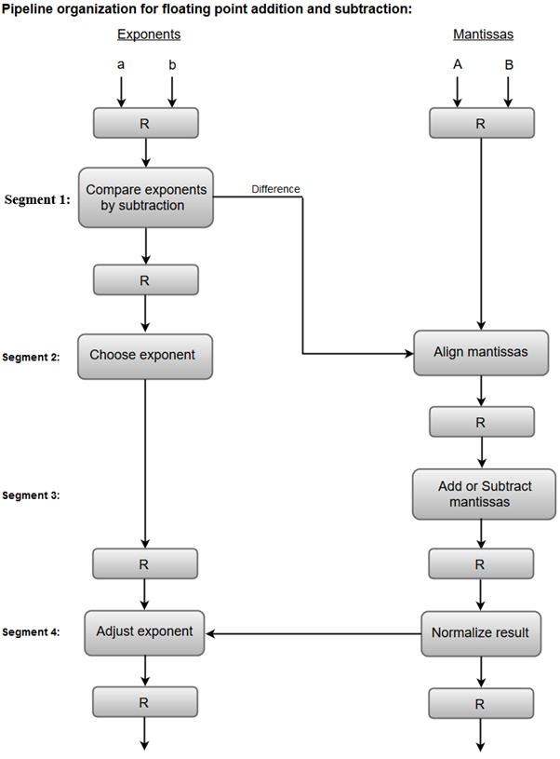

Slide 16
Arithmetic Pipeline
Compare exponents by subtraction:
The exponents are compared by subtracting them to determine their difference.
The larger exponent is chosen as the exponent of the result.
The difference of the exponents, i.e., 3 - 2 = 1 determines how many times the mantissa associated with the smaller exponent must be shifted to the right.

Slide 17
Arithmetic Pipeline
2. Align the mantissas:
The mantissa associated with the smaller exponent is shifted according to the difference of exponents determined in segment one.
X = 0.9504 * 10³
Y = 0.08200 * 10³

Slide 18
Arithmetic Pipeline
3. Add mantissas:
The two mantissas are added in segment three.
Z = X + Y = 1.0324 * 10³
4. Normalize the result:
After normalization, the result is written as:
Z = 0.1324 * 10⁴

Slide 19
Instruction Pipeline
Pipeline processing can occur not only in the data stream but in the instruction stream as well.
Most of the digital computers with complex instructions require instruction pipeline to carry out operations like fetch, decode and execute instructions.

Slide 20
Instruction Pipeline
In general, the computer needs to process each instruction with the following sequence of steps.
Fetch instruction from memory.
Decode the instruction.
Calculate the effective address.
Fetch the operands from memory.
Execute the instruction.
Store the result in the proper place.

Slide 21
Instruction Pipeline
Each step is executed in a particular segment, and there are times when different segments may take different times to operate on the incoming information.
Moreover, there are times when two or more segments may require memory access at the same time, causing one segment to wait until another is finished with the memory.

Slide 22
Instruction Pipeline
The organization of an instruction pipeline will be more efficient if the instruction cycle is divided into segments of equal duration.
One of the most common examples of this type of organization is a Four-segment instruction pipeline.

Slide 23
Instruction Pipeline
A four-segment instruction pipeline combines two or more different segments and makes it as a single one.
For instance, the decoding of the instruction can be combined with the calculation of the effective address into one segment.
The following block diagram shows a typical example of a four-segment instruction pipeline. The instruction cycle is completed in four segments.

Slide 24
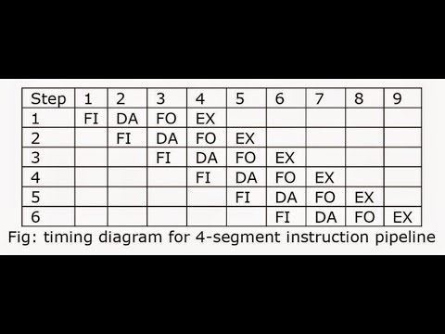
Instruction Pipeline

Slide 25
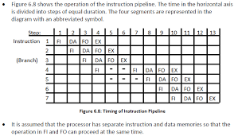

Slide 26
Instruction Pipeline
Segment 1:
The instruction fetch segment can be implemented using first in, first out (FIFO) buffer.
Segment 2:
The instruction fetched from memory is decoded in the second segment, and eventually, the effective address is calculated in a separate arithmetic circuit.

Slide 27
Instruction Pipeline
Segment 3:
An operand from memory is fetched in the third segment.
Segment 4:
The instructions are finally executed in the last segment of the pipeline organization.

Slide 28
RISC Pipeline
RISC stands for Reduced Instruction Set Computers. It was introduced to execute as fast as one instruction per clock cycle.
This RISC pipeline helps to simplify the computer architecture’s design.

Slide 29
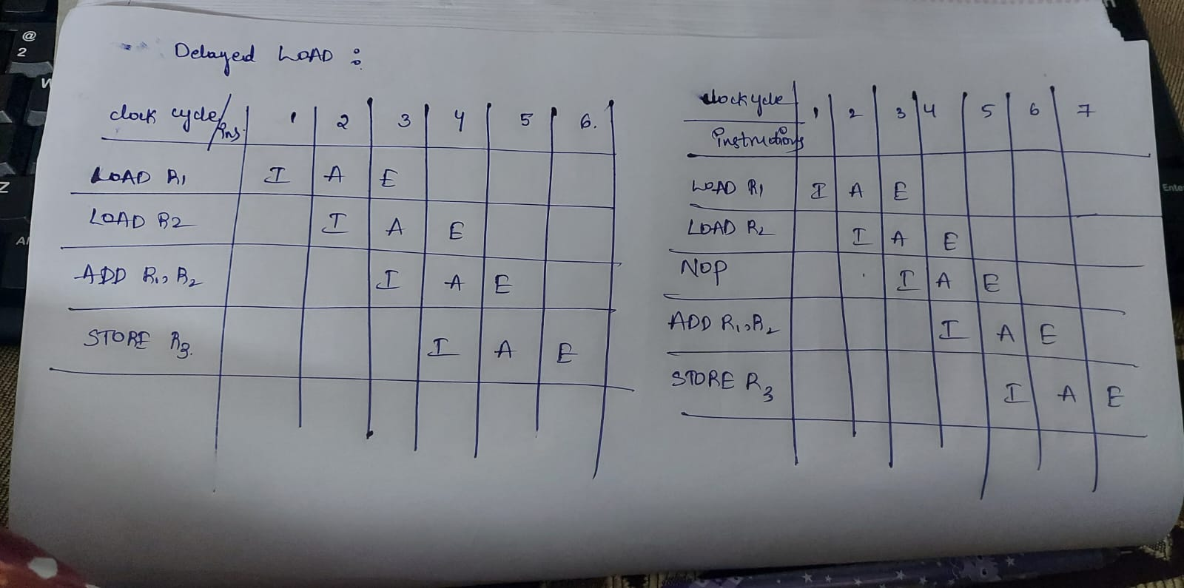

Slide 30
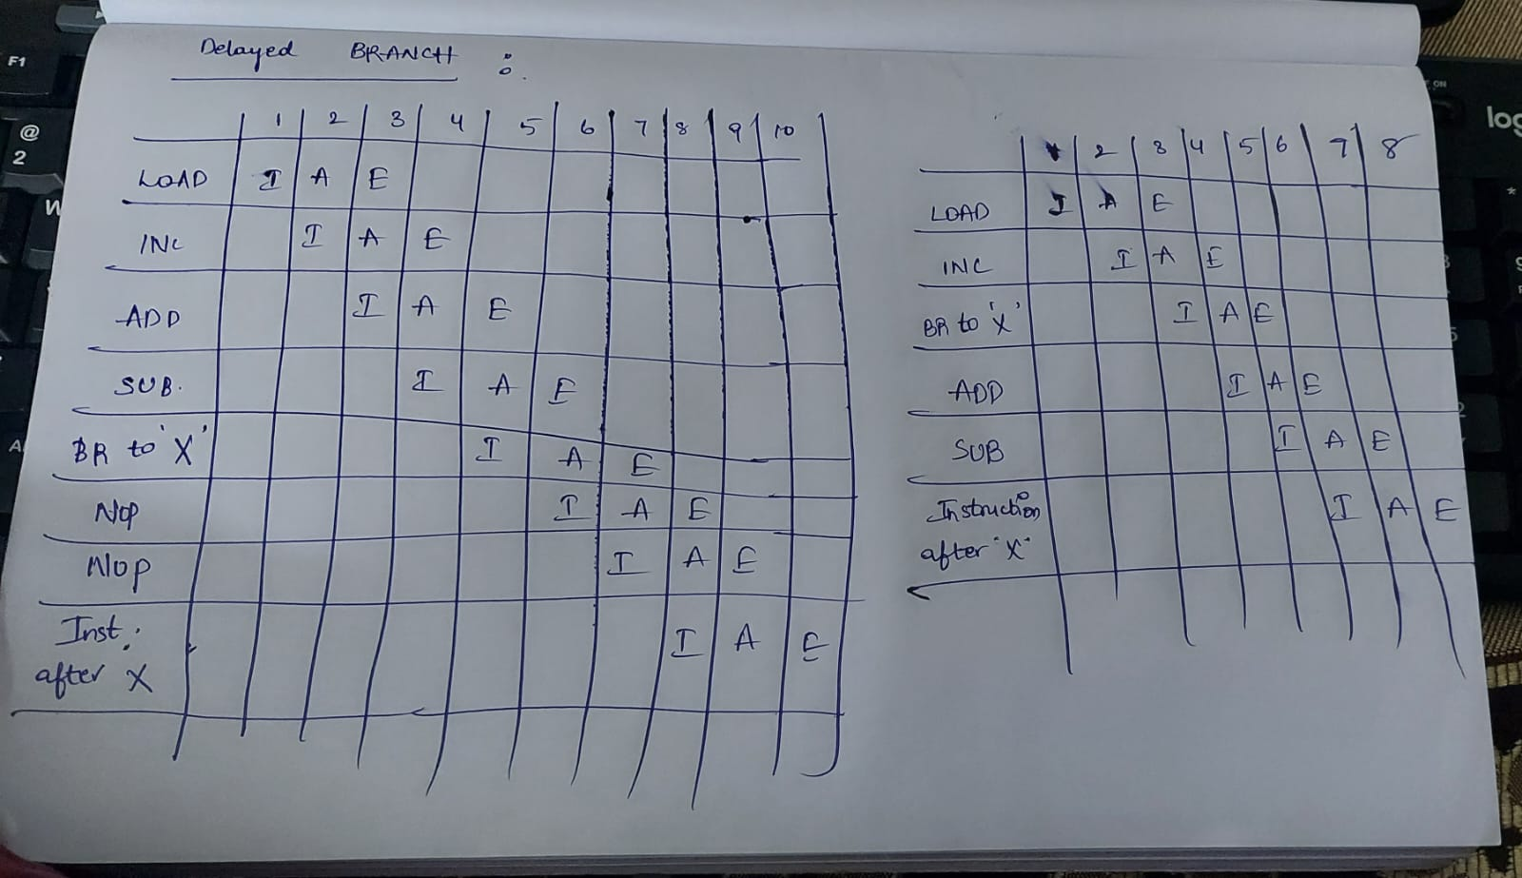

Slide 31
Advantages of Pipelining
Instruction throughput increases.
Increase in the number of pipeline stages increases the number of instructions executed simultaneously.
Faster ALU can be designed when pipelining is used.
Pipelined CPU’s works at higher clock frequencies than the RAM.
Pipelining increases the overall performance of the CPU.

Slide 32
Disadvantages of Pipelining
Designing of the pipelined processor is complex.
Instruction latency increases in pipelined processors.
The throughput of a pipelined processor is difficult to predict.
The longer the pipeline, worse the problem of hazard for branch instructions.

Slide 33


