Slide 1
Segmentation in OS
By
M. BABY ANUSHA,
ASST.PROF IN CSE DEPT.,
RGUKT,NUZVID

Slide 2
Segmentation
In Operating Systems, Segmentation is a memory management technique in which the memory is divided into the variable size partitions.
Each partition is known as a segment which can be allocated to a process.
The details about each segment are stored in a table called a segment table. Segment table is stored in one (or many) of the segments.

Slide 3
Segmentation
Segment table contains mainly two information about segment:
Base: It is the base address of the segment
Limit: It is the length of the segment.

Slide 4
Why Segmentation is required?
Till now, we were using Paging as our main memory management technique. Paging is more close to the Operating system rather than the User.
It divides all the processes into the form of pages regardless of the fact that a process can have some relative parts of functions which need to be loaded in the same page.

Slide 5
Why Segmentation is required?
Operating system doesn't care about the User's view of the process.
It may divide the same function into different pages and those pages may or may not be loaded at the same time into the memory.
It decreases the efficiency of the system.

Slide 6
Why Segmentation is required?
It is better to have segmentation which divides the process into the segments.
Each segment contains the same type of functions such as the main function can be included in one segment and the library functions can be included in the other segment.

Slide 7
Segmentation Hardware
Translation of Logical address into physical address by segment table
CPU generates a logical address which contains two parts:
Segment Number
Offset

Slide 8
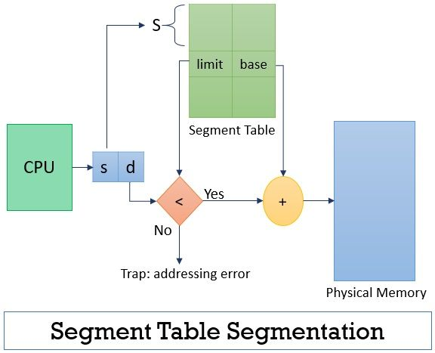

Slide 9
Segmentation Hardware
The Segment number is mapped to the segment table. The limit of the respective segment is compared with the offset. If the offset is less than the limit then the address is valid otherwise it throws an error as the address is invalid.
In the case of valid addresses, the base address of the segment is added to the offset to get the physical address of the actual word in the main memory.

Slide 10
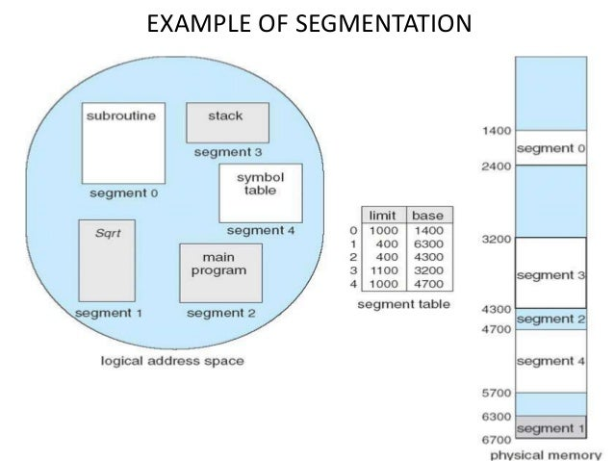

Slide 11
Advantages of Segmentation
No internal fragmentation
Average Segment Size is larger than the actual page size.
Less overhead
It is easier to relocate segments than entire address space.
The segment table is of lesser size as compared to the page table in paging.

Slide 12
Disadvantages
It can have external fragmentation.
it is difficult to allocate contiguous memory to variable sized partition.
Costly memory management algorithms.

Slide 13
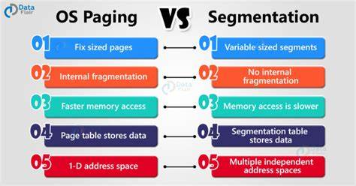

Slide 14


