Slide 1
SnopenGL – A Snow Simulation in OpenGL 4
Alasdair Hitchen – i7621977

Slide 2
Introduction
  The Primary Aims:
    Develop a particle based snow system including detailed snowfall and accumulation
    Create a 3D scene to demonstrate the system working
    Include customisation options for the user
  Details:
    Target platform MS Windows 10
    C++
    OpenGL
    Python (Benchmarking)

Slide 3
Motivations
  Personal Development: Wide Range of Programming Techniques
    Particle Simulation (Parallelisation)
    GPGPU
    OpenGL Abstraction
    I/O
  Under Researched
  Improvements in Hardware and Software

Slide 4
Literature Review

Slide 5
Implementation

Slide 6
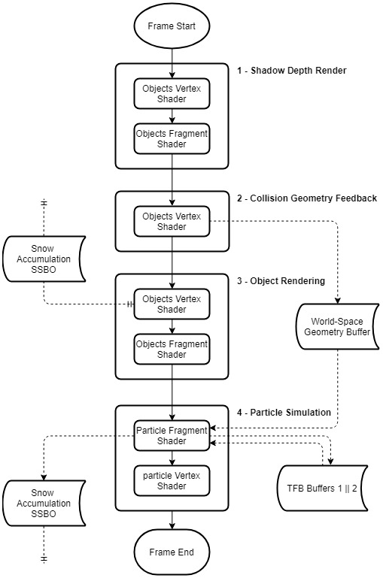
System Flowchart
4 Primary Elements
Shadow Depth Rendering
  Render to texture
Collision Geometry Processing
  Storing world space geometry
Object Rendering
  Object Visuals including textures
  Accumulation Visualisation
Particle Simulation
  Updating Position
  Detecting Collisions
  Adding to accumulation SSBO where necessary

Slide 7
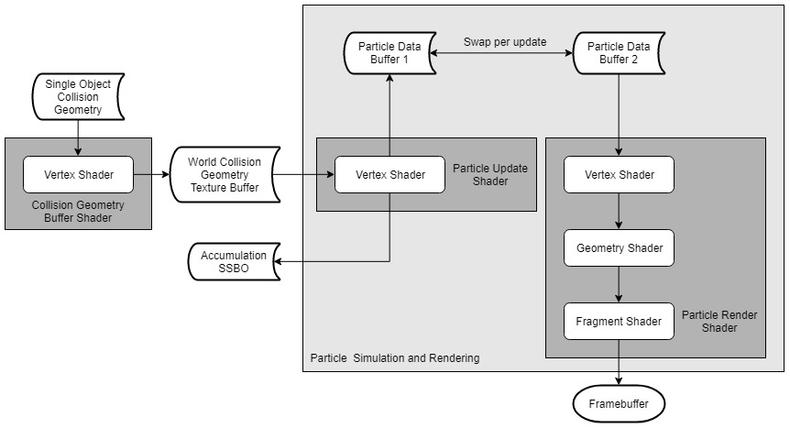
Particle System
Simulates particles through transform feedback
Detects collisions with world space geometry
Adds to Accumulation SSBO where a collision occurs
While one buffer is being updated, the other is being rendered

Slide 8
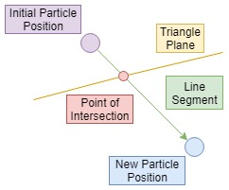
Collision Detection
Each particle is tested against all collision geometry every frame
Create a line segment between the initial and updated position of the particle
Test this line segment against the triangle

Slide 9
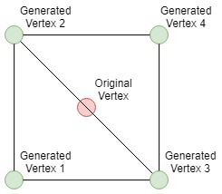
Particle Rendering
Billboard particle rendering
Mesh generated through a Geometry Shader – particle only represented by a single point

Slide 10
Accumulation Method
  Split the scene into a spatial partition
  Store the bins and partition data in a Shader Storage Buffer Object (SSBO)
    Bins stored as array of integers
    Data stored as Vec4s (size, position, etc.)
  Write to this array of bins in the Particle System when a collision occurs
  Read from the array of bins in the vertex shader when drawing scene objects
  Offset the vertex based on the value in the bin

Slide 11
Results

Slide 12
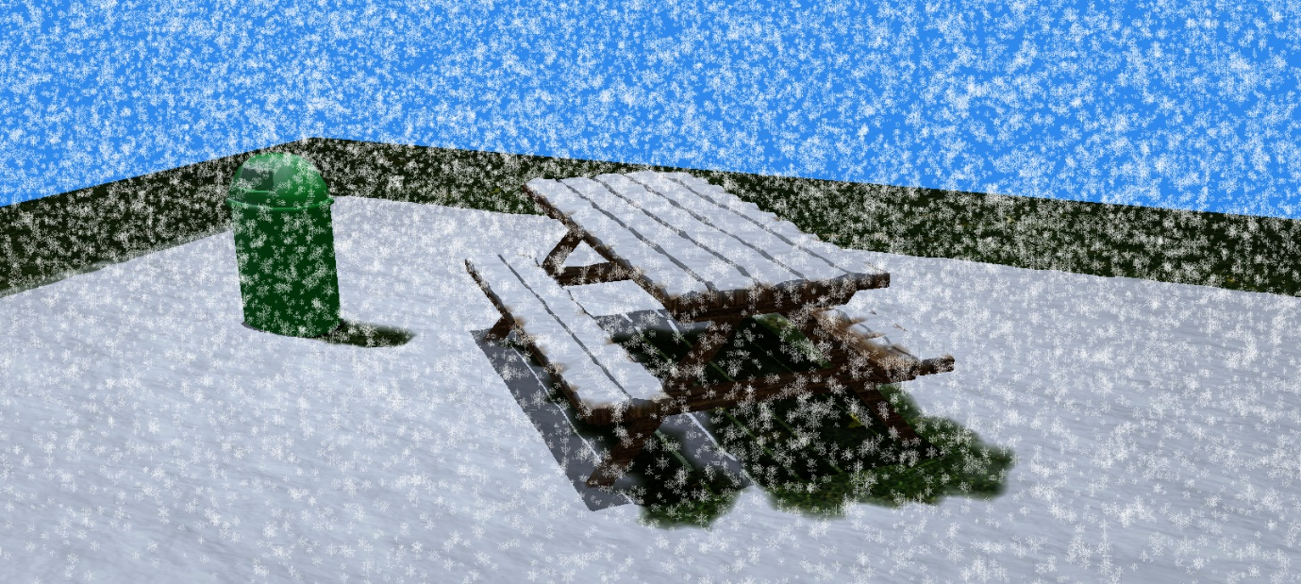

Slide 13
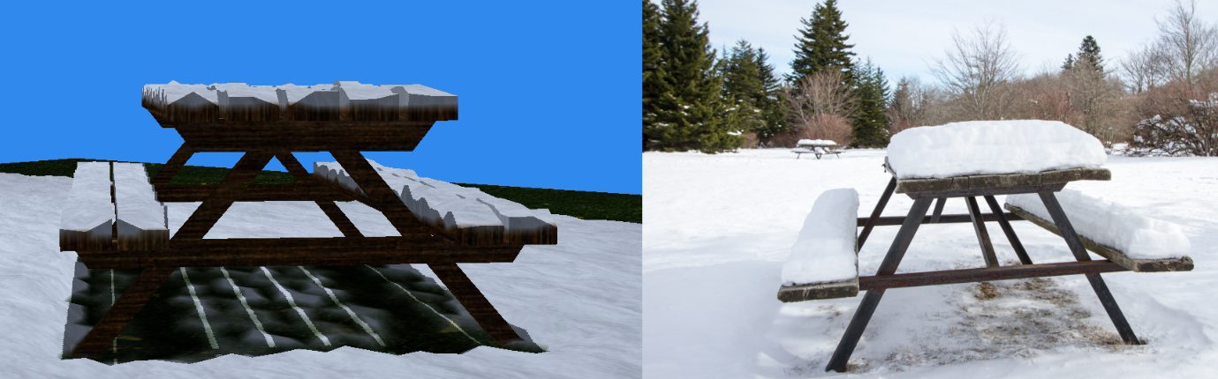

Slide 14
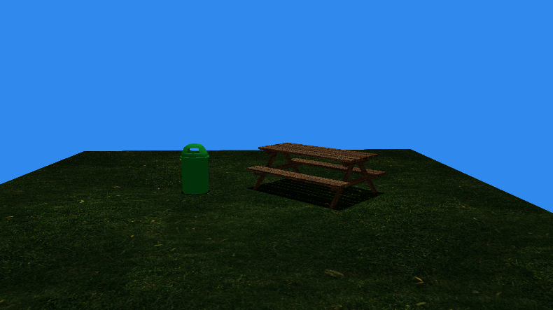
Step 1

Slide 15
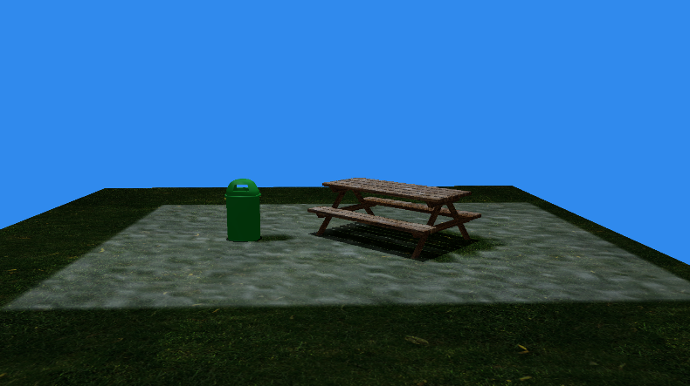
Step 2

Slide 16
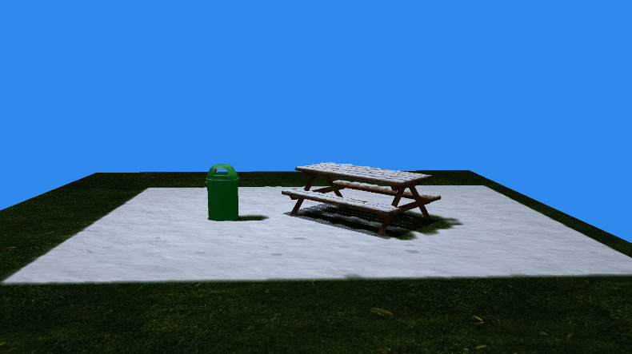
Step 3

Slide 17
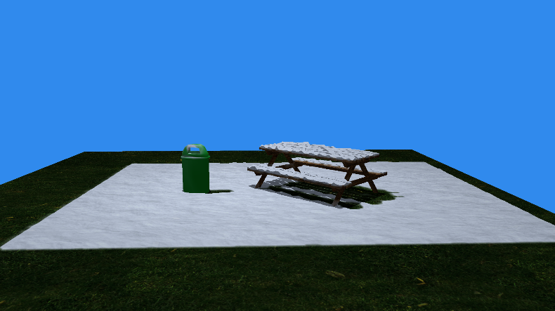
Step 4

Slide 18
Performance
Intel I7 4790k – Nvidia gtx970 – 16gb ram

Slide 19
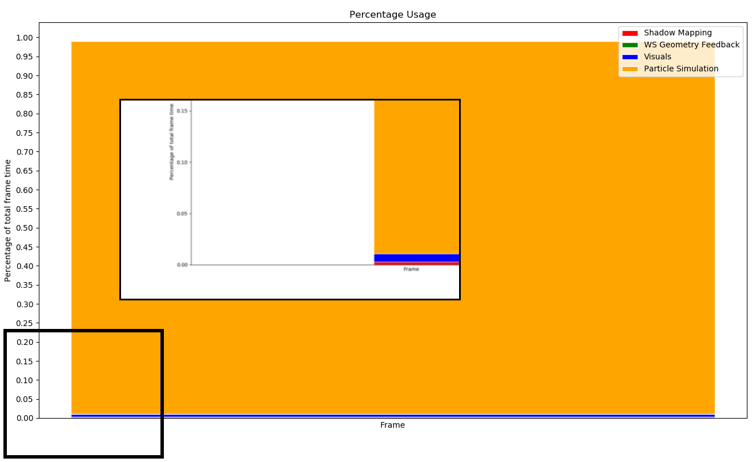
Performance Distribution

Slide 20
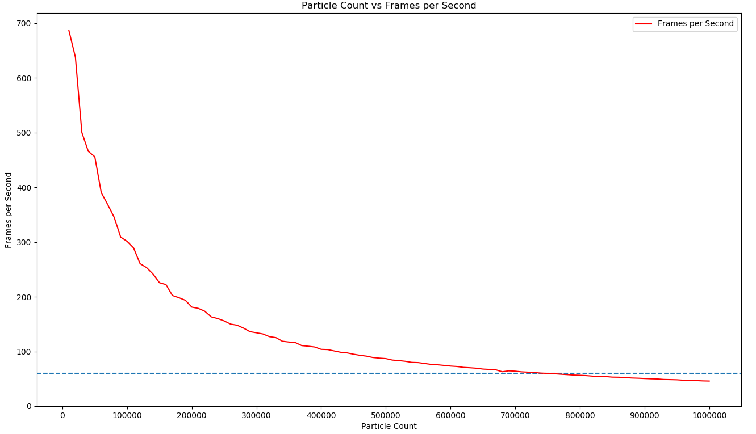
Particle Count / FPS
794 Triangle Collision Geometry

Slide 21
Conclusions

Slide 22
Limitations
  Scene must be static (non-moving)
    Objects can be added and removed
    Accumulated snow will not follow objects
  Limited Performance at high particle counts
    Hardware dependent
  Accumulated snow resolution is tied to the underlying mesh (No tessellation)
  OpenGL 4.2+

Slide 23
Future Work
  Tessellation
  Improved visual fidelity
    Fog
    Multi-texturing
  Dynamic scene support
    Multiple SSBOs
  HBV / KD-Tree Optimisation
    Collision detection performance impact

Slide 24
Conclusion
  Project met the primary goals
  Proven concept
  Can be integrated into smaller scenes
  Room for improvement
  Learnt a great deal about GPGPU and OpenGL
  Improvements in large project structure

Slide 25
Questions?

