Slide 1
MQ Monitoring

Slide 2
Monitoring Requirements
On Project COBRA we started using MQs to communicate between services
This led to a blind spot in our monitoring, we needed something to give us a better overview of our queues
Requirements Checklist
Display relevant queue data in a single location
Store and display historical data + current data
Configure alerts to be sent out e.g. when queue depth is too large

Slide 3

Queue Architecture
Cluster One
Cluster Two
Node One
Node Two
Node One
Node Two
TEST
CURRENT
TEST
CURRENT
TEST
CURRENT
TEST
CURRENT
~ 80 Queues
~ 80 Queues
~ 80 Queues
~ 80 Queues
~ 80 Queues
~ 80 Queues
~ 80 Queues
~ 80 Queues

Slide 4
Scale of the Problem
640 Queues total
However nodes in a cluster are mirrored – so monitoring either node in a cluster is enough
Nodes are not there for load balancing, only for high availability
i.e. if one node goes down the other one can pick up where it left off
Halves the amount of queues to 320 (still a lot)

Slide 5
The Solution
Docker Network –
Single Pod
Cluster One
Java app will pull in data from MQ API on demand
Prometheus scrapes and stores the data at regular intervals
Grafana queries Prometheus for data
Java App
Prometheus
DB
Grafana
Cluster Two
Container Nº Two
Container Nº One
Container Nº Three
Storage
Volume

Slide 6
MQ Exporter
This is a Java application that calls the RabbitMQ HTTP API and gathers data on queues and exchanges
It will only do this on request (no polling involved)
The data will be formatted into a string that is readable by Prometheus
By using this library - https://mvnrepository.com/artifact/io.micrometer/micrometer-registry-prometheus
Also has an endpoint that Grafana can call for sending an SMS

Slide 7
Prometheus DB
This polls the MQ Exporter regularly for data
Entries in the DB are identified by Metric, Label and by Timestamp
Timestamping is handled in the background for us
A Storage Volume in OpenShift is used to store data
By default data is stored in memory in the Prometheus container
External storage means if the pod/container crashed or is re-deployed historical data is preserved
Metric
Labels
Value

Slide 8
Grafana
Grafana can query Prometheus and use the results to populate Dashboards with data
Alerting thresholds can also be set
Alerts can be sent via email
Grafana can also POST JSON when an alert triggers (so custom handlers can be made)
In this case a call is made to the MQ Exporter which sends an SMS out

Slide 9
Example Production Issue
One of our consumers crashed without acknowledging messages
Normally, when a consumer dies it’s connection to RabbitMQ is killed, and “Un-acknowledged” messages return to the “Ready” state for re-processing
However the consumer crashed without releasing the connection
Basically the issue was a zombie process
This means the messages were stuck in a queue and could not be processed by the other consumers
The queue in question only held audit data (customer journey unaffected)
This meant the issue was not immediately obvious to us

Slide 10
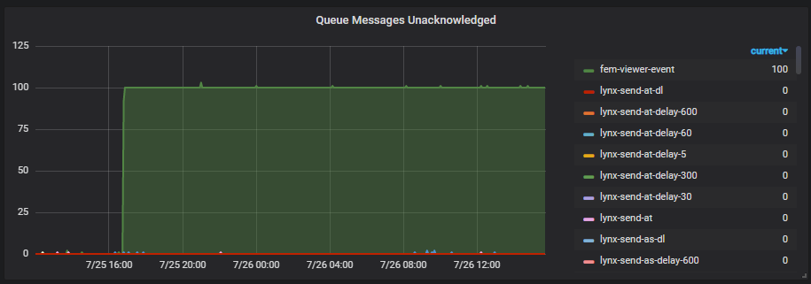
Snapshot

Slide 11
Resolution
The number of messages held in the queue exceeded 50 and triggered an alert
An email was automatically sent out with the alert details
Thanks to the Monitoring Dashboard we knew exactly when the issue started and which services were likely to be affected
We could then go to Kibana and search for error messages in that time-frame on certain pods
After consulting the team who manage the MQs a plan was put in place to resolve the issue
Ultimately, we were able to diagnose and react quickly to the issue

Slide 12
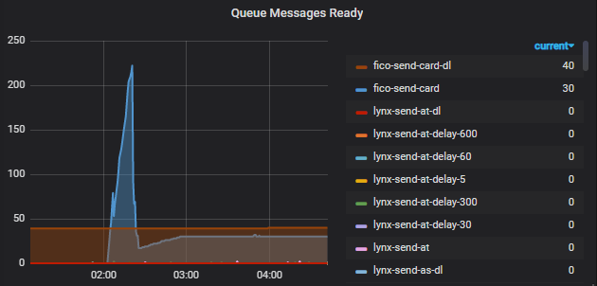
Another Production Incident

Slide 13
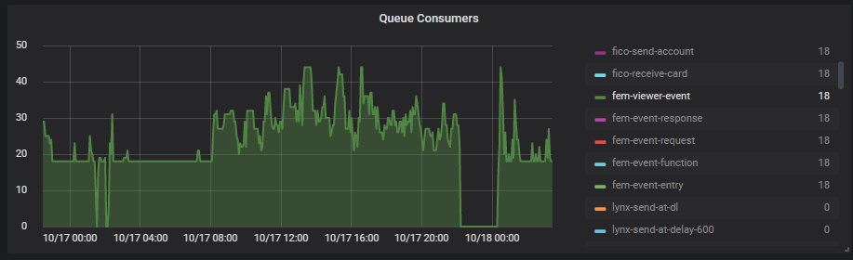
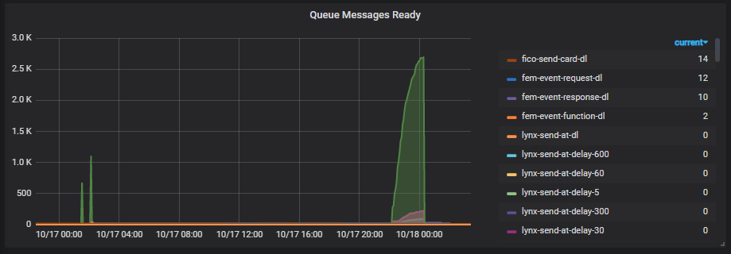
Network Outage

Slide 14
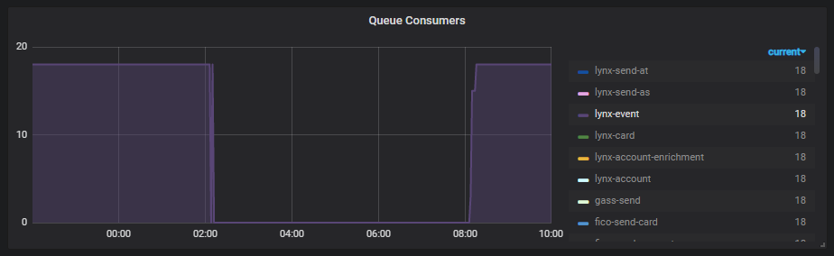
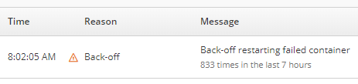
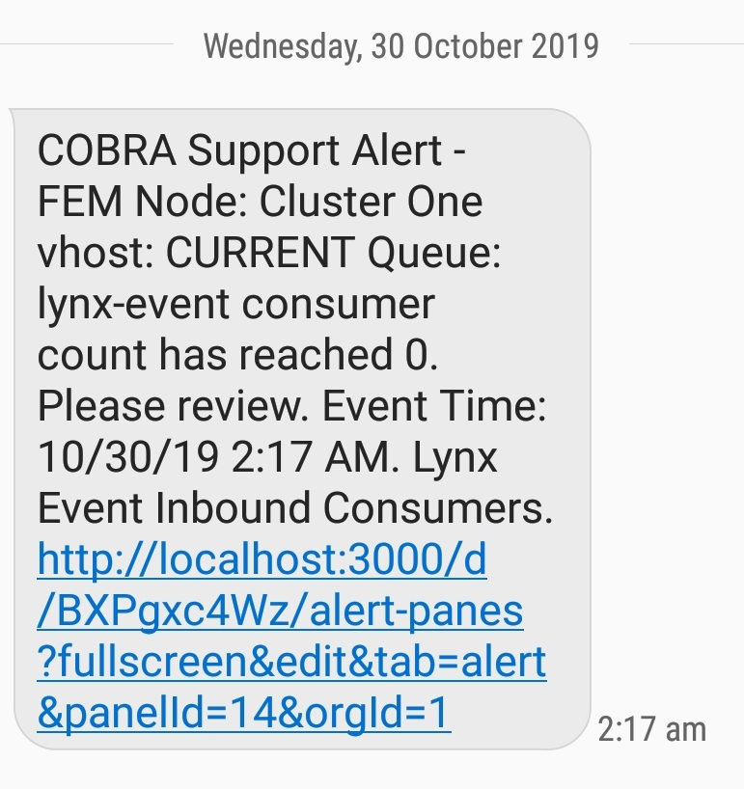
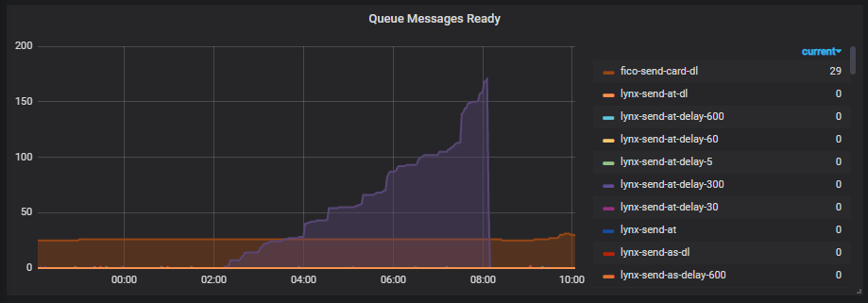

Slide 15
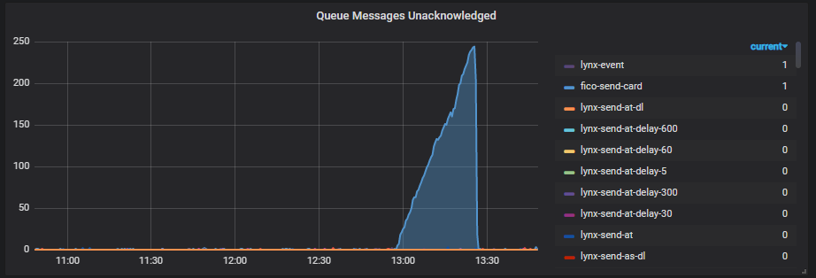
PROD Issue

Slide 16
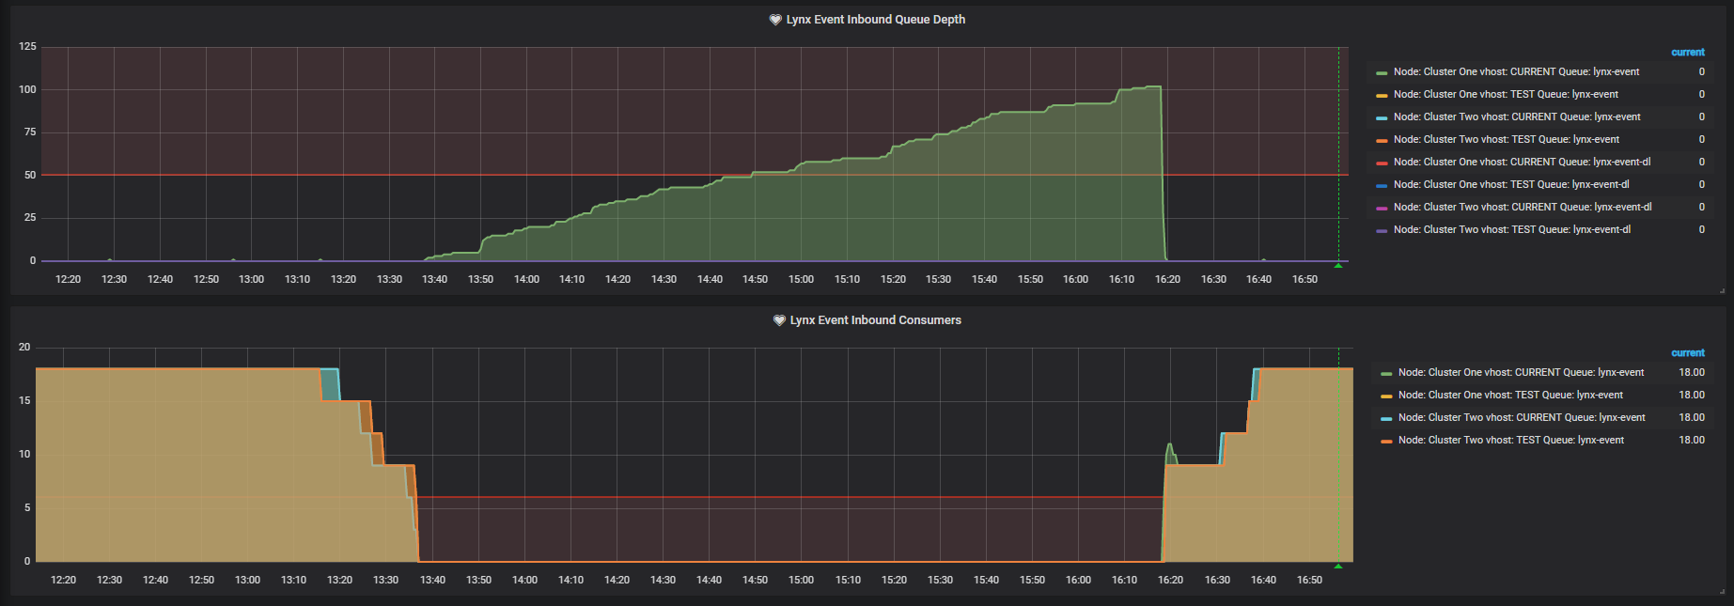
DNS Issue

