Slide 1
Distributed Database Systems
Chapter 1
Introduction

Slide 2
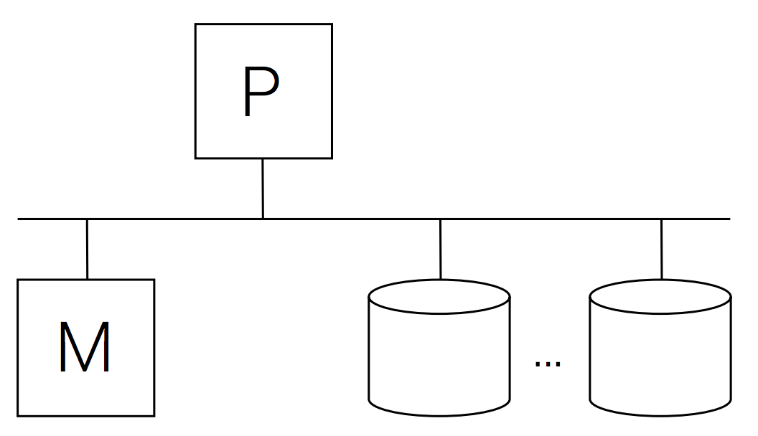
Centralized Database
Application
Front end (SQL)
Query processor
Transaction processor
Simplifications
Single front end
One place to keep data
If processor fails then system fails
File access
Notes:
I assume that all of you are familiar with the traditional centralized database system, because you have taken such courses when you are undergraduate.

Slide 3


Multiple Processors
Good News
Opportunities for parallelism
Opportunities for reliability
Bad News
Challenges with synchronization
Heterogeneous and autonomous components

Slide 4
Multiple processors (and memories)

Slide 5
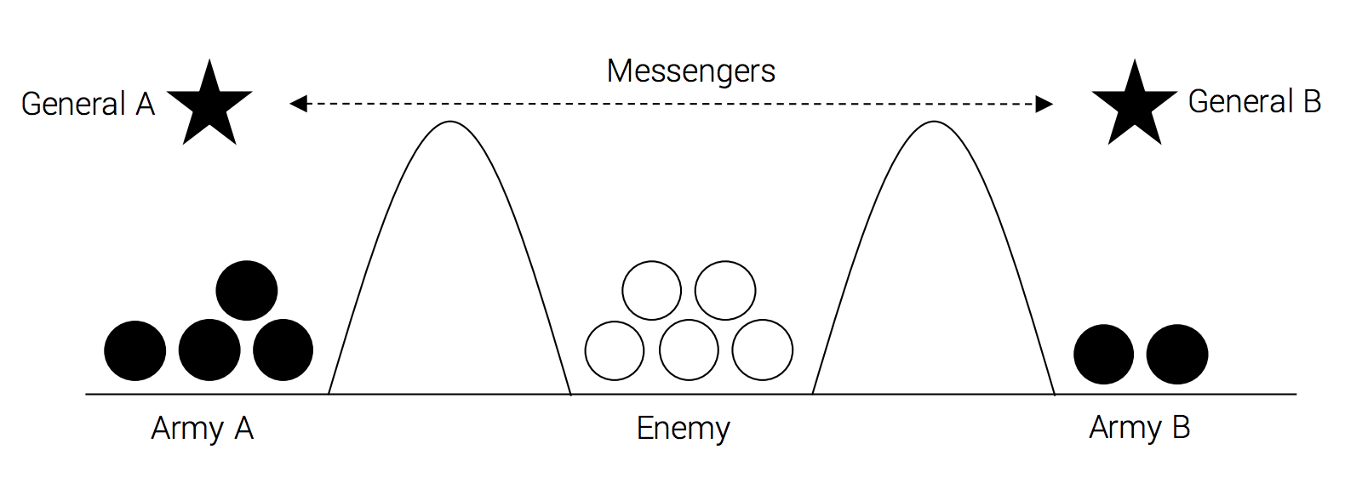
Two Generals’ Problem
Rules
A and B must attack at the same time
A and B synchronize through messengers
Messengers can get lost
Notes:
Let us use an example to show what is synchronization.

Slide 6
How Many Messages Do We Need?
General A
General B
Attack at 9am!
Ack, attacking at 9am!
Got your ack!

Slide 7
How Many Messages Do We Need?
Theorem
No protocol with a finite number of messages can solve the stated two generals’ problem
Alternatives?
Probabilistic Approach
Send as many messages as possible, hope at least one gets through

Slide 8
Eventual Commit
General A
General B
Attack ASAP!
retransmit
retransmit
On my way!
Eventually both armies attack
A attacks right away, keeps resending until receives confirmation from B

Slide 9
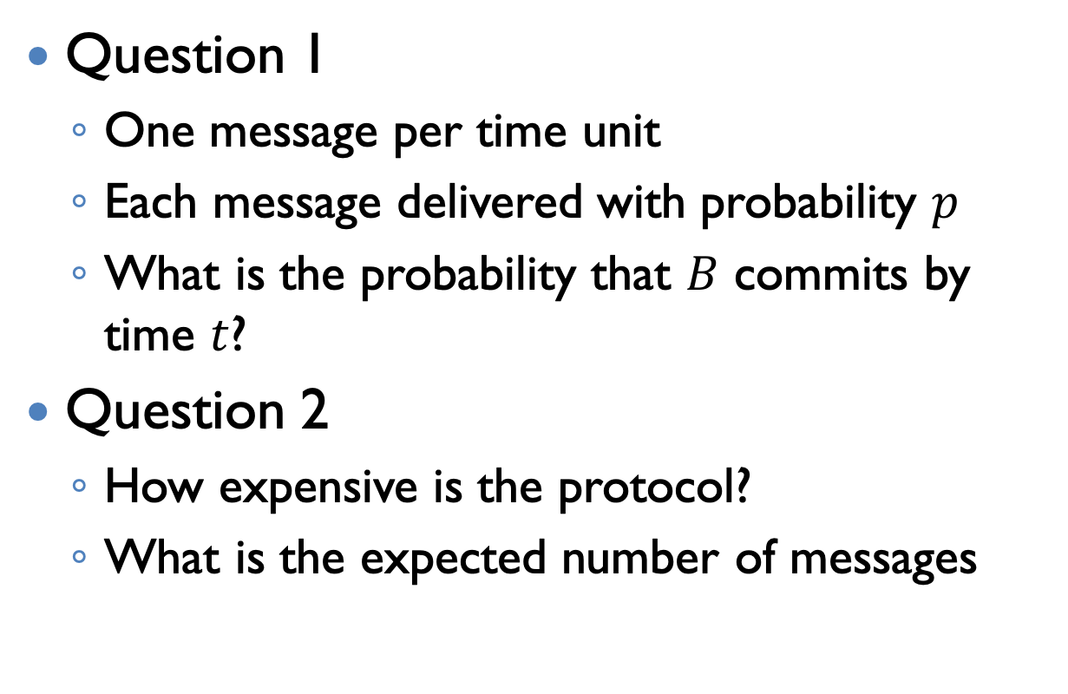
Eventual Commit
Question 1
One message per time unit
Each message delivered with probability $p$
What is the probability that $B$ commits by time $t$?
Question 2
How expensive is the protocol?
What is the expected number of messages

Slide 10
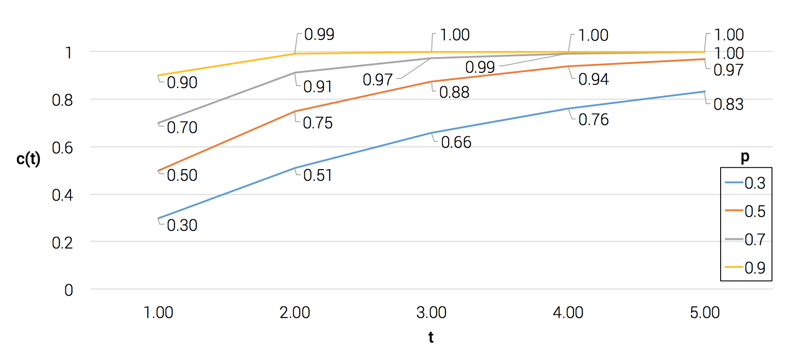
Eventual Commit

Slide 11
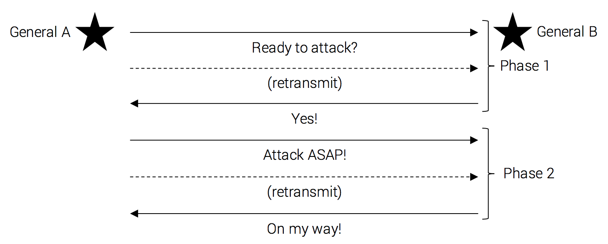
Two-Phase Eventual Commit
Eventually both armies attack:
A attacks in phase 2, keeps resending until receives confirmation from B

Slide 12
Autonomous and heterogeneous components
Notes:
The second challenge is autonomous and heterogeneous components

Slide 13
Example: a nationwide manufacturing company
Each location keeps records of employees working at that location;
R&D facility maintains its own project data;
Manufacturing plants keep engineering data and access data at research facility, and access data at warehouse location;
Headquarters keep region’s marketing and sales and access inventory data at plants and warehouses.

Slide 14
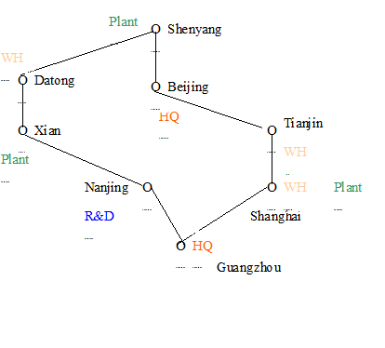
HQ: Headquarter, WH: warehouse

Slide 15
Features
Data are distributed over sites, e.g. employee, inventory
Queries, e.g. ’get employees who are younger than 45’, involve more than one site

Slide 16
Complications
Harder (if not unable) to get statistics for query optimization
Communication Cost
Components may not agree to perform computation
Why?
The Two-Phase protocol
Notes:
Query optimization

Slide 17
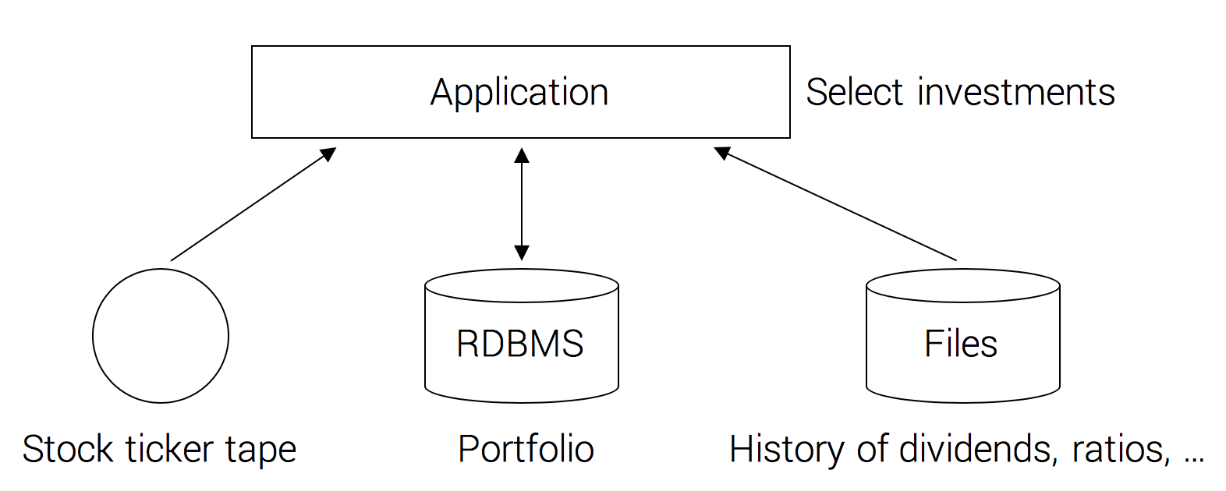
Complications
Autonomy
Heterogeneity of the operating system & the hardware is quite common

Slide 18
Course Scope
We study data management with multiple processors and possible heterogeneity and autonomy, impacting:
Data organization
Query processing
Access structures
Concurrency control
Recovery

Slide 19
Parallel vs. Distributed
More
Similarities
than
Differences

Slide 20
Parallel Databases
Typical system properties
Fast interconnect
Homogeneous software (and even hardware)
Example: Goal of query processing
Typically, we can distribute/partition/sort/etc. data to make DB operations (e.g., joins) fast

Slide 21
Distributed Databases
Typical system properties
Fast interconnect
Homogeneous software (and even hardware)
Example: Goal of query processing
Typically, data distribution is given – we need to find query processing strategy to minimize cost (e.g., communication cost)
Focus of this course

Slide 22
What is a Distributed Database System

Slide 23
计算机大百科全书词条DDB 1/5
分布式数据库由通过网络相互联结、多个不同场地上的局部数据库构成。这些数据库服从于同一个应用需求，它们在业务逻辑上相互关联，由一个全局统一的软件 – 分布式数据库管理系统进行管理。七、八十年代迅速发展的网络技术与数据库技术导致了分布式数据库的诞生。它的典型应用情景是：一个大的组织、单位通常由地理位置分散的各个部门组成。由于业务处理的客观要求，每个部门除了要使用在本地的数据库外，还经常要互相共享其它部门的数据库。分布式数据库为这样的应用提供了最好的支持。

Slide 24
计算机大百科全书词条DDB 2/5
分布式数据库通过分布式数据库管理系统实现对数据的存储、查询等功能。而分布式数据库管理系统为所有用户提供全局统一的数据模型、数据库模式以及查询语言，屏蔽了数据分布、网络连接等特征，具备网络透明、位置透明等特性。因此，对普通用户而言，使用分布式数据库与使用集中式数据库并无多大区别。

Slide 25
计算机大百科全书词条DDB 3/5
数据分布与功能分布是分布式数据库与集中式数据库本质上的不同。从数据分布的角度出发，分布式数据库的设计除了要完成数据库模式设计以外，还必须决定数据的划分与在各个场地的分布方案。以关系数据库为例，数据的划分就有以关系纪录为基础的水平划分，以关系属性为基础的垂直划分，两者相互结合的混合划分，以及诱导划分等多种方法。完成了数据划分以后，分布式数据库的设计工作要决定由数据划分所产生的各个数据片段存储在那个场地上，这种数据分布的选择对分布式数据库系统的性能将产生很大的影响。一个较好的设计会有助于减少查询处理中的网络通讯开销，减少查询的响应时间，加大系统吞吐量。分布式数据库的设计可以采用人工设计与启发式规则、仿真相结合的方法来完成。

Slide 26
计算机大百科全书词条DDB 4/5
分布式数据库管理系统的主要功能包括查询处理、并发控制、事务管理、故障恢复等。对于上述功能，系统必须考虑数据分布的特点，由控制全局的分布式数据库系统以及不同场地上局部数据库管理系统共同完成。因此，它们的处理过程比集中式数据库要复杂得多。例如，在查询处理中，系统要对一个查询进行分解、优化，把它变换成由数据所在地的局部查询组成的查询执行计划。在查询的执行过程中，系统还要使用恰当的策略减少数据在网络上传输的开销。并发控制要使用加锁或时间戳的办法，解决多个用户读写多个场地数据时产生的冲突。在事务处理中，事务的开始、提交、取消要遵循两阶段提交（2 Phase Commit）的协议。在出现局部数据库故障或网络连接的失败时，要执行恢复协议与终结协议等，才能确保数据库的正确性与一致性。

Slide 27
计算机大百科全书词条DDB 5/5
分布式数据库具有局部自治性强、性能好、可用性强、可扩展性好等方面的优势。但系统设计与实现变得复杂，软硬件成本也明显加大。

Slide 28
The marriage of DB and network
DDB
A collection of multiple, logically interrelated database distributed over a computer network
DDBMS
the software that permits the management of the DDBs and makes the distribution transparent to the users
DDBs are neither of
Multi-processor systems
Server based systems

Slide 29
1.4 Promises of Distributed DBMSs

Slide 30
1.4.1 Transparent Management of Distributed and Replicated Data
X transparency means the existence of X is not known to users.
Example
Consider an engineering firm that has offices in Boston, Waterloo, Paris, and San Francisco.
They run projects at each of these sites and would like to maintain a database of their employees, the projects, and other related data

Slide 31

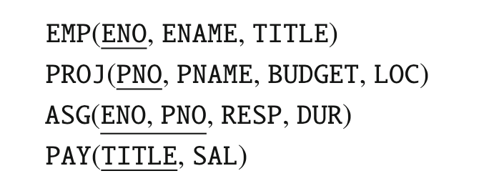
1.4.1 Transparent Management of Distributed and Replicated Data

Slide 32
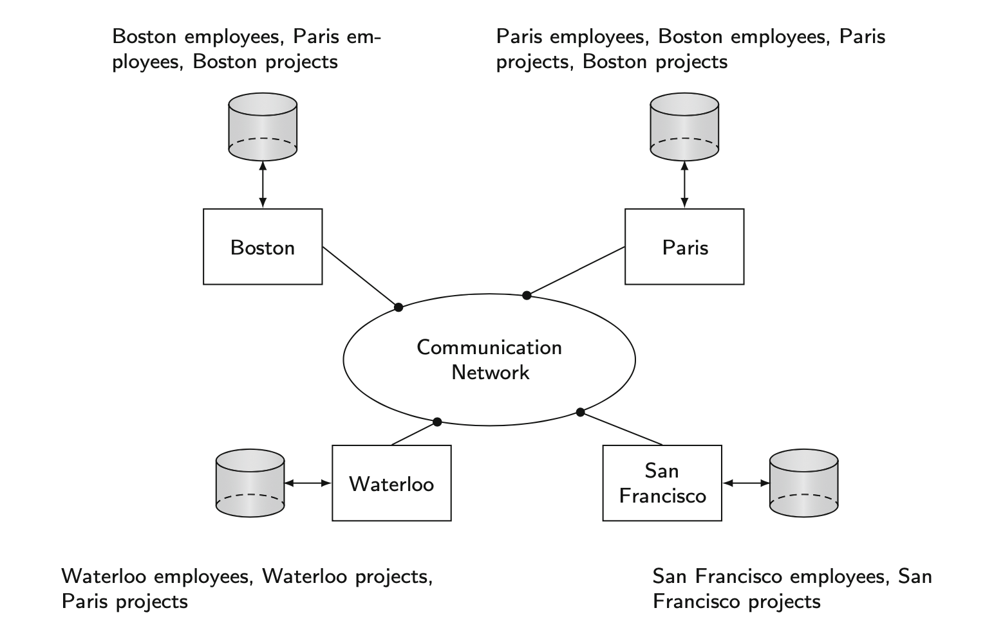
1.4.1 Transparent Management of Distributed and Replicated Data
Notes:
given the distributed nature of this firm’s business, it is preferable, under these circumstances, to localize data such that data about the employees in Waterloo office is stored in Waterloo, those in the Boston office is stored in Boston, and so forth. The same applies to the project and salary information. Thus, what we are engaged in is a process where we partition each of the relations and store each partition at a different site.
Furthermore, it may be preferable to duplicate some of this data at other sites for performance and reliability reasons. The result is a distributed database which is fragmented and replicated
Fully transparent access means that the users can still pose the query as specified above, without paying any attention to the fragmentation, location, or replication of data, and let the system worry about resolving these issues. For a system to adequately deal with this type of query over a distributed, fragmented, and replicated database, it needs to be able to deal with a number of different types of transparencies as discussed below.

Slide 33
Data independence
Same as in centralized DBMS:
Logical data independence
applications are immune to changes in schema
Physical independence
applications are immune to changes in physical storage, and data distribution

Slide 34
Network transparency
Users should be protected from the details of the communication network that connects the sites
Location transparency
The command used to perform a task is independent of both the location of the data and the system on which an operation is carried out
Naming transparency
A unique name is provided for each object in the database

Slide 35
Replication transparency
For performance, reliability, and availability reasons, it is usually desirable to be able to distribute data in a replicated fashion across the machines on a network.
From a user’s perspective it is preferable not to be involved with handling copies and having to specify the fact that a certain action can and/or should be taken on multiple copies.

Slide 36
1.4.2 Reliability Through Distributed Transactions
An engineering firm wants to update the salaries of all the employees by 10%
Obstacles
What if a system failure occurs half-way through the execution of this program
What if some other user runs a query calculating the average salaries while the update action is going on
Solution
Distributed transactions and application protocols

Slide 37
1.4.3 Improved Performance
Data stored in close proximity to its points of use - data locality
Contention for CPU and I/O services
Remote access delays involved in wide area networks
Most distributed DBMSs are designed to gain maximum benefit from data locality

Slide 38
1.4.4 Scalability
In a distributed environment, it is much easier to accommodate increasing database sizes and bigger workloads
System expansion can usually be handled by adding processing and storage power to the network
Scale-up vs. Scale-out

Slide 39
1.5 Design Issues
Distributed DB design
Distributed query processing
Distributed directory management
Distributed concurrency control
Distributed deadlock management
Reliability of DDBMS
Replication

Slide 40
Directory Management
Distributed DB Design
Query Processing
Reliability
Concurrency Control
Deadlock Management

Slide 41
1.6 Distributed DBMS Architecture

Slide 42
1.6.1 Architectural Models for Distributed DBMSs

Slide 43
Architecture Models for Distributed DDBMS
Classification of multiple DBs shared by multiple DBMSs
Criteria for classification
Distribution
0: centralized, 1: C/S, 2: P2P
Autonomy
0: tight integration, 1: semi-autonomous, 2: total isolation
Heterogeneity
0: homogeneous, 1: heterogeneous

Slide 44
Autonomy: the distribution of control
(0) tightly integrated
a single image of the entire DB to and user and a single DBMS
(1) semi-autonomous
all DBMSs can operated independently but have to join a federation to make local data sharable
(2) total isolation
each DBMS is stand-alone and enjoy 100% freedom of autonomy

Slide 45
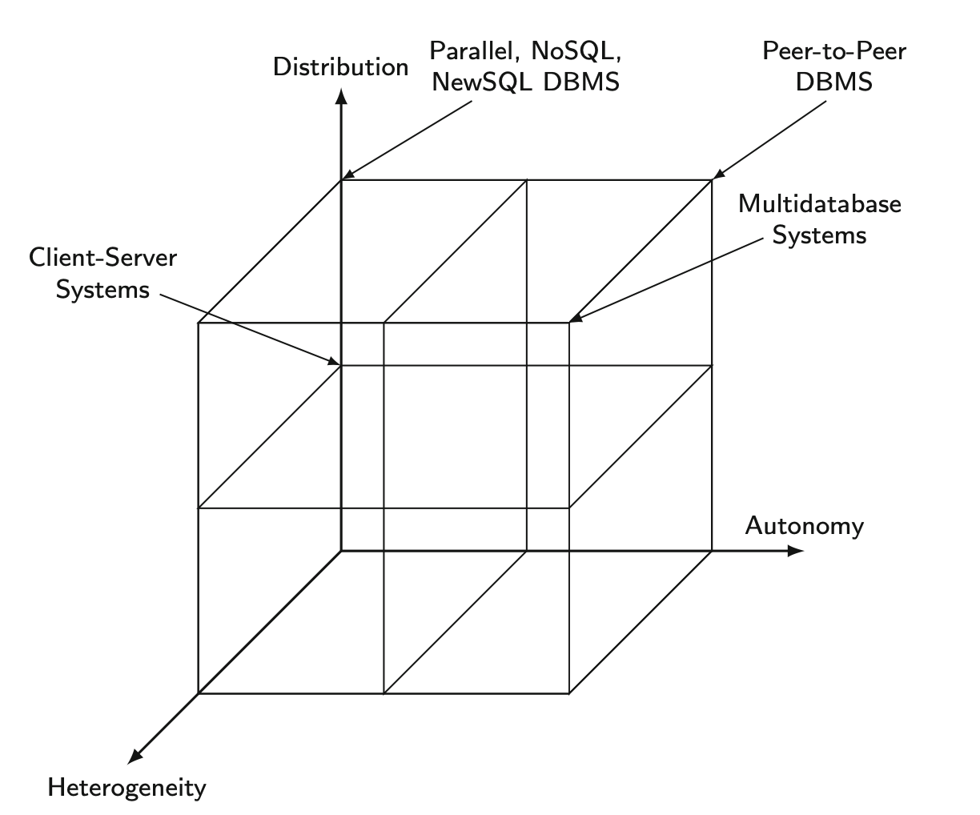

Slide 46
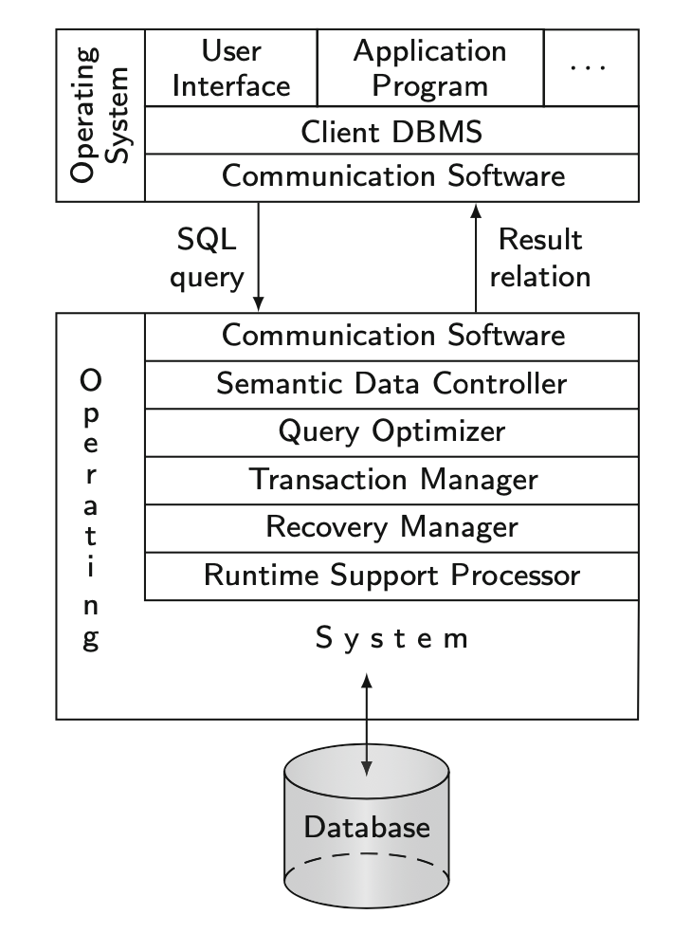
1.6.2 Client/Server Systems
Distinguish the functionality that needs to be provided on a server machine from those that need to be provided on a client.

Slide 47
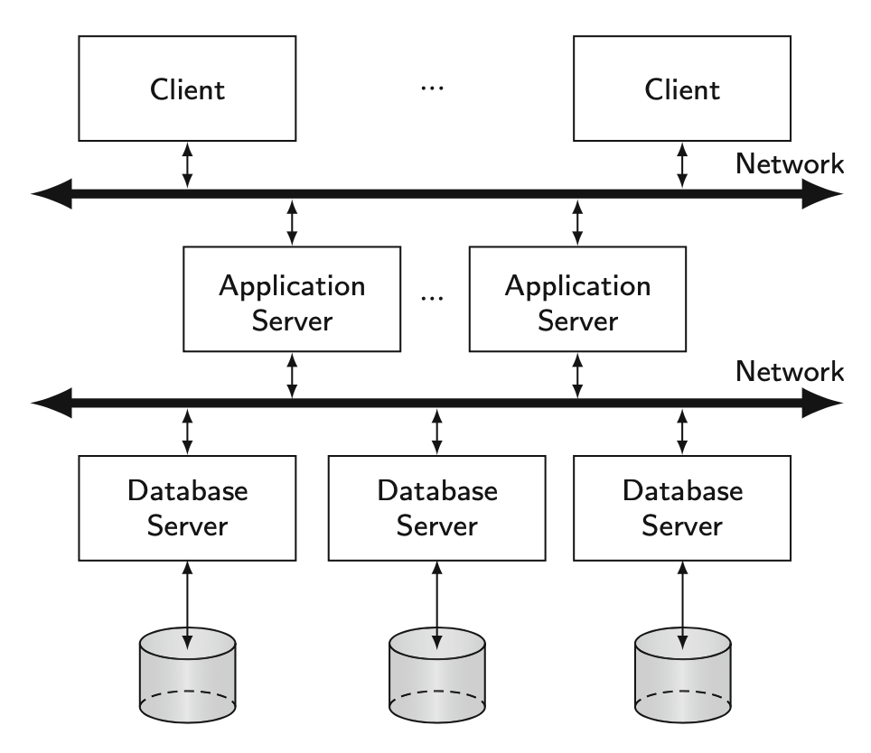
1.6.2 Client/Server Systems

Slide 48
1.6.3 Peer-to-Peer Systems
The early works on distributed DBMSs all focused on peer-to-peer architectures
No differentiation between the functionality of each site in the system.
Modern peer-to-peer systems have two important differences
The massive distribution
The inherent heterogeneity of every aspect of the sites and their autonomy

Slide 49
1.6.3 Peer-to-Peer Systems
An architecture based on data organization

Slide 50
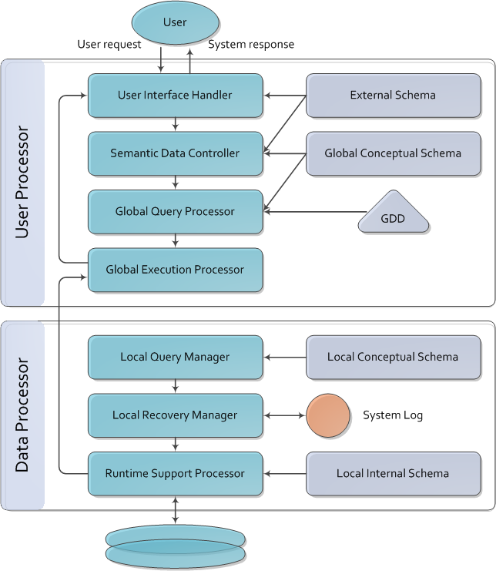
Components of a Distributed DBMS
Semantic data controller
Integrity constraint and authorization
Global Query Processor
decompose and optimize global query
Global Execution Monitor
Distributed transaction manager
Runtime Support Processor
physical access to database

Slide 51
1.6.4 Multidatabase Systems
Individual DBMSs are fully autonomous and have no concept of cooperation
Difference between MDB and DDB
Global conceptual schema in DDB defines the conceptual view of the entire database
Global conceptual schema in MDB represents only the collection of some of the local databases that each local DBMS wants to share.

Slide 52
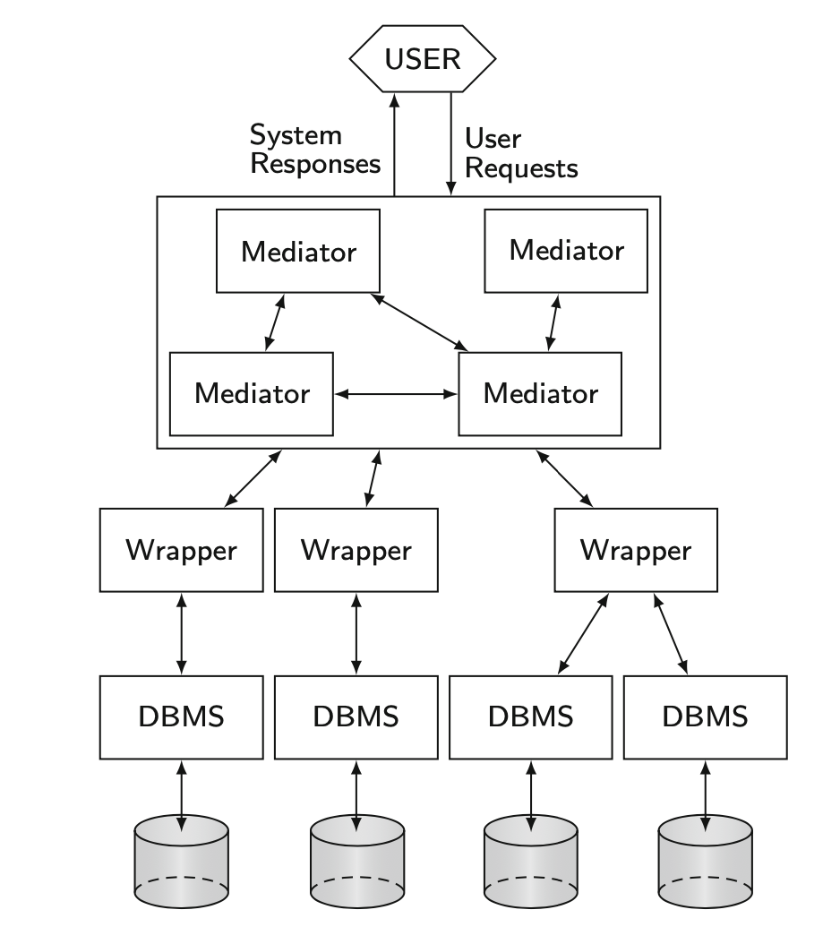
1.6.4 Multidatabase Systems

Slide 53
1.6.5 Cloud Computing

Slide 54

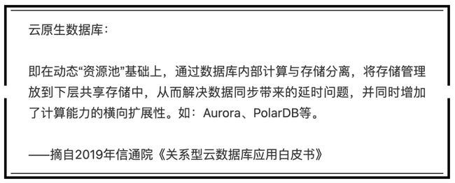
1.4.3 Improved Performance
思考
“存算一体” vs. “存算分离”？

Slide 55
Note
Relational data model is used throughout this course

