Slide 1
Distributed Database Systems
Autumn, 2018
Optimization of Distributed Queries
(Part 3/3)

Slide 2
Join Ordering in Fragment Query
Join ordering is
important in centralized DB, and is
more important in distributed DB.

Slide 3
Join Ordering
Understand the difficulty of join ordering without using semi-join.
Assumptions necessary to state the main issues
Fragments and relations are indistinguishable
Local processing cost is omitted;
Relations are transferred in one-set-at-a-time mode; and
Cost to transfer data to produce the final result at the result site is omitted

Slide 4
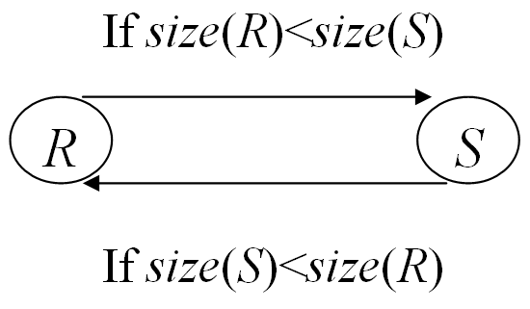
Join Ordering
Single join
R⋈S
Transfer the smaller size

Slide 5
Join Ordering
Join of multi-relations
The size of intermediate relations must be considered.
The number of possible ways to process a query grows rapidly with the number of relations involved.
Example (next page)

Slide 6
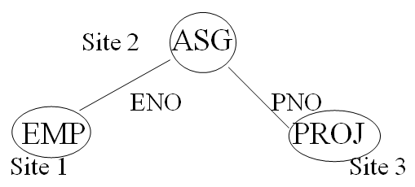
Join Ordering
Strategies
Choose two relations to join and send the result to the 3rd site – 6 ways.
Choose two relations and send them to the 3rd site to join – 3 ways.
…

Slide 7
Join Ordering
Shortcoming of the method
Transfer the entire relation which may contain some useless tuples.

Slide 8
Semi-join Based Algorithm
Semi-join reduces the size of operand relation to be transferred.
Semi-join is beneficial if the cost to produce and send it to the other site is less than sending the whole relation.

Slide 9
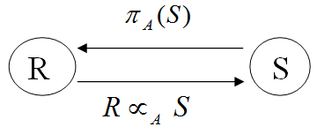
Semi-join Based Algorithm
Four steps in computing R⋈S
The semi-join method is beneficial if
size(π_{A}(S))+size(R⋉_{A}S)<size(R)
The join method is better if size(R⋉_{A}S) is close to size(R)

Slide 10
Semi-join Based Algorithm
In general, semi-join can be used to reduce the size of operand relations in multiple join queries.
Example
The join of EMP, ASG, and PROJ
(next page)

Slide 11
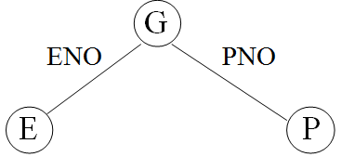
Semi-join Based Algorithm
Semi-join can be used more than once to reduce operand relations
E⋉(G⋉P) -- to reduce E
P⋉(G⋉E) -- to reduce P

Slide 12
Semi-join Based Algorithm
The sequence of semi-join is called semi-join program. For a given relation, the number of semi-join programs is exponential in the number of relations. But only one is optimal, called full reducer.
It’s difficult to find the full reducer. Most systems just use single semi-join to reduce the size of operand relations.

Slide 13
Distributed QOA
The Algorithms vary from system to system.
Four distributed query optimization algorithms:
Distributed INGRES
System R*
SDD-1
AHY

Slide 14
Distributed QOA
Features Algo | Timing | Objective Function | Optim. Factors | Networks | Semi- joins | Sta-tistics | Frag-ments
Distri. INGRES | Dynamic | Response Time, Total cost | Msg. Size, Process-ing cost | General Or broadcast | No | 1 | Hori-zontal
R* | Static | Total Cost | # of msg Msg size I/O, &CPU | General or local | No | 1 2 | No
SDD-1 | Static | Total Cost | Msg. Size | General | Yes | 1,3 4,5 | No
AHY | Static | Response time,total cost | # of msg &Msg. Size | General | Yes | 1,3 5 | No

Slide 15
Distributed INGRES QOA
Derived from centralized INGRES, and consists of dynamically optimizing the processing strategy of a given query.
Objective
To optimize both communication cost and response time by controlling the weight of the two conflicting objectives.

Slide 16
Distributed INGRES QOA
Input of the optimization:
Horizontal fragmentation
Network topology
General or broadcast. In broadcast network, fragments are replicated to maximize the degree of parallelism.

Slide 17
Distributed INGRES QOA
The optimization algorithm for RETRIEVE statement
Algorithm 9.3 D_INGRES_QOA

Slide 18
Distributed INGRES QOA
Explanation to the algorithm
Step 1: process all one variable queries.
Step 2: reduce the query, i.e. isolate all irreducible sub-queries and one-variable queries by detachment. OVQs will be ignored since they have been processed in step 1.

Slide 19
Distributed INGRES QOA
Explanation to the algorithm
Step 3.1 and 3.2: select the best strategy to process the query MVQ’ (to be discussed) described by a list of pair (F, S) meaning to transfer fragment F to site S.
Step 3.3: transfer all fragments to their processing sites.
Step 3.4: execute MVQ’.

Slide 20
Distributed INGRES QOA
Optimization techniques in 3.1 and 3.2
At this stage, the algorithm has produced sub-queries with several components and their dependency order (similar to algebra tree).
Step 3.1 chooses the next one having no predecessor and involving the smaller fragment. (see the figure on the next page)

Slide 21
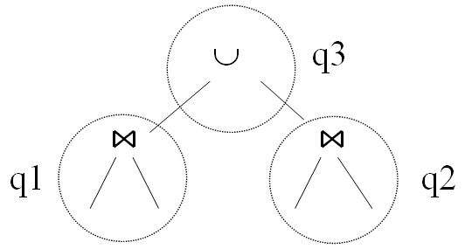
Distributed INGRES QOA
Optimization techniques in 3.1 and 3.2
Choose q1 or q2 whichever has the smaller fragments

Slide 22
Distributed INGRES QOA
Optimization techniques in 3.1 and 3.2
Step 3.2 determines how to execute the subquery by moving fragments at sites to a processing site, e.g.
Site 1: EMP1, ASG
Site 2: EMP2, PROJ

Slide 23
Distributed INGRES QOA
Optimization techniques in 3.1 and 3.2
E⋈G⋈J could be executed by
Moving EMP1, ASG to site 2, or
Moving EMP1∞ASG, and ASG to site 2, and
etc……

Slide 24
Distributed INGRES QOA
How to select the best?
Use fragment-and-replicate method for an n-variable query
Rp: a relation which may be partitioned into k equalized fragments.
n-1 relations are moved to the k sites of Rp and duplicated for parallel processing at k sites.

Slide 25
Distributed INGRES QOA
The selection of Rp and k processing sites depends on
network topology, and
objective function
to minimize total communication cost or response time, the two conflicting factors.

Slide 26
Distributed INGRES QOA
Consider rule for minimizing communication cost, let
be n relations (variables)
be the fragment of R_{i} stored at site j
be the communication cost of transferring #bytes to k sites, 1 ≤ k ≤ m, where m is the number of sites involved in the query.

Slide 27
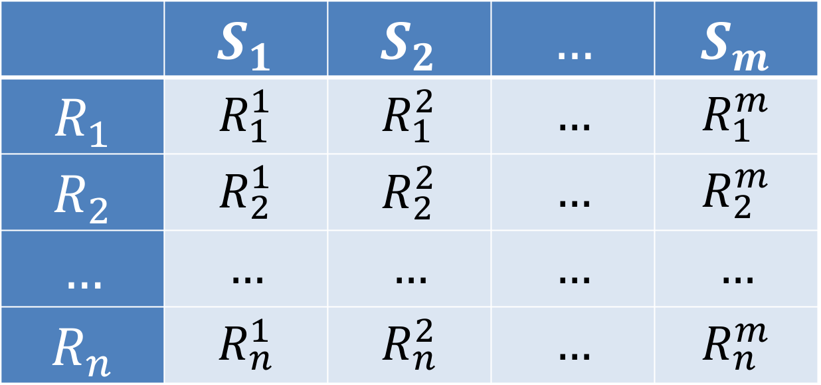
Distributed INGRES QOA
 | $$S_{1}$$ | $$S_{2}$$ | $$…$$ | $$S_{m}$$
$$R_{1}$$ | $$R_{1}^{1}$$ | $$R_{1}^{2}$$ | $$…$$ | $$R_{1}^{m}$$
$$R_{2}$$ | $$R_{2}^{1}$$ | $$R_{2}^{2}$$ | $$…$$ | $$R_{2}^{m}$$
$$…$$ | $$…$$ | $$…$$ | $$…$$ | $$…$$
$$R_{n}$$ | $$R_{n}^{1}$$ | $$R_{n}^{2}$$ | $$…$$ | $$R_{n}^{m}$$

Slide 28
Distributed INGRES QOA
In a broadcasting network
Featured by CC_{k}(#bytes)=CC₁(#bytes)
The rule for selecting Rp and k:
If Then
the processing site is j with the largest amount of data
Else Rp is the largest relation and sites of Rp are the processing sites

Slide 29
S1 S2 Sm
R1
R2
Rn

Slide 30
Distributed INGRES QOA
In a point-to-point network
Featured by CC_{k}(#bytes)=k*CC₁(#bytes)
Rp: Rp is the largest Ri.
k: (next page)

Slide 31
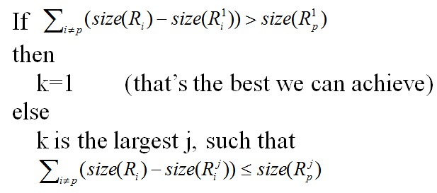
Distributed INGRES QOA
The choice of k (the number of processing sites)
Assuming sites are arranged by decreasing order of amount of data for the query.

Slide 32
S1 S2 Sm
R1
R2
Rn

Slide 33
Distributed INGRES QOA
The choice of k (the number of processing sites)
A site is selected as a processing site only if the amount of data it must receive is smaller than it would have to send if it were not a processing site.

Slide 34
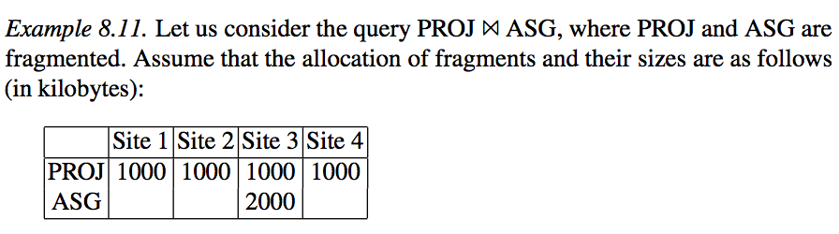
Distributed INGRES QOA
Example
P2P Network
Sending each PROJi to site 3 → 3000 bytes
Broadcasting Network
Broadcasting ASG → 2000 bytes

Slide 35
R* Algorithm
The extension of System R
Compilation method
Exhaustive search
No replication
No fragmentation
The objective function of R*
QOA General cost function including both communication cost and local processing cost.

Slide 36
R* Algorithm
Query compilation is distributed and coordinated by the master site, where the query is initiated.
Master site makes all inter-site decisions, e.g. selecting the execution site, data transferring method, and etc.
Apprentice sites make the remaining local decisions.

Slide 37
R* Algorithm
Algorithm 9.4 D*_QOA

Slide 38
R* Algorithm
R*-QOA must select
join algorithm(nested loop, or merge join)
the access path for each relation
the joining order
sites of join result, and
method of transferring data
based on
statistics
access path information, and
the estimation of intermediate relations

Slide 39
R* Algorithm
Data transfer method for R⋈_{A}S (R: external, S: internal)
Ship whole
The entire relation is shipped to the join site and store temporarily before joining. If the join algorithm is merge join, then the joining site can process incoming tuples as they arrive and avoid saving the relation.
Large data transfer but fewer messages used if relations are small, or join selectivity is large.

Slide 40
R* Algorithm
Data transfer method for R⋈_{A}S (R: external, S: internal)
Fetch as needed
Sequentially scan the external relation and send the join value of each tuple to the site of internal relation, which selects the internal tuples matching the value and send them back to the site of external relation (semijoin).
Used if relations are large and selectivity is small.

Slide 41
R* Algorithm
Strategies and cost calculations
LC | Local processing cost
CC | Communication cost
 | Average tuples of S that match a tuple of R

Slide 42
R* Algorithm
Strategy 1
Ship-whole of R(external) and join at S
No storage cost for storing R or S, as join can be processed when R’s tuples arrive at S

Slide 43
R* Algorithm
Strategy 2
Ship-whole of S (internal) and nested-loop join at R (external)

Slide 44
R* Algorithm
Strategy 3
Fetch as needed of S for R

Slide 45
R* Algorithm
Strategy 4
Move both R and S to a 3rd site and compute join there. S is moved and stored in a temporary relation T. R is moved and its tuples are joined as they arrive.

Slide 46
R* Algorithm
Strategy 4

Slide 47
R* Algorithm
Example: PROJ⋈_{PNO} ASG
PROJ and ASG are stored at two different sites, ASG is indexed on PNO.
Possible strategies:
Ship whole PROJ to the site of ASG.
Ship whole ASG to the site of PROJ.
Fetch ASG as needed for each tuple of PROJ.
Move PROJ and ASG to the 3rd site.

Slide 48
R* Algorithm
Analysis
Strategy (4) has the highest CC.
If PROJ is much larger than ASG, strategy 2 is likely the best compared with (1) and (3).
Otherwise, if PROJ is larger and only a few tuples of ASG match, then strategy (3) probably is the best.
If PROJ is small or many tuples of G match, then strategy (1) may be the best.

Slide 49
Conclusion
Distributed query processing is concerned with network bandwidth;
Statistics is important input to optimization;
Semi-join is useful for distributed query processing;
Two optimization algorithms illustrated by distributed INGRES and R*.

