Slide 1
Kick-off展示
要求，流程，框架与代码
李晓桐

Slide 2
Requirement
Build an experimental DDBMS
Support of the creation of distributed database including
the creation of a named database, a table and data segmentation methods of
Horizontal fragmentation，compulsory
Vertical fragmentation, compulsory
Hybrid fragmentation, optional
Derived fragmentation, optional

Slide 3
Requirement
Loading of data from prepared files into database according to database schema definition, fragmentation and allocation scheme.
Support the SQL query select…from …where…. statement with minimal features.

Slide 4
User commands
createdb for the creation of a database
dropdb fro the deletion of a database
createTable for creating a relational table including its fragmentation strategy such as horizontal, vertical etc.
dropTable for the deletion of a table from the database
select … from … where… for database query
insert for adding a record to a table
delete for deletion of a record from a table

Slide 5
System Environment
Three computers (sites) connected by a network. The architecture of the system must be P2P.
The local DBMS can be any commercial product or open source software.
The communication mechanism between sites can be socket, RPC, or others.
The programming language for the DDBMS of the project is open

Slide 6
Distributed Query Processing
The DDBMS of the project shall have the components for Query decomposition and localization, and Query optimization, such as
The optimization on initial general query tree
Query tree reduction using fragmentation information
Network traffic optimization
Optimization effect must be presented on the screen

Slide 7
Report and Documentation
Midterm report – Nov. 30
Final report due before the on-site evaluation of the DDBM. It shall include the details of the design and implementation of the DDBMS

Slide 8
Project Evaluation
The DDBMS implemented by every team shall be evaluated by a benchmark of the course.

Slide 9
What you should do now - make design decision and prepare your report

Slide 10
Read related materials and download then if necessary. Play with the demo systems.
Prepare your DDB project environment, and allocate project works and roles of members for your team.
Discuss your DDB user interface, two options:
Linear SQL command interface, or
GUI interface

Slide 11
Discuss the fragmentation strategy and associated commands or operations to be supported by your system.
Discuss data dictionary and other important data structures such as internal representation for queries etc.
P2P Architecture design
DDBMS software components design
Components and their functions and interactions
Distribution of components
Communication protocol , choose of its supporting package, protocol commands etc.

Slide 12
Report Preparation
Give a time schedule for the project
Summarize your above works and prepare slides for report
Make the slides and system ready to be presented at class!

Slide 13
流程
各组3个站点，后续发账号+密码
站点3个月后还学校，做好备份+熟悉github使用
功能角度思考流程
创建表格（schema层面）
存储表格（按照划分方法划分数据并存储到对应站点）
选择操作（select语句的实现）
更改表格（增删改）
上述功能离不开基础设施ETCD,gRPC以及mysql的使用
Notes:
什么程度的github使用？不是只会add和push，后期团队赶进度的时候你还需要能从github的返回信息上了解版本信息的那种会，版本维护很关键

Slide 14
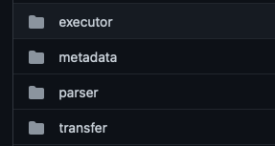
框架
代码分成4大块
用户接口: parser
ETCD功能实现: metadata
gRPC功能实现: transfer
站点执行: executor
定好框架写文档
沟通交流的点：两个模块合作的地方
举例说明：select语句的实现

Slide 15
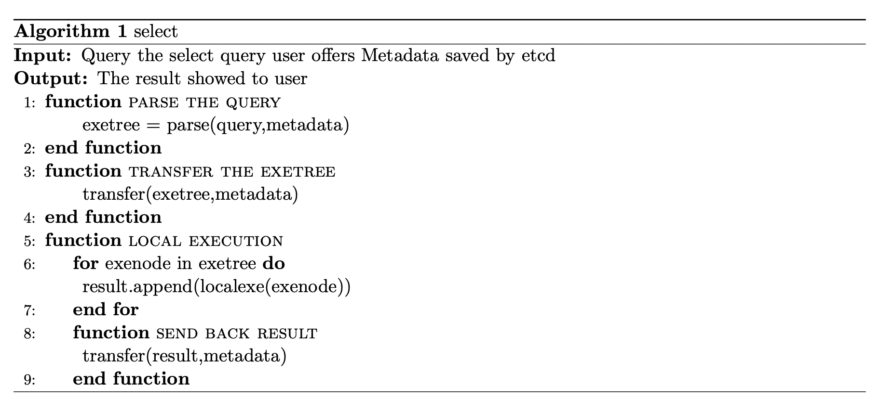
select语句的实现

Slide 16
代码
函数命名方式，注释等细节
为编译做准备，确立引用关系（分层）
定义抽象概念的物理存储
定义函数操作数据

Slide 17
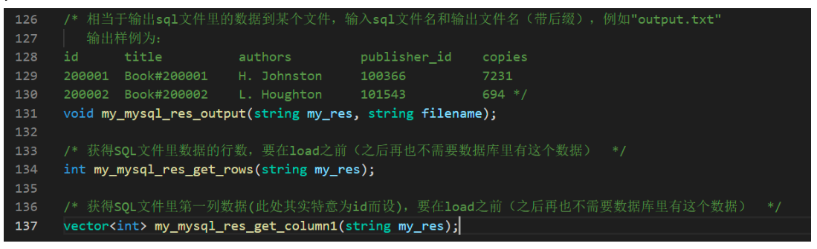
代码
函数命名方式，注释等细节
为编译做准备，确立引用关系（分层）
定义抽象概念的物理存储
定义函数操作数据

Slide 18
代码
8个主要功能构成
1个主要函数
5个功能函数文件
1个工具函数文件
函数命名方式，注释等细节
为编译做准备，确立引用关系（分层）
定义抽象概念的物理存储
定义函数操作数据

Slide 19
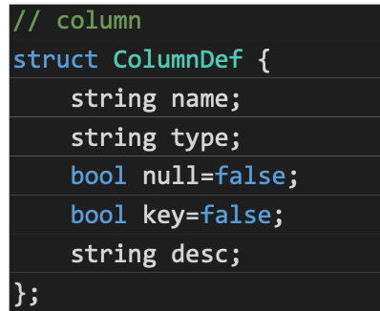
代码
函数命名方式，注释等细节
为编译做准备，确立引用关系（分层）
定义抽象概念的物理存储
定义函数操作数据

Slide 20
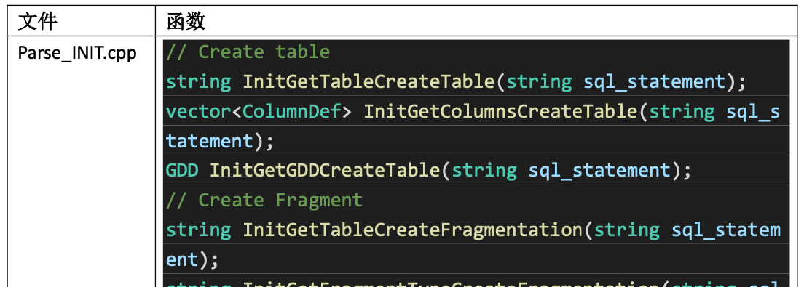
代码
函数命名方式，注释等细节
为编译做准备，确立引用关系（分层）
定义抽象概念的物理存储
定义函数操作数据

Slide 21
经验之谈
环境搭建是最难的部分，多看官方文档，少看csdn上的偏方
会遇到许多奇奇怪怪的问题，心平气和
写注释很关键！！！

Slide 22
Take home message
ddl: 11/30 report: ppt+system

