Slide 1
etcd tutorial
安装、配置、使用与原理
李晓桐

Slide 2
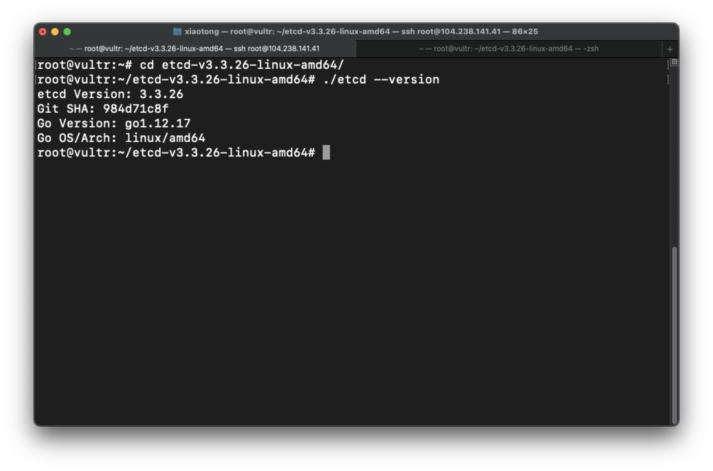
安装：环境准备
账号 | 密码
45.76.175.78 | Y1%bV+_vC4+2$C#6
104.238.141.41 | }1xEQ!X!cAnr]?yY
45.32.173.175 | F(f7Nt{Hv-CLU@,M
3台机器
官网上列举各种版本的etcd安装包
下载后解压即可使用
运行./etcd --version查看是否成功安装etcd
开启防火墙

Slide 3
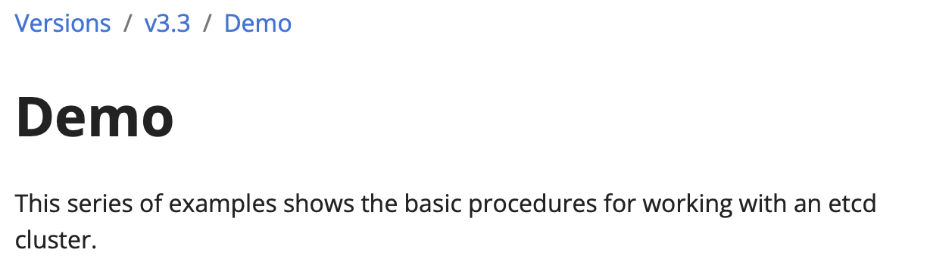
配置：所有节点的配置
参考etcd官网的配置
# for all machines
TOKEN=token-01
CLUSTER_STATE=new
NAME_1=machine-1
NAME_2=machine-2
NAME_3=machine-3
HOST_1=45.76.175.78
HOST_2=104.238.141.41
HOST_3=45.32.173.175
CLUSTER=${NAME_1}=http://${HOST_1}:2380,${NAME_2}=http://${HOST_2}:2380,${NAME_3}=http://${HOST_3}:2380

Slide 4
配置：1号站点的配置
# For machine 1 启动第一个站点上的服务
THIS_NAME=${NAME_1}
THIS_IP=${HOST_1}
./etcd --data-dir=data.etcd --name ${THIS_NAME} \
--initial-advertise-peer-urls http://${THIS_IP}:2380 --listen-peer-urls http://${THIS_IP}:2380 \
--advertise-client-urls http://${THIS_IP}:2379 --listen-client-urls http://${THIS_IP}:2379 \
--initial-cluster ${CLUSTER} \
--initial-cluster-state ${CLUSTER_STATE} --initial-cluster-token ${TOKEN}

Slide 5
配置：2号站点的配置
# For machine 2启动第二个站点上的服务
THIS_NAME=${NAME_2}
THIS_IP=${HOST_2}
./etcd --data-dir=data.etcd --name ${THIS_NAME} \
--initial-advertise-peer-urls http://${THIS_IP}:2380 --listen-peer-urls http://${THIS_IP}:2380 \
--advertise-client-urls http://${THIS_IP}:2379 --listen-client-urls http://${THIS_IP}:2379 \
--initial-cluster ${CLUSTER} \
--initial-cluster-state ${CLUSTER_STATE} --initial-cluster-token ${TOKEN}

Slide 6
配置：3号站点的配置
# For machine 3启动第三个站点上的服务
THIS_NAME=${NAME_3}
THIS_IP=${HOST_3}
./etcd --data-dir=data.etcd --name ${THIS_NAME} \
--initial-advertise-peer-urls http://${THIS_IP}:2380 --listen-peer-urls http://${THIS_IP}:2380 \
--advertise-client-urls http://${THIS_IP}:2379 --listen-client-urls http://${THIS_IP}:2379 \
--initial-cluster ${CLUSTER} \
--initial-cluster-state ${CLUSTER_STATE} --initial-cluster-token ${TOKEN}

Slide 7
配置：查看集群是否启动正常
export ETCDCTL_API=3
HOST_1=45.76.175.78
HOST_2=104.238.141.41
HOST_3=45.32.173.175
ENDPOINTS=$HOST_1:2379,$HOST_2:2379,$HOST_3:2379
./etcdctl --endpoints=$ENDPOINTS member list

Slide 8
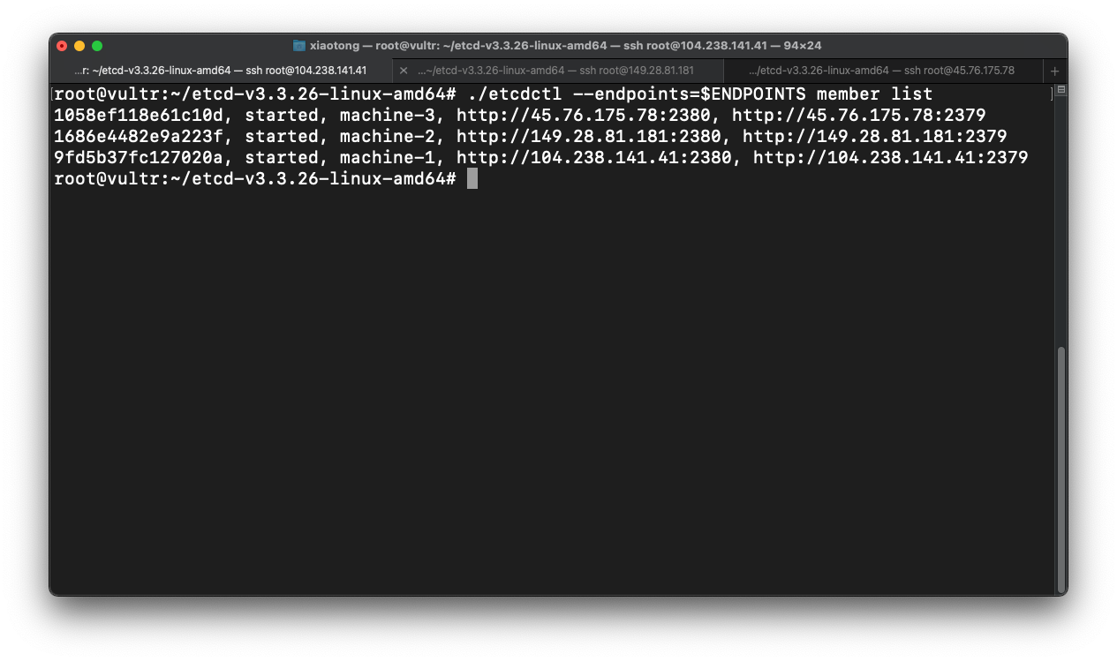
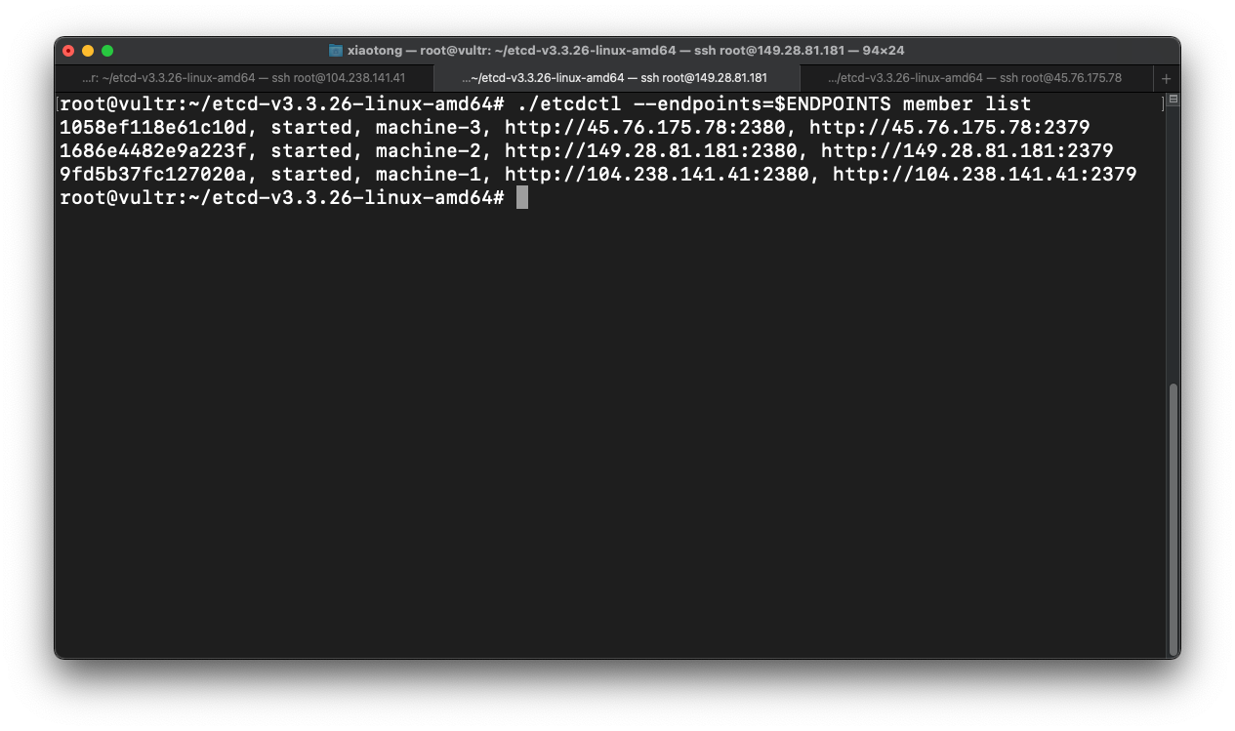
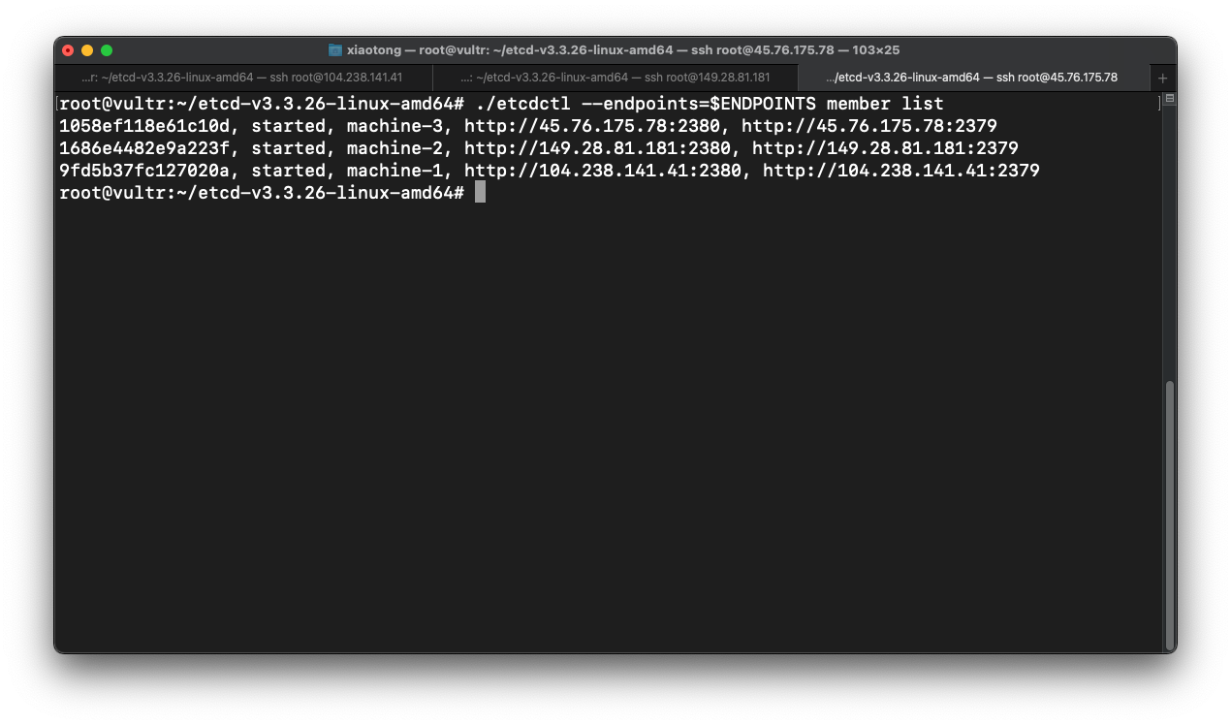
配置：查看集群是否启动正常

Slide 9

使用：put+get
./etcdctl --endpoints=$ENDPOINTS put greeting hello
./etcdctl --endpoints=$ENDPOINTS get greeting

Slide 10
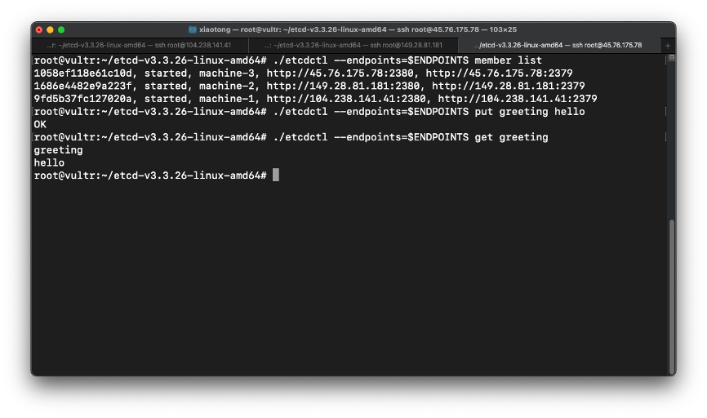
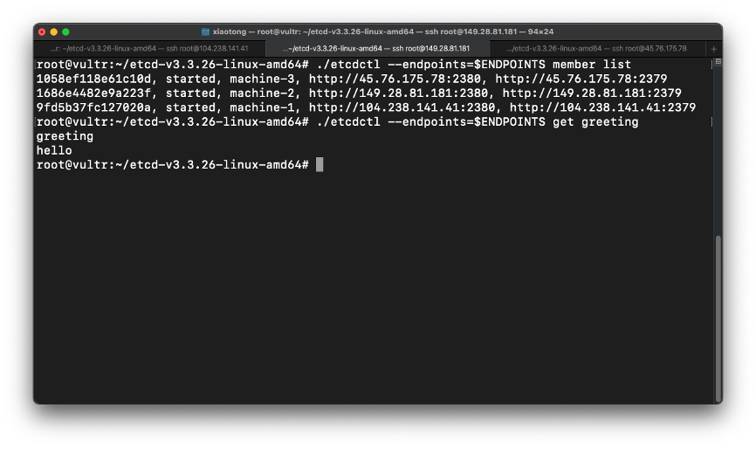
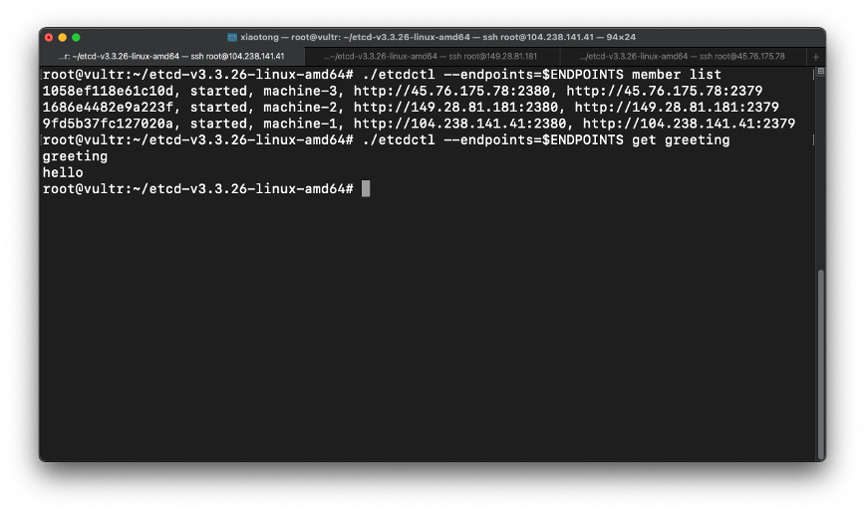
使用：put+get

Slide 11
使用：更多功能
功能 | 解释
Get by prefix | 通过前缀查找key对应的value
Delete | 删除一个key
Transactional write | 将一组请求包装在一次事务里
Lease | 使用TTL写
Watch | 查看某一key是否改变value
Distributed lock
Snapshot | 将当前的key-value的快照存入数据库
Elections | 选举集群中的leader
Cluster status | 查看集群状态
Migrate | 从v2版本转换至v3版本
Member | 对于集群中成员的操作，包括add, removed等
Auth | 用户权限设置

Slide 12
原理
动画演示raft协议
分布式系统的一致性
leader选举
Log Replication基于日志的复制
Raft的论文

Slide 13
参考
安装etcd
etcd官方文档demo篇
教你如何开启/关闭ubuntu防火墙
Visualizations Raft: Understandable Distributed Consencus

Slide 14
谢谢聆听☀️

