Slide 1
Distributed Database Systems
Chapter 11
Distributed Concurrency Control

Slide 2
Concurrency control ensures the consistency and reliability properties of transactions.

Slide 3
11.1 Serializability Theory
The most widely accepted correctness criterion for concurrency control algorithms.
A schedule S (also called history) is defined over a set of transactions
T = {T₁, T₂, …,T_{n}}
and specifies order of execution of these transactions’ operations.

Slide 4
11.1 Serializability Theory
Two operations
O_{ij}(x) and O_{kl}(x)
accessing the same data item x are in conflict if one of them is a write.
Conflicts are divided into read-write and write-write types.

Slide 5
11.1 Serializability Theory
Two transactions are in conflict if
an operation of one transaction is in conflict with an operation of the other by above definition.

Slide 6
11.1 Serializability Theory
A complete schedule defined over a set of transactions T = {T₁, T₂, …,T_{n}} is a partial order
where
1.
2.
3.
For any two conflicting operations
and
in ∑_{T} , either
or

Slide 7
11.1 Serializability Theory
The last condition defines the execution order among conflicting operations.
Example:
Find a complete schedule for two transactions T1 and T2
(see next pages)

Slide 8
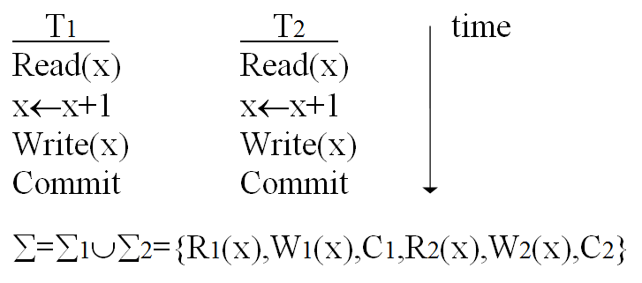
11.1 Serializability Theory

Slide 9
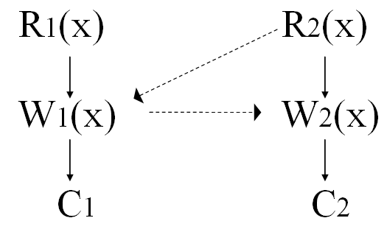
11.1 Serializability Theory
DAG representation of one possible complete schedule:
Note the dashed lines are added to make the schedule complete. The complete schedule can be simplified by
{R1(x),R2(x),W1(x),C1,W2(x),C2}
that specifies all operations of T1 and T2 and their relative orders.

Slide 10
11.1 Serializability Theory
A schedule is a prefix of a complete schedule. A prefix of a partial order P = {∑, } is a partial order P’ = {∑’, } where
1.
2.
3.
The last condition requires that for any element in ∑’, all its predecessors in ∑ have to be in ∑’.

Slide 11
11.1 Serializability Theory
Prefix is used to deal with
conflicting operations only, or
incomplete schedule caused by failures

Slide 12
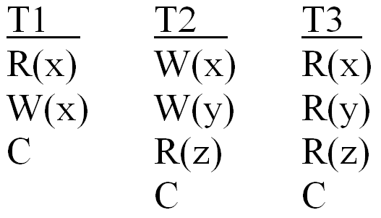
Example
Three transactions

Slide 13
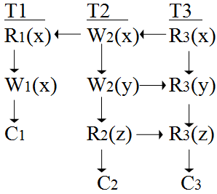
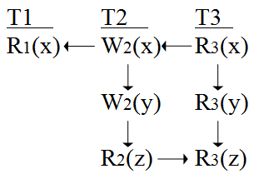
Example
A complete schedule
A prefix of this complete schedule

Slide 14
11.1 Serializability Theory
Serial schedule: to complete all operations of a transaction before starting any new transactions.
Conflict-equivalent schedules
Two schedules S1 and S2 defined over same set of transactions are equivalent if for any pair of conflicting operations
and
, i ≠k, whenever
then

Slide 15
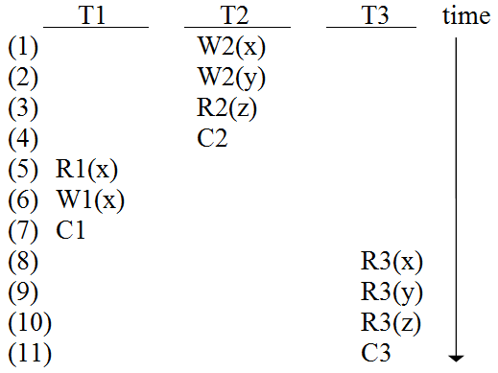
11.1 Serializability Theory
A serial schedule for the three transactions on previous page:
S = {W2(x),W2(y),R2(z),C2,R1(x),W1(x),C1,R3(x),R3(y),R3(z),C3}

Slide 16
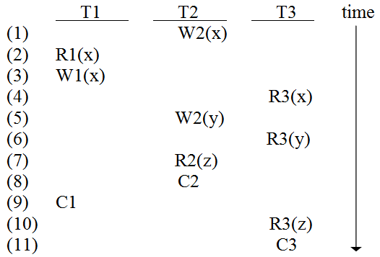
11.1 Serializability Theory
An equivalent schedule for concurrent (i.e. interleaved) execution of T1, T2, and T3:
S’={W2(x),R1(x),W1(x),R3(x),W2(y),R3(y),R2(z),C2,C1,R3(z),C3}

Slide 17
11.1 Serializability Theory
Note:
concurrent execution is the interleaved execution of transactions. It is different from parallel execution.

Slide 18
11.1 Serializability Theory
Definition of serializability
A schedule S is serializable if and only if it is conflict equivalent to a serial schedule.
The above S’ is serializable since it is equivalent to the serial execution of T2, T1 and then T3. This serial execution order is called serialization order.

Slide 19
11.1 Serializability Theory
For a non-replicated distributed database, if each local schedule is serializable, their union (the global schedule) is also serializable as long as local serialization orders are identical.
For replicated distributed database, the issue is complicated. The system has to synchronize updates of n-replicas by using replica protocol.

Slide 20
To be continued…

