Slide 1
Distributed Database Systems
Chapter 3
Distributed Database Design

Slide 2
Introduction
DDB design
Making decision on the placement of data across the network components
Input of the design: queries (applications), use case of applications concerned with sites and frequency
Output of the design: a set of fragments located at different sites
Critical to the performance of DDB and applications

Slide 3
Top-down design process
An iteration of five steps:
Requirement analysis
Conceptual design and view integration
E-R representation and translation to RDB schema
Distribution design
Data fragmentation and allocation
Physical design
Tuning Closely related to architecture issues.
Notes:
4. Distribution Design: Local Conceptual Schema (LCS)

Slide 4
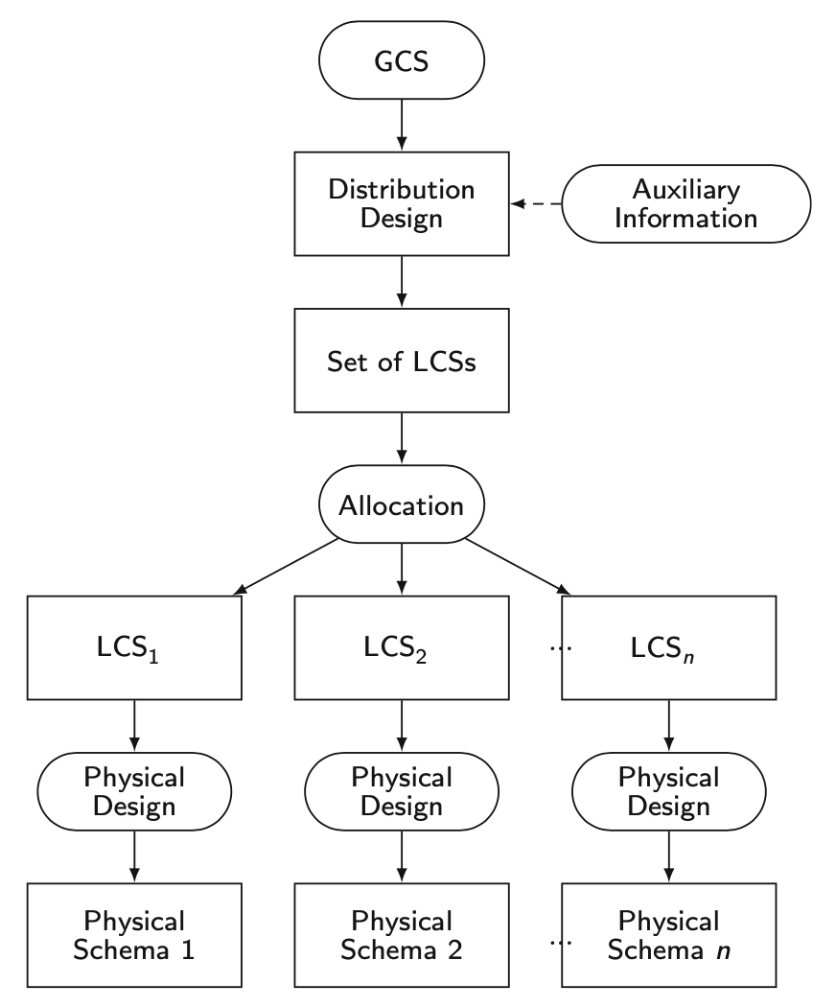

Slide 5
Bottom-up design process
Primarily for multidatabase applications
It’s been studied for years and becomes very hot today as Internet is penetrating to every aspect of society
Terms related
Data integration/fusion
P2P
Marsh-up\
Not covered by this course

Slide 6
Distribution Design Issues
New Issues
Fragmentation
How to split the data?
Allocation
Where should each fragment go?
Not independent, but will cover them separately

Slide 7
Fragmentation Alternatives
Horizontal, or vertical, or both
Example:
EMP(Employee)
PAY(Payment)
ASG(Assignment)
ENO | ENAME | TITLE
E1 | J.Doe | Elec. Eng.
E2 | M.Smith | Syst. Anal.
E3 | A.Lee | Mach. Eng.
E4 | J.Miller | Programmer
E5 | B.Casey | Syst. Anal.
E6 | L.Chu | Elec. Eng.
E7 | R.Davis | Mach. Eng.
E8 | J.Jones | Syst. Anal.
TITLE | SAL
Elec. Eng. | 40000
Syst. Anal. | 34000
Mesh. Eng. | 27000
Programmer | 24000
ENO | PNO | RESP | DUR
E1 | P1 | Manager | 12
E2 | P1 | Analyst | 24
E2 | P2 | Analyst | 6
E3 | P3 | Consultant | 10
E3 | P4 | Engineer | 48
E4 | P2 | Programmer | 18
E5 | P2 | Manager | 24
E6 | P4 | Manager | 48
E7 | P3 | Engineer | 36
E8 | P3 | Manager | 40
PROJ(Project)
PNO | PNAME | BUDGET | LOC
P1 | Instrumentation | 150000 | Paris
P2 | Database Develop | 135000 | NY
P3 | CAD/CAM | 250000 | Paris
P4 | Maintenance | 310000 | Paris
An engineering database

Slide 8
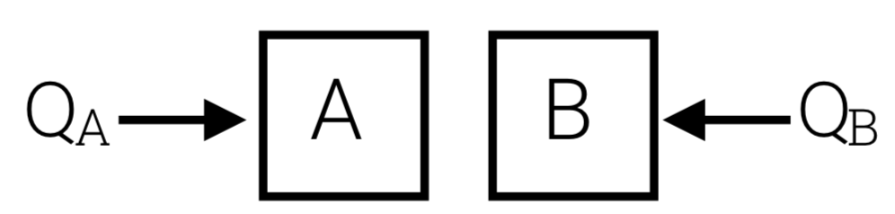
Example Queries
PROJ relation
PROJ (PNO, PNAME, BUDGET, LOC)
Query workload
Motivation: two sites
40% of queries
SELECT *
FROM PROJ
WHERE LOC = ‘NY’ AND…
40% of queries
SELECT *
FROM PROJ
WHERE LOC = ‘Paris’ AND…

Slide 9
Reasons for Fragmentation in DDB
Reason 1: Data Locality
Queries access data at a single site in order to avoid costly remote data access
Reason 2: Inter-query Parallelism
Fragmentation enables a number of queries to execute concurrently
Reason 3: Intra-query Parallelism
Fragmentation enables parallel execution of a single query by dividing it into a set of subqueries that operate on fragments

Slide 10
Reasons for Fragmentation in PDB
Difference from DDB
Communication cost among nodes is much less
Key Issue: Load Balancing
Each node in the system to be doing more or less the same amount of work
Otherwise, there is the danger of the entire system thrashing since one or a few nodes end up doing a majority of the work, while many nodes remain idle.

Slide 11
Fragmentation
PROJ(Project)
PNO | PNAME | BUDGET | LOC
P1 | Instrumentation | 150000 | Paris
P2 | Database Develop | 135000 | NY
P3 | CAD/CAM | 250000 | Paris
P4 | Maintenance | 310000 | Paris
PROJ_{A}
PROJ_{B}
PNO | PNAME | BUDGET | LOC
P2 | Database Develop | 135000 | NY
PNO | PNAME | BUDGET | LOC
P1 | Instrumentation | 150000 | Paris
P3 | CAD/CAM | 250000 | Paris
P4 | Maintenance | 310000 | Paris

Slide 12
Fragmentation
Example:
F = { PROJA, PROJB }
PROJA = σ LOC=‘NY’ PROJ
PROJB = σ LOC=‘Paris’ PROJ
→ Primary horizontal fragmentation

Slide 13
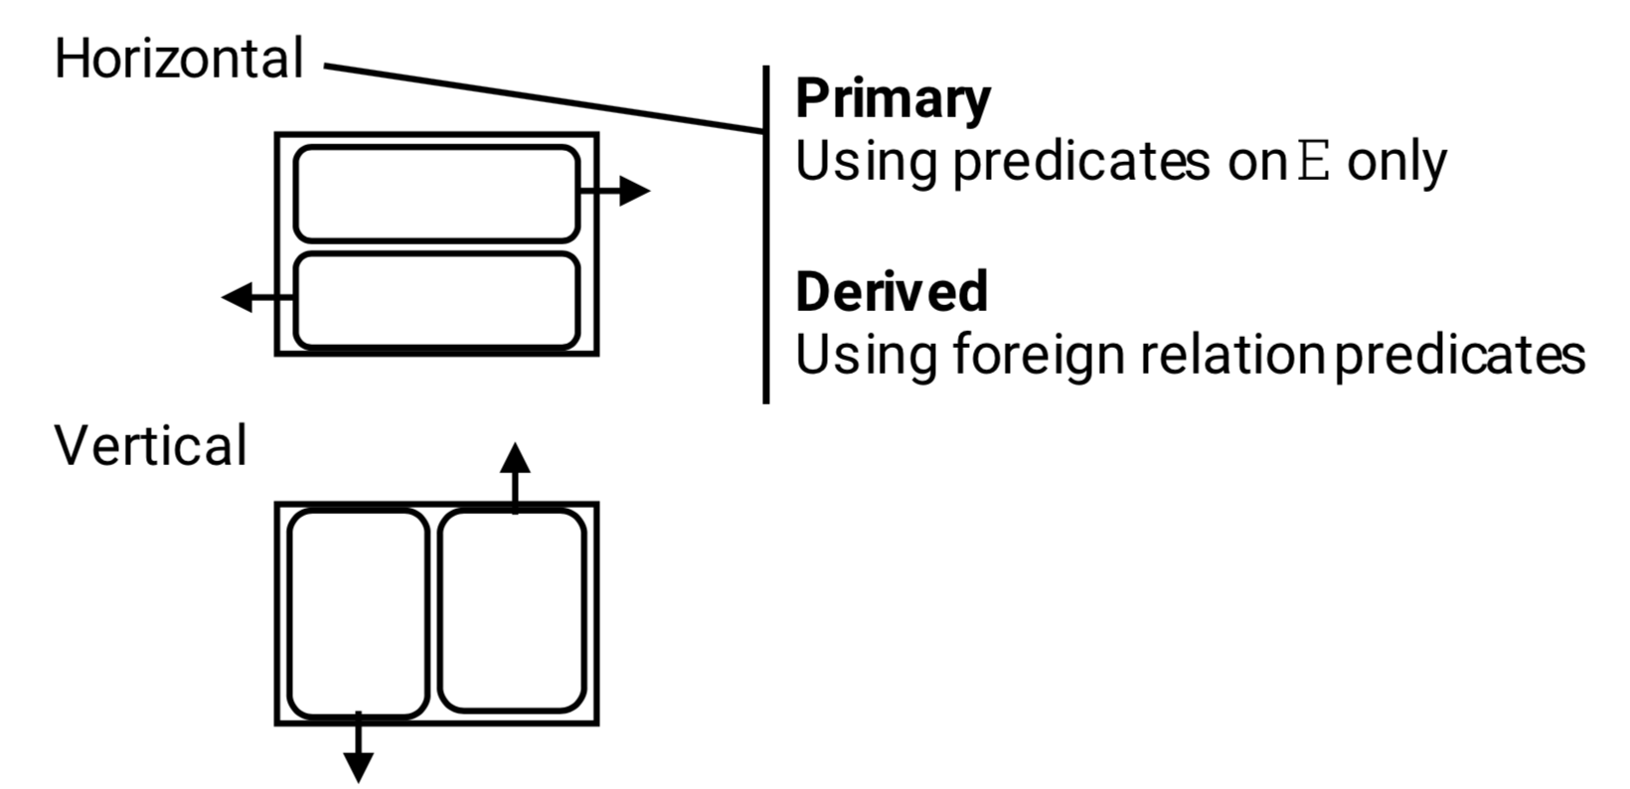
Fragmentation

Slide 14
Horizontal Fragmentation
Primary horizontal fragmentation
To partition a relation by using predicates on that relation
Derived horizontal fragmentation
To partition a relation by using predicates on another relation
Two aspects affecting fragmentation
Data information, and
Application information

Slide 15
Primary Horizontal Fragmentation

Slide 16
Primary Horizontal Fragmentation
What options for horizontal fragmentation?
Three common horizontal partitioning techniques
Round robin
Hash partitioning
Range partitioning

Slide 17
Round Robin
R F0 F1 F2
t1 t1
t2 t2
t3 t3
t4 t4
... t5
Evenly distributes data
Good for scanning full relation
Not good for point or range queries

Slide 18
Hash partitioning
R D0 D1 D2
t1→h(k1)=2 t1
t2→h(k2)=0 t2
t3→h(k3)=0 t3
t4→h(k4)=1 t4
...
Good for point queries on key; also for joins
Not good for range queries; point queries not on key
If hash function good, even distribution

Slide 19
Range partitioning
R D0 D1 D2
t1: A=5 t1
t2: A=8 t2
t3: A=2 t3
t4: A=3 t4
...
Good for some range queries on A
Need to select good vector: else unbalance
→ data skew
→ execution skew
partitioning
vector
4
7
V0 V1

Slide 20

Good Fragmentations?
Example 1:
F = { PROJA, PROJB }
PROJA = σ BUDGET<10 PROJ
PROJB = σ BUDGET>20 PROJ
Problem: some tuples are lost
E.g., $10≤$ BUDGET $≤20$

Slide 21
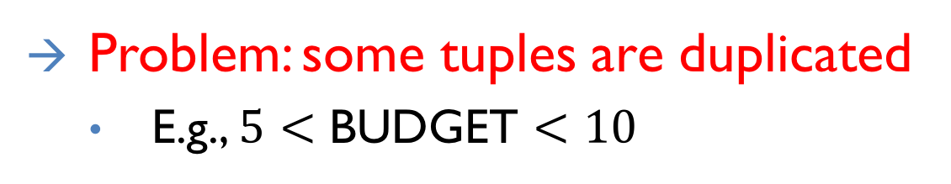
Good Fragmentations?
Example 2:
F = { PROJA, PROJB }
PROJA = σ BUDGET<10 PROJ
PROJB = σ BUDGET>5 PROJ
Problem: some tuples are duplicated
E.g., $5<$ BUDGET $<10$

Slide 22
Correctness for Rules of Fragmentation
Completeness
If R is decomposed into R₁,R₂,...,R_{n}, then for any data item d: d∈R → d∈R_{i}’s (one or more R_{i}, 1≤i≤n)
Reconstruction
If R is decomposed into R₁,R₂,...,R_{n}, then ∃ψ, s.t. R = R₁ψR₂ψ...ψR_{n} where ψ is a relational operation
Disjointness
If R is horizontally decomposed into R₁,R₂,...,R_{n}, then R_{i} ∩ R_{j} = Φ for any i and j, s.t. 1≤i, j≤n and i≠j
Notes:
Disjointness for horizontal fragmentation / duplicated keys for vertical fragementation

Slide 23
Fragmentation Properties
How to ensure properties of completeness, disjointness and reconstruction?
Check manually
Example 3:
F = { PROJA, PROJB }
PROJA = σ BUDGET<10 PROJ
PROJB = σ BUDGET>=10 PROJ

Slide 24
Fragmentation Properties
How to ensure properties of completeness, disjointness and reconstruction?
Automatically generate fragments with the properties

Slide 25
Idea of auto-generation
We need to know more about queries
Say queries use predicates:
A<10, A>5, Loc = SA, Loc = SB
Next: - generate “minterm” predicates
- eliminate useless ones

Slide 26
Minterm predicates (part I)
(1) A<10 ∧ A>5 ∧ Loc=SA ∧ Loc=SB
(2) A<10 ∧ A>5 ∧ Loc=SA ∧ ¬(Loc=SB)
(3) A<10 ∧ A>5 ∧ ¬(Loc=SA) ∧ Loc=SB
(4) A<10 ∧ A>5 ∧ ¬(Loc=SA) ∧ ¬(Loc=SB)
(5) A<10 ∧ ¬(A>5) ∧ Loc=SA ∧ Loc=SB
(6) A<10 ∧ ¬(A>5) ∧ Loc=SA ∧ ¬(Loc=SB)
(7) A<10 ∧ ¬(A>5) ∧ ¬(Loc=SA) ∧ Loc=SB
(8) A<10 ∧ ¬(A>5) ∧ ¬(Loc=SA) ∧ ¬(Loc=SB)

Slide 27
Minterm predicates (part I)
(1) A<10 ∧ A>5 ∧ Loc=SA ∧ Loc=SB
(2) A<10 ∧ A>5 ∧ Loc=SA ∧ ¬(Loc=SB)
(3) A<10 ∧ A>5 ∧ ¬(Loc=SA) ∧ Loc=SB
(4) A<10 ∧ A>5 ∧ ¬(Loc=SA) ∧ ¬(Loc=SB)
(5) A<10 ∧ ¬(A>5) ∧ Loc=SA ∧ Loc=SB
(6) A<10 ∧ ¬(A>5) ∧ Loc=SA ∧ ¬(Loc=SB)
(7) A<10 ∧ ¬(A>5) ∧ ¬(Loc=SA) ∧ Loc=SB
(8) A<10 ∧ ¬(A>5) ∧ ¬(Loc=SA) ∧ ¬(Loc=SB)

Slide 28
Minterm predicates (part 2)
(9) ¬(A<10) ∧ A>5 ∧ Loc=SA ∧ Loc=SB
(10) ¬(A<10) ∧ A>5 ∧ Loc=SA ∧¬(Loc=SB)
(11) ¬(A<10) ∧ A>5 ∧¬(Loc=SA) ∧ Loc=SB
(12) ¬(A<10) ∧ A>5 ∧¬(Loc=SA) ∧¬(Loc=SB)
(13) ¬(A<10) ∧¬(A>5) ∧ Loc=SA ∧ Loc=SB
(14) ¬(A<10) ∧¬(A>5) ∧ Loc=SA ∧¬(Loc=SB)
(15) ¬(A<10) ∧¬(A>5) ∧¬(Loc=SA) ∧ Loc=SB
(16) ¬(A<10) ∧¬(A>5) ∧¬(Loc=SA) ∧¬(Loc=SB)

Slide 29
Minterm predicates (part 2)
(9) ¬(A<10) ∧ A>5 ∧ Loc=SA ∧ Loc=SB
(10) ¬(A<10) ∧ A>5 ∧ Loc=SA ∧¬(Loc=SB)
(11) ¬(A<10) ∧ A>5 ∧¬(Loc=SA) ∧ Loc=SB
(12) ¬(A<10) ∧ A>5 ∧¬(Loc=SA) ∧¬(Loc=SB)
(13) ¬(A<10) ∧¬(A>5) ∧ Loc=SA ∧ Loc=SB
(14) ¬(A<10) ∧¬(A>5) ∧ Loc=SA ∧¬(Loc=SB)
(15) ¬(A<10) ∧¬(A>5) ∧¬(Loc=SA) ∧ Loc=SB
(16) ¬(A<10) ∧¬(A>5) ∧¬(Loc=SA) ∧¬(Loc=SB)

Slide 30
Final fragments
F2: 5 < A < 10 ∧ Loc=SA
F3: 5 < A < 10 ∧ Loc=SB
F6: A ≤ 5 ∧ Loc=SA
F7: A ≤ 5 ∧ Loc=SB
F10: A ≥ 10 ∧ Loc=SA
F11: A ≥ 10 ∧ Loc=SB

Slide 31
Match Access Patterns
The previous method assumes uniform access of all fragments
Frag A
try to
place in
same
fragment
frequently
accessed
together
Frag B
Frag C

Slide 32
Example
E(#, NM, LOC, SAL,…)
Common queries:
Qa: Qb:
select * select *
from E from E
where LOC=Sa where LOC=Sb
and … and ...

Slide 33
Which one is better?
(1) Pr = { } F1 ={ E }
(2) Pr = {LOC=Sa, LOC=Sb}
F2={ σ loc=Sa E, σ loc=Sb E }
(3) Pr = {LOC=Sa, LOC=Sb, Sal<10}
F3={ σloc=Sa ∧ sal<10 E, σloc=Sa ∧ sal≥10 E,
σloc=Sb ∧ sal<10E, σloc=Sb ∧ sal≥10 E }

Slide 34
How should we analyze it?
Loc=Sa ∧
sal < 10
Qa: Select … loc = Sa ...
Qb: Select … loc = Sb ...
Loc=Sa ∧
sal ≥ 10
F1
F3
F2
F2 is good…
(not F1 , F3 )
Loc=Sb ∧
sal < 10
Loc=Sb ∧
sal ≥ 10

Slide 35
Scientific Training
How to do Problem Formulation

Slide 36
Problem Formulation
Qualitative predicates used in queries
Simple predicate
A_{i} θ value over relation R(A₁,A₂,...,A_{n}) where θ∈{≠,<,≤,≥,>} and value ∈D_{i} (domain of A_{i} )
Minterm predicate – the conjunction of simple predicates
Given a set of simple predicates for relation Ri, Pri = {Pi₁,Pi₂,_,Pi_{m}}, the set of minterm predicates Mi = {m_{i1},m_{i2},_,m_{iz}} is defined as where

Slide 37
Application Information
Example
Simple predicates
TITLE = “Elect. Eng.” TITLE = “Syst. Anal.” TITLE = “Mech. Eng.” TITLE = “Programmer” SAL < 30000 SAL ≥ 30000
Midterm predicates
TITLE = “Elect. Eng.”∧SAL < 30000 TITLE = “Elect. Eng.”∧SAL ≥ 30000 ¬(TITLE = “Programmer”)∧SAL < 30000 ¬(TITLE = “Programmer”)∧SAL ≥ 30000 … more, but some are meaningless.
Minterm is a general form since it is always possible to translate a Boolean expression into conjunctive normal form.

Slide 38
Application Information
Attention for negation
Negation of equality is meaningful
¬(Attribute = Value)
Negation of inequality can be changed to its complement, e.g.
¬(Attribute ≤ Value) is changed to (Attribute > Value)
To keep simple predicate assumption, the form Value1 ≤ Attribute ≤ Value2 is excluded

Slide 39
Application Information
Quantitative information
Minterm selectivity – sel(m_{i})
The number of tuples of a relation returned by a query specified by the minterm m_{i}
Access frequency – acc(m_{i})
The frequency with which user applications access data using a query specified by the minterm m_{i}

Slide 40
Primary Horizontal Fragmentation
A Primary horizontal fragmentation is defined by a selection operation on the owner relation of a DB schema where R_{i} is a relation and F_{j} is a minterm predicate, w is the total number of fragments.

Slide 41

Primary Horizontal Fragmentation
Example
The fragmentation of PROJ in the engineering database: where PROJ₁ and PROJ₂ are called horizontal fragment
A good example is very important for DB papers

Slide 42
Scientific Training
How to do Algorithm Design

Slide 43
Primary Horizontal Fragmentation - First Step
The first step for primary horizontal fragmentation is to find a set of simple predicates with the properties of Completeness and Minimanity

Slide 44
Completeness
Example
Pr = { LOC = “Montreal”, LOC = “New York”, LOC = “Paris”}

Slide 45
Completeness
If there is one and only one application that accesses J according to the location, then Pr is complete
An application accessing PROJ according to BUDGET < 200000 will make Pr incomplete (why?). But
Pr = {LOC = “Montreal”, LOC = “New York”,LOC = “Paris”, BUDGET < 200000, BUDGET ≥ 200000}
is complete.
Notes:
As the data distribution based on BUDGET is unknown!

Slide 46
Completeness
A set of predicates Pr is complete iff there is an equal probability of access by any application to any two tuples belonging to any minterm fragment that is defined according to Pr.
Note: this formal definition requires to specify the access probability for each tuple of relation for each application, which is considerably more work than the common sense and experience of the designer.

Slide 47
Completeness
Reasons for completeness
logically uniform and statistically homogeneous.

Slide 48
Minimanity
Let
m_{i} contains p_{i}, determines f_{i}, and m_{j} contains ¬p_{i}, determines f_{j}
Pi is relevant iff A set of simple predicates Pr is minimal if all of its predicates are relevant.
Notes:
This definition is very formal and difficult to realize. Therefore, intuition and expertise are encouraged to use.

Slide 49
A rule for COM_MIN algorithm
Rule 1: a relation or fragment must be partitioned "into at least two parts which are accessed by at least one application differently"
Notation fi of Pr’: fragment fi defined by a minterm predicate Pr’
COM_MIN

Slide 50
Primary Horizontal Fragmentation - 2nd Step
To derive the set of minterm predicates -- trivial.
Minterm predicates are exponential on the number of simple predicates.

Slide 51
Primary Horizontal Fragmentation - 3rd Step
To eliminate meaningless minterm predicates by identifying those that contradict to a set of implications I.
Example
={att=value_1, att=value_2}
domain(att)={value_1, value_2}
I:

Slide 52
Four minterm predicates generated from
and
are contradictory to I.

Slide 53
Algorithm for PHORIZONTAL
PHORIZONTAL

Slide 54
Example for Primary Horizontal Fragmentation
Distributed Database Systems
54
Example: Horizontal fragmentation of J in the engineering database
Application 1
Issue at 3 sites and finds the names and budget of project according to the sites. SELECT JNAME, BUDGET FROM PROJ WHERE LOC = value
Simple predicates: p₁ : LOC = “Montreal” p₂ : LOC = “New York” p₃ : LOC = “Paris”

Slide 55
Example for Primary Horizontal Fragmentation
Distributed Database Systems
55
Application 2
Issued at 2 sites, one manages projects with budgets less than 200000, the other manages the rest projects. SELECT * FROM PROJ WHERE BUDGET θ value
Simple predicates: p₄ : BUDGET ≤ 200000 p₅ : BUDGET > 200000

Slide 56
Example for Primary Horizontal Fragmentation
Distributed Database Systems
56
Use COM_MIN algorithm to get a complete and minimal simple predicates

Slide 57
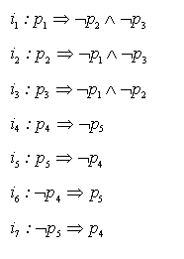
Example for Primary Horizontal Fragmentation
Distributed Database Systems
57
Implications I derived from P_{r}’

Slide 58
Example for Primary Horizontal Fragmentation
Distributed Database Systems
58
From P_{r}’, 2^5 = 32 minterm predicates can be generated; However, only the following 6 are left due to I:
m₁ : (LOC="Montreal") (BUDGET≤200000)
m₂ : (LOC="Montreal") (BUDGET>200000)
m₃ : (LOC="New York") (BUDGET≤200000)
m₄ : (LOC="New York") (BUDGET>200000)
m₅ : (LOC="Paris") (BUDGET≤200000)
m₆ : (LOC="Paris") (BUDGET>200000)

Slide 59
Example for Primary Horizontal Fragmentation
Distributed Database Systems
59
Note that m_{i}’s are simplified version by using I, e.g.

Slide 60
Example for Primary Horizontal Fragmentation
Distributed Database Systems
60
Fragment J according to m_{i}:
SELECT *
FROM PROJ
WHERE m_{i}
J1={(P1,Instrumentation,150000,Montreal)}
J2={}
J3={(P2,Database Develop,135000,New York)}
J4={(P3,CAD/CAM,250000,New York)}
J5={}
J6={(P4,Maintenance,310000,Paris)}

Slide 61
Vertical Fragmentation

Slide 62
Vertical fragmentation
E
Example:
E1
E2

Slide 63
Properties: R[T] ⇒ Ri[Ti]
(1) Completeness
U Ti = T
all i

Slide 64
(2) Disjointness
Ti ∩ Tj = ∅ for all i,j i≠j
E(#,LOC,SAL)
E1(#,LOC)
E2(SAL)

Slide 65
(2) Disjointness
Ti ∩ Tj = ∅ for all i,j i≠j
E(#,LOC,SAL)
E1(#,LOC)
E2(SAL)
Not a desirable property!!
(could not reconstruct R!)

Slide 66
(3) Lossless join
Ri = R
all i
 One way to achieve lossless join:
Repeat key in all fragments, i.e.,
Key ⊆ Ti for all i

Slide 67
⬄ How do we decide what attributes are grouped with which?
E1(#,NM,LOC)
E2(#,SAL)
Example:
E(#,NM,LOC,SAL) E1(#,NM)
E2(#,LOC)
E3(#,SAL)
?

Slide 68
Attribute affinity matrix
A1 A2 A3 A4 A5
A1 - - - - -
A2 50 - - - -
A3 45 48 - - -
A4 1 2 0 - -
A5 0 0 4 75 -

Slide 69
Attribute affinity matrix
A1 A2 A3 A4 A5
A1 - - - - -
A2 50 - - - -
A3 45 48 - - -
A4 1 2 0 - -
A5 0 0 4 75 -
R1[K,A1,A2,A3] R2[K,A4,A5]

Slide 70
Derived Horizontal Fragmentation

Slide 71
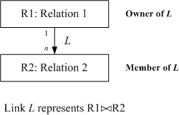
Problem Formulation
The relationships are important for distribution design
Links are used to represent equal joins between relations
Quantitative information on DB – cardinality of relation R: card(R)

Slide 72
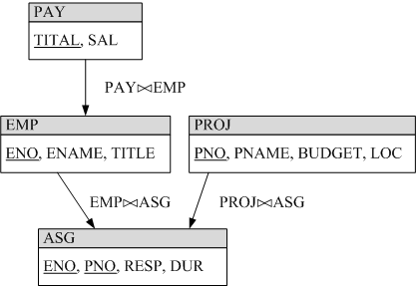
Problem Formulation
Example

Slide 73
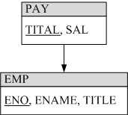
Derived Horizontal Fragmentation
Distributed Database Systems
73
The derived fragmentation of R
Example E is fragmented according to S1 and S2

Slide 74
Check for Correctness
E1
E2
(at Sa)
(at Sb)
J

Slide 75
Check for Correctness
E1
E2
(at Sa)
(at Sb)
J1
J2
J1 = J E1 J2 = J E2

Slide 76
Checking for Correctness
Completeness
Primary horizontal fragmentation
So long as the simple predicate set P_{r} is complete and minimal
Derived horizontal fragmentation
As long as the referential integrity rule is conformed

Slide 77
Checking completeness
Example: Say J is:
 But no #= 33 in E1 nor in E2!
This J tuple will not be in J1 nor J2
Fragmentation not complete

Slide 78
Check for Correctness
Reconstruction
For a relation R with fragmentation {R₁, R₂, …, R_{n}, }

Slide 79
Check for Correctness
Disjointness
Primary horizontal fragmentation
As long as minterm predicates are mutually exclusive
Derived horizontal fragmentation
If a tuple of a member relation is joinable with only one fragment of its owner relation

Slide 80
Example:
E1
E2
J
Fragmentation
is not
disjoint!
J1
J2

Slide 81
Allocation

Slide 82
Example of Allocation
Example: E(#,NM,LOC,SAL) ⇒
F1 = σloc=Sa E ; F2 = σloc=Sb E
Qa: select … where loc=Sa...
Qb: select … where loc=Sb…
Where do
F1,F2 go?
Site a
Site b
?

Slide 83
Issues
Where do queries originate
What is communication cost? and size of answers, relations,…
What is storage capacity, cost at sites? and size of fragments?
What is processing power at sites?
What is query processing strategy?
How are joins done?
Where are answers collected?

Slide 84
Allocation Problem
Assuming:
A set of fragments
A set of sites
A set of applications
Problem Find the optimal distribution of F over S

Slide 85
Optimization problem:
What is best placement of fragments and/or best number of copies to:
minimize query response time
maximize throughput
minimize “some cost”
...
Subject to constraints?
Available storage
Available bandwidth, power,…
Keep 90% of response time below X
...
This is an incredibly hard problem

Slide 86
Example: Single fragment F
Read cost: ∑ [ti × MIN Cij]
i: Originating site of request
ti: Read traffic at Si
Cij: Retrieval cost
Accessing fragment F at Sj from Si
m
i=1
j

Slide 87
Scenario - Read cost
1 2
.
. .
F
F
.
.
ci,1
ci,2
3
C=inf
ci,3
F
.
i
Stream of read
requests for F
ti REQ/SEC
C=inf
C=inf

Slide 88
Write cost
m
m
∑ ∑ Xj ui C’ij
i: Originating site of request
j: Site being updated
Xj: 0 if F not stored at Sj
1 if F stored at Sj
ui: Write traffic at Si
C’ij: Write cost
Updating F at Sj from Si
i=1
j=1

Slide 89
Scenario - write cost
Updates
ui updates/sec
. .
F
F
.
.
F
.
.
i

Slide 90
Storage cost:
m
∑ Xi di
Xi: 0 if F not stored at Si
1 if F stored at Si
di: storage cost at Si
i=1

Slide 91
Target function:
min ∑ [ti ×MIN Cij + ∑ Xj × ui × C’ij ]
+ ∑ Xi × di
m
m
i=1
j
j=1
m
i=1

Slide 92
Can add more complications:
Examples:
- Multiple fragments
- Fragment sizes
- Concurrency control cost

Slide 93
A Simple Formulation of the Cost Problem
A precise formulation must consider:
All fragments together
How query is processed
The enforcement of integrity constraint
The cost of concurrency control and transaction control
The allocation problem is NP-complete!

Slide 94
A Simple Formulation of the Cost Problem
Possible solutions
Heuristics
Simulation

Slide 95
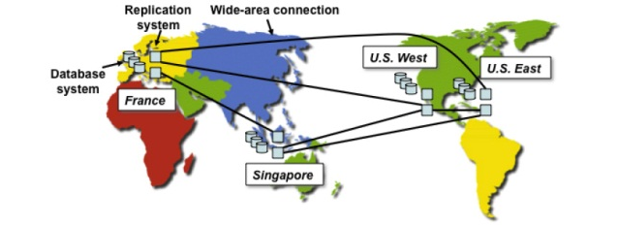
Case Study: PNUTS
Where in the World is My Data? Sudarshan Kadambi, Jianjun Chen, Brian F. Cooper, David Lomax, Raghu Ramakrishnan, Adam Silberstein, Erwin Tam, Hector Garcia-Molina; VLDB 2011
Distributed object/tuple store for Yahoo!

Slide 96
Case Study: PNUTS
Issue: Where to locate data
Issue: What and where to replicate

Slide 97
Conclusions
DDB design is still OPEN

