Slide 1
Distributed Database Systems
Autumn, 2020
Overview of Query Processing

Slide 2
SQL: Non-Procedural Language of RDB
End user uses non-procedural languages to express queries.
SELECT ENO,ENAME
FROM EMP
WHERE TITLE=“Programmer”
Formally, SQL is a tuple calculus language

Slide 3
SQL: Non-Procedural Language of RDB
Tuple calculus
{ t | F(t) } where:
t : tuple variable
F(t) : well formed formula
Example
Get the No. and name of all managers

Slide 4
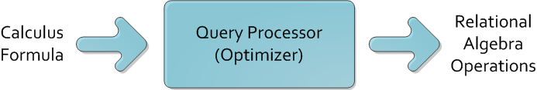
Query Processor
Query processor transforms queries into procedural operations to access data

Slide 5
Query Processor
Distributed query processor has to deal with
query decomposition, and
data localization

Slide 6
Query Processing Problems

Slide 7
Centralized Query Processing
Centralized query processor must
transform calculus query into algebra operations, and
choose the best execution plan
Example:
SELECT ENAME
FROM EMP E,ASG G
WHERE E.ENO = G.ENO
AND RESP=“Manager”

Slide 8
Centralized Query Processing
Relational Algebra 1
Relational Algebra 2
Execution plan 2 is better for consuming less resources!

Slide 9
Distributed Query Processing
In a distributed system, relational algebra is not enough to express execution strategies.
Besides the choice of ordering relational algebra operators, the distributed query processor must also
select the best sites to process data, and
possibly the way data should be transformed.

Slide 10
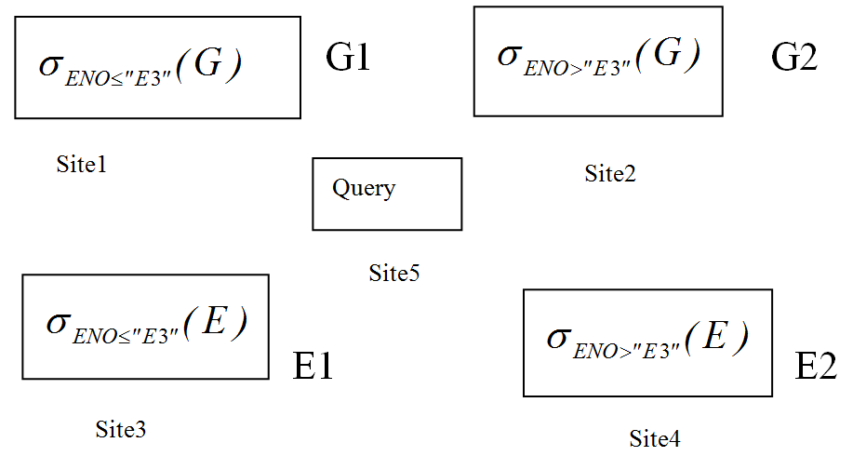
Distributed Query Processing
Let us consider an example
Fragments and Distribution of E and G

Slide 11
Distributed Query Processing
Let us use a very simple cost model
We assume that a tuple access, denoted by tupacc, is 1 unit
We assume that a tuple transfer, denoted tuptrans, is 10 units

Slide 12
Distributed Query Processing
We assume that
Relations E and G have 400 and 1000 tuples, respectively;
There are 20 managers in relation G;
Data is uniformly distributed among sites;
Relations G and E are locally clustered on attributes RESP and ENO, respectively
There is direct access to tuples of ASG (respectively, EMP) based on the value of attribute RESP (respectively, ENO).

Slide 13
Distributed Query Processing
The Query Example from centralized optimization
Simple plan to execute the query :
To transport all segments to query site and execute there.
too much network traffic, very costly.

Slide 14
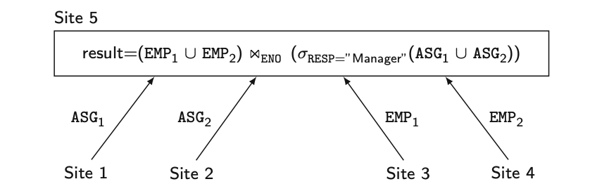
Distributed Query Processing
Optimized Distributed Query Processing

Slide 15
Distributed Query Processing
Total cost of the simple strategy
Transfer E to site 5 requires 400∗tuptrans = 4,000
Transfer G to site 5 requires 1000∗tuptrans = 10,000
Produce G′ by selecting G requires 1000∗tupacc = 1,000
Join EMP and ASG′ requires 400 ∗ 20 ∗ tupacc = 8,000
The total cost is 23,000

Slide 16
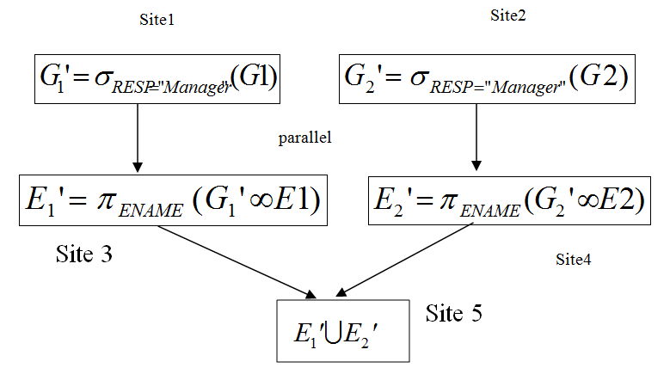
Distributed Query Processing
Optimized Distributed Query Processing

Slide 17
Distributed Query Processing
Total cost of the optimized strategy
Produce G′ by selecting G requires (10 + 10)∗ tupacc = 20 -- Why not (500+500)*tuacc?
Transfer ASG′ to the sites of EMP requires (10 + 10)∗ tuptrans = 200
Produce EMP′ by joining ASG′ and EMP requires (10+10)∗tupacc∗2 = 40 -- Why not 400*20*tuacc?
Transfer EMP′ to result site requires (10 + 10)∗ tuptrans = 200
The total cost is 460

Slide 18
Distributed Query Processing
In DDB, the query processor must consider the communication cost and select the best site!
Same query as last example, but G and E are distributed.

Slide 19
Overview of Query Processing

Slide 20
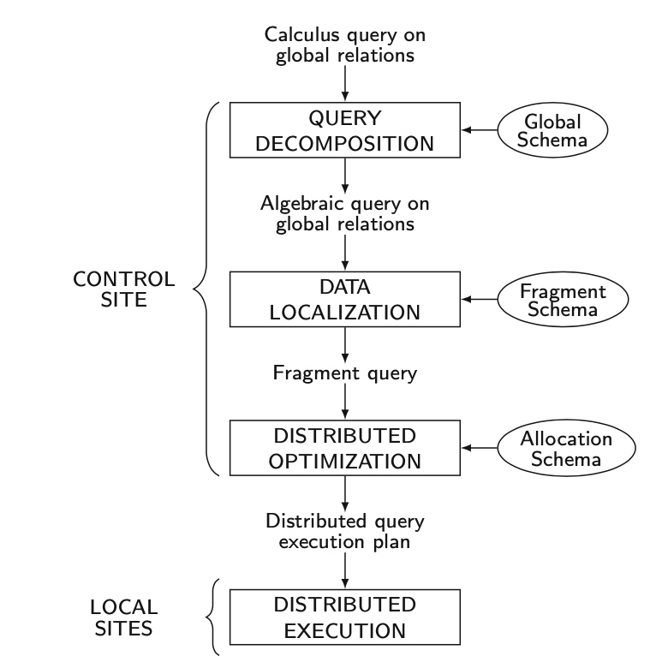
Generic Laying Scheme for Distributed Query Processing

Slide 21
Query Decomposition
Decompose calculus query into algebra query using global conceptual schema information.
Step 1 – calculus normalization
Step 2 – semantic analysis to reject incorrect queries
Step 3 – simplification to eliminate redundant components
Step 4 – translation of calculus query into optimized algebra query.

Slide 22
Data Localization
Distributed query is mapped into a fragment query and simplified to produce a good one.

Slide 23
Distributed Optimization
Find an execution strategy close to optimal.
An execution strategy:
Relational algebra operators
Communication primitives (send/receive operators) for transferring data between sites.
Find the best ordering of operators in the fragment query, including communication primitives.

Slide 24
Distributed Execution
All the sites involved in the query will perform execution on their fragments
Each subquery executing at one site, called a local query, is optimized using the local schema of the site and executed.
Learn more from Prof. Xiao Zhang

Slide 25
Objectives of Query Processing

Slide 26
Objectives of Query Processing
Two-fold objectives:
Transformation, and
Optimization

Slide 27
Objectives of Query Processing
Cost to be considered for optimization:
CPU time
I/O time, and
Communication time
WAN: the last cost is dominant
LAN: all three are equal

Slide 28
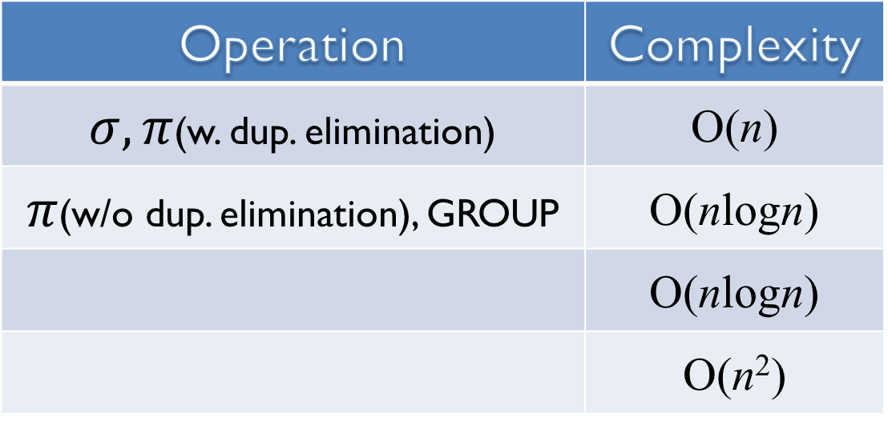
Complexity of Relational Algebra Operations
Measured by n (cardinality) and tuples are sorted on comparison attributes
Operation | Complexity
$σ, π$(w. dup. elimination) | O(n)
$π$(w/o dup. elimination), GROUP | O(nlogn)
 | O(nlogn)
 | O(n²)

Slide 29
Types of Optimization
Exhaustive search
Workable for small solution space
Heuristics
Perform first, semi-join, etc. for large solution space

Slide 30
Optimization Timing
Static
Do it at compiling time by using statistics, optimized once, but executed many times.
Dynamic
Do it at execution time, accurate, repeated for every execution, expensive.

Slide 31
Statistics
Facts of
Cardinalities
Attribute value distribution
Size of relation, etc.
Provided to query optimizer and periodically updated.

Slide 32
Decision Site
For query optimization, it may be done by
Single site – centralized approach, or
All the sites involved – distributed, or
Hybrid – one site makes major decision in cooperation with other sites making local decisions

