Slide 1
DDBS MIDTERM
Distributed Database System
Reporter: Jiang LY(Leader), Sun WH, Li JY, Zhang T.
2020.11.11

Slide 2
System Environment
System Environment
CentOS 7
Mysql 5.7
Mysql connector for C++ 1.x
Boost
Etcd 3.4
Brpc 0.9.7
Protobuf 3.x, 2.x

Slide 3
Contents
1
SQL-Parser & Graphviz
2
Generate sql query tree
3
Environment & Communication

Slide 4
SQL-Parser & Graphviz
Graphviz & sql-parser

Slide 5
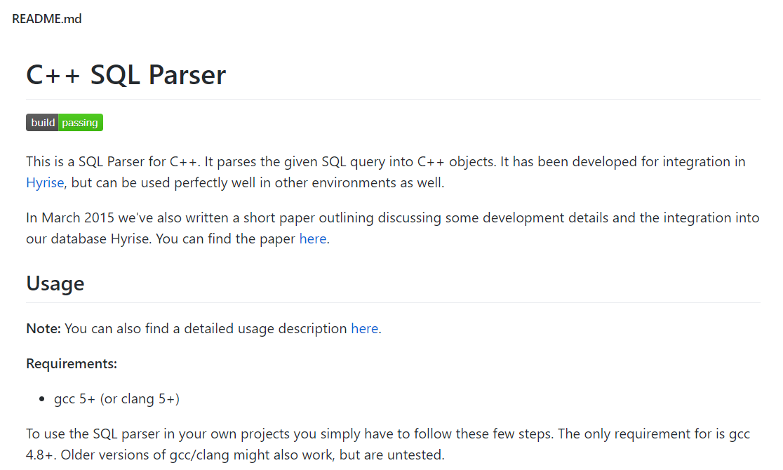
Sql-parser
https://github.com/hyrise/sql-parser

Slide 6

Graphviz
What is Graphviz：
Graphviz is open source graph visualization software.
The Graphviz layout programs take descriptions of graphs in a simple text language, and make diagrams in useful formats, such as images and SVG for web pages.
http://www.graphviz.org/

Slide 7
Graphviz
Usage
display the query syntax tree according to the query plan on different sites.
Dot Language
nodes、edges、graph、subgraphs、cluster subgraphs
http://www.graphviz.org/

Slide 8
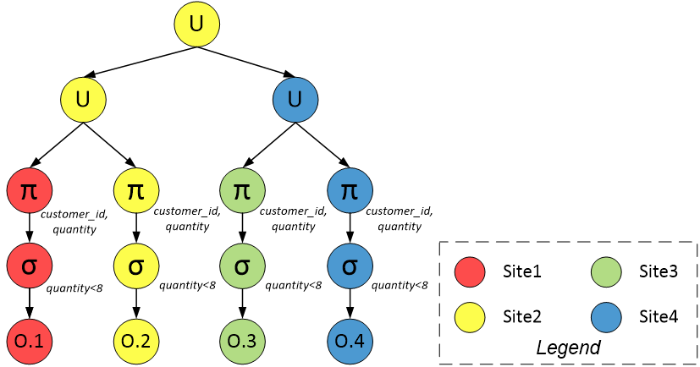
Result Picture

Slide 9
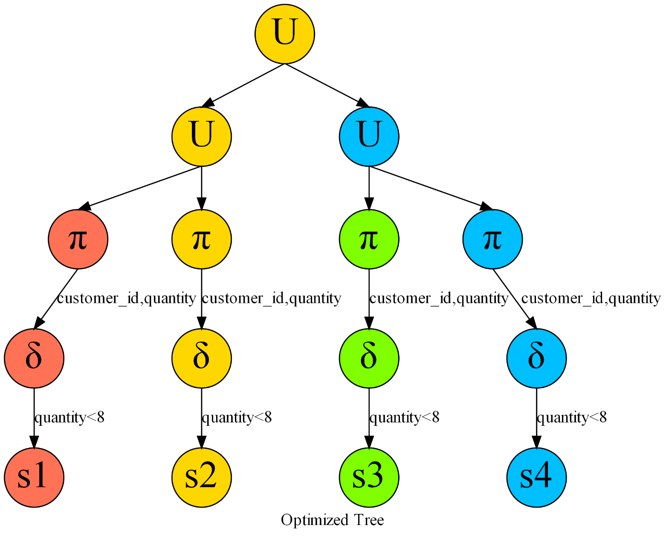
Result Picture – By Graphviz

Slide 10
Query tree
Generate sql query tree

Slide 11
Core Ideas
Steps to generate optimized query tree
Find fragments of all participant relations and corresponding participant attributes
Pruning Vertical Fragments according to participant attributes
Do Selection according to non-join predicates in “Where” and pruning empty fragments after selection
Do Projection on later involving attributes

Slide 12
Core Ideas
Steps to generate optimized query tree
Join Vertical Fragments.(Algorithm 1)
Join different relations.(Algorithm 2)
Do Projection on eventual output attributes.
Union all resulting fragments(Algorithm 3)

Slide 13
Algorithm 1
Join Vertical Fragments

Slide 14
Algorithm 2
Join Fragments of different relations

Slide 15
Algorithm 2
Join Fragments of different relations
Step1. Find Rp as the largest Ri
Step2.Decide the number of processing sites: k
(A site is selected as a processing site only if the amount of data it must receive is smaller than it would have to send if it were not a processing site.)
.g. p=k=3
Notice that when k=1
it is similar to vertical situation in broadcasting network

Slide 16
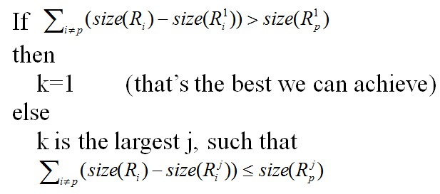
Algorithm 2
.g. p=k=3
Notice that when k=1
it is similar to vertical situation in broadcasting network

Slide 17
Algorithm 3
Union all
Resulting fragments

Slide 18
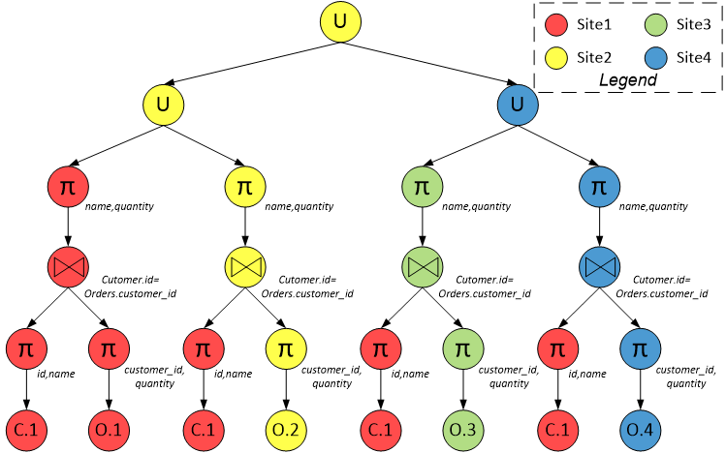
One Example
SELECT Customer.name, Orders.quantity
FROM Customer, Orders
WHERE Customer.id = Orders.customer_id
① C1 C2 → name, id
O1 O2 O3 O4 → quantity, customer_id
② pruning C2
③ there's no non-join predicate in “where”
④ C1 projection on name,id; O1 O2 O3 O4
projection on quantity, customer_id
⑤ there's no vertical fragments left to join

Slide 19
One Example
⑥ join C1 and O1,O2,O3,O4 after projection using algorithm 2: p=2,k=4
⑦ Do projection on eventual output attributes:name, quantity
⑧ Union all fragments to one site using algorithm 3

Slide 20
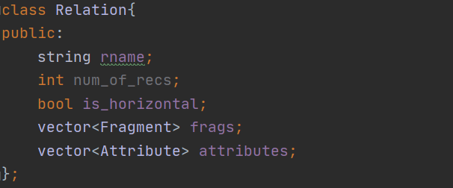
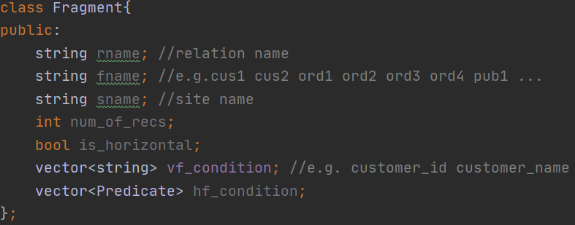
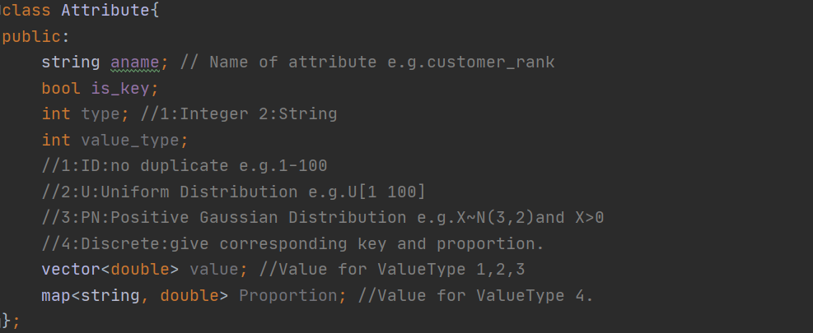
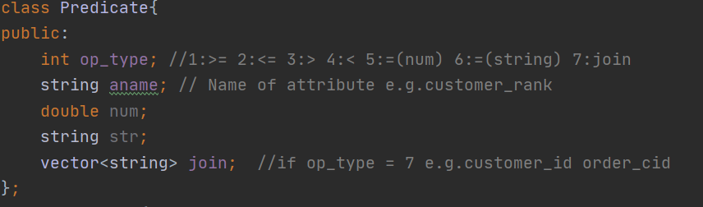
Data Structure：Relation

Slide 21
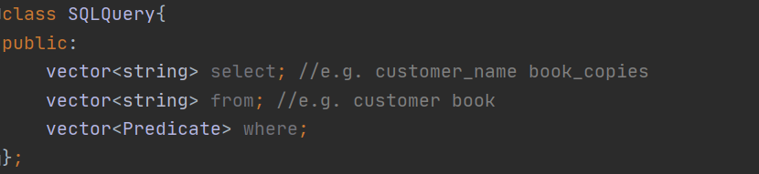
Data Structure：SQLQuery

Slide 22
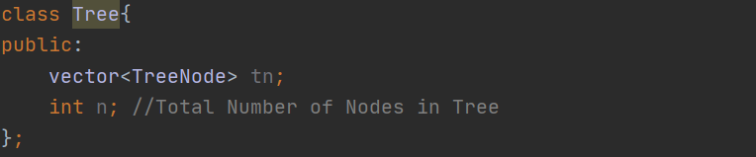
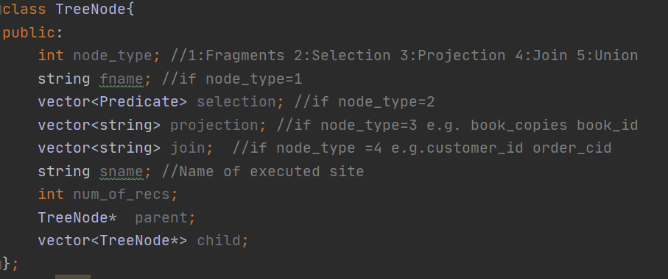
Data Structure：Query Tree

Slide 23
Environment & Communication
System Environment & Network Connection

Slide 24
Network Communication
Network Communication：
Brpc & Protobuf
ParallelChannel (Combine Channel)
Asynchronous
CallMapper & ResponseMerger
Naïve Response Latency Measurement Support

Slide 25
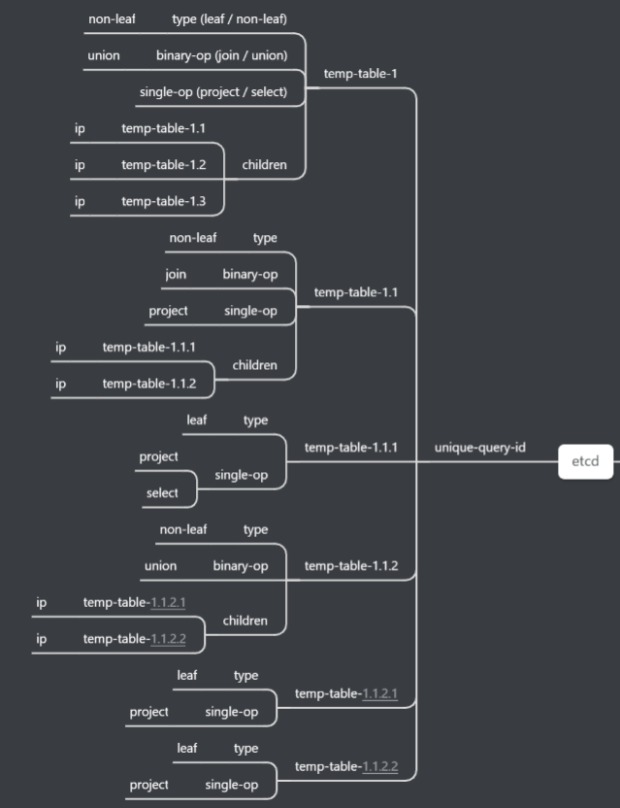
Query Tree Scheduling(Pull, Cascade Request)
temp-table-1
异步(ParallelChannel)
temp-table-1.1
temp-table-1.2
temp-table-1.3
temp-table-1.1.1
temp-table-1.1.2
temp-table-1.1.2.1
temp-table-1.1.2.2
The intermediate table is created only after the network data transmission

Slide 26
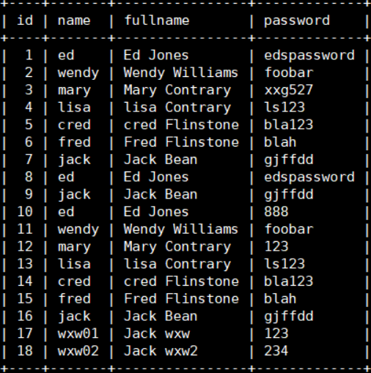
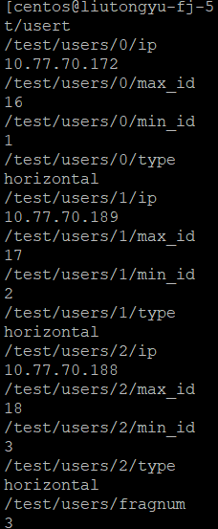
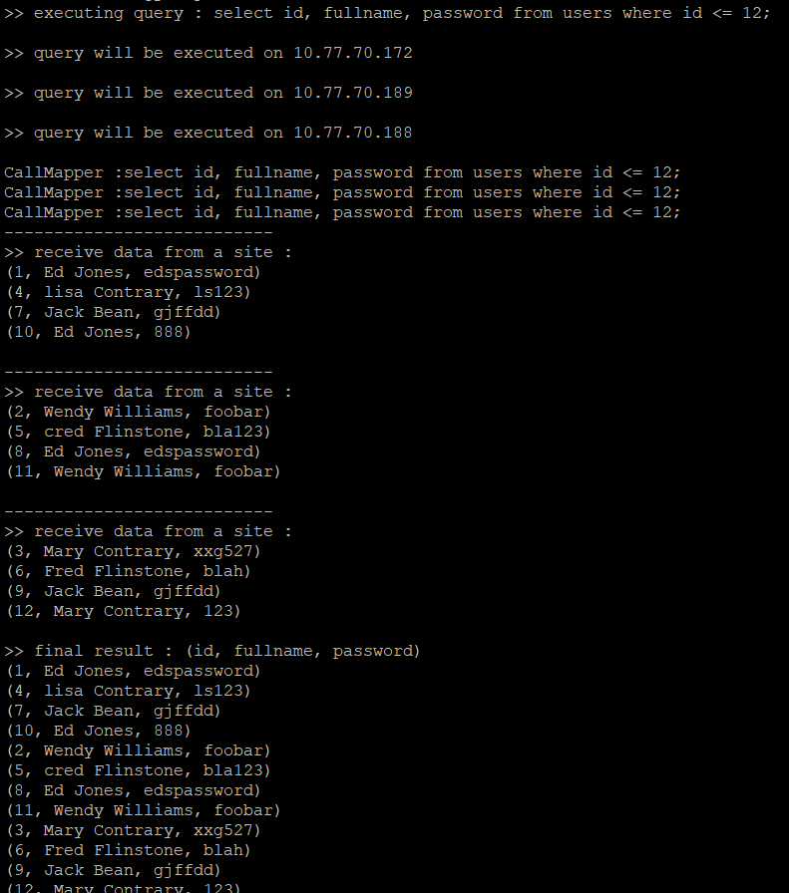
Scheduling Demo
Users Table
Three Fragments
Query Execution
Horizontal Fragmentation : Round Robin

Slide 27
THANKS

