Slide 1
Distributed Database Systems
Chapter 5
Distributed Database Design

Slide 2
Introduction
DDB design
Making decision on the placement of data across the network components
Input of the design: queries (applications), use case of applications concerned with sites and frequency
Output of the design: a set of fragments located at different sites
Critical to the performance of DDB and applications

Slide 3
5.1.1 Top-down design process
An iteration of five steps:
Requirement analysis
Conceptual design and view integration
E-R representation and translation to RDB schema
Distribution design
Data fragmentation and allocation
Physical design
Tuning Closely related to architecture issues.
Notes:
4. Distribution Design: Local Conceptual Schema (LCS)

Slide 4
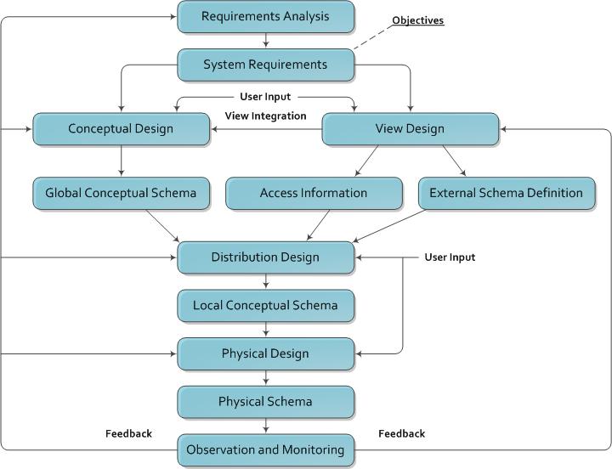

Slide 5
5.1.2 Bottom-up design process
Primarily for multidatabase applications
It’s been studied for years and becomes very hot today as Internet is penetrating to every aspect of society
Terms related
Data integration/fusion
P2P
Marsh-up\
Not covered by this course

Slide 6
5.2 Distribution Design Issues
New Issues
Fragmentation
How to split the data?
Allocation
Where should each fragment go?
Not independent, but will cover them separately

Slide 7
Fragmentation Alternatives
Horizontal, or vertical, or both
Example:
EMP(Employee)
PAY(Payment)
ASG(Assignment)
ENO | ENAME | TITLE
E1 | J.Doe | Elec. Eng.
E2 | M.Smith | Syst. Anal.
E3 | A.Lee | Mach. Eng.
E4 | J.Miller | Programmer
E5 | B.Casey | Syst. Anal.
E6 | L.Chu | Elec. Eng.
E7 | R.Davis | Mach. Eng.
E8 | J.Jones | Syst. Anal.
TITLE | SAL
Elec. Eng. | 40000
Syst. Anal. | 34000
Mesh. Eng. | 27000
Programmer | 24000
ENO | PNO | RESP | DUR
E1 | P1 | Manager | 12
E2 | P1 | Analyst | 24
E2 | P2 | Analyst | 6
E3 | P3 | Consultant | 10
E3 | P4 | Engineer | 48
E4 | P2 | Programmer | 18
E5 | P2 | Manager | 24
E6 | P4 | Manager | 48
E7 | P3 | Engineer | 36
E8 | P3 | Manager | 40
PROJ(Project)
PNO | PNAME | BUDGET | LOC
P1 | Instrumentation | 150000 | Paris
P2 | Database Develop | 135000 | NY
P3 | CAD/CAM | 250000 | Paris
P4 | Maintenance | 310000 | Paris
An engineering database

Slide 8
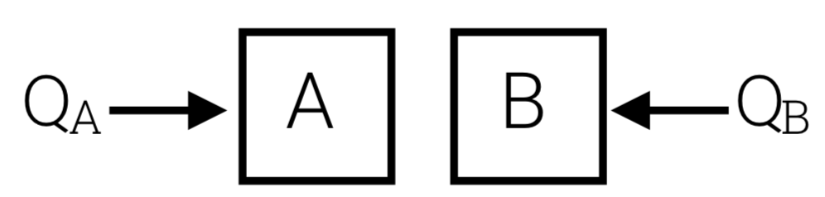
Example Queries
PROJ relation
PROJ (PNO, PNAME, BUDGET, LOC)
Query workload
Motivation: two sites
40% of queries
SELECT *
FROM PROJ
WHERE LOC = ‘NY’ AND…
40% of queries
SELECT *
FROM PROJ
WHERE LOC = ‘Paris’ AND…

Slide 9
Reasons for Fragmentation
To enhance intra-query concurrency
To increase the throughput
But extra cost for queries involving more than one segment residing at different sites
Closely related to query processing and optimization

Slide 10
Fragmentation
PROJ(Project)
PNO | PNAME | BUDGET | LOC
P1 | Instrumentation | 150000 | Paris
P2 | Database Develop | 135000 | NY
P3 | CAD/CAM | 250000 | Paris
P4 | Maintenance | 310000 | Paris
PROJ_{A}
PROJ_{B}
PNO | PNAME | BUDGET | LOC
P2 | Database Develop | 135000 | NY
PNO | PNAME | BUDGET | LOC
P1 | Instrumentation | 150000 | Paris
P3 | CAD/CAM | 250000 | Paris
P4 | Maintenance | 310000 | Paris

Slide 11
Fragmentation
Example:
F = { PROJA, PROJB }
PROJA = σ LOC=‘NY’ PROJ
PROJB = σ LOC=‘Paris’ PROJ
→ Primary horizontal fragmentation

Slide 12
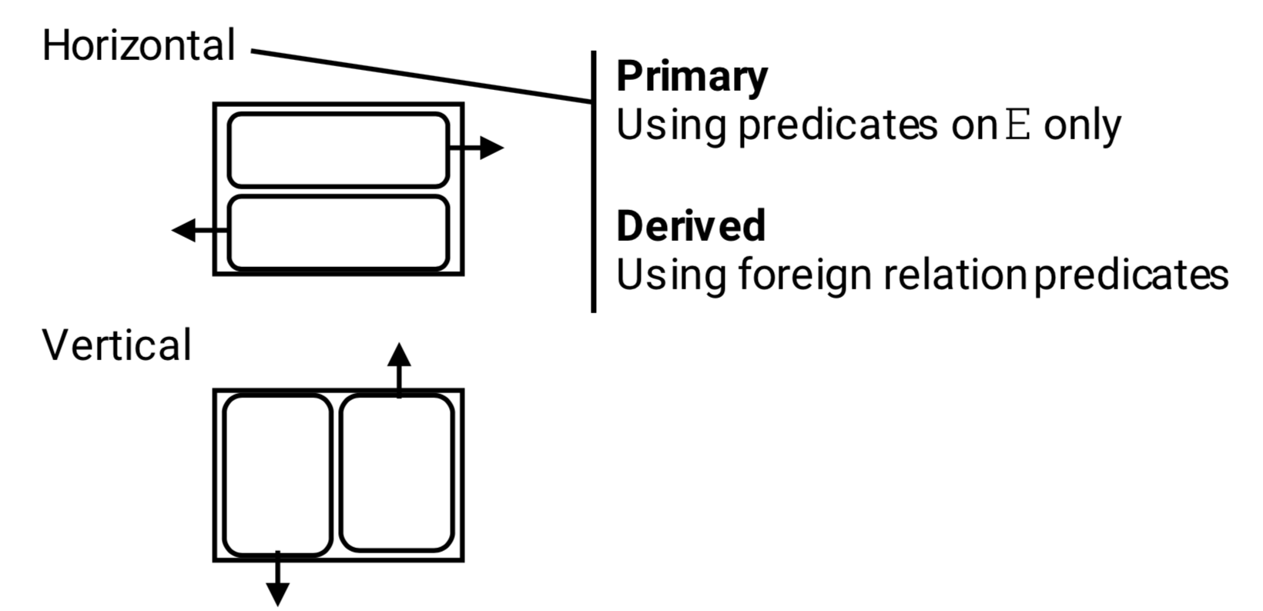
Fragmentation

Slide 13
Horizontal Fragmentation
Primary horizontal fragmentation
To partition a relation by using predicates on that relation
Derived horizontal fragmentation
To partition a relation by using predicates on another relation
Two aspects affecting fragmentation
Data information, and
Application information

Slide 14
Primary Horizontal Fragmentation

Slide 15
Primary Horizontal Fragmentation
What options for horizontal fragmentation?
Three common horizontal partitioning techniques
Round robin
Hash partitioning
Range partitioning

Slide 16
Round Robin
R F0 F1 F2
t1 t1
t2 t2
t3 t3
t4 t4
... t5
Evenly distributes data
Good for scanning full relation
Not good for point or range queries

Slide 17
Hash partitioning
R D0 D1 D2
t1→h(k1)=2 t1
t2→h(k2)=0 t2
t3→h(k3)=0 t3
t4→h(k4)=1 t4
...
Good for point queries on key; also for joins
Not good for range queries; point queries not on key
If hash function good, even distribution

Slide 18
Range partitioning
R D0 D1 D2
t1: A=5 t1
t2: A=8 t2
t3: A=2 t3
t4: A=3 t4
...
Good for some range queries on A
Need to select good vector: else unbalance
→ data skew
→ execution skew
partitioning
vector
4
7
V0 V1

Slide 19

Good Fragmentations?
Example 1:
F = { PROJA, PROJB }
PROJA = σ BUDGET<10 PROJ
PROJB = σ BUDGET>20 PROJ
Problem: some tuples are lost
E.g., $10≤$ BUDGET $≤20$

Slide 20
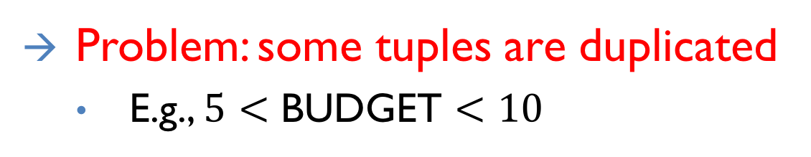
Good Fragmentations?
Example 2:
F = { PROJA, PROJB }
PROJA = σ BUDGET<10 PROJ
PROJB = σ BUDGET>5 PROJ
Problem: some tuples are duplicated
E.g., $5<$ BUDGET $<10$

Slide 21
5.2.3 Correctness for Rules of Fragmentation
Completeness
If R is decomposed into R₁,R₂,...,R_{n}, then for any data item d: d∈R → d∈R_{i}’s (one or more R_{i}, 1≤i≤n)
Reconstruction
If R is decomposed into R₁,R₂,...,R_{n}, then ∃ψ, s.t. R = R₁ψR₂ψ...ψR_{n} where ψ is a relational operation
Disjointness
If R is horizontally decomposed into R₁,R₂,...,R_{n}, then R_{i} ∩ R_{j} = Φ for any i and j, s.t. 1≤i, j≤n and i≠j
Notes:
Disjointness for horizontal fragmentation / duplicated keys for vertical fragementation

Slide 22
Fragmentation Properties
How to ensure properties of completeness, disjointness and reconstruction?
Check manually
Example 3:
F = { PROJA, PROJB }
PROJA = σ BUDGET<10 PROJ
PROJB = σ BUDGET>=10 PROJ

Slide 23
Fragmentation Properties
How to ensure properties of completeness, disjointness and reconstruction?
Automatically generate fragments with the properties

Slide 24
Example of auto-generation
Say queries use predicates:
A<10, A>5, Loc = SA, Loc = SB
Next: - generate “minterm” predicates
- eliminate useless ones

Slide 25
Minterm predicates (part I)
(1) A<10 ∧ A>5 ∧ Loc=SA ∧ Loc=SB
(2) A<10 ∧ A>5 ∧ Loc=SA ∧ ¬(Loc=SB)
(3) A<10 ∧ A>5 ∧ ¬(Loc=SA) ∧ Loc=SB
(4) A<10 ∧ A>5 ∧ ¬(Loc=SA) ∧ ¬(Loc=SB)
(5) A<10 ∧ ¬(A>5) ∧ Loc=SA ∧ Loc=SB
(6) A<10 ∧ ¬(A>5) ∧ Loc=SA ∧ ¬(Loc=SB)
(7) A<10 ∧ ¬(A>5) ∧ ¬(Loc=SA) ∧ Loc=SB
(8) A<10 ∧ ¬(A>5) ∧ ¬(Loc=SA) ∧ ¬(Loc=SB)

Slide 26
Minterm predicates (part I)
(1) A<10 ∧ A>5 ∧ Loc=SA ∧ Loc=SB
(2) A<10 ∧ A>5 ∧ Loc=SA ∧ ¬(Loc=SB)
(3) A<10 ∧ A>5 ∧ ¬(Loc=SA) ∧ Loc=SB
(4) A<10 ∧ A>5 ∧ ¬(Loc=SA) ∧ ¬(Loc=SB)
(5) A<10 ∧ ¬(A>5) ∧ Loc=SA ∧ Loc=SB
(6) A<10 ∧ ¬(A>5) ∧ Loc=SA ∧ ¬(Loc=SB)
(7) A<10 ∧ ¬(A>5) ∧ ¬(Loc=SA) ∧ Loc=SB
(8) A<10 ∧ ¬(A>5) ∧ ¬(Loc=SA) ∧ ¬(Loc=SB)

Slide 27
Minterm predicates (part 2)
(9) ¬(A<10) ∧ A>5 ∧ Loc=SA ∧ Loc=SB
(10) ¬(A<10) ∧ A>5 ∧ Loc=SA ∧¬(Loc=SB)
(11) ¬(A<10) ∧ A>5 ∧¬(Loc=SA) ∧ Loc=SB
(12) ¬(A<10) ∧ A>5 ∧¬(Loc=SA) ∧¬(Loc=SB)
(13) ¬(A<10) ∧¬(A>5) ∧ Loc=SA ∧ Loc=SB
(14) ¬(A<10) ∧¬(A>5) ∧ Loc=SA ∧¬(Loc=SB)
(15) ¬(A<10) ∧¬(A>5) ∧¬(Loc=SA) ∧ Loc=SB
(16) ¬(A<10) ∧¬(A>5) ∧¬(Loc=SA) ∧¬(Loc=SB)

Slide 28
Minterm predicates (part 2)
(9) ¬(A<10) ∧ A>5 ∧ Loc=SA ∧ Loc=SB
(10) ¬(A<10) ∧ A>5 ∧ Loc=SA ∧¬(Loc=SB)
(11) ¬(A<10) ∧ A>5 ∧¬(Loc=SA) ∧ Loc=SB
(12) ¬(A<10) ∧ A>5 ∧¬(Loc=SA) ∧¬(Loc=SB)
(13) ¬(A<10) ∧¬(A>5) ∧ Loc=SA ∧ Loc=SB
(14) ¬(A<10) ∧¬(A>5) ∧ Loc=SA ∧¬(Loc=SB)
(15) ¬(A<10) ∧¬(A>5) ∧¬(Loc=SA) ∧ Loc=SB
(16) ¬(A<10) ∧¬(A>5) ∧¬(Loc=SA) ∧¬(Loc=SB)

Slide 29
Final fragments
F2: 5 < A < 10 ∧ Loc=SA
F3: 5 < A < 10 ∧ Loc=SB
F6: A ≤ 5 ∧ Loc=SA
F7: A ≤ 5 ∧ Loc=SB
F10: A ≥ 10 ∧ Loc=SA
F11: A ≥ 10 ∧ Loc=SB

Slide 30
Match Access Patterns
Another Desired Fragmentation Property
data A
try to
place in
same
fragment
frequently
accessed
together
data B
data C

Slide 31
Example
E(#, NM, LOC, SAL,…)
Common queries:
Qa: Qb:
select * select *
from E from E
where LOC=Sa where LOC=Sb
and … and ...

Slide 32
Which one is better?
(1) Pr = { } F1 ={ E }
(2) Pr = {LOC=Sa, LOC=Sb}
F2={ σ loc=Sa E, σ loc=Sb E }
(3) Pr = {LOC=Sa, LOC=Sb, Sal<10}
F3={ σloc=Sa ∧ sal<10 E, σloc=Sa ∧ sal≥10 E,
σloc=Sb ∧ sal<10E, σloc=Sb ∧ sal≥10 E }

Slide 33
How should we analyze it?
Loc=Sa ∧
sal < 10
Qa: Select … loc = Sa ...
Qb: Select … loc = Sb ...
Loc=Sa ∧
sal ≥ 10
F1
F3
F2
F2 is good…
(not F1 , F3 )
Loc=Sb ∧
sal < 10
Loc=Sb ∧
sal ≥ 10

Slide 34
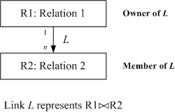
Problem Formulation
The relationships are important for distribution design
Links are used to represent equal joins between relations
Quantitative information on DB – cardinality of relation R: card(R)

Slide 35
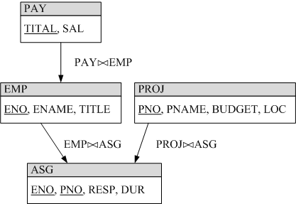
Problem Formulation
Example

Slide 36
Problem Formulation
Qualitative predicates used in queries
Simple predicate
A_{i} θ value over relation R(A₁,A₂,...,A_{n}) where θ∈{≠,<,≤,≥,>} and value ∈D_{i} (domain of A_{i} )
Minterm predicate – the conjunction of simple predicates
Given a set of simple predicates for relation Ri, Pri = {Pi₁,Pi₂,_,Pi_{m}}, the set of minterm predicates Mi = {m_{i1},m_{i2},_,m_{iz}} is defined as where

Slide 37
Application Information
Example
Simple predicates
TITLE = “Elect. Eng.” TITLE = “Syst. Anal.” TITLE = “Mech. Eng.” TITLE = “Programmer” SAL < 30000 SAL ≥ 30000
Midterm predicates
TITLE = “Elect. Eng.”∧SAL < 30000 TITLE = “Elect. Eng.”∧SAL ≥ 30000 ¬(TITLE = “Programmer”)∧SAL < 30000 ¬(TITLE = “Programmer”)∧SAL ≥ 30000 … more, but some are meaningless.
Minterm is a general form since it is always possible to translate a Boolean expression into conjunctive normal form.

Slide 38
Application Information
Attention for negation
Negation of equality is meaningful
¬(Attribute = Value)
Negation of inequality can be changed to its complement, e.g.
¬(Attribute ≤ Value) is changed to (Attribute > Value)
To keep simple predicate assumption, the form Value1 ≤ Attribute ≤ Value2 is excluded

Slide 39
Application Information
Quantitative information
Minterm selectivity – sel(m_{i})
The number of tuples of a relation returned by a query specified by the minterm m_{i}
Access frequency – acc(m_{i})
The frequency with which user applications access data using a query specified by the minterm m_{i}

Slide 40
Primary Horizontal Fragmentation
A Primary horizontal fragmentation is defined by a selection operation on the owner relation of a DB schema where R_{i} is a relation and F_{j} is a minterm predicate, w is the total number of fragments.

Slide 41
Primary Horizontal Fragmentation
Example
The fragmentation of PROJ in the engineering database: where PROJ₁ and PROJ₂ are called horizontal fragment

Slide 42
Primary Horizontal Fragmentation - First Step
The first step for primary horizontal fragmentation is to find a set of simple predicates with the properties of Completeness and Minimanity

Slide 43
Completeness
Example
Pr = { LOC = “Montreal”, LOC = “New York”, LOC = “Paris”}

Slide 44
Completeness
If there is one and only one application that accesses J according to the location, then Pr is complete
An application accessing PROJ according to BUDGET < 200000 will make Pr incomplete (why?). But
Pr = {LOC = “Montreal”, LOC = “New York”,LOC = “Paris”, BUDGET < 200000, BUDGET ≥ 200000}
is complete.
Notes:
As the data distribution based on BUDGET is unknown!

Slide 45
Completeness
A set of predicate Pr is complete iff there is an equal probability of access by any application to any two tuples belonging to any minterm fragment that is defined according to Pr.
Note: this formal definition requires to specify the access probability for each tuple of relation for each application, which is considerably more work than the common sense and experience of the designer.

Slide 46
Completeness
Reasons for completeness
logically uniform and statistically homogeneous.

Slide 47
Minimanity
Let
m_{i} contains p_{i}, determines f_{i}, and m_{j} contains ¬p_{i}, determines f_{j}
Pi is relevant iff A set of simple predicates Pr is minimal if all of its predicates are relevant.
Notes:
This definition is very formal and difficult to realize. Therefore, intuition and expertise are encouraged to use.

Slide 48
A rule for COM_MIN algorithm
Rule 1: a relation or fragment must be partitioned "into at least two parts which are accessed by at least one application differently"
Notation fi of Pr’: fragment fi defined by a minterm predicate Pr’
COM_MIN

Slide 49
Primary Horizontal Fragmentation - 2nd Step
To derive the set of minterm predicates -- trivial.
Minterm predicates are exponential on the number of simple predicates.

Slide 50
Primary Horizontal Fragmentation - 3rd Step
To eliminate meaningless minterm predicates by identifying those that contradict to a set of implications I.
Example
={att=value_1, att=value_2}
domain(att)={value_1, value_2}
I:

Slide 51
Four minterm predicates generated from
and
are contradictory to I.

Slide 52
Algorithm for PHORIZONTAL
PHORIZONTAL

Slide 53
Example for Primary Horizontal Fragmentation
Distributed Database Systems
53
Example: Horizontal fragmentation of J in the engineering database
Application 1
Issue at 3 sites and finds the names and budget of project according to the sites. SELECT JNAME, BUDGET FROM PROJ WHERE LOC = value
Simple predicates: p₁ : LOC = “Montreal” p₂ : LOC = “New York” p₃ : LOC = “Paris”

Slide 54
Example for Primary Horizontal Fragmentation
Distributed Database Systems
54
Application 2
Issued at 2 sites, one manages projects with budgets less than 200000, the other manages the rest projects. SELECT * FROM PROJ WHERE BUDGET θ value
Simple predicates: p₄ : BUDGET ≤ 200000 p₅ : BUDGET > 200000

Slide 55
Example for Primary Horizontal Fragmentation
Distributed Database Systems
55
Use COM_MIN algorithm to get a complete and minimal simple predicates

Slide 56
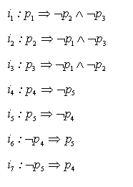
Example for Primary Horizontal Fragmentation
Distributed Database Systems
56
Implications I derived from P_{r}’

Slide 57
Example for Primary Horizontal Fragmentation
Distributed Database Systems
57
From P_{r}’, 2^5 = 32 minterm predicates can be generated; However, only the following 6 are left due to I:
m₁ : (LOC="Montreal") (BUDGET≤200000)
m₂ : (LOC="Montreal") (BUDGET>200000)
m₃ : (LOC="New York") (BUDGET≤200000)
m₄ : (LOC="New York") (BUDGET>200000)
m₅ : (LOC="Paris") (BUDGET≤200000)
m₆ : (LOC="Paris") (BUDGET>200000)

Slide 58
Example for Primary Horizontal Fragmentation
Distributed Database Systems
58
Note that m_{i}’s are simplified version by using I, e.g.

Slide 59
Example for Primary Horizontal Fragmentation
Distributed Database Systems
59
Fragment J according to m_{i}:
SELECT *
FROM PROJ
WHERE m_{i}
J1={(P1,Instrumentation,150000,Montreal)}
J2={}
J3={(P2,Database Develop,135000,New York)}
J4={(P3,CAD/CAM,250000,New York)}
J5={}
J6={(P4,Maintenance,310000,Paris)}

Slide 60
Derived Horizontal Fragmentation

Slide 61
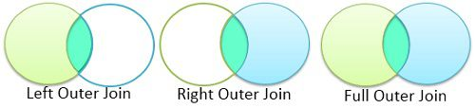
Basic Concepts
Inner Join
Outer Join
Left join
Right join
Full join
Notes:
布置一道题

Slide 62
Problem Formulation
The relationships are important for distribution design
Links are used to represent equal joins between relations
Quantitative information on DB – cardinality of relation R: card(R)

Slide 63
Fragmentation Alternatives
Horizontal, or vertical, or both
Example:
EMP(Employee)
PAY(Payment)
ASG(Assignment)
ENO | ENAME | TITLE
E1 | J.Doe | Elec. Eng.
E2 | M.Smith | Syst. Anal.
E3 | A.Lee | Mach. Eng.
E4 | J.Miller | Programmer
E5 | B.Casey | Syst. Anal.
E6 | L.Chu | Elec. Eng.
E7 | R.Davis | Mach. Eng.
E8 | J.Jones | Syst. Anal.
TITLE | SAL
Elec. Eng. | 40000
Syst. Anal. | 34000
Mesh. Eng. | 27000
Programmer | 24000
ENO | PNO | RESP | DUR
E1 | P1 | Manager | 12
E2 | P1 | Analyst | 24
E2 | P2 | Analyst | 6
E3 | P3 | Consultant | 10
E3 | P4 | Engineer | 48
E4 | P2 | Programmer | 18
E5 | P2 | Manager | 24
E6 | P4 | Manager | 48
E7 | P3 | Engineer | 36
E8 | P3 | Manager | 40
PROJ(Project)
PNO | PNAME | BUDGET | LOC
P1 | Instrumentation | 150000 | Paris
P2 | Database Develop | 135000 | NY
P3 | CAD/CAM | 250000 | Paris
P4 | Maintenance | 310000 | Paris
An engineering database

Slide 64
Problem Formulation
Example

Slide 65
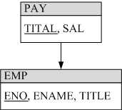
Derived Horizontal Fragmentation
Distributed Database Systems
65
The derived fragmentation of R
Example E is fragmented according to S1 and S2

Slide 66
Check for Correctness
E1
E2
(at Sa)
(at Sb)
J

Slide 67
Check for Correctness
E1
E2
(at Sa)
(at Sb)
J1
J2
J1 = J E1 J2 = J E2

Slide 68
Checking for Correctness
Completeness
Primary horizontal fragmentation
So long as the simple predicate set P_{r} is complete and minimal
Derived horizontal fragmentation
As long as the referential integrity rule is conformed

Slide 69
Checking completeness
Example: Say J is:
 But no #= 33 in E1 nor in E2!
This J tuple will not be in J1 nor J2
Fragmentation not complete

Slide 70
Check for Correctness
Reconstruction
For a relation R with fragmentation {R₁, R₂, …, R_{n}, }

Slide 71
Check for Correctness
Disjointness
Primary horizontal fragmentation
As long as minterm predicates are mutually exclusive
Derived horizontal fragmentation
If a tuple of a member relation is joinable with only one fragment of its owner relation

Slide 72
Example:
E1
E2
J
Fragmentation
is not
disjoint!
J1
J2

Slide 73
Vertical Fragmentation

Slide 74
Vertical fragmentation
E
Example:
E1
E2

Slide 75
Properties: R[T] ⇒ Ri[Ti]
(1) Completeness
U Ti = T
all i

Slide 76
(2) Disjointness
Ti ∩ Tj = ∅ for all i,j i≠j
E(#,LOC,SAL)
E1(#,LOC)
E2(SAL)

Slide 77
(2) Disjointness
Ti ∩ Tj = ∅ for all i,j i≠j
E(#,LOC,SAL)
E1(#,LOC)
E2(SAL)
Not a desirable property!!
(could not reconstruct R!)

Slide 78
(3) Lossless join
Ri = R
all i
 One way to achieve lossless join:
Repeat key in all fragments, i.e.,
Key ⊆ Ti for all i

Slide 79
⬄ How do we decide what attributes are grouped with which?
E1(#,NM,LOC)
E2(#,SAL)
Example:
E(#,NM,LOC,SAL) E1(#,NM)
E2(#,LOC)
E3(#,SAL)
?

Slide 80
Attribute affinity matrix
A1 A2 A3 A4 A5
A1 - - - - -
A2 50 - - - -
A3 45 48 - - -
A4 1 2 0 - -
A5 0 0 4 75 -

Slide 81
Attribute affinity matrix
A1 A2 A3 A4 A5
A1 - - - - -
A2 50 - - - -
A3 45 48 - - -
A4 1 2 0 - -
A5 0 0 4 75 -
R1[K,A1,A2,A3] R2[K,A4,A5]

Slide 82
Allocation

Slide 83
Example of Allocation
Example: E(#,NM,LOC,SAL) ⇒
F1 = σloc=Sa E ; F2 = σloc=Sb E
Qa: select … where loc=Sa...
Qb: select … where loc=Sb…
Where do
F1,F2 go?
Site a
Site b
?

Slide 84
Issues
Where do queries originate
What is communication cost? and size of answers, relations,…
What is storage capacity, cost at sites? and size of fragments?
What is processing power at sites?
What is query processing strategy?
How are joins done?
Where are answers collected?

Slide 85
Allocation Problem
Assuming:
A set of fragments
A set of sites
A set of applications
Problem Find the optimal distribution of F over S

Slide 86
Optimization problem:
What is best placement of fragments and/or best number of copies to:
minimize query response time
maximize throughput
minimize “some cost”
...
Subject to constraints?
Available storage
Available bandwidth, power,…
Keep 90% of response time below X
...
This is an incredibly hard problem

Slide 87
Example: Single fragment F
Read cost: ∑ [ti × MIN Cij]
i: Originating site of request
ti: Read traffic at Si
Cij: Retrieval cost
Accessing fragment F at Sj from Si
m
i=1
j

Slide 88
Scenario - Read cost
1 2
.
. .
F
F
.
.
ci,1
ci,2
3
C=inf
ci,3
F
.
i
Stream of read
requests for F
ti REQ/SEC
C=inf
C=inf

Slide 89
Write cost
m
m
∑ ∑ Xj ui C’ij
i: Originating site of request
j: Site being updated
Xj: 0 if F not stored at Sj
1 if F stored at Sj
ui: Write traffic at Si
C’ij: Write cost
Updating F at Sj from Si
i=1
j=1

Slide 90
Scenario - write cost
Updates
ui updates/sec
. .
F
F
.
.
F
.
.
i

Slide 91
Storage cost:
m
∑ Xi di
Xi: 0 if F not stored at Si
1 if F stored at Si
di: storage cost at Si
i=1

Slide 92
Target function:
min ∑ [ti ×MIN Cij + ∑ Xj × ui × C’ij ]
+ ∑ Xi × di
m
m
i=1
j
j=1
m
i=1

Slide 93
Can add more complications:
Examples:
- Multiple fragments
- Fragment sizes
- Concurrency control cost

Slide 94
A Simple Formulation of the Cost Problem
A precise formulation must consider:
All fragments together
How query is processed
The enforcement of integrity constraint
The cost of concurrency control and transaction control
The allocation problem is NP-complete!

Slide 95
A Simple Formulation of the Cost Problem
Possible solutions
Heuristics
Simulation

Slide 96
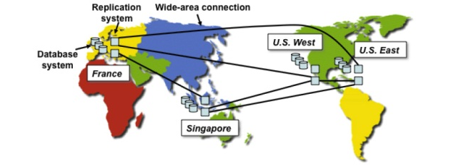
Case Study: PNUTS
Where in the World is My Data? Sudarshan Kadambi, Jianjun Chen, Brian F. Cooper, David Lomax, Raghu Ramakrishnan, Adam Silberstein, Erwin Tam, Hector Garcia-Molina; VLDB 2011
Distributed object/tuple store for Yahoo!

Slide 97
Case Study: PNUTS
Issue: Where to locate data
Issue: What and where to replicate

Slide 98
Conclusions
DDB design is still OPEN

