Slide 1
Distributed Database Systems
Autumn, 2019
Chapter 11 – Part 2 of 3
Distributed Concurrency Control

Slide 2
Review: Serializability Theory
Can you describe the following concepts?
Schedule (history) / Complete schedule
Conflicting operations/transactions
Serial schedule
Conflict-equivalent schedules
Serializable schedule
Serialization order
Union of local schedules in different sites

Slide 3
Definition of P(S)
The precedence graph for schedule S, P(S), is a directed graph where
nodes: the transactions in S
edges: T_{i} → T_{j} is an edge IFF ∃ p ∈ T_{i}, q ∈ T_{j} such that p, q conflict and p <_{S} q

Slide 4
Example
r₃[X] → w₃[X]
S₁: r₁[X] → w₁[X] → w₁[Y]
r₂[X] → w₂[Y]
P(S₁): T₂ → T₁ → T₃

Slide 5
Serializability Theorem
Theorem: A schedule S is serializable IFF P(S) is acyclic.

Slide 6
Taxonomy Of Concurrency Control Algorithms
Section 11.2

Slide 7
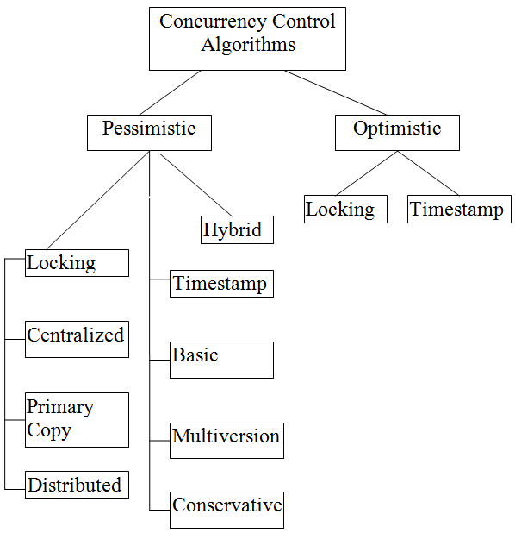
For locking-based methods, locking granularity, i.e. the size of the portion of database that a lock is applied, is an important issue. This portion is called locking unit (lu).

Slide 8
Locking-based Concurrency Control Algorithms
Section 11.3

Slide 9
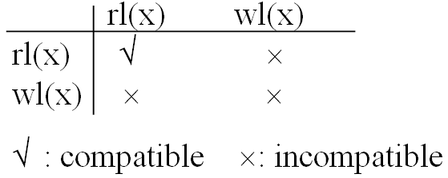
11.3 Locking-based Concurrency Control Algorithms
Lock modes
read lock (rl), and write lock (wl).
Compatibility of lock modes
In a locking-based system, the SC is a lock manager (LM).

Slide 10
Basic LM Algorithm
LM receives DB operations and associated information (transaction ID etc.) from the TM, or a message from the data processor.

Slide 11
Basic LM Algorithm
For a message from the TM, LM checks if the lu which contains the required data item is locked:
If so, and the locking mode is incompatible, then put the current operation on queue;
Otherwise
the lock is set in an appropriate mode, and
database operation is passed onto the data processor, and then
wait for messages from the data processor.

Slide 12
Basic LM Algorithm
Upon the receive of a message from the data processor:
Release the lock on lu;
check if there are more locks on lu and operations in the waiting queue and take proper actions.
For detailed algorithm, read algorithm 11.1 on p310-p311.

Slide 13
Basic LM Algorithm
Problem
Early release of data
Example (next page):

Slide 14
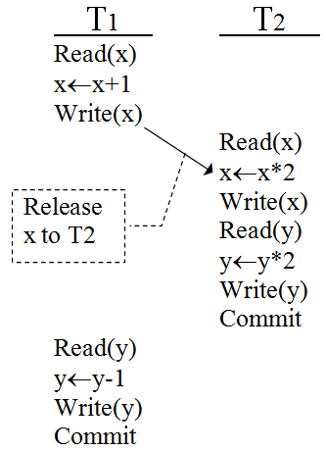
Example – Early release of data
Initial: x = 50 y = 20
Result of above scheduling:
x = 102 y = 39
Result of schedule {T1,T2}:
x = 102 y = 38
Result of schedule {T2,T1}:
x = 101 y = 39
Basic LM algorithm may generate non-serializable schedule!

Slide 15
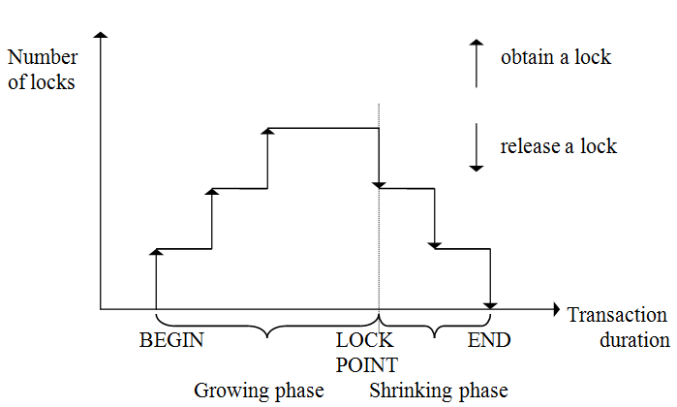
Two-Phase Locking (2PL)
Note: (1). 2PL is serializable; (2) 2PL can cause cascading aborts!

Slide 16
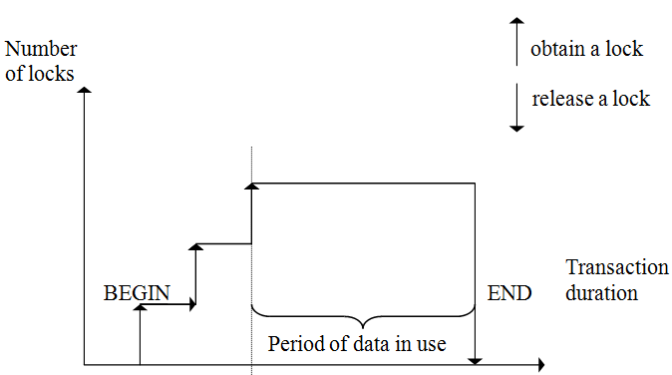
Strict 2PL (S2PL)
S2PL provides degree 3 consistency!
S2PL requires minimal modification to 2PL algorithm.

Slide 17
Details
The TM algorithm and cooperative S2PL algorithm, algorithm 11.2 and 11.3, are presented on p314-316.
Read them for details.

Slide 18
Locking-based Concurrency Control Algorithms
Section 11.3
Subsection 11.3.1
Centralized 2PL for Distributed Databases

Slide 19
11.3.1 Centralized 2PL for Distributed Databases
A method to delegate lock management responsibility to a single site only, known as primary 2PL algorithm.
Coordinating TM
The TM at the site where the transaction is initiated.
Participating site
Those at which database operations to be carried out.

Slide 20
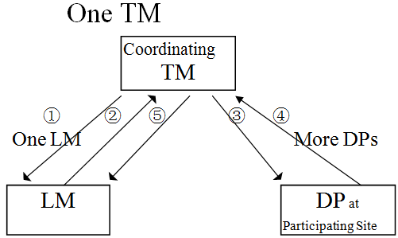
Communication structure of centralized 2PL
Messages:
Lock request
Lock granted
Database operation
End of database operation
Release locks

Slide 21
Communication structure of centralized 2PL
Algorithms for Centralized 2PL TM and LM – see algorithm 11.4 and 11.5 on p319, 321.
Problems:
poor performance and reliability.

Slide 22
Locking-based Concurrency Control Algorithms
Section 11.3
Subsection 11.3.2
Distributed 2PL

Slide 23
11.3.2 Distributed 2PL
There is a lock manager at every site.
Concurrency control is accomplished by the cooperation of lock manager at the sites where data are involved in the set of transactions.
If database is not replicated, distributed 2PL becomes primary copy 2PL.
For replicated database, a Read One Write All protocol is needed.

Slide 24
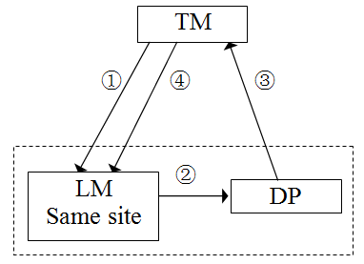
Communication structure
Messages:
Lock request
Lock granted
End of database operation
Release Lock
Differences between centralized 2PL and distributed 2PL can be observed by looking at the communication structures.

Slide 25
Differences between centralized 2PL and distributed 2PL
Centralized 2PL
Distributed 2PL
Lock request
Lock granted
Database operation
End of database operation
Release locks
Lock request
Lock granted
End of database operation
Release Lock

Slide 26
Deadlocks
Note: 2PL may lead to deadlocks
Need to avoid cycles in wait-for graph (WFG) between transactions
Many deadlock solutions
Detection vs. prevention
Timeouts
Wait-die
Wound-wait
T1 L(X), r(X), L(Y)
T2 L(Y), r(Y), L(X)

Slide 27
Wait-die Scheme
When transaction Ti requests a data item currently held by Tj, Ti is allowed to wait only if it has a timestamp smaller than that of Tj (That is Ti is older than Tj), otherwise Ti is rolled back (dies).
(1) If TS(Ti) < TS(Tj) − that is Ti, which is requesting a conflicting lock, is older than Tj − then Ti is allowed to wait until the data-item is available.
(2) If TS(Ti) > TS(tj) − that is Ti is younger than Tj − then Ti dies. Ti is restarted later with a random delay but with the same timestamp.

Slide 28
Wait-die Scheme
When transaction Ti requests a data item currently held by Tj, Ti is allowed to wait only if it has a timestamp smaller than that of Tj (That is Ti is older than Tj), otherwise Ti is rolled back (dies).
Suppose that transaction T22, T23, T24 have time-stamps 5, 10 and 15 respectively. If T22requests a data item held by T23 then T22 will wait. If T24 requests a data item held by T23, then T24 will be rolled back.

Slide 29
Wound-wait scheme
A counterpart to the wait-die scheme.
When Transaction Ti requests a data item held by Tj, Ti is allowed to wait only if it has a timestamp larger than that of Tj, otherwise Tj is rolled back (Tj is wounded by Ti).
(1) If TS(Ti) < TS(Tj), then Ti forces Tj to be rolled back − that is Ti wounds Tj. Tj is restarted later with a random delay but with the same timestamp.
(2) If TS(Ti) > TS(Tj), then Ti is forced to wait until the resource is available.

Slide 30
Wound-wait scheme
A counterpart to the wait-die scheme.
When Transaction Ti requests a data item held by Tj, Ti is allowed to wait only if it has a timestamp larger than that of Tj, otherwise Tj is rolled back (Tj is wounded by Ti).
Suppose that Transactions T22, T23, T24 have time-stamps 5, 10 and 15 respectively . If T22requests a data item held by T23, then data item will be preempted from T23 and T23 will be rolled back. If T24 requests a data item held by T23, then T24 will wait.

Slide 31
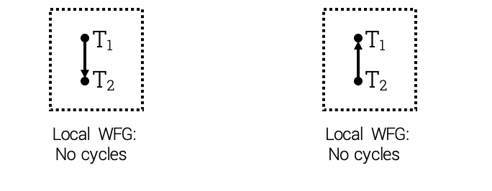
Deadlocks
Even if nodes check WFG locally, global deadlocks are possible

Slide 32
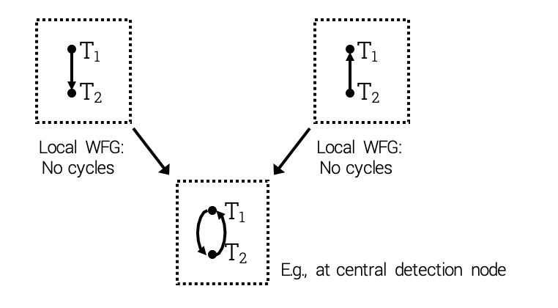
Deadlocks
Need to combine local WFG to discover global deadlocks

Slide 33
Timestamp-based Concurrency Control Algorithms
Section 11.4

Slide 34
11.4 Tiemstamp-based Concurrency Control Algorithms
Lock method maintains serializability by mutual exclusion.
Timestamp method maintains serializability by assigning a unique timestamp to every transaction and executing transactions accordingly.

Slide 35
What is a timestamp?
An identifier for transaction
Used to permit ordering
Monotonicity – timestamps generated by the same TM are monotonically increased in values.

Slide 36
How to assign a timestamp value
Use a monotonically increasing counter, but this is difficult in distributed environment.
Use a two-tuple form: <local-counter-value, site-identifier>
Use another two-tuple form: <local-system-clock, site-identifier>
site ID is put in the least significant position to avoid the situation that timestamps from a site will always be larger/smaller than timestamps from another site.

Slide 37
TO (Timestamps Ordering) Rule
Given two conflicting operations O_{ij}(x) and O_{kl}(x) belonging to transaction T_{i} and T_{k} respectively, O_{ij}(x) is executed before O_{kl}(x) iff ts(T_{i}) < ts(T_{k}), i.e. the older transaction gets executed first.
ts(T_{i}) - the timestamp value of transaction T_{i}.

Slide 38
Consider the previous example
Initial: x = 50 y = 20
Result of above scheduling:
x = 102 y = 39
Result of schedule {T1,T2}:
x = 102 y = 38
Result of schedule {T2,T1}:
x = 101 y = 39
Basic LM algorithm may generate non-serializable schedule!

Slide 39
Schedule by the TO Rule
Basic procedure:
Check each new operation against conflicting operations that have been scheduled;
IF the new operation belongs to a younger (later) transaction than all conflicting ones THEN
accept it;
ELSE
reject it;
restart the entire transaction with a new timestamp.
This means the system maintains the execution order according to the timestamps order.

Slide 40
Tiemstamp-based Concurrency Control Algorithms
Section 11.4
Subsection 11.4.1
Basic TO Algorithm

Slide 41
11.4.1 Basic TO Algorithm
TM is responsible for assigning a timestamp to each transaction and attaching it to each database operation.
Two timestamps maintained by DBMS for each data item x for scheduling:
rts(x): the largest (youngest) of timestamps of transactions that have read x.
wts(x): the largest (youngest) of timestamps of transactions that have written x.

Slide 42
11.4.1 Basic TO Algorithm
ts(T) - the timestamp for a new transaction accessing x
For read
IF ts(T) > rts(x) THEN
send read(x) to DP;
rts(x) ← ts(T).
END IF

Slide 43
11.4.1 Basic TO Algorithm
For write
IF ts(T) > rts(x) AND ts(T) > wts(x) THEN
send write(x) to DP;
rts(x) ← ts(T);
wts(x) ← ts(T).
END IF
For basic timestamp algorithms for the TM and scheduler, read p319 to p322.

Slide 44
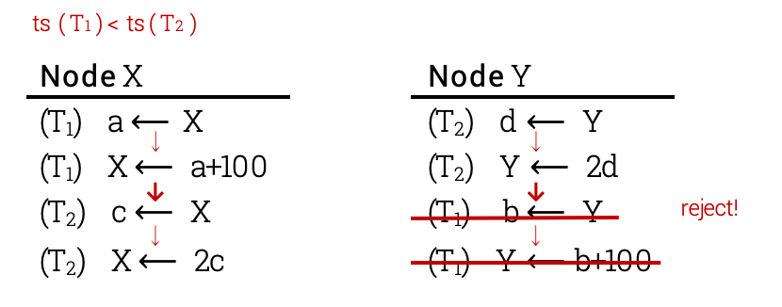
11.4.1 Basic TO Algorithm

Slide 45
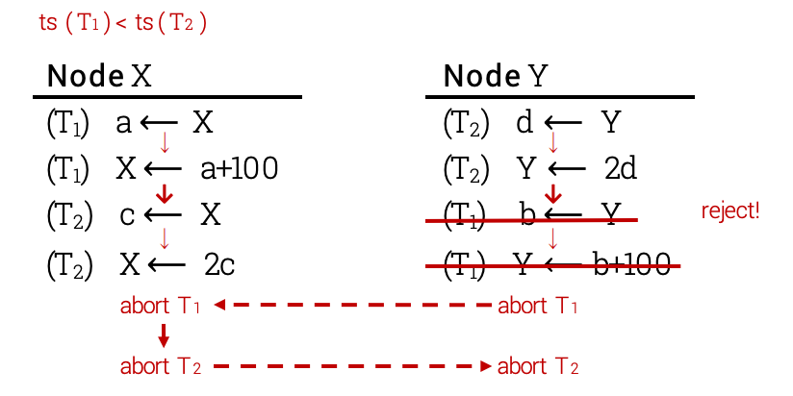
11.4.1 Basic TO Algorithm
cascading aborts

Slide 46
Strict TO
Lock written items until it is certain that writing transaction has been successful
Avoid cascading aborts

Slide 47
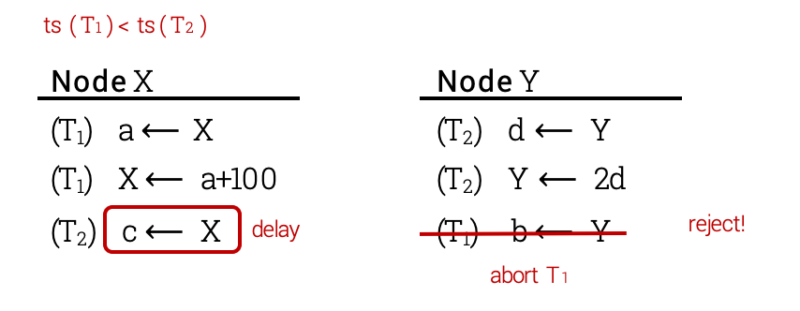
Strict TO
Lock written items until it is certain that writing transaction has been successful
Avoid cascading aborts

Slide 48
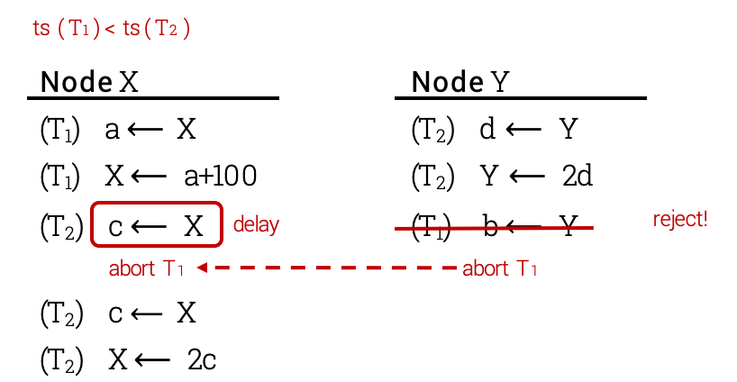
Strict TO
Lock written items until it is certain that writing transaction has been successful
Avoid cascading aborts

Slide 49
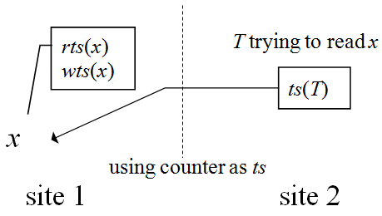
Maintain timestamps among sites
When ts(T) < rts(x), the read is rejected.
Site 2 adjusts its timestamp by making it larger than rts(x) and restart.
Why? Avoid ts(site 1) >> ts(site 2) which may make operations from site 2 never get executed.

Slide 50
2PL <> TO
T1 w1[Y]
T2 r2[X] r2[Y] w2[Z]
T3 w3[X]
ts(T1) < ts(T2) < ts(T3)
S r2[X] w3[X] w1 [Y] r2[Y] w2[Z]
S could be produced with TO but not with 2PL

Slide 51
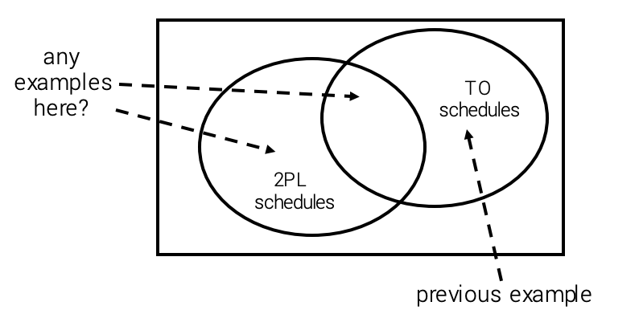
2PL <> TO

Slide 52
Timestamp-based Concurrency Control Algorithms
Section 11.4
Subsection 11.4.2
Conservative TO Algorithm

Slide 53
11.4.2 Conservative TO Algorithm
Basic TO algorithm:
dead lock free but too many restarts.
Can you give an example?
Conservative TO algorithm:
delays each operation until there is an assurance that no operation with smaller timestamps can arrive at that scheduler.

Slide 54
Basic technique
At site i, each scheduler i has one queue Q_{ij} for each TM at site j in the system.
An operation from TM_{j} is placed in Q_{ij} in increasing timestamp order.
Scheduler i executes operation from all queues in this order also.
This reduces the number of restarts.
But restart may occur when a queue is empty.

Slide 55
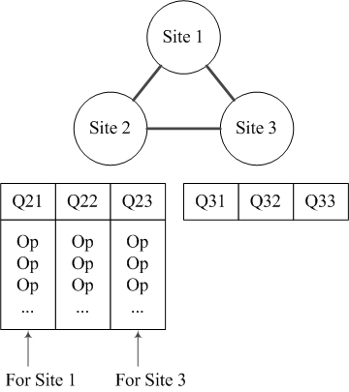
Basic technique
Suppose Q23 is empty and scheduler 2 chooses an operation op from Q21 and Q22.
But later a conflicting operation with smaller timestamp than ts(op) from site 3 arrives, then this operation must be rejected and restarted!

Slide 56
Improvement 1
Use extremely conservative algorithm complemented by
In each queue there is at least one operation, or
if a TM does not have a transaction to process, it has to send a message periodically to inform that in the future it will send timestamp larger than that of the message.
Extremely conservative algorithm actually executes transaction serially at each site – too conservative!
An operation may have to wait for the coming of a younger operation of an empty queue – a delay problem!

Slide 57
Improvement 2
Define transaction classes and set a queue for each class instead of each TM.
Transaction classes are defined by their read set and write set:
If a transaction’s read set and write set are subset of a class, then the transaction belongs to that class.
It is difficult to define transaction classes!

Slide 58
Timestamp-based Concurrency Control Algorithms
Section 11.4
Subsection 11.4.3
Multiversion TO Algorithm

Slide 59
11.4.3 Multiversion TO Algorithm
Each write creates a new version of the data item to be updated. Versions are transparent to users.
Transactions are processed on a state of database that it would have seen if they were executed serially.

Slide 60
Work of the scheduler
For a read from transaction T_{i} , i.e. R_{i}(x) :
Find a version of x, say x_{v} , s.t. ts(x_{v}) is the largest timestamp less than ts(T_{i});
Send R_{i}(x_{v}) to the data processor.

Slide 61
Work of the scheduler
For W_{i}(x) from transaction T_{i} :
IF the scheduler has already processed a R_{j}(x_{r}) such that ts(T_{i})<ts(x_{r})<ts(T_{j}) THEN
reject W_{i}(x);
ELSE
translate W_{i}(x) into W_{i}(x_{w});
ts(x_{w}) ← ts(T_{i}).

Slide 62
Work of the scheduler
This scheduler generates serializable schedule.
Versions may be purged when they are not accessed by any transactions.

Slide 63
Optimistic Concurrency Control Algorithms
Section 11.5

Slide 64
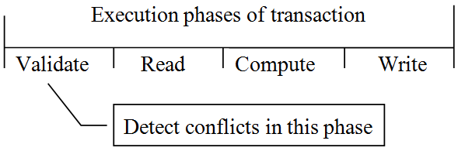
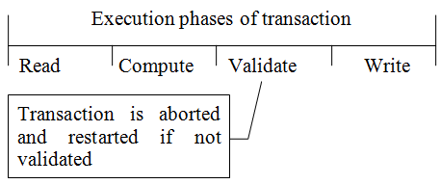
11.5 Optimistic Concurrency Control Algorithms
Pessimistic algorithms assume conflicts happen quite often.
Optimistic algorithms delay the validation phase until write phase.

Slide 65
Concepts
Timestamps are only associated with transactions, but not with data items.
Timestamps are assigned at the beginning of validation phase, but not the initialization of transactions.
T_{i} | A transaction
T_{ij} | a sub-transaction of T_{i} executed at site j

Slide 66
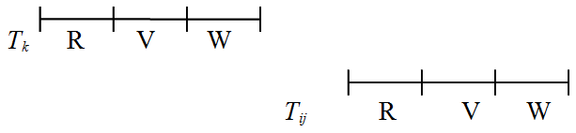
Local validation of T_{ij} – Rule 1
If all T_{k} with ts(T_{k}) < ts(T_{ij}) have completed before T_{ij} has started, then the validation succeeds.
This is a serial order.

Slide 67
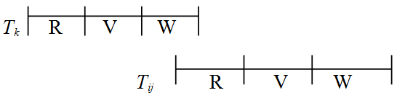
Local validation of T_{ij} – Rule 2
If there is any transaction T_{k} , s.t.
ts(T_{k}) < ts(T_{ij}), and
T_{k} is in write phase, and
T_{ij} is in read phase, and
WS(T_{k}) ∩ RS(T_{ij}) = ∅
then the validation succeeds.

Slide 68
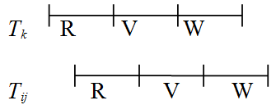
Local validation of T_{ij} – Rule 3
If there is any transaction T_{k} , s.t.
ts(T_{k}) < ts(T_{ij}), and
T_{k} completes the read phase before T_{ij} completes the read phase, and
WS(T_{k}) ∩ RS(T_{ij}) = ∅ , and
RS(T_{k}) ∩ WS(T_{ij}) = ∅
then the validation succeeds.

Slide 69
Global validation
There is no known optimistic method for doing it!
One pessimistic method for doing it
A transaction is globally validated if all the transactions that precede it in the serialization order (at that site) terminate i.e. commit/abort.

Slide 70
Conclusion
Advantages of optimistic algorithm
higher concurrency.
Disadvantages
higher storage cost for ordering of transactions.
No implementation at the time of writing the textbook.

