Slide 1
Distributed Database Systems
Welcome!

Slide 2
Teaching Staff
Instructor: Ju Fan (范举)
Associate Professor
School of Information / DEKE Lab
Renmin University of China Email: fanj@ruc.edu.cn
Homepage: http://iir.ruc.edu.cn/~fanj/
Office: Room 500, Information Building

Slide 3
Course Name
Distributed
Database
Systems

Slide 4
Teaching language
English

Slide 5
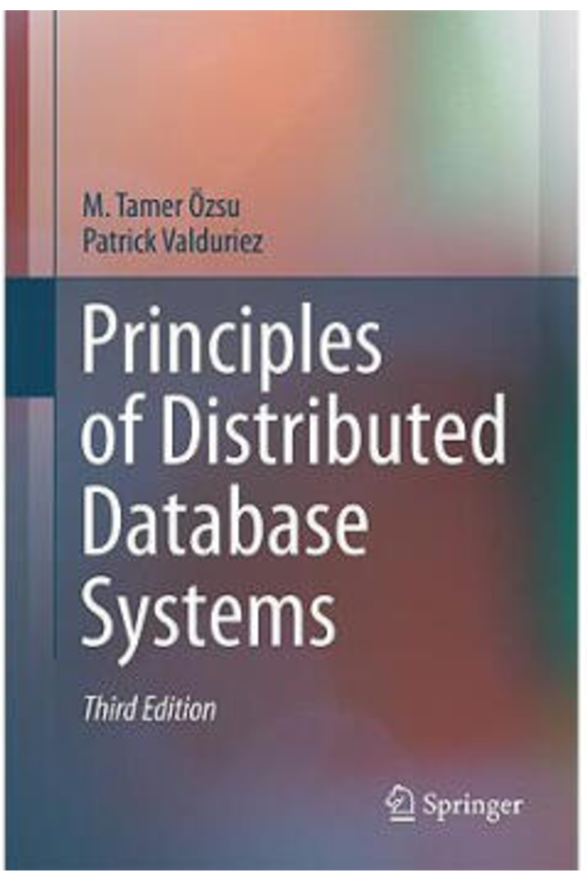

Textbook
Principles of Distributed Database Systems
(3nd Edition)
M. Tame Özsu
Patrick Valduriez
Springer, 2011
Price: RMB 73.30

Slide 6
Reference
Distributed Databases: Principles and Systems Ceri & Pelagatti McGraw-Hill, 1985
许多中文参考书

Slide 7
Prerequisite
Undergraduate database course
Computer networks

Slide 8
Contents
No. | Chapter # | Title
1 | 1 | Introduction
2 | 3 | Distributed Database Design
3 | 6 | Overview of Query Processing
4 | 7 | Query Decomposition and Data Localization
5 | 8 | Optimization of Distributed Queries
6 | 10 | Introduction to Transaction Management
7 | 11 | Distributed Concurrency Control
8 | 12 | Distributed DBMS Reliability

Slide 9
Contents- project
Design and implementation of a course project of DDBMS capable of
defining DDB
support of SQL
Teamwork of 3 members
To be evaluated by a benchmark of data and queries
Demo

Slide 10
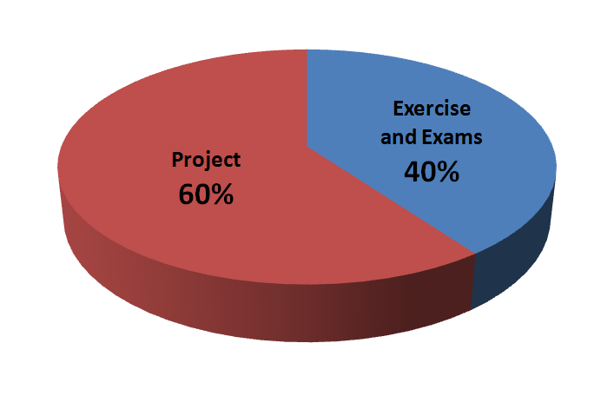
Evaluation

Slide 11
Course home page
https://github.com/fanju1984/ddb/wiki
On the home page you can
Get notifications
Download the latest courseware
Download other related materials

Slide 12
Why take this course?

Slide 13
History of DB Systems
1960’s
IBM IMS
DBTG network data model
1970’s
E. F. Codd RDB model
Pioneering systems: INGRES, System R
1980’s
Booming of RDBs
Federated, Multi-database
DDB
OODB

Slide 14
History of DB Systems
1990’s
Merge of RDB and OODB
Internet Fame
P2P model
2000’s
XML DB
Web data processing
Semantic Web
Data Integration

Slide 15
History of DB Systems
2010’s
NoSQL
NewSQL
More details in course 分布式系统与云计算（卢卫、覃雄派）

Slide 16
Why study DDB
Reason 1: The fundamental principles for parallel & distributed data processing
Reason 2: Scientific training on

Slide 17
Why study DDB
Reason 1: The fundamental principles for parallel & distributed data processing
Reason 2: Scientific training on
basic concepts
problem formulation
identification of key technical issues
algorithm presentation
system level design and implementation

Slide 18
往届学生反馈……
都觉得有难度……
在编码的过程中遇到了许许多多的问题
项目伊始，我就预料到工作量可能比较大
我会记住 12.30 午夜阳光地带编程的
当自己三步一Bug，每天Debug想要放弃的时候，发现已经写了这么 多，征服它的愿望越来越强烈，还好最后坚持下来了
这门课真是一点也不“水”

Slide 19
往届学生反馈……
但都觉得收获很大！
我在这门课学习了分布式系统的知识、提升了coding能力、锻炼了团队合 作的能力
在本次大作业中有许多收获：明白了数据结构对于整个系统实现的重要性……其次，任务的切割也非常重 要，通过预先定义好的接口能让多个任务并行的完成。
这门课真的满满干货，上的很值得，大作业做的也很值得，原来 我真的可以学计算机耶!
感谢范老师，他讲课超棒!这门课很硬，收获很大
总结一下，选这门课，值。

Slide 20
Friendly Reminding Messages from the Instructor

Slide 21
课程设计中应注意的问题
选课太多，疲于奔命，无暇顾忌
缺乏总体设计，系统划分不当，随意编程，接口混乱
设计目标很高，实现时想一步到位，指望一次成功
选择开发环境欠考虑
代码管理混乱，难以形成正确版本

Slide 22
实现时不考虑调试需求（例如反复建立表格，生成数据字典）
匆忙上马，反复折腾
各自为战，缺少交流
众人平等，没有核心
分工不均，事后抱怨

