Slide 1
Distributed Database Systems
Autumn, 2019
Chapter 6
Overview of Query Processing

Slide 2
SQL: Non-Procedural Language of RDB
End user uses non-procedural languages to express queries.
SELECT ENO,ENAME
FROM EMP
WHERE TITLE=“Programmer”
Formally, SQL is a tuple calculus language

Slide 3
SQL: Non-Procedural Language of RDB
Tuple calculus
{ t | F(t) } where:
t : tuple variable
F(t) : well formed formula
Example
Get the No. and name of all managers

Slide 4
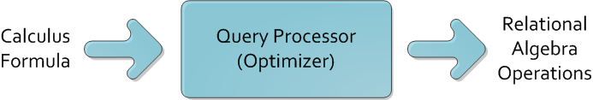
Query Processor
Query processor transforms queries into procedural operations to access data

Slide 5
Query Processor
Distributed query processor has to deal with
query decomposition, and
data localization

Slide 6
Query Processing Problems

Slide 7
Centralized Query Processing
Centralized query processor must
transform calculus query into algebra operations, and
choose the best execution plan
Example:
SELECT ENAME
FROM EMP E,ASG G
WHERE E.ENO = G.ENO
AND RESP=“Manager”

Slide 8
Centralized Query Processing
Relational Algebra 1
Relational Algebra 2
Execution plan 2 is better for consuming less resources!

Slide 9
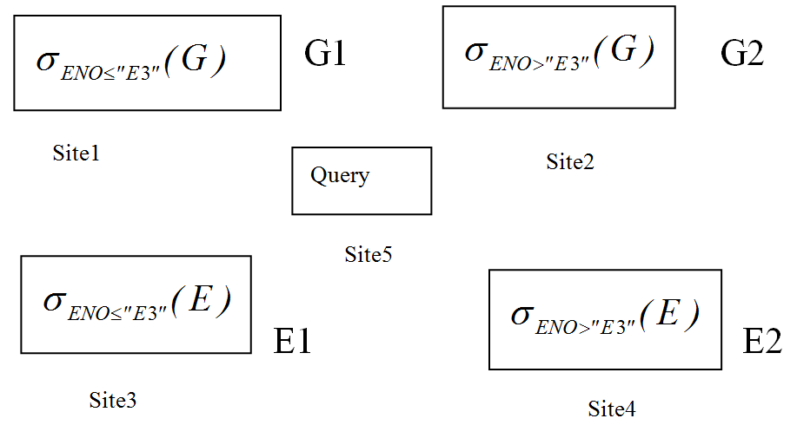
Distributed Query Processing
Let us consider an example
Fragments and Distribution of E and G

Slide 10
Distributed Query Processing
The Query Example from centralized optimization
Simple plan to execute the query :
To transport all segments to query site and execute there.
too much network traffic, very costly.

Slide 11
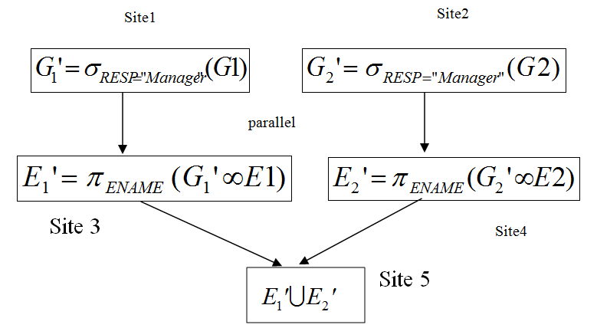
Distributed Query Processing
Optimized Distributed Query Processing

Slide 12
Distributed Query Processing
In DDB, the query processor must consider the communication cost and select the best site!
Same query as last example, but G and E are distributed.

Slide 13
Overview of Query Processing

Slide 14
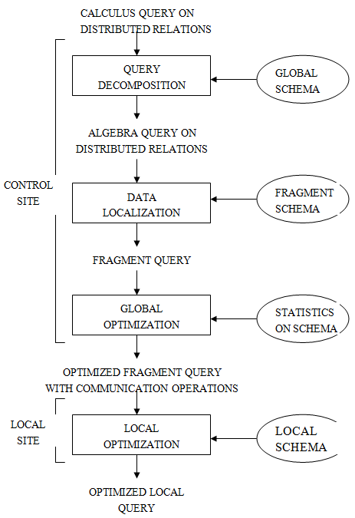
Generic Laying Scheme for Distributed Query Processing

Slide 15
Query Decomposition
Decompose calculus query into algebra query using global conceptual schema information.
Step 1 – calculus normalization
Step 2 – semantic analysis to reject incorrect queries
Step 3 – simplification to eliminate redundant components
Step 4 – translation of calculus query into optimized algebra query.

Slide 16
Data Localization
Distributed query is mapped into a fragment query and simplified to produce a good one.

Slide 17
Global Query Optimization
Find an execution strategy close to optimal.
Find the best ordering of operations in the fragment query, including communication operations.
Cost function defined in time is required.

Slide 18
Local Query Optimization
Centralized system algorithms
(to be discussed in chapter 9)

Slide 19
Objectives of Query Processing

Slide 20
Objectives of Query Processing
Two-fold objectives:
Transformation, and
Optimization

Slide 21
Objectives of Query Processing
Cost to be considered for optimization:
CPU time
I/O time, and
Communication time
WAN: the last cost is dominant
LAN: all three are equal

Slide 22
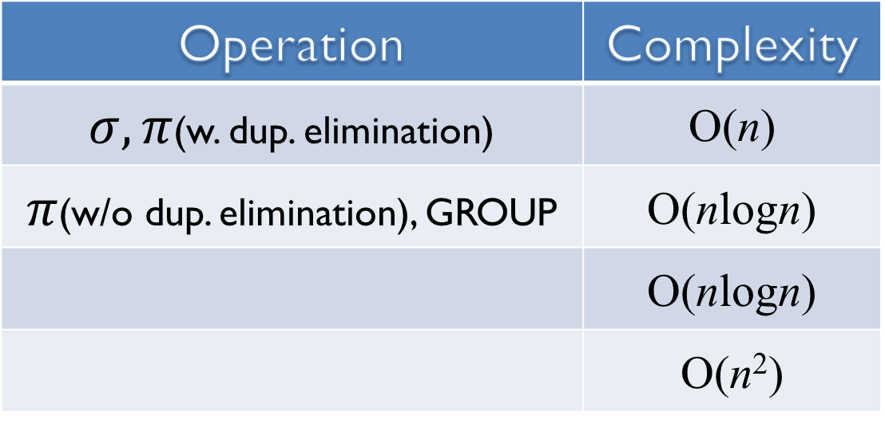
Complexity of Relational Algebra Operations
Measured by n (cardinality) and tuples are sorted on comparison attributes
Operation | Complexity
$σ, π$(w. dup. elimination) | O(n)
$π$(w/o dup. elimination), GROUP | O(nlogn)
 | O(nlogn)
 | O(n²)

Slide 23
Types of Optimization
Exhaustive search
Workable for small solution space
Heuristics
Perform first, semi-join, etc. for large solution space

Slide 24
Optimization Timing
Static
Do it at compiling time by using statistics, optimized once, but executed many times.
Dynamic
Do it at execution time, accurate, repeated for every execution, expensive.

Slide 25
Statistics
Facts of
Cardinalities
Attribute value distribution
Size of relation, etc.
Provided to query optimizer and periodically updated.

Slide 26
Decision Site
For query optimization, it may be done by
Single site – centralized approach, or
All the sites involved – distributed, or
Hybrid – one site makes major decision in cooperation with other sites making local decisions

