Slide 1
WEB DEVELOPMENT INTERNSHIP
Internship Report & Presentation
InAmigos Foundation
Alaukik Awasthi • 21 Aug 2026 – 3 Sep 2026
B.Tech – Artificial Intelligence | IILM University, Greater Noida

Slide 2




ROADMAP
Internship Agenda
From opportunity to learning
Internship Overview
Objectives
Organisation, role and duration
What the internship was designed to develop
Work
Learning & Evidence
Web-development projects and AI-oriented product work
Outcomes, deployment and completion certificate
InAmigos Foundation | Alaukik Awasthi
2

Slide 3




AT A GLANCE
Internship Overview
A confirmed web-development internship
ORGANISATION
INTERN
ROLE
InAmigos Foundation
Alaukik Awasthi
Web Development Intern
DURATION
CERTIFICATE ISSUED
PROGRAMME
21 Aug – 3 Sep 2026
10 September 2026
B.Tech – Artificial Intelligence
InAmigos Foundation | Alaukik Awasthi
3

Slide 4



THE HOST ORGANISATION
Organisation Profile
InAmigos Foundation
Internship organisation: InAmigos Foundation
The internship certificate formally records successful completion of the internship
Uniting Minds For Change
Organisation identity tagline
Certificate signatory: Mr. Vignesh N, HR Operations Lead
InAmigos Foundation | Alaukik Awasthi
4

Slide 5





PURPOSE
Internship Objectives
What I aimed to gain
Practical exposure to web-development workflows
Stronger HTML, CSS and JavaScript skills
Understanding of planning, development, testing and deployment
Experience with GitHub and GitHub Pages
Exposure to AI-oriented web product thinking
Improved documentation and technical presentation
InAmigos Foundation | Alaukik Awasthi
5

Slide 6






BOUNDARIES OF WORK
Scope of the Internship
From front-end development to product presentation
NGO Website Development
Website Improvement & Analysis
Learnova — AI-Powered Learning Platform Concept
NGO Feature-Highlight Page
Project Deployment & Repository Management
Final Documentation & Reflection
InAmigos Foundation | Alaukik Awasthi
6

Slide 7




TECHNOLOGY RECORD
Technologies & Tools
HTML5
CSS3
JavaScript
GitHub
Page structure
Styling, layout & responsiveness
Client-side interaction
Repository management
GitHub Pages
VS Code
AI / Generative AI Tools
Static deployment
Development environment
Ideation & development support
InAmigos Foundation | Alaukik Awasthi
7

Slide 8




PROCESS
Work Methodology
A practical development workflow
1
2
3
4
5
6
Understand
Plan
Develop
Test & Refine
Deploy
Document
the requirement
interface, content & functionality
the required components
debug and refine
eligible static projects
the work and learning
InAmigos Foundation | Alaukik Awasthi
8

Slide 9
DELIVERABLES
Project Work
What I completed
01
Task 1
InAmigos Foundation website
02
Task 2
Website improvement / analysis
03
Task 3
Learnova — AI-powered learning platform concept
04
Task 4
NGO feature-highlight website
05
Task 5
Final documentation, review and reflection
InAmigos Foundation | Alaukik Awasthi
9

Slide 10




TASK 3 — AI PRODUCT WORK
Learnova
AI-powered learning platform concept
Designed around a student-focused learning experience
AI Tutor concept for learning assistance
Study Tools for day-to-day study support
Learning Paths for structured learning
Responsive web interface
Published through GitHub Pages
InAmigos Foundation | Alaukik Awasthi
10

Slide 11





TASK 4 — ENGAGEMENT PAGE
NGO Feature Highlight
Designed around participation and impact
Donate
Volunteer
Impact
Campaigns
Testimonials
Contribution-focused action
Participation opportunity
Communicate results
Highlight initiatives
Build trust and social proof
InAmigos Foundation | Alaukik Awasthi
11

Slide 12
REFLECTION
Learning Outcomes
What this experience contributed
Better practical understanding of web development
Improved responsive UI and front-end skills
Hands-on GitHub and deployment experience
Exposure to AI product thinking
Better debugging and iterative improvement
Stronger documentation and presentation skills
InAmigos Foundation | Alaukik Awasthi
12

Slide 13
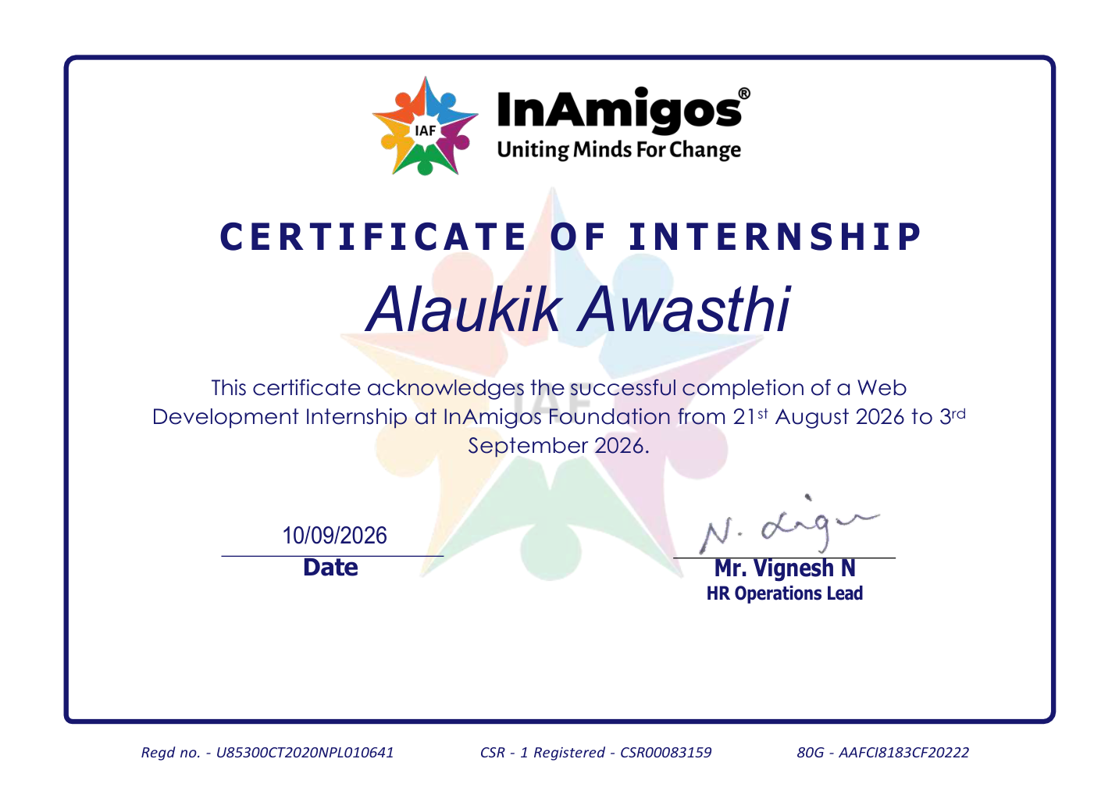

FORMAL EVIDENCE
Completion Certificate
Internship successfully completed
Web Development Internship — InAmigos Foundation
21 August 2026 – 3 September 2026
Certificate dated 10 September 2026
Signed by Mr. Vignesh N, HR Operations Lead
InAmigos Foundation | Alaukik Awasthi
13

Slide 14
THANK YOU
Questions & Discussion
Alaukik Awasthi • B.Tech – Artificial Intelligence
InAmigos Foundation

