Slide 1

Financial Analysis: Visa Inc. (V) & Mastercard Incorporated (MA) EWU: BADM 531 Student Alazar Hailemeskel
BADM 531 – Alazar Hailemeskel

Slide 2
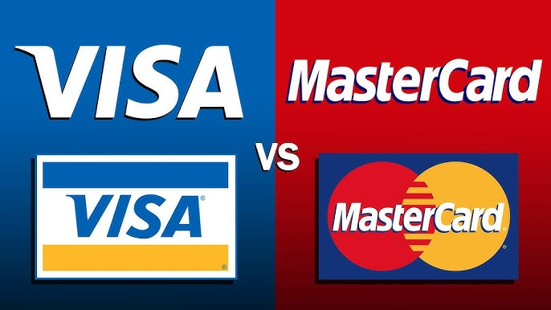
Company and Industry Background
• Visa Inc. (V): Founded in 1958, operates in over 200 countries.
• Mastercard Inc. (MA): Founded in 1966, operates in over 210 countries.

Slide 3
Financial Ratios Comparison (2024)
Metric | Visa | Mastercard
Current Ratio | 1.62 | 1.33
Debt-to-Equity | 1.25 | 4.51
ROE (%) | 41.5 | 45.2
Asset Turnover | 0.18 | 0.20
Net Profit Margin (%) | 55.0 | 52.3

Slide 4
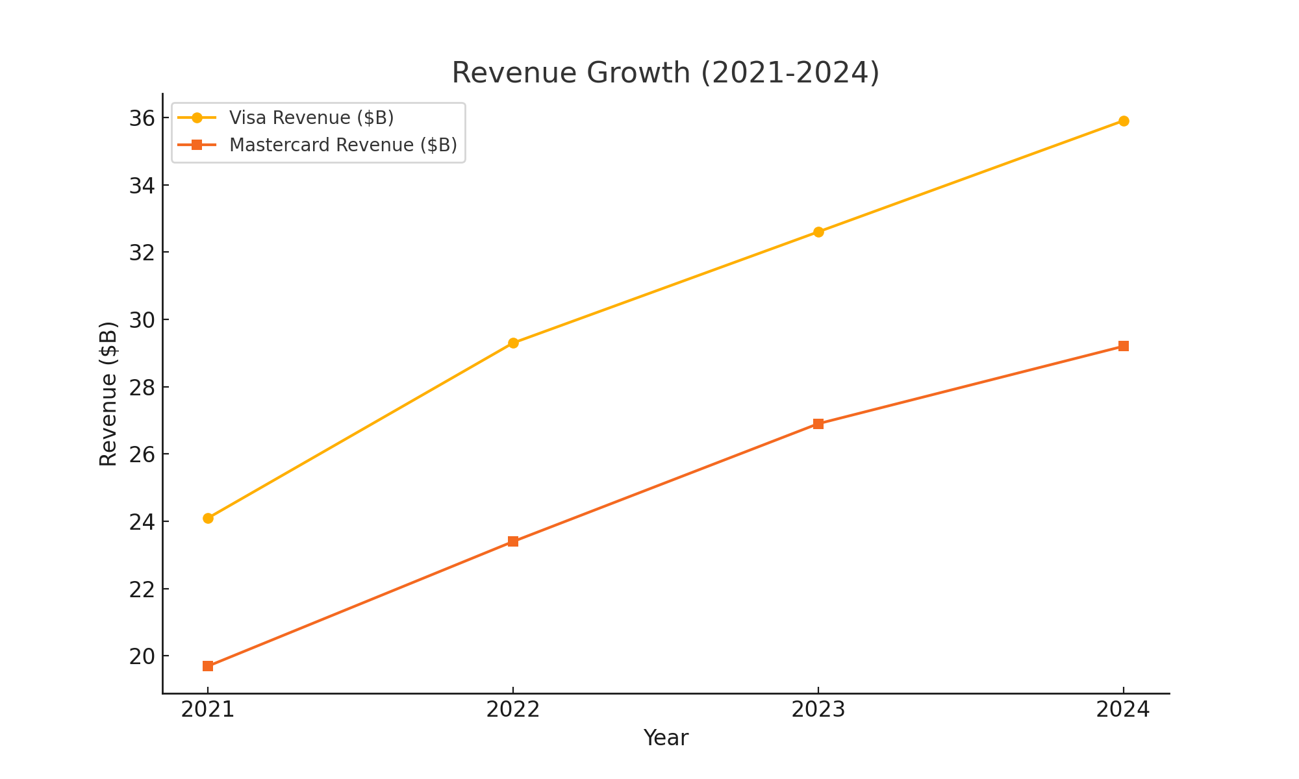
Revenue Growth (2021-2024)

Slide 5
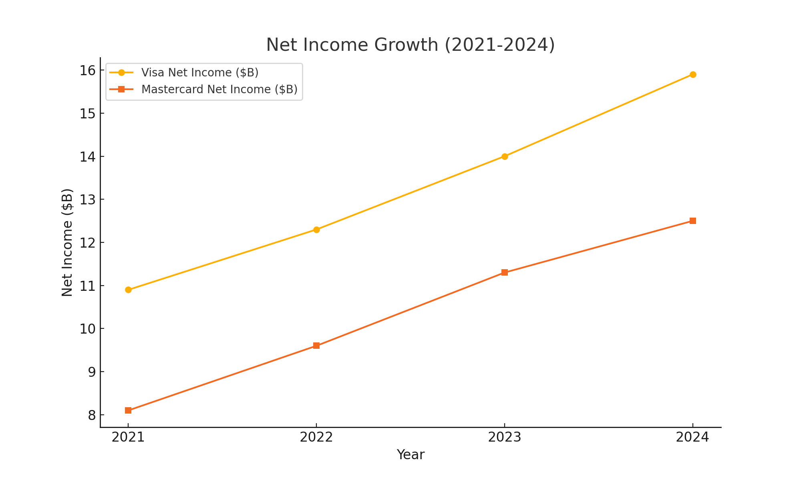
Net Income Growth (2021-2024)

Slide 6
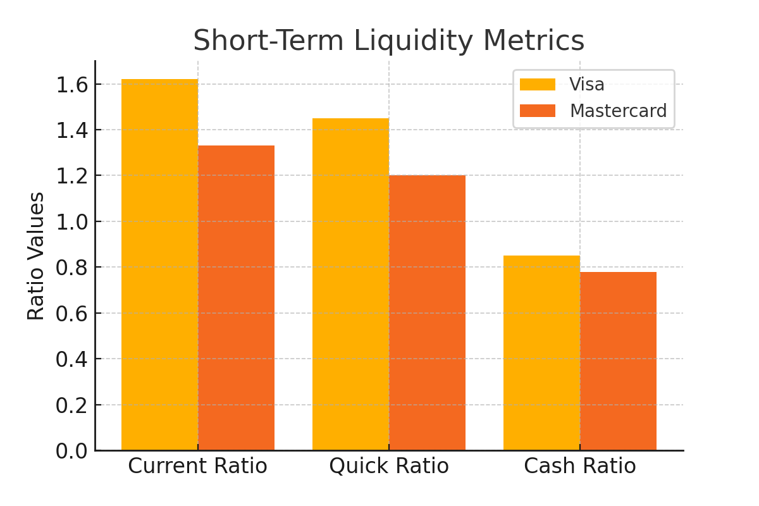
Short-Term Liquidity
Visa - Current Ratio: 1.62.
Mastercard - Current Ratio: 1.33.
Higher ratio indicates better short-term liquidity.

Slide 7
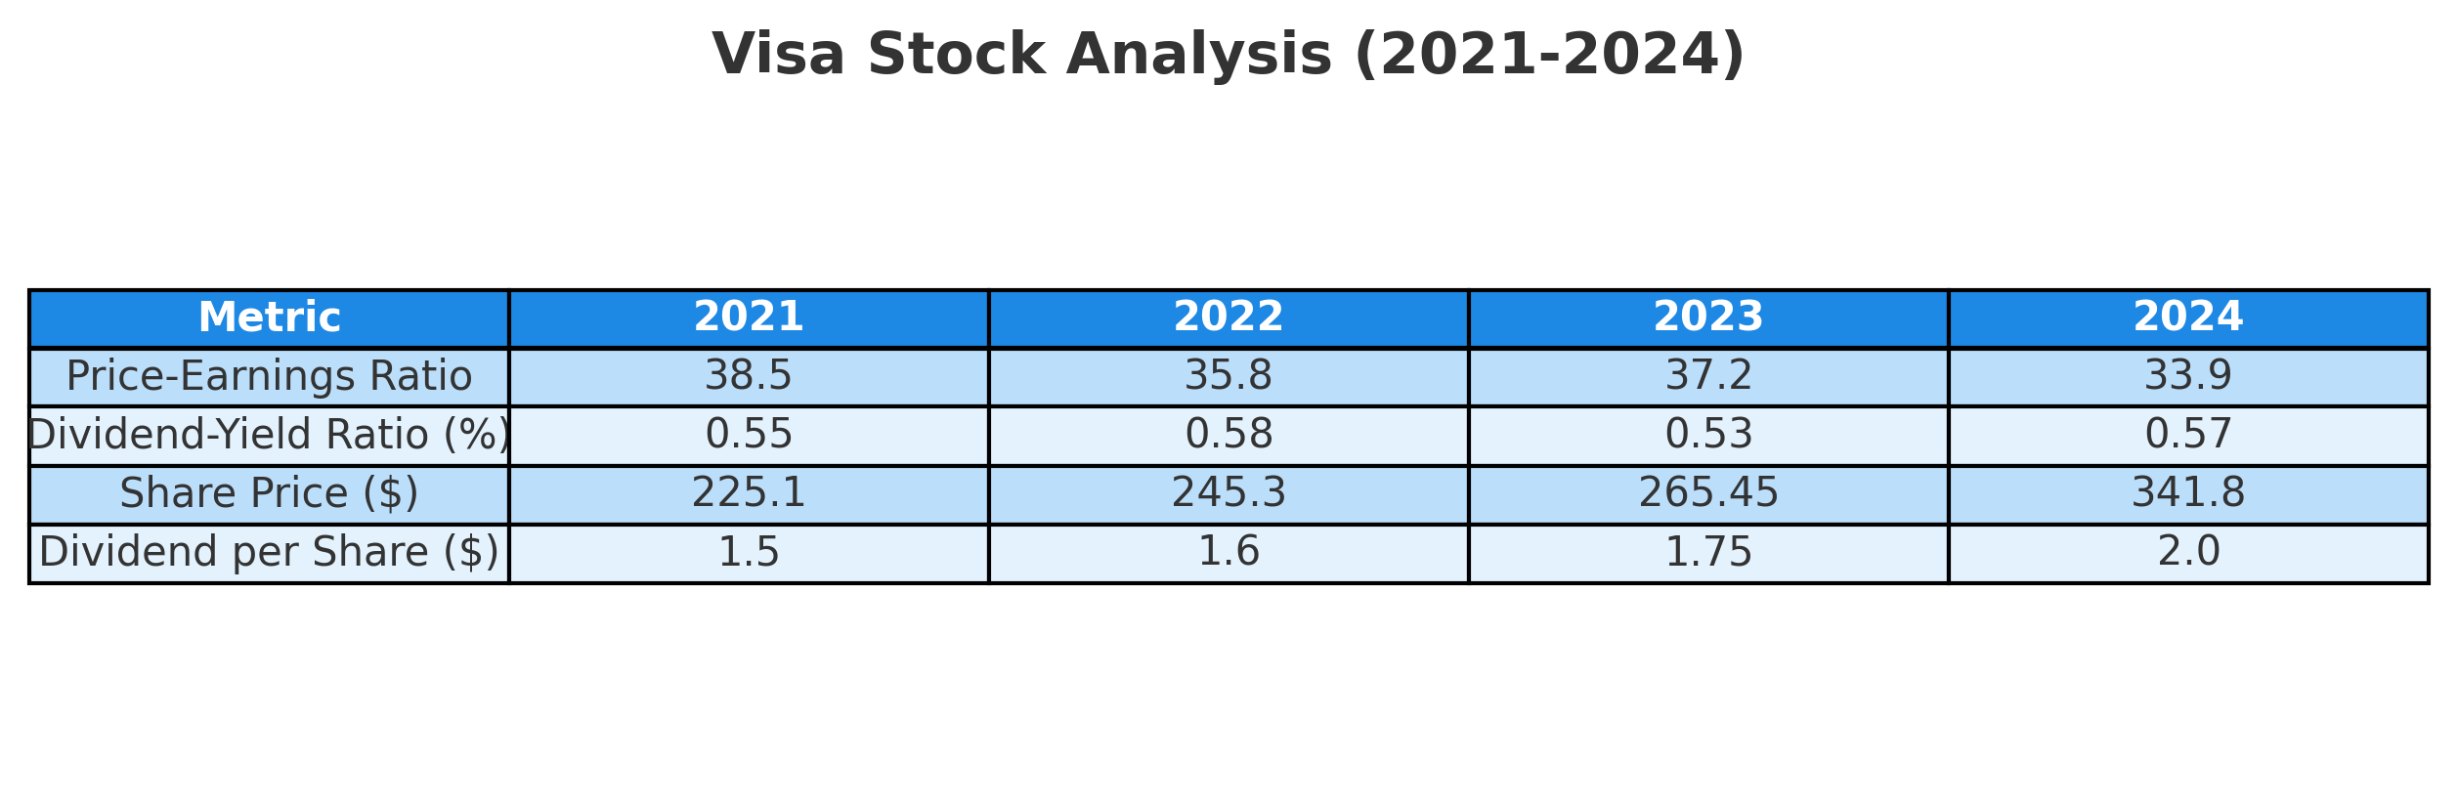
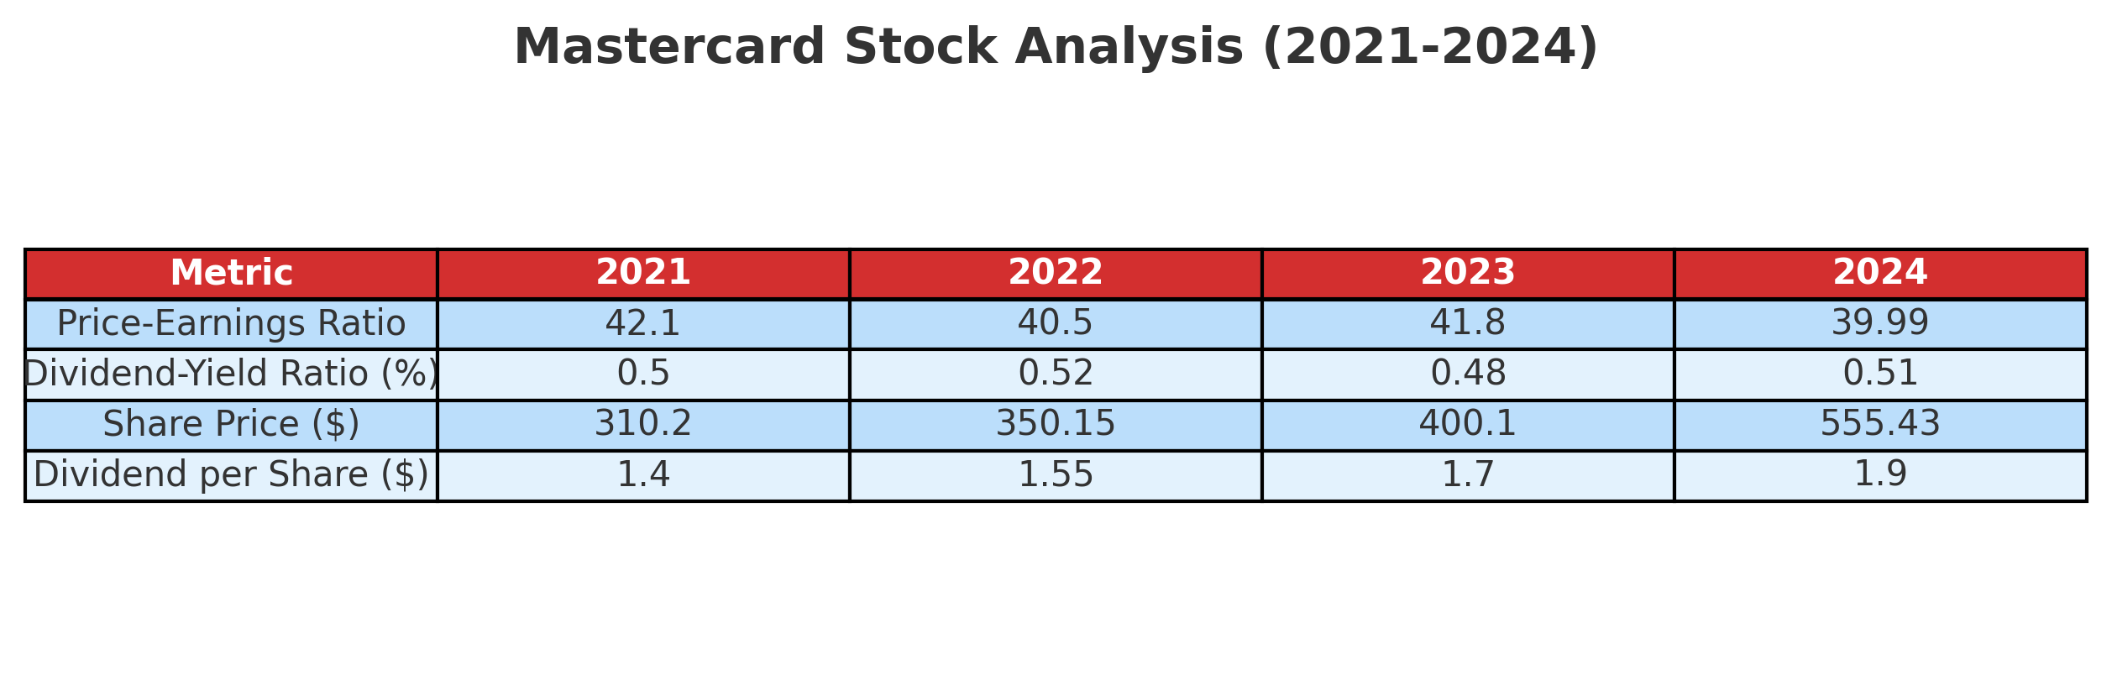
Stock Analysis
Visa - Stock Price: $341.80, P/E Ratio: 33.9.
Mastercard - Stock Price: $555.43, P/E Ratio: 39.99.
Both stocks are performing well, with Mastercard trading at a higher valuation.

Slide 8
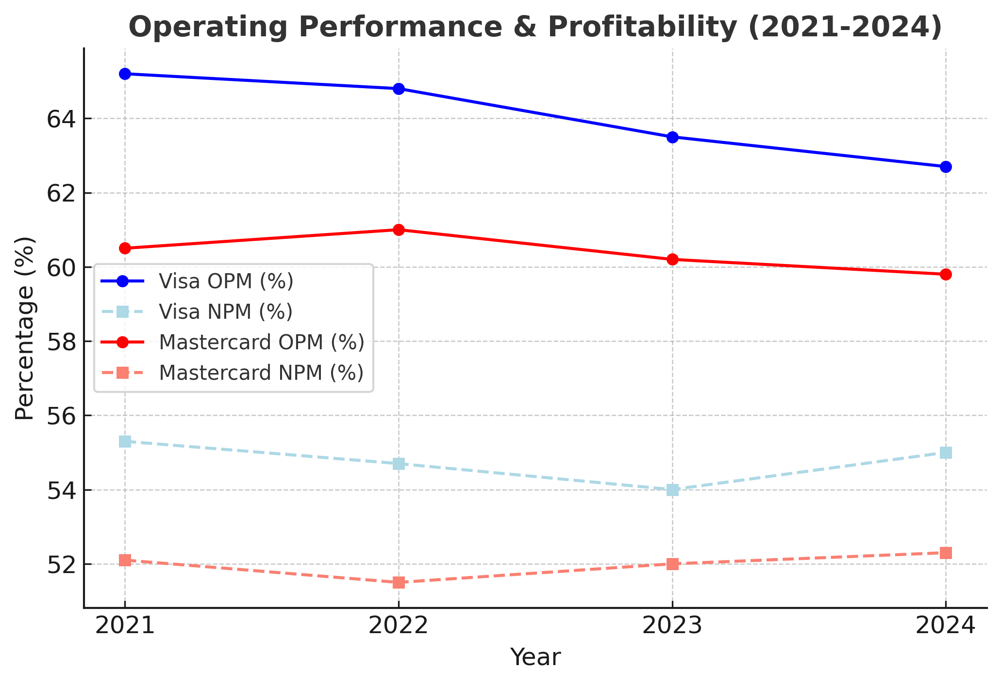
Operating Performance & Profitability
Visa - Net Profit Margin: 55.0%.
Mastercard - Net Profit Margin: 52.3%.
Visa has a slightly higher profit margin.

Slide 9
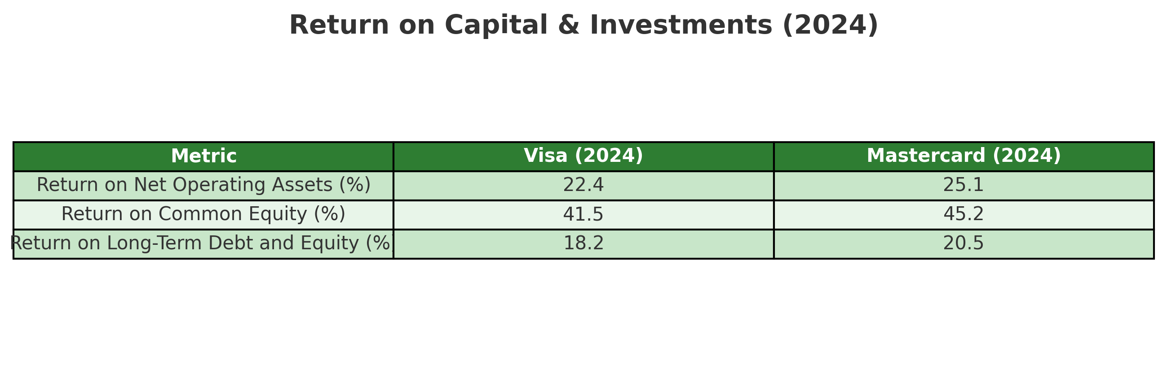
Visa - ROE: 41.5%.
Mastercard - ROE: 45.2%.
Both companies exhibit strong returns, with Mastercard slightly leading.

Slide 10
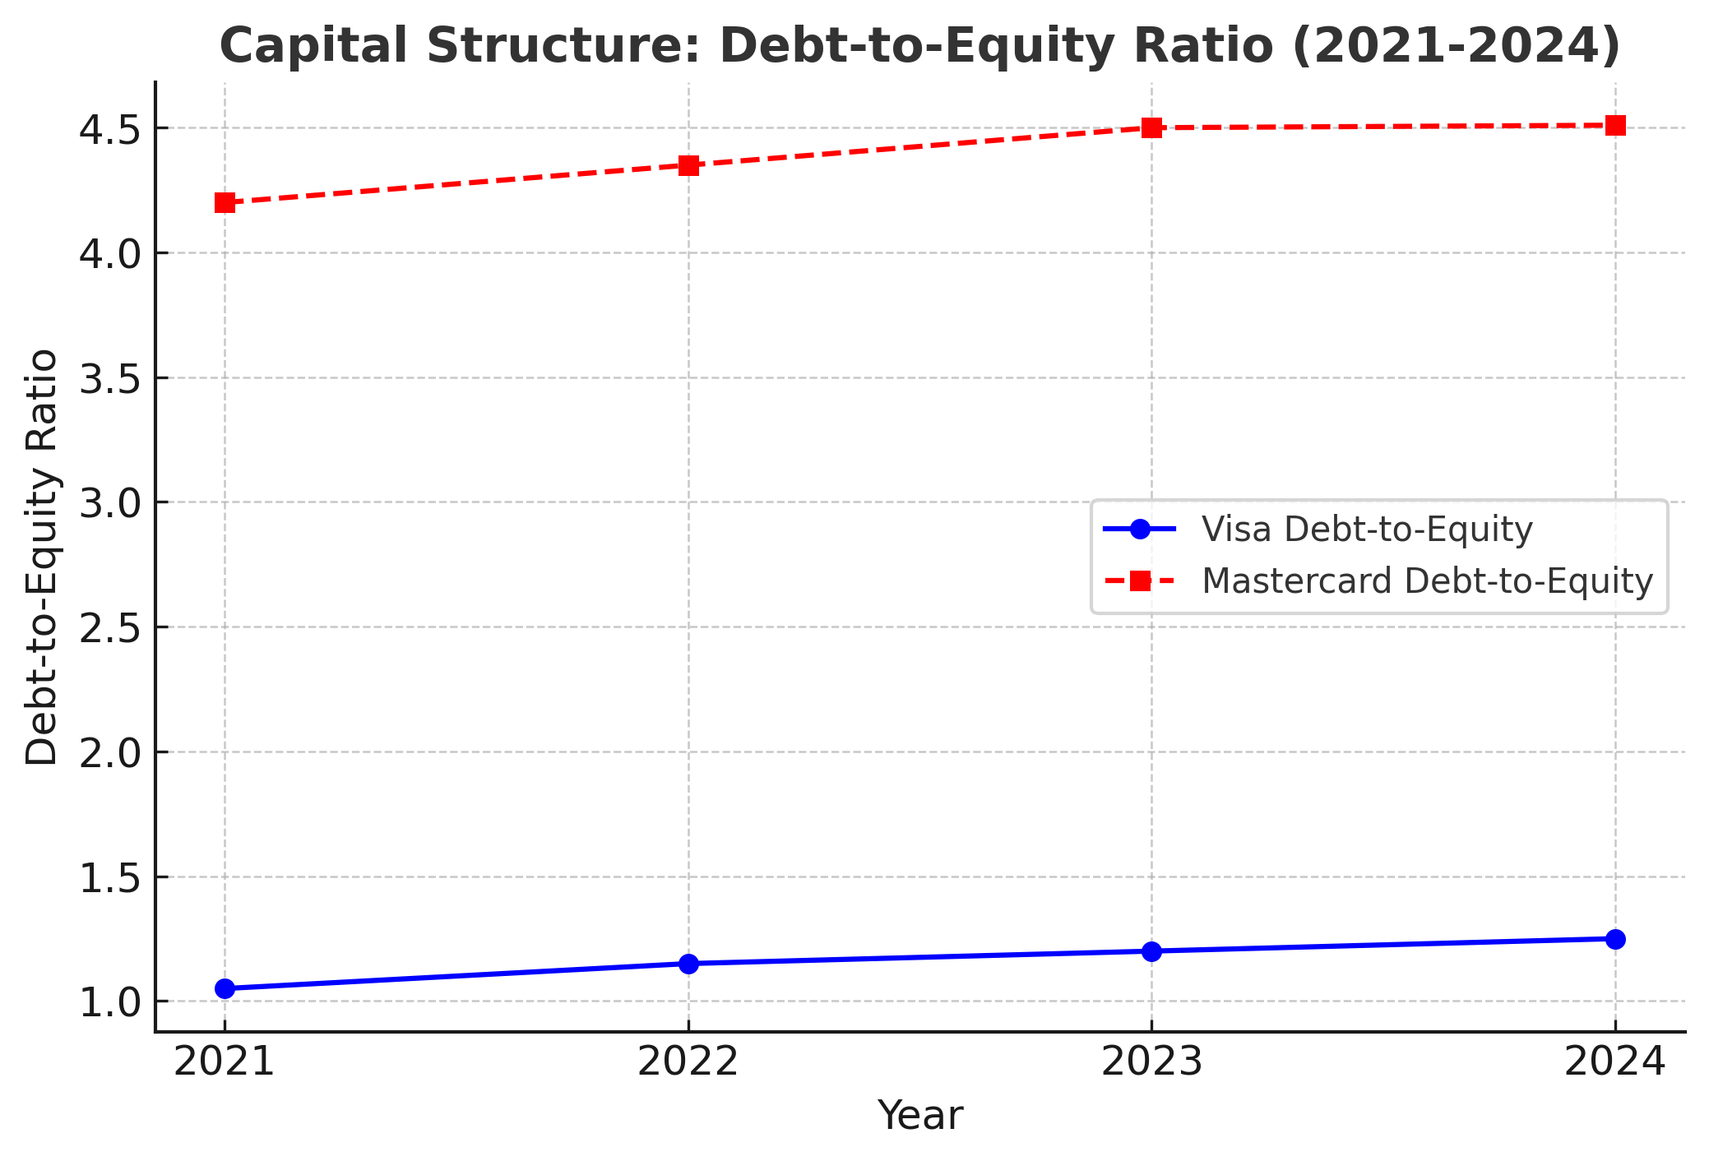
Capital Structure
Visa - Debt-to-Equity Ratio: 1.25.
Mastercard - Debt-to-Equity Ratio: 4.51.
Visa maintains a more conservative capital structure.

Slide 11

Forecasting
Visa - Projected revenue growth in 2025: Low double-digit %.
Mastercard - Projected revenue growth in 2025: Low double-digit %.
Visa focuses on expanding digital payment solutions.
Mastercard emphasizes technological advancements.

Slide 12

The Pick: Visa
Superior profit margins.
More conservative capital structure.
Strong liquidity position.
Consistent revenue growth.

Slide 13
References
• Visa Inc. Annual Report 2024.
• Mastercard Inc. Annual Report 2024.
• Market reports from Investors.com, Barron's, and MarketWatch.

