Slide 1
Identifying Genres of Music - Comparing Model Performances
Adam Lizerbram

Slide 2
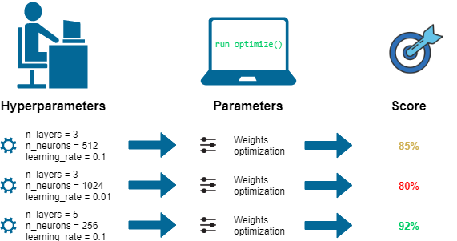
Task
Identify genre of music from given audio clip
Compare several different models
Within each model, test different hyperparameters

Slide 3
Dataset
GTZAN Genre Classification dataset (https://www.kaggle.com/andradaolteanu/gtzan-dataset-music-genre-classification/activity)
10,000 30-second audio tracks
10 genres with 1,000 tracks each
Blues, Classical, Country, Disco, Hip-Hop, Jazz, Metal, Pop, Reggae, Rock
CSV file with 60 total features
65% training, 25% validation, 10% testing

Slide 4
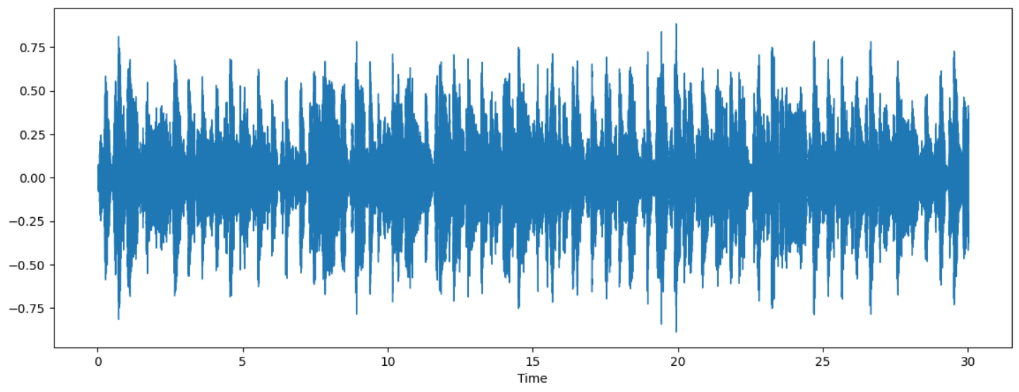
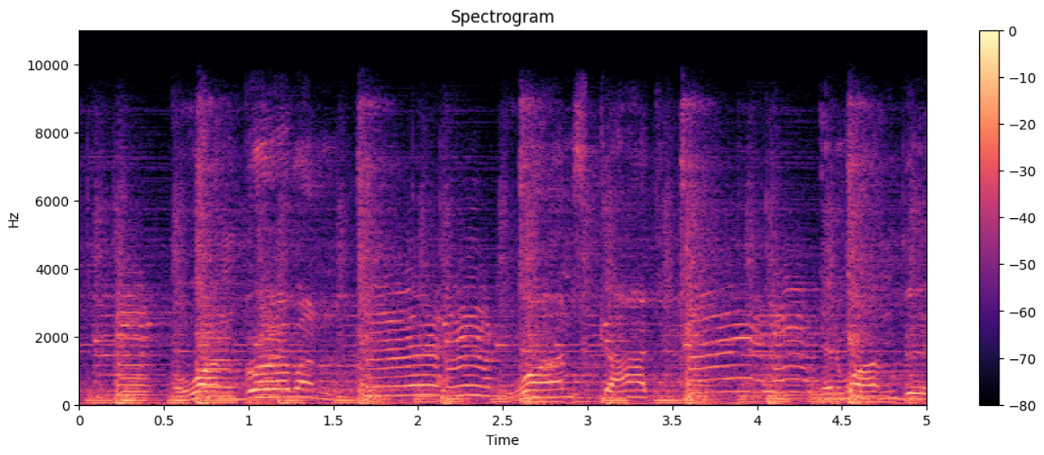
Data Visualization

Slide 5
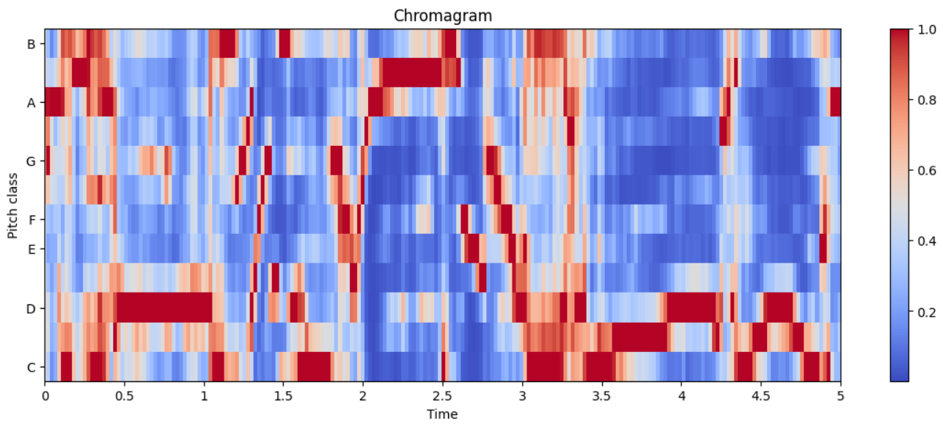
Data Visualization

Slide 6
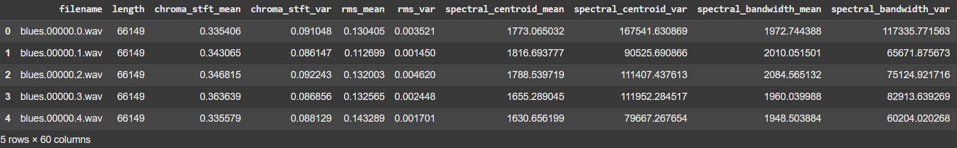
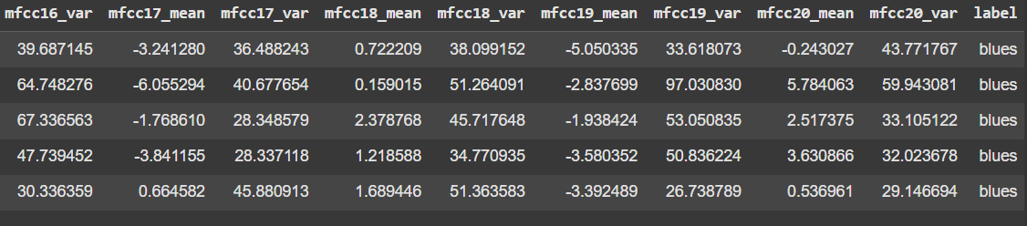
Data Visualization

Slide 7
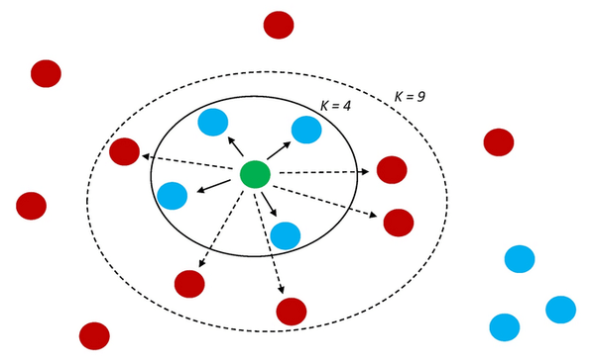
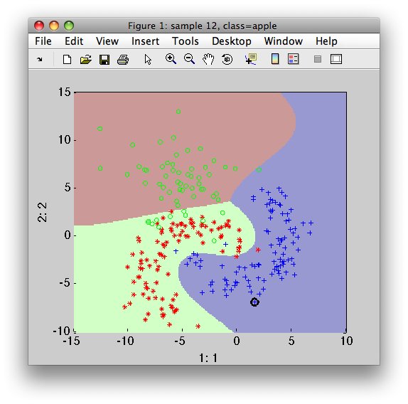
Models & Their Hyperparameters
K-Nearest Neighbors (KNN)
K (tested K=1,2,...,30)
Multiclass Support Vector Machine (SVM)
Kernel (tested linear, polynomial, RBF, sigmoid)
C (tested C=1,4,7,...,28)
Convolutional Neural Network (CNN)
# Layers
# Neurons per layer
Activation functions
Optimizers
(Haven’t tested yet)

Slide 8
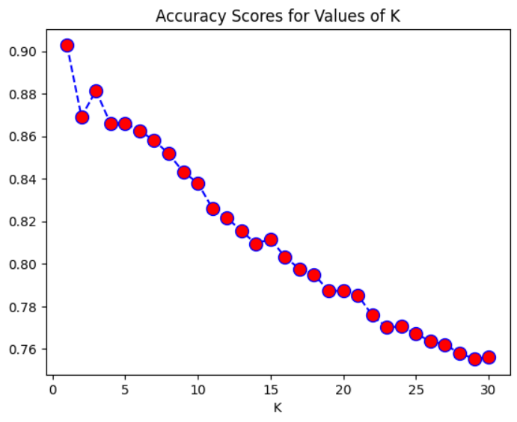

Training: KNN
Best values from training:

Slide 9
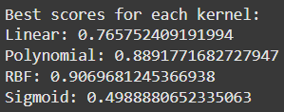
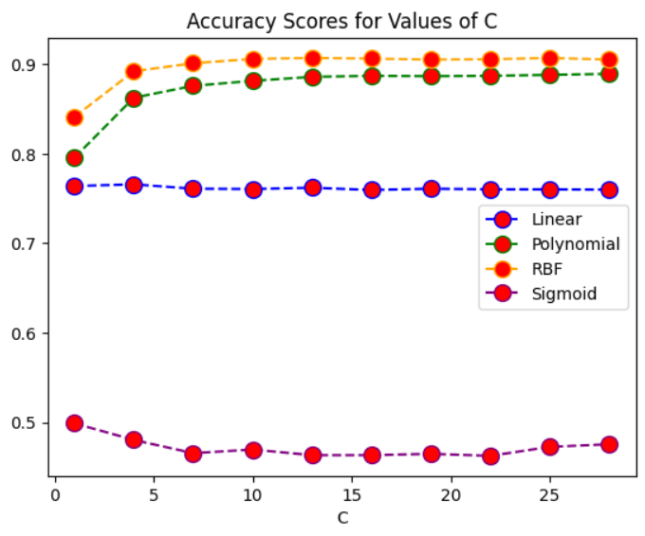
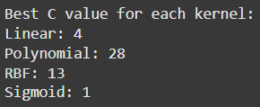
Training: SVM

Slide 10
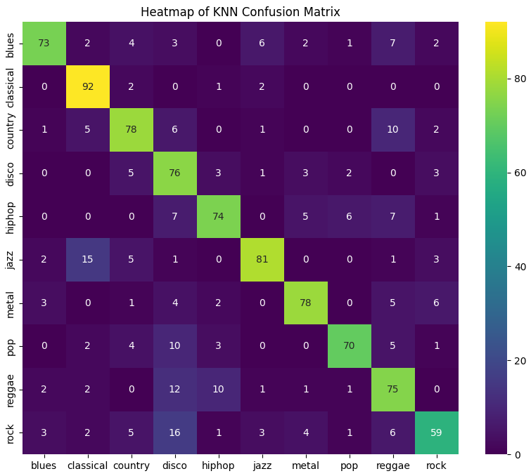
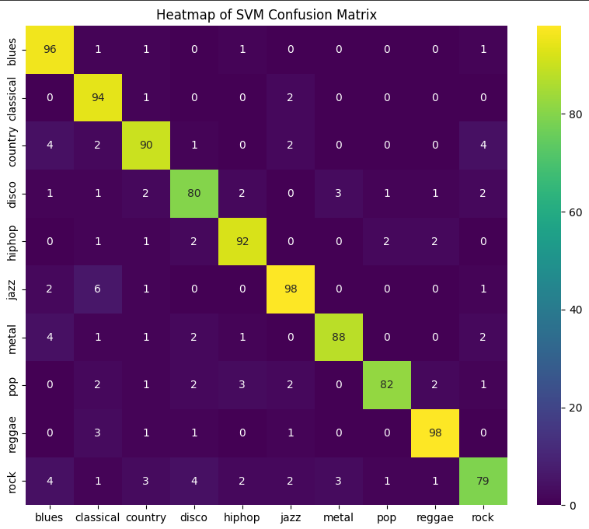
Results: Confusion Matrices

Slide 11
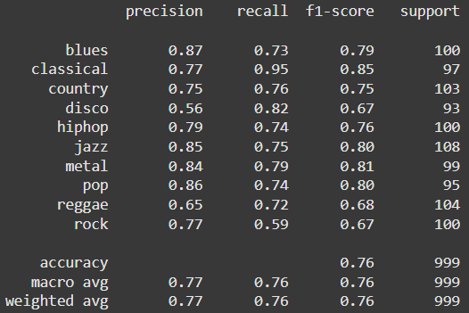
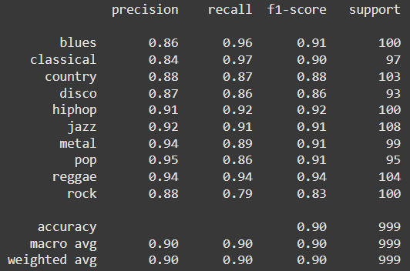
Results: Summary
KNN
SVM

Slide 12
Conclusion
SVM vastly outperformed KNN on testing data
SVM 90% accuracy
KNN 76% accuracy
Both models struggled with Rock
KNN performed best with Classical
SVM performed best with Reggae

Slide 13
Moving Forward
Better understand the features in the CSV file
Implement & optimize CNN
Compare to other models
Visualize & explain incorrect predictions
More models?

