Slide 1
Analysis of Derived Features for the Motion Classification of a Passive Lower Limb Exoskeleton
Albert Costa Ruiz
Supervisors: Isabel Patzer, Jonas Beil and Tamim Asfour
Notes:
Presentation : I am __ , a Student from the Polytechnic University of Catalonia, who has written his master thesis in this Institute
Now I’m going to do the presentation of my Master thesis with title ‘ Analysis of Derived Features for the Motion Classification of a Passive Exoskeleton’.
In this thesis it is pursued to find new MEANINGFUL derived features to do a motion classification for a lower-limb Exoskeleton using Hidden Markov Models
1

Slide 2
Motivation
Main problem: achieve online motion classification for a lower limb exoskeleton to improve support.
Which is our problem?
Search meaningful derived features to classify data captured by exoskeleton’s sensors.
Which challenges does it pose?
Find features physically connected to the motion
Kinematic ( e.g. joint angles , acceleration of the CoM)
Dynamic (e.g. torques on articulations, reaction ground force)
Improve current classification setup
Why is the problem important to solve?
Physical meaningful features describe better a motion
Decrease the amount of features → Reduction of compute time
Notes:
First mention the main problem trying to solve behind this thesis. This is be capable of classifying the motion that an exoskeleton wearer wants to perform, short after it starts. In that way it is possible to support online the control of an exoskeleton
In this thesis the problem that is intended to solve deals with the data used to do this classification. We want to use meaningful derived features from the raw data of the exoskeleton’s sensors to classify motions.
Which challenges does it pose? So, firstly, meaningful derived features should be calculated and extracted from the raw data. For example features that describe a motion kinematically (like joint angles or the accelerations of the Center of Mass of some parts of the leg) or in a dynamic way, in that case we would find features like the torque on the articulations or reaction ground forces of the foot to the ground.
And why do we want to do so? Because features with a physical connection to a motion, it can described better. At the same time, extracting derived features from a set of data might suppose a dimensional reduction and consequently a reduction of the training times of the motion algorithm.
2

Slide 3
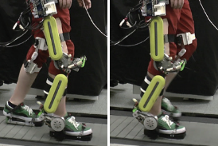
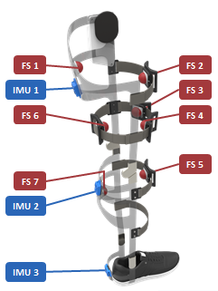
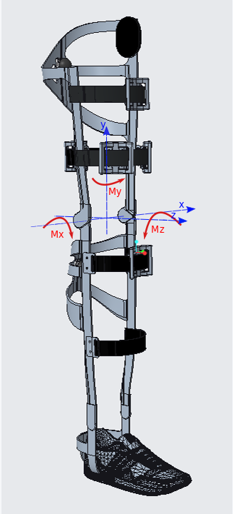
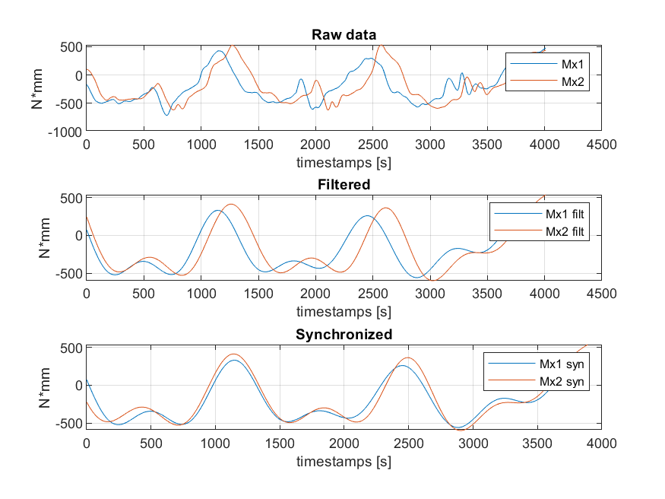
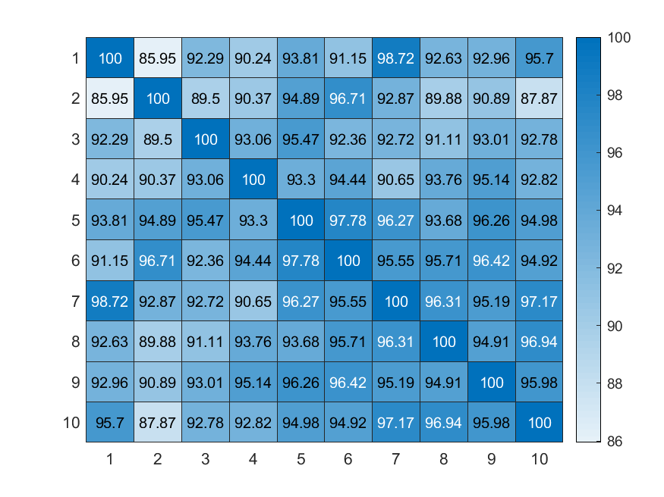
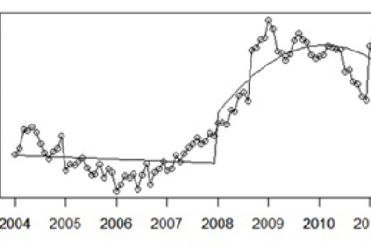
Outline
State of the Art
H²T Passive Exoskeleton and Motion Data
Derived Features
Resemblance Analysis
HMM Classification Results
Conclusions and Outlook
Notes:
That is the outline of my presentation
First I will mention all the work done until now about motion classification.
I will also look at the passive exoskeleton set up and the data captured
Next, I will present the new features employed for the classification, how they were calculated and afterwards an Analysis done among some of them.
Finally I will present the results obtained in the motion classification in different cases.
3

Slide 4
Outline
State of the Art
H²T Passive Exoskeleton and Motion Data
Derived Features
Resemblance Analysis
HMM Classification Results
Conclusions and Outlook
Notes:
4

Slide 5
State of the Art – Motion Recognition
Ref. | Scope | Sensors | Data | Results
C. Freeman, (2014) [1] | Hand Gesture, Multi-modal Binary Tree, Derived Features | 8 EMGs | 5 motions and 9 subjects. | 73,00% accuracy
G.Panahandeh (2013) [2] | Human Activity Classification, HMMs | 1 IMU (3 acc and 3 angVel) | 5 motions and 10 subjects Window 80ms | 95,00% accuracy
C.Chen, R.Jafari (2015) [3] | Whole-Body, HMMs | 1 Depth Camera (3 2-D motion maps) 2 Accelerometers | 11 motions and 14 subjects | 96,68% accuracy
C.Manderey (2016) [4] | Whole-Body, HMMs, Derived features, Dimensionality Reduction | 56 Markers (Cartesian pos.) | 28 derived features, 353 motions. 4 features used | 94,76% accuracy
J.Beil and I.Ehrenberger (2018) [5] | LLE (Lower Limb Exoskeletons), HMMs | 3 IMUs (acc, Euler angles) 7 Force Sensors (forces) | 13 motions and 10 subjects. 39 features Window 300ms | 92,80% accuracy
I.Patzer (2019) [6] | LLE, HMMs Dimensionality reduction | 2 IMUs (acc , Eul angles) 2 Force Sensors | 14 motions and 10 subjects. 18 features Window 300ms | 90,73% accuracy
Previous work at H²T
Notes:
About all the work done until now in motions classification, I want to mention some publications related to it.
In this first article, a classifier based on a bynary tree algorithm used to recognize hand gestures using 8 EMG sensors placed around the arm, that record the electrical activity of the muscles. Last column shows the results.
In this second one, it is used one IMU sensor mounted on the chest. Five classes of activity were considered and one HMM with 5 states that represent each one.
The third article they use also HMMs to recognise human actions using a depth camera and inertial sensors (2 accelerometers)
The three last papers is the work done in this institute about this area.
fourth row) In this last paper, it was done a feature space dimensionality reduction for the recognition of hole-body human actions from data of markers that give coordinates of different points of the body, and from which meaningful features like joint angles, the velocity of the Centre of Mass or the angular momentums were calculated
(fifth row) In this paper the basics, the set up of the senssors and the Lower Limb Exoskeleton are presented and the performance of the HMM classification is exposed.
(sixth row) In this last paper it was pursued a dimensionality reduction , trying to find a trade-off between the minimum subset of features and the highest classification efficacy. With 4 sensors (2 IMUs and 2 Force Sensors), this accuracy was obtained.
5

Slide 6
Outline
State of the Art
H²T Passive Exoskeleton and Motion Data
Derived Features
Resemblance Analysis
HMM Classification Results
Conclusions and Outlook
Notes:
6

Slide 7
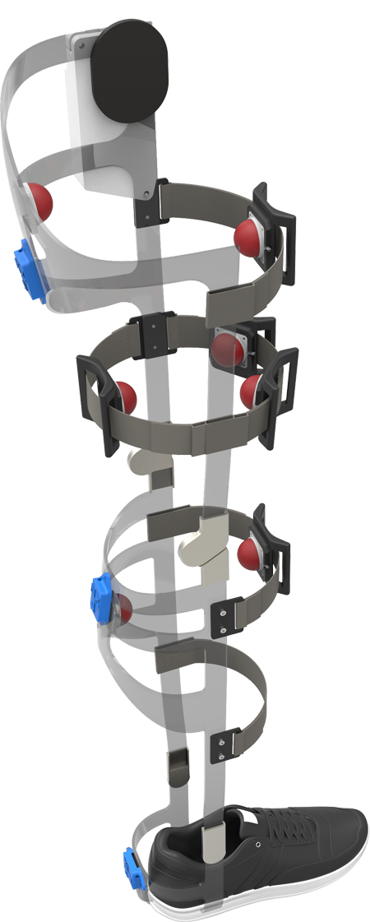
H²T Passive Exoskeleton and Motion Data
3 Inertial Measurement Units
Linear accelerations (ax, ay and az)
Euler angles (φx, φy and φz)
7 Force Sensors
Force vectors (Fx, Fy and Fz)
10 Subjects, 14 Motions
Walking forward/backward
Going up-/downstairs, going downstairs backwards
Turn left/right
Lift/Drop object
Sidesteps left/right
Sit down/stand up
Stand
IMU
FS 1
FS 2
FS
IMU 1
FS 3
FS 6
FS 4
Ref. | Features/ Sensors | Accuracy
J.Beil and I.Ehrenberger (2018) [6] | 39 / 10 | 92,80%
I.Patzer (2019) [7] | 12 / 2 | 86,35%
 | 15 / 3 | 89,53%
 | 18 / 4 | 90,73%
 | 36 / 9 | 92,77%
FS 5
FS 7
IMU 2
IMU 3
H2T Passive Exoskeleton
Notes:
The passive exoskeleton employed to do all the recordings, includes 3 IMUs with which linear accelerations and angles are measured, and 7 force sensors, each one giving a force vector in the Cartesian coordinate system.
In this picture we can see the location of the 10 sensors.
The whole data available consists of recordings of different common motions, like WalkingForwad, GoingUpStairs,, sit down , stand up... carried out by 10 subjects, each one repeated 10 times.
This table shows results obtained in previous work, where a maximum accuracy is reached with 9 sensors and it is almost 93%
7

Slide 8
Outline
State of the Art
H²T Passive Exoskeleton and Motion Data
Derived Features
Resemblance Analysis
HMM Classification Results
Conclusions and Outlook
Notes:
8

Slide 9
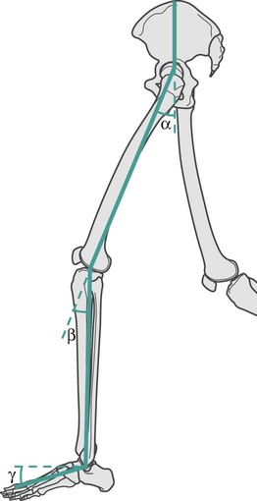
Derived Features
Knee Moments
Mx, My, Mz and |M|
Calculated from the force sensors
Dynamic description
Joint Angles
φknee and φankle
Calculated from the Euler angles of the IMUs
Kinematic description
Notes:
These two new derived features are the knee Moments and the joint angles of the leg (on the knee and on the ankle). The first feature was calculated from the data of the force sensors values and with this features we try to describe a motion in dynamic way.In total we have 4 new features ( 3 about the 3 coordination axes and a 4th one that is the norm that vector. On the other hand we have the joint angles, with which we are using the Euler angles gathered from the IMUs sensors to calculate them and they give Kinematic information of the motions.
9

Slide 10
Outline
State of the Art
H²T Passive Exoskeleton and Motion Data
Derived Features
Resemblance Analysis
HMM Classification Results
Conclusions and Outlook
Notes:
Before testing these new features in the motion classification algorithm, we checked and studied their constitution, pattern and other characteristics by plotting them.
10

Slide 11
Resemblance Analysis - Moments
Motion analysis using knee moments.
Analyse the constitution of this new feature.
Subject | Global ρ
ID1717 | 86,39%
ID1718 | 72,59%
ID1719 | 85,50%
ID1720 | 82,33%
ID1722 | 76,54%
ID1723 | 79,75%
ID1724 | 81,16%
ID1725 | 81,84%
ID674 | 83,25%
ID917 | 79,69%
Analysis Intra-Subjects:
Mean of Intra-correlations for each subject.
Heat map of correlations among repetitions of the same subject.
Subject ID1717, Motion Walking Forward and Mx
Notes:
Concerning the motion features, a resemblance analysis was carried out to check the level of similarity among repetitions of the same subject. To do so, we computed the correlations between pairs of samples for each motion and subject. We created heatmaps like this one , that it is for the motion walking forward and the moment´s component about X axis.
These are the results obtained for each subject. We can appreciate that these two subjects have the highest correlations, which means that they performed the motions more similarly each time that the others
11

Slide 12
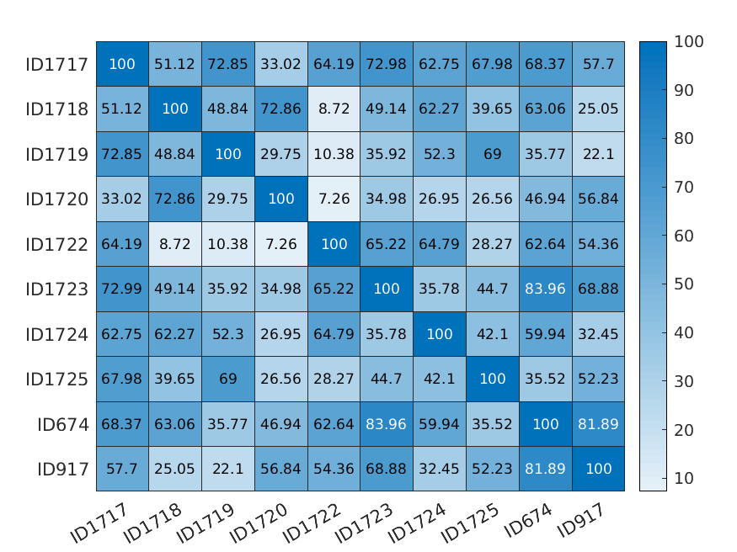
Resemblance Analysis - Moments
Analysis inter-subjects: correlations of the motions among subjects
Spot motions that are easier to repeat in a similar way.
Motion | Global ρ
Walking Forward | 65,96%
Walking Backward | 60,16%
Turn Right | 56,80%
Turn Left | 65,52%
Going Upstairs | 57,82%
Stand Up | 77,35%
Sit Down | 74,27%
Side Step Right | 55,62%
Side Step Left | 55,54%
Lift Object | 72,14%
Drop Object | 67,98%
Going Downstars | 55,08%
Analysis Inter-Subjects:
Heat map of correlations among different subjects.
Global correlations for each motion
Motion resemblance among subjects. Motion Walking Forward
Notes:
Afterwards, it was carried out a similar study but among all the subjects, in order to spot similarities among the way each subject perform each motions (analysis of inter-correlations). This heatmap presents correlation among pair of subjects for the motion WalkingForward.
Click Then global correlations were calculated for each motion and the results on the table were obtained.
Click Taking a look at it, we might say that Stand Up, Sit Down and Lift Object are the motions that are more similarly performed by the subjects, maybe because they are the simplest and shortest in time.
12

Slide 13
Outline
State of the Art
H²T Passive Exoskeleton and Motion Data
Derived Features
Resemblance Analysis
HMM Classification Results
Conclusions and Outlook
Available Features
Direct Comparison
Data Filtering
Final Results
Notes:
That’s the ouline of my presentation / My talk is divided into these parts. → just read the names → fast / no explain each topic!
-----------------------------------------
First I will begin with the motivation behind the motion classification and I will mention all the work done until now.
I will also speak about passive exoskeleton set up and the data captured used to test the algorithm
Next I will present the new features employed for the classification, how they were calculated and afterwards analysed.
Finally I will present the results obtained in the motion classification with these new features and we will look at the next steps that could be taken.
Time → 50’’
----------------------------------------------------------
13

Slide 14
HMM Classification – Available Features
39 Primary Features
6 Derived Features
Forces
Fx, Fy and Fz
Euler angles
Φx, Φy and Φz
Linear accelerations
ax, ay and az
Knee Moments
Mx, My, Mz and |M|
Based on force sensors
Joint Angles
Φknee , Φankle
Based on Euler angles
45 Features
Tests considering single subjects and all subjects.
Window size 300 ms.
Window overlapping 10 ms.
Fully Connected HMMs with 14 states.
5 - Fold Cross Validation.
Notes:
This is the global setup of features available: 39 primary features from the sensor data and 6 new derived features calculated from them. In total 35 features to choose from.
Also mention that the tests were carried out on all the subjects and on single subjects, with a data window size of 300ms , windows overlapped each 10ms , Fully Connected HMMs of 14 states and using a 5-Fold Cross Validation to prove the results.
14

Slide 15
Outline
State of the Art
H²T Passive Exoskeleton and Motion Data
Derived Features
Resemblance Analysis
HMM Classification Results
Conclusions and Outlook
Available Features
Direct Comparison
Data Filtering
Final Results
Notes:
That’s the ouline of my presentation / My talk is divided into these parts. → just read the names → fast / no explain each topic!
-----------------------------------------
First I will begin with the motivation behind the motion classification and I will mention all the work done until now.
I will also speak about passive exoskeleton set up and the data captured used to test the algorithm
Next I will present the new features employed for the classification, how they were calculated and afterwards analysed.
Finally I will present the results obtained in the motion classification with these new features and we will look at the next steps that could be taken.
Time → 50’’
----------------------------------------------------------
15

Slide 16
HMM Classification – Direct Comparison
Comparison: derived features vs primary features (from where they are calculated)
Use of derived and primary features together → Results get worse → Redundant set of features and overfitting problem.
Moments and Forces
All subjects, all motions, W300 and S14
Diff. | Features | Num. | Accuracy(%)
No | Mx | 1 | 17,64
No | My | 1 | 16,88
No | Mz | 1 | 16,31
No | |M| | 1 | 20,35
No | Moments | 3 | 37,60
Yes | Moments | 3 | 36,42
No | Forces | 18 | 81,78
Yes | Forces | 18 | 82,32
No | Moments, Forces | 21 | 81,43
Yes | Moments, Forces | 21 | 81,31
≈
Notes:
First we did a comparison of the new derived features and the features used to calculate them. This table shows Tests results with different setups comparing Moments and the Force values. As a single feature the norm of the moments is the one that performs better. Only using moments the maximum value obtained is almost 41% .
Also highlight that if moments and Forces are used together the results don’t improve in comparison with only using forces, since we are using a redundant set of features.
16

Slide 17
HMM Classification – Direct Comparison
Comparison: derived features vs primary features (from where they are calculated)
Use of derived and primary features together → Results get worse → Redundant set of features and overfitting problem.
Joint Angles and Euler Angles (IMUs)
All subjects, all motions, W300 and S14
Diff. | Features | Num. | Accuracy(%)
No | Knee angle | 1 | 21,32
No | Ankle angle | 1 | 24,22
No | Joint angles | 2 | 41,92
Yes | Joint angles | 2 | 29,43
No | IMU(e) | 9 | 81,22
Yes | IMU(e) | 9 | 87,00
No | Joint angles, IMU(e) | 11 | 80,36
Yes | Joint angles, IMU(e) | 11 | 86,11
≈
Notes:
Same comparison was done between Joint angles and the Euler angles of the IMUS. As a single feature the results obtained are better than in the case of the moments. We obtained the same accuracy with 2 features of the Joint angles as with the three features of the moments. Also , as with the moments if we used these features with their primary features the results don’t improve.
17

Slide 18
Outline
State of the Art
H²T Passive Exoskeleton and Motion Data
Derived Features
Resemblance Analysis
HMM Classification Results
Conclusions and Outlook
Available Features
Direct Comparison
Data Filtering
Final Results
Notes:
That’s the ouline of my presentation / My talk is divided into these parts. → just read the names → fast / no explain each topic!
-----------------------------------------
First I will begin with the motivation behind the motion classification and I will mention all the work done until now.
I will also speak about passive exoskeleton set up and the data captured used to test the algorithm
Next I will present the new features employed for the classification, how they were calculated and afterwards analysed.
Finally I will present the results obtained in the motion classification with these new features and we will look at the next steps that could be taken.
Time → 50’’
----------------------------------------------------------
18

Slide 19
HMM Classification – Data Filtering
Moment data was filtered to soften irregularities and mitigate noise.
Digital low pass filter applied forward and backward.
Single subjects, all motions, W300 and S14
Diff. | Filt. | Features | Num. | Avg. Accuracy (%)
Yes | No | Moments | 3 | 75,27
No | No | Moments | 3 | 75,74
Yes | Yes | Moments | 3 | 71,74
No | Yes | Moments | 3 | 82,42
≈7%
All subjects, all motions, W300 and S14
Diff. | Filt. | Features | Num. | Accuracy (%)
Yes | No | Moments | 3 | 36,42
No | No | Moments | 3 | 37,60
Yes | Yes | Moments | 3 | 34,50
No | Yes | Moments | 3 | 41,13
≈4%
Notes:
Once we compare these new features we tried to filter them in order to soften irregularities and mitigate noise. A digital low pass filter was tuned and use for the moment data.
Click Here we can compare the results with data that was previously filtered and data that didn’t. For single subjects we have an improvement of around the 7 percent and for tests on all the subjects the improvement is around the 4%.
19

Slide 20
Outline
State of the Art
H²T Passive Exoskeleton and Motion Data
Derived Features
Resemblance Analysis
HMM Classification Results
Conclusions and Outlook
Available Features
Direct Comparison
Data Filtering
Final Results
Notes:
That’s the ouline of my presentation / My talk is divided into these parts. → just read the names → fast / no explain each topic!
-----------------------------------------
First I will begin with the motivation behind the motion classification and I will mention all the work done until now.
I will also speak about passive exoskeleton set up and the data captured used to test the algorithm
Next I will present the new features employed for the classification, how they were calculated and afterwards analysed.
Finally I will present the results obtained in the motion classification with these new features and we will look at the next steps that could be taken.
Time → 50’’
----------------------------------------------------------
20

Slide 21
HMM Classification – Final Results
Primary Features
All subjects, all motions, W300 and S14
Diff. | Features | Num. Features | Num. Sensors | Accuracy(%) | Time[min]
Yes | IMU1,IMU3 | 12 | 2 | 86,99 | 236,69
Yes | FS5,IMU1,IMU3 | 15 | 3 | 89,71 | 244,98
Yes | FS6,FS7,IMU1,IMU3 | 18 | 4 | 90,76 | 250,83
Yes | FS3,FS5,IMUs | 24 | 5 | 91,17 | 266,78
Yes | FS:1,2,3,5,6,7 IMUs | 36 | 9 | 92,77 | 303,34
Primary and Derived Features
All subjects, all motions, W300 and S14
Diff. | Features | Num. Features | Num. Sensors | Accuracy(%) | Time[min]
No | Leg Angles, Moments | 5 | 9 | 78,43 | 211,47
No | Leg Angles, IMUs(l) | 11 | 3 | 84,94 | 227,98
No | Moments, IMUs(l) | 12 | 9 | 83,90 | 233,53
No | Leg Angles,Moments,IMUs(l) | 14 | 9 | 88,93 | 241,75
No | |M|, IMUs | 19 | 9 | 89,39 | 247,17
Yes | Leg Angles, Forces | 20 | 9 | 88,27 | 253,28
No | Moments, IMUs | 21 | 9 | 88,62 | 264,49
≈
Notes:
In this last section we present the results obtained looking for the best combinations.
First table show results of the best combination set found in previous works with the correspondent compute time.
Second Table there are results were I used derived features in the test setups.
The combinations are ordered from less to more number of features used. We can notice that the less features we have the lower is the compute time, although the training times don’t decrease a lot.
I want to highlight the following results:
|M|, IMUs gave good results and allowed to reduce all the forces (21 features) in only one value
|M|,IMUs compared with Moments, IMUs → gave almost the same results and we are using 2 more features
Leg Angles and Forces → gave a good accuracy and at the same time we are using all Euler angles (9 features) from the IMUs as only two angles
Finally also mention the combination of LegAngles, Moments and IMUs than achieve a similar result with this combination of 15 features but without using the acceleration components of the IMUs
21

Slide 22
Outline
State of the Art
H²T Passive Exoskeleton and Motion Data
Derived Features
Resemblance Analysis
HMM Classification Results
Conclusions and Outlook
Notes:
22

Slide 23
Conclusions and Outlook
Conclusions
Derived features didn’t improve maximum accuracies in comparison with best setups of primary data.
Derived features are a good representation of their primary features (e.g |M|)
Possible directions of improvement:
Not use of derived features with its primary data.
Filtering of the data
The filtering of moments improved the accuracy → Apply a filter for each feature (different filter setup for each one).
New derived features → Ankle moments
Use other HMM configurations
Tailored HMM for each motion – Number of states and topologies.
Not fully connected topologies and less states reduce compute times.
Change how the problem is addressed
1 HMM → Each motion is a state → Time independent features could be used (e.g. statistical values during a time interval)
Notes:
Say that tests changing the topologies of the HMMs have been already carried out, a compute times are reduced significantly meanwhile results are comparable with the ones achieved with full connected topologies.
23

Slide 24
Thank you for your attention!
Notes:
That’s the end of the presentation .Thank you for your attention.
24

Slide 25
References
[1] C. Freeman, Feature selection and hierarchical classifier design with applications to human motion recognition pp. 1–297, 2014.
[2] G. Panahandeh, N. Mohammadiha, A. Leijon and P. Händel, Continuous Hidden Markov Model for Pedestrian Activity Classification and Gait Analysis. IEEE Transactions on Instrumentation and Measurement 2013.
[3] C. Chen, R. Jafari, and N. Kehtarnavaz, Improving human action recognition using fusion of depth camera and inertial sensors IEEE Trans. Human-Machine Syst., vol. 45, no. 1, pp. 51–61, 2015.
[4] C. Mandery, M Plappert, J. Borràs and T. Asfour. Dimensionality reduction for whole-body human motion recognition. 19th International Conference on Information Fusion (FUSION), 355–362, 2016.
[5] J. Beil, I. Ehrenberger, C. Scherer, C. Mandery, and T. Asfour. Human motion classification based on multi-modal sensor data for lower limb exoskeletons. In IEEE/RSJ International Conference on Intelligent Robots and Systems (IROS), 2018.
[6] I. Patzer and T. Asfour. Minimal Sensor Setup in Lower Limb Exoskeleton for Motion Classification based on Multi-Modal Sensor Data. In IEEE/RSJ International Conference on Intelligent Robots and Systems (IROS), 2019.
Notes:
[bei Bedarf:] Referenzen, vor allem für Exoskelett-Beispiele
Prof. Dr. Max Mustermann | Name of Faculty
25

Slide 26
Backup Slides
Notes:
That’s the end of the presentation .Thank you for your attention.
26

Slide 27
Moments calculation
Notes:
That’s the end of the presentation .Thank you for your attention.
27

Slide 28
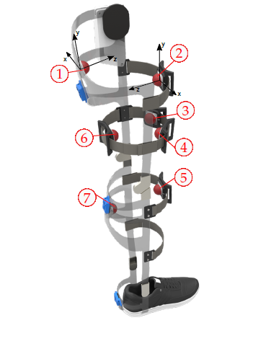
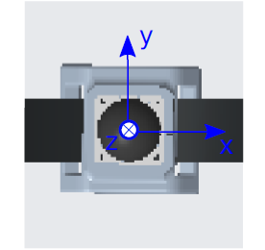
Moments calculation – transformation matrices
Orthogonal coordinate system of one force sensor
Force sensors distribution. Reference axes of sensors 1 and 2 are drawn on the picture
Notes:
Prof. Dr. Max Mustermann | Name of Faculty
28

Slide 29

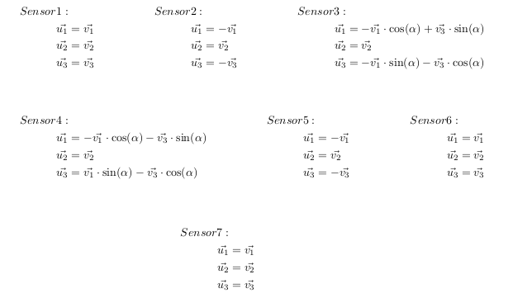
Moments calculation – transformation matrices
v → basis of the sensor
u → new common basis
Notes:
Prof. Dr. Max Mustermann | Name of Faculty
29

Slide 30
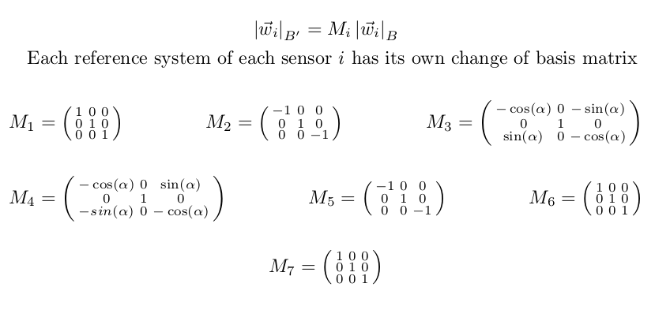
Moments calculation – transformation matrices
B → basis of the sensor
B’ → new common basis
Notes:
Prof. Dr. Max Mustermann | Name of Faculty
30

Slide 31
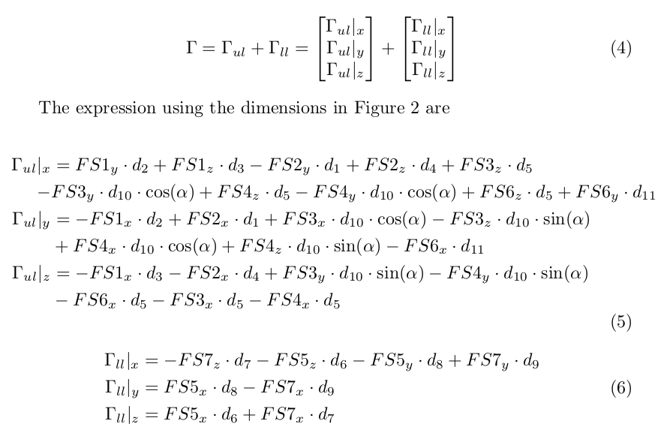
Moments calculation – moments expressions
B → basis of the sensor
B’ → new common basis
Notes:
Prof. Dr. Max Mustermann | Name of Faculty
31

Slide 32
Resemblance Analysis + Classification Results
Notes:
That’s the end of the presentation .Thank you for your attention.
32

Slide 33
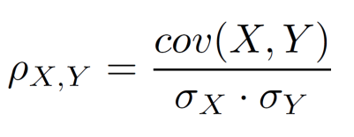
Analysis of the moments
Pair of samples are filtered and synchronized before the correlation is calculated
Pearson correlation coefficient
X, Y: pair of data samples analysed
Data from repetitions 6 and 9 of Subject ID1717,
Motion: Walking Forward and moment about X-axis
Notes:
Once computed all the moments for each subject and motion, it was decided to carry out an analysis to study the pattern, the constitution and other characteristics of these new features.
To do so, the motions values were plotted and the correlation between pair of samples were calculated with the target of quantifying the similarities and spot irregular events.
As we can see in this picture, first the data was smoothed using a low-pass filter, and then the two samples were synchronized in time in order to compute the Pearson correlation coefficient.
---------------------------------------------------------------------------------------------------------
33

Slide 34
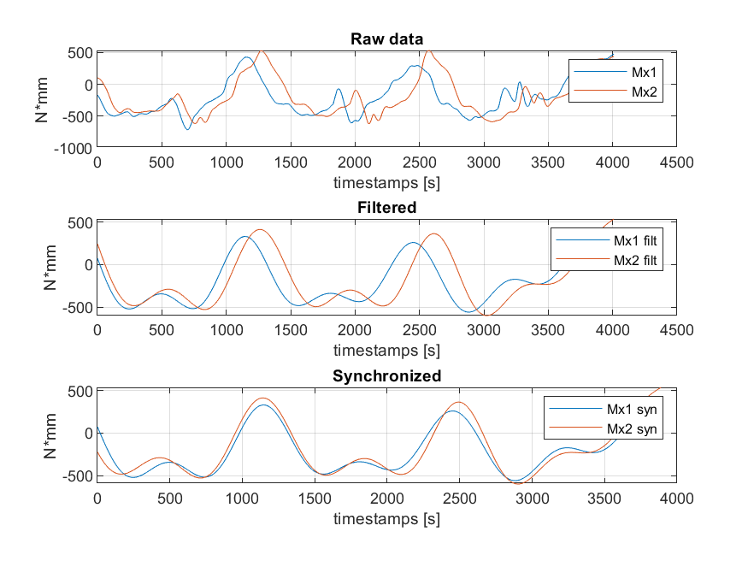
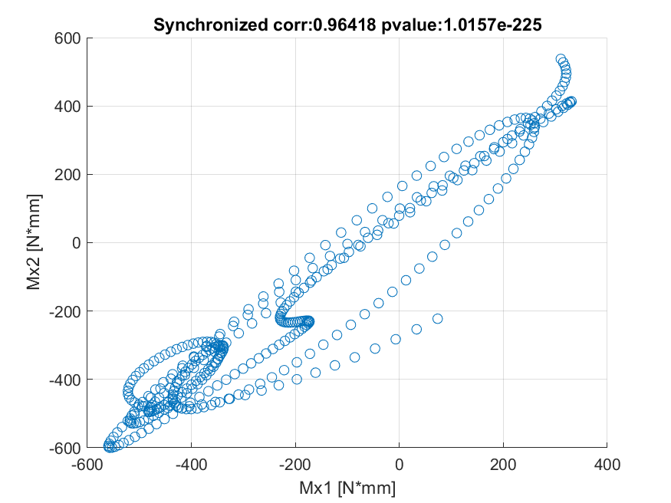
Moments analysis – Intra-subject
Subject ID1717, Motion Walking Forward and moment about X-axis, repetitions 6th and 9th
Notes:
Prof. Dr. Max Mustermann | Name of Faculty
34

Slide 35

Moments analysis – Intra-subject
Correlation matrix among repetitions for one subject
Subject ID1717, Motion Walking Forward and moment about X-axis, repetitions 6th and 9th
Notes:
Prof. Dr. Max Mustermann | Name of Faculty
35

Slide 36
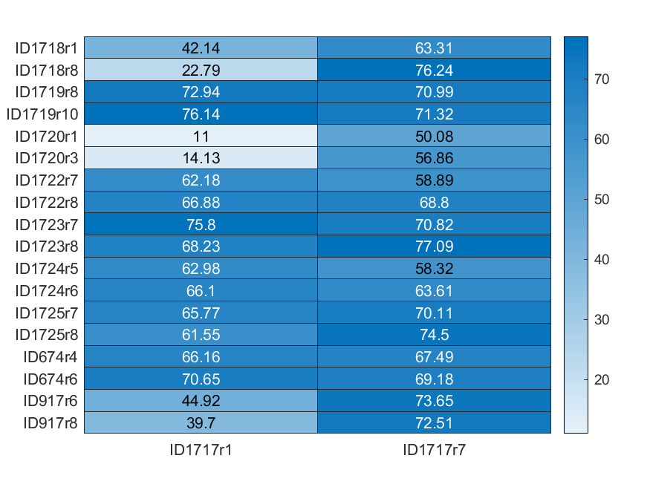
Moments analysis – Inter-subjects
Correlation matrix among the two repetitions with highest correlation of each subject with the other two repetition with highest correlation of the other subjects.
Comparison of Subject ID1717 with the other subjects, Motion: Walking Forward and moment about X-axis
Notes:
Prof. Dr. Max Mustermann | Name of Faculty
36

Slide 37
Moments analysis – Inter-subjects
Motion resemblance among subjects, Motion Walking Forward
Notes:
Prof. Dr. Max Mustermann | Name of Faculty
37

Slide 38
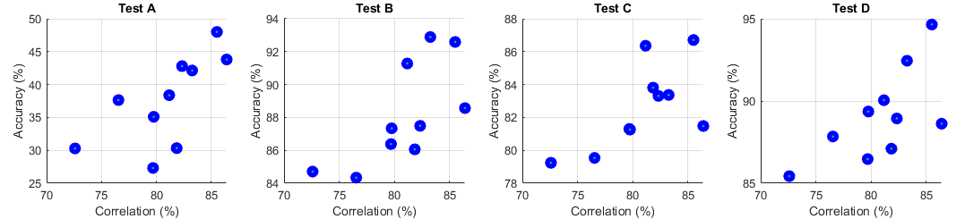
HMM Classification – Effect of the Correlations
Connection of the Motion Classification with the Motion Analysis
Always using Moments as a feature in the tests.
‘High correlations in the data imply high accuracies in the Motion Classification’
Subject | Global ρ
ID1717 | 86,39
ID1718 | 72,59
ID1719 | 85,50
ID1720 | 82,33
ID1722 | 76,54
ID1723 | 79,75
ID1724 | 81,16
ID1725 | 81,84
ID674 | 83,25
ID917 | 79,69
All subjects, all motions, W300 and S14
Diff | Filt | Features | Num | Test
No | Yes | Moments | 3 | A
Yes | No | Moments, IMU(euler) | 12 | B
No | No | Moments, IMU(euler) | 12 | C
Yes | No | Moments, IMU | 21 | D
Subject result in a test run on all subjects.
Notes:
Picture taken from → https://link.springer.com/chapter/10.1007/978-1-4471-6308-4_8 (book)
Finally I would like to present some results about the performance of the new features. (they were tested alone and in combination with the IMUs values)
Talk about the tables:
The train and testing of the HMM were done using overlapping windows of 10 milliseconds with a total of 300 milliseconds size samples and a stratified 5-fold cross validation
The states employed were 14. And sometimes the data was filtered or the differences among consecutive values was computed.
Single motions:
There is no significant difference comparing the single performance of the sensors → it is logical because all the components of the moments are computed with similar components of the force sensors.
The use of the filter to avoid noise improves a bit the performance (10% more)
All subjects
The use of linear accelerations in all motions gives a lower improvement than the use of Euler angles (using the same number of features)
Testing on single subjects the results are better, due to there is less variability
Other:
Hit rate = right predictions / total predictions
Talk about errors Euler angles calculation ??
----------------------------------------------------
38

Slide 39
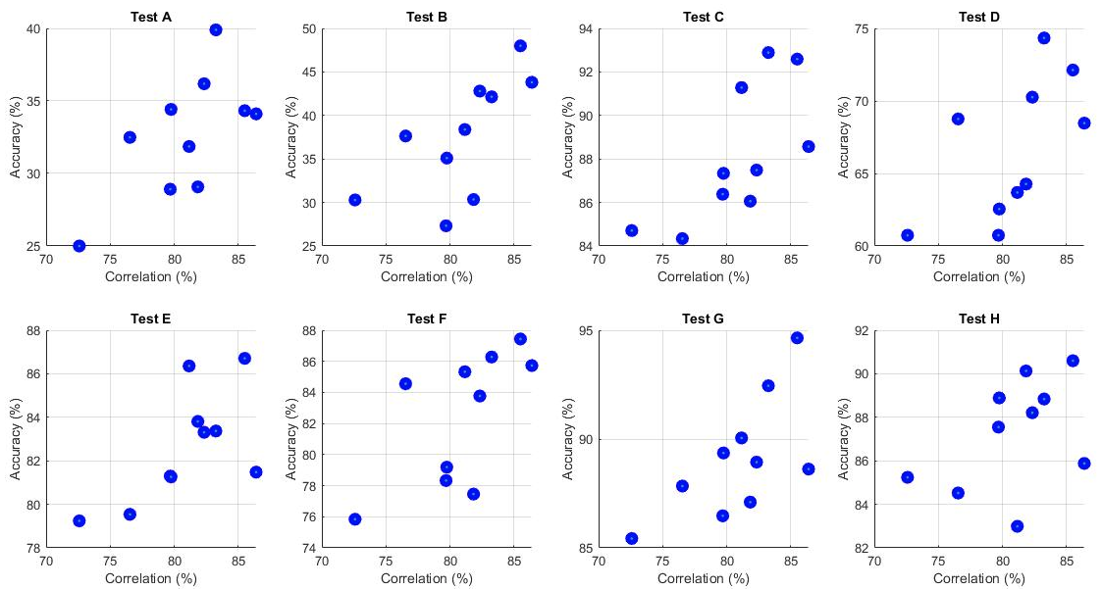
HMM Classification – Effect of the Correlations
‘High correlations in the training data imply high accuracies in the Motion Classification’
Notes:
Picture taken from → https://link.springer.com/chapter/10.1007/978-1-4471-6308-4_8 (book)
Finally I would like to present some results about the performance of the new features. (they were tested alone and in combination with the IMUs values)
Talk about the tables:
The train and testing of the HMM were done using overlapping windows of 10 milliseconds with a total of 300 milliseconds size samples and a stratified 5-fold cross validation
The states employed were 14. And sometimes the data was filtered or the differences among consecutive values was computed.
Single motions:
There is no significant difference comparing the single performance of the sensors → it is logical because all the components of the moments are computed with similar components of the force sensors.
The use of the filter to avoid noise improves a bit the performance (10% more)
All subjects
The use of linear accelerations in all motions gives a lower improvement than the use of Euler angles (using the same number of features)
Testing on single subjects the results are better, due to there is less variability
Other:
Hit rate = right predictions / total predictions
Talk about errors Euler angles calculation ??
----------------------------------------------------
39

Slide 40
First Results
Notes:
That’s the end of the presentation .Thank you for your attention.
40

Slide 41

HMM Classification Results
The three moments show a similar performance as a single feature
Filtered data improves a bit the Hit Rate.
Accelerations present worst results than Euler angles in combination with the moments
W: window size in milliseconds
S: number of states used for the HMMs
IMU l: linear acceleration values of all IMU sensors
IMU e: Euler angle values of all IMU sensors
Differences: differences among the features values were calculated before creating the windows
Filtered: data previously filtered with a digital low-pass filter
Notes:
Finally I would like to present some results about the performance of the new features. (they were tested alone and in combination with the IMUs values)
Talk about the tables:
The train and testing of the HMM were done using overlapping windows of 10 milliseconds with a total of 300 milliseconds size samples and a stratified 5-fold cross validation
The states employed were 14. And sometimes the data was filtered or the differences among consecutive values was computed.
Single motions:
There is no significant difference comparing the single performance of the sensors → it is logical because all the components of the moments are computed with similar components of the force sensors.
The use of the filter to avoid noise improves a bit the performance (10% more)
All subjects
The use of linear accelerations in all motions gives a lower improvement than the use of Euler angles (using the same number of features)
Testing on single subjects the results are better, due to there is less variability
Other:
Hit rate = right predictions / total predictions
Talk about errors Euler angles calculation ??
----------------------------------------------------
41

Slide 42
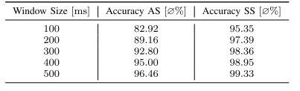
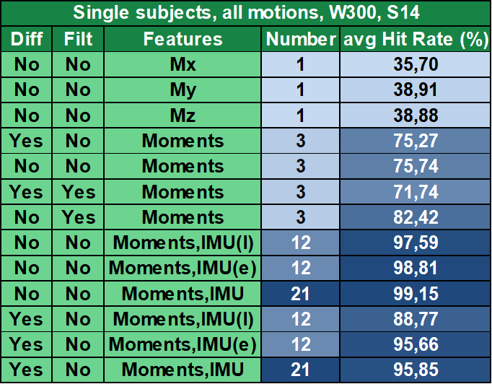
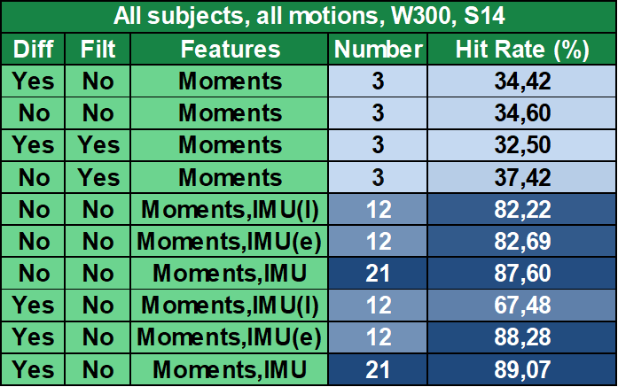
Results comparison
Accuracies of stratified 5-fold cross for different window sizes over all subjects
Force sensors and IMUs → 39 features
Results from [3] AS: all Subjects SS: singles Subjects
Notes:
Even better when we are talking about single subjects
Prof. Dr. Max Mustermann | Name of Faculty
42

Slide 43
Types of HMMs
Notes:
That’s the end of the presentation .Thank you for your attention.
43

Slide 44
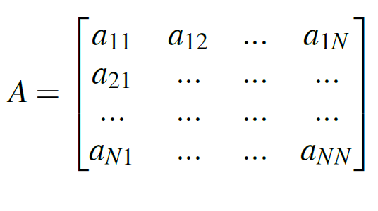
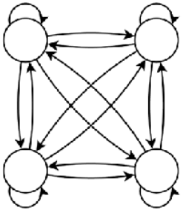

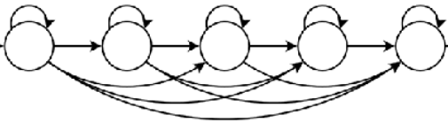

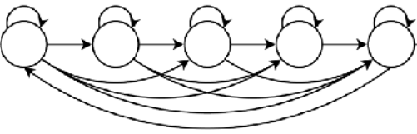

HMM Classification – Comparison of topologies
Different types of HMMs were tested → different Matrix transitions.
Not fully connected topologies reduce the model complexity and the compute times.
Ergodic
Left-Right
Cyclic
Notes:
Picture taken from → https://link.springer.com/chapter/10.1007/978-1-4471-6308-4_8 (book)
Finally I would like to present some results about the performance of the new features. (they were tested alone and in combination with the IMUs values)
Talk about the tables:
The train and testing of the HMM were done using overlapping windows of 10 milliseconds with a total of 300 milliseconds size samples and a stratified 5-fold cross validation
The states employed were 14. And sometimes the data was filtered or the differences among consecutive values was computed.
Single motions:
There is no significant difference comparing the single performance of the sensors → it is logical because all the components of the moments are computed with similar components of the force sensors.
The use of the filter to avoid noise improves a bit the performance (10% more)
All subjects
The use of linear accelerations in all motions gives a lower improvement than the use of Euler angles (using the same number of features)
Testing on single subjects the results are better, due to there is less variability
Other:
Hit rate = right predictions / total predictions
Talk about errors Euler angles calculation ??
----------------------------------------------------
44

Slide 45
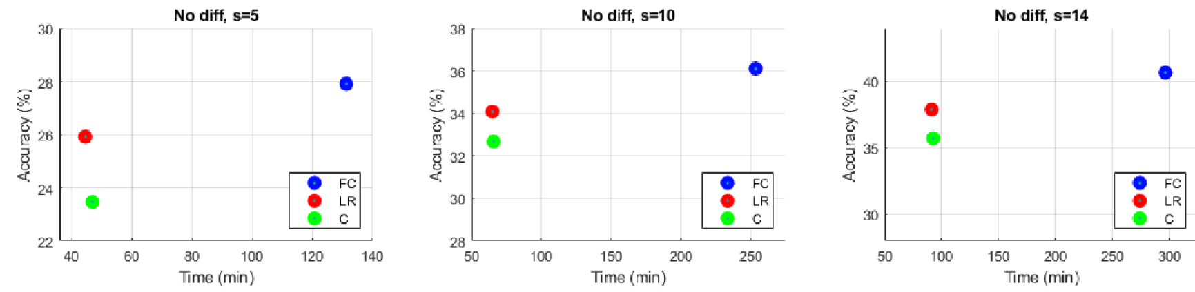
HMM Classification – Comparison of Topologies
Different types of HMMs tested → Different Matrix Transitions.
Not fully connected topologies reduce model complexity and compute times.
For 14 states: compute time decreases 2/3 Time accuracy gets 2% worse (Left-Right case).
≈ - 2%
Fully Connected
Left-Right
Cyclic
≈ 2/3 time
Test carried out under the same conditions: on all subjects, using moment features and window size of 300ms.
Notes:
Picture taken from → https://link.springer.com/chapter/10.1007/978-1-4471-6308-4_8 (book)
Finally I would like to present some results about the performance of the new features. (they were tested alone and in combination with the IMUs values)
Talk about the tables:
The train and testing of the HMM were done using overlapping windows of 10 milliseconds with a total of 300 milliseconds size samples and a stratified 5-fold cross validation
The states employed were 14. And sometimes the data was filtered or the differences among consecutive values was computed.
Single motions:
There is no significant difference comparing the single performance of the sensors → it is logical because all the components of the moments are computed with similar components of the force sensors.
The use of the filter to avoid noise improves a bit the performance (10% more)
All subjects
The use of linear accelerations in all motions gives a lower improvement than the use of Euler angles (using the same number of features)
Testing on single subjects the results are better, due to there is less variability
Other:
Hit rate = right predictions / total predictions
Talk about errors Euler angles calculation ??
----------------------------------------------------
45

Slide 46
Final Results
Notes:
That’s the end of the presentation .Thank you for your attention.
46

Slide 47
HMM Classification – Effect of the Correlations
Connection of the Motion Classification with the Motion Analysis
Tests with different configurations using only moments as features.
Results analysed by subjects
Notes:
Picture taken from → https://link.springer.com/chapter/10.1007/978-1-4471-6308-4_8 (book)
Finally I would like to present some results about the performance of the new features. (they were tested alone and in combination with the IMUs values)
Talk about the tables:
The train and testing of the HMM were done using overlapping windows of 10 milliseconds with a total of 300 milliseconds size samples and a stratified 5-fold cross validation
The states employed were 14. And sometimes the data was filtered or the differences among consecutive values was computed.
Single motions:
There is no significant difference comparing the single performance of the sensors → it is logical because all the components of the moments are computed with similar components of the force sensors.
The use of the filter to avoid noise improves a bit the performance (10% more)
All subjects
The use of linear accelerations in all motions gives a lower improvement than the use of Euler angles (using the same number of features)
Testing on single subjects the results are better, due to there is less variability
Other:
Hit rate = right predictions / total predictions
Talk about errors Euler angles calculation ??
----------------------------------------------------
47

Slide 48
HMM Classification – Minimum set of sensors
Configurations to try to reduce the minimum set of sensors needed
W: window size in milliseconds
S: number of states used for the HMMs
IMU l: linear acceleration values of all IMU sensors
IMU e: Euler angle values of all IMU sensors
Differences: differences among the features values were calculated before creating the windows
Filtered: data previously filtered with a digital low-pass filter
Notes:
Finally I would like to present some results about the performance of the new features. (they were tested alone and in combination with the IMUs values)
Talk about the tables:
The train and testing of the HMM were done using overlapping windows of 10 milliseconds with a total of 300 milliseconds size samples and a stratified 5-fold cross validation
The states employed were 14. And sometimes the data was filtered or the differences among consecutive values was computed.
Single motions:
There is no significant difference comparing the single performance of the sensors → it is logical because all the components of the moments are computed with similar components of the force sensors.
The use of the filter to avoid noise improves a bit the performance (10% more)
All subjects
The use of linear accelerations in all motions gives a lower improvement than the use of Euler angles (using the same number of features)
Testing on single subjects the results are better, due to there is less variability
Other:
Hit rate = right predictions / total predictions
Talk about errors Euler angles calculation ??
----------------------------------------------------
48

Slide 49
HMM Classification – Minimum number of features
Configurations to try to reduce the minimum number of features needed
W: window size in milliseconds
S: number of states used for the HMMs
IMU l: linear acceleration values of all IMU sensors
IMU e: Euler angle values of all IMU sensors
Differences: differences among the features values were calculated before creating the windows
Filtered: data previously filtered with a digital low-pass filter
Notes:
Finally I would like to present some results about the performance of the new features. (they were tested alone and in combination with the IMUs values)
Talk about the tables:
The train and testing of the HMM were done using overlapping windows of 10 milliseconds with a total of 300 milliseconds size samples and a stratified 5-fold cross validation
The states employed were 14. And sometimes the data was filtered or the differences among consecutive values was computed.
Single motions:
There is no significant difference comparing the single performance of the sensors → it is logical because all the components of the moments are computed with similar components of the force sensors.
The use of the filter to avoid noise improves a bit the performance (10% more)
All subjects
The use of linear accelerations in all motions gives a lower improvement than the use of Euler angles (using the same number of features)
Testing on single subjects the results are better, due to there is less variability
Other:
Hit rate = right predictions / total predictions
Talk about errors Euler angles calculation ??
----------------------------------------------------
49

Slide 50
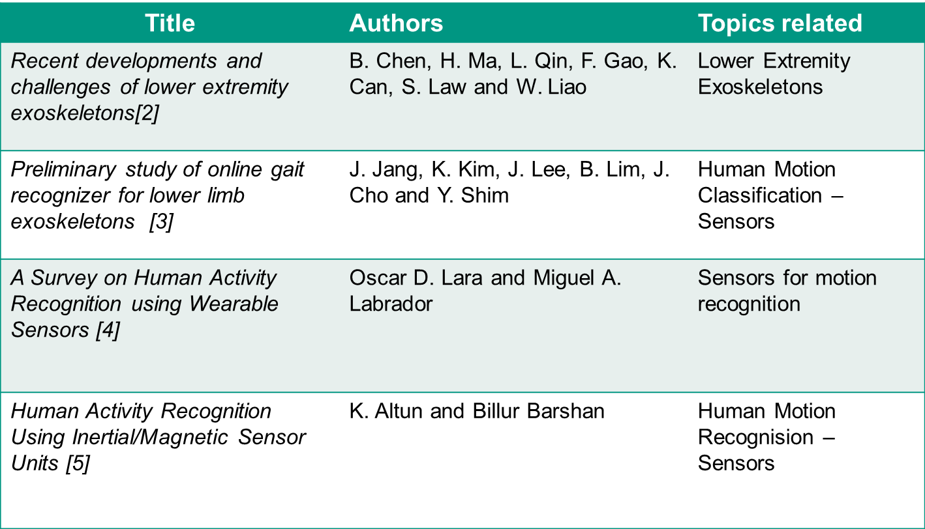

Slide 51
Previous Results
Notes:
That’s the end of the presentation .Thank you for your attention.
51

Slide 52
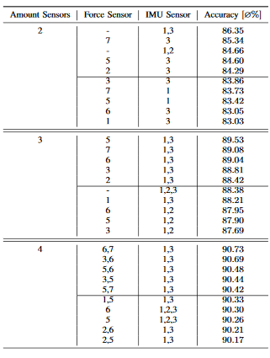
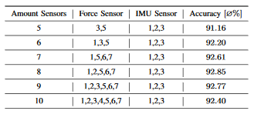
HMM Classification – Previous Results
Notes:
Finally I would like to present some results about the performance of the new features. (they were tested alone and in combination with the IMUs values)
Talk about the tables:
The train and testing of the HMM were done using overlapping windows of 10 milliseconds with a total of 300 milliseconds size samples and a stratified 5-fold cross validation
The states employed were 14. And sometimes the data was filtered or the differences among consecutive values was computed.
Single motions:
There is no significant difference comparing the single performance of the sensors → it is logical because all the components of the moments are computed with similar components of the force sensors.
The use of the filter to avoid noise improves a bit the performance (10% more)
All subjects
The use of linear accelerations in all motions gives a lower improvement than the use of Euler angles (using the same number of features)
Testing on single subjects the results are better, due to there is less variability
Other:
Hit rate = right predictions / total predictions
Talk about errors Euler angles calculation ??
----------------------------------------------------
52

Slide 53
HMM Classification – Minimum Number of Features
Configurations to try to reduce the minimum number of features needed
All subjects, all motions, W300 and S14
Diff | Filt | Features | Num Features | Num Sensors | Hit Rate (%)
No | No | Mx | 1 | 6 | 17,64
No | No | My | 1 | 6 | 16,88
No | No | Mz | 1 | 6 | 16,31
No | No | M_norm | 1 | 6 | 20,35
No | No | Moments | 3 | 6 | 40,66
Yes | No | Moments | 3 | 6 | 36,45
No | No | Leg Angles, M_norm | 3 | 9 | 53,71
Yes | No | Leg Angles, M_norm | 3 | 9 | 51,08
No | No | Knee angle, Moments | 4 | 8 | 57,09
No | No | Ankle angle, Moments | 4 | 8 | 58,83
Yes | No | Knee angle, Moments | 4 | 8 | 62,18
Yes | No | Ankle angle, Moments | 4 | 8 | 63,52
No | No | Leg Angles, Moments | 5 | 9 | 70,98
Yes | No | Leg Angles, Moments | 5 | 9 | 78,43
W: window size in milliseconds
S: number of states used for the HMMs
IMU l: linear acceleration values of all IMU sensors
IMU e: Euler angle values of all IMU sensors
Differences: differences among the features values were calculated before creating the windows
Filtered: data previously filtered with a digital low-pass filter
Notes:
Highligh that here the feature of the moment normalized appears
All subjects
The use of linear accelerations in all motions gives a lower improvement than the use of Euler angles (using the same number of features)
Testing on single subjects the results are better, due to there is less variability
Other:
Hit rate = right predictions / total predictions
Talk about errors Euler angles calculation ??
----------------------------------------------------
53

Slide 54
HMM Classification – Minimum Set of Sensors
Configurations to try to reduce the minimum set of sensors needed
All subjects, all motions, W300 and S14
Diff | Filt | Features | Num Sensors | Num Features | Hit Rate (%)
No | No | Knee Angle | 2 | 1 | 21,32
No | No | Ankle Angle | 2 | 1 | 24,22
No | No | Leg Angles | 3 | 2 | 41,92
No | No | Leg Angles | 3 | 2 | 29,43
No | No | Leg Angles, IMU(accel) | 3 | 11 | 84,94
Yes | No | Leg Angles, IMU(accel) | 3 | 11 | 78,61
No | No | Forces (noFS4) | 6 | 21 | 81,78
Yes | No | Forces (noFS4) | 6 | 21 | 82,32
W: window size in milliseconds
S: number of states used for the HMMs
IMU l: linear acceleration values of all IMU sensors
IMU e: Euler angle values of all IMU sensors
Differences: differences among the features values were calculated before creating the windows
Filtered: data previously filtered with a digital low-pass filter
Notes:
in a red rectangle the best result appears
54

