Slide 1
Shadow Mapping
...........................................................................
Alba Navarro Rosales
January 27, 2021
Churchill College CompSci Talks

Slide 2
Outline
Lights & Shadows
What is Shadow Mapping?
OpenGL rendering pipeline overview
Method
Artefacts that occur
Demo time! :)
Summary – key takeaways

Slide 3
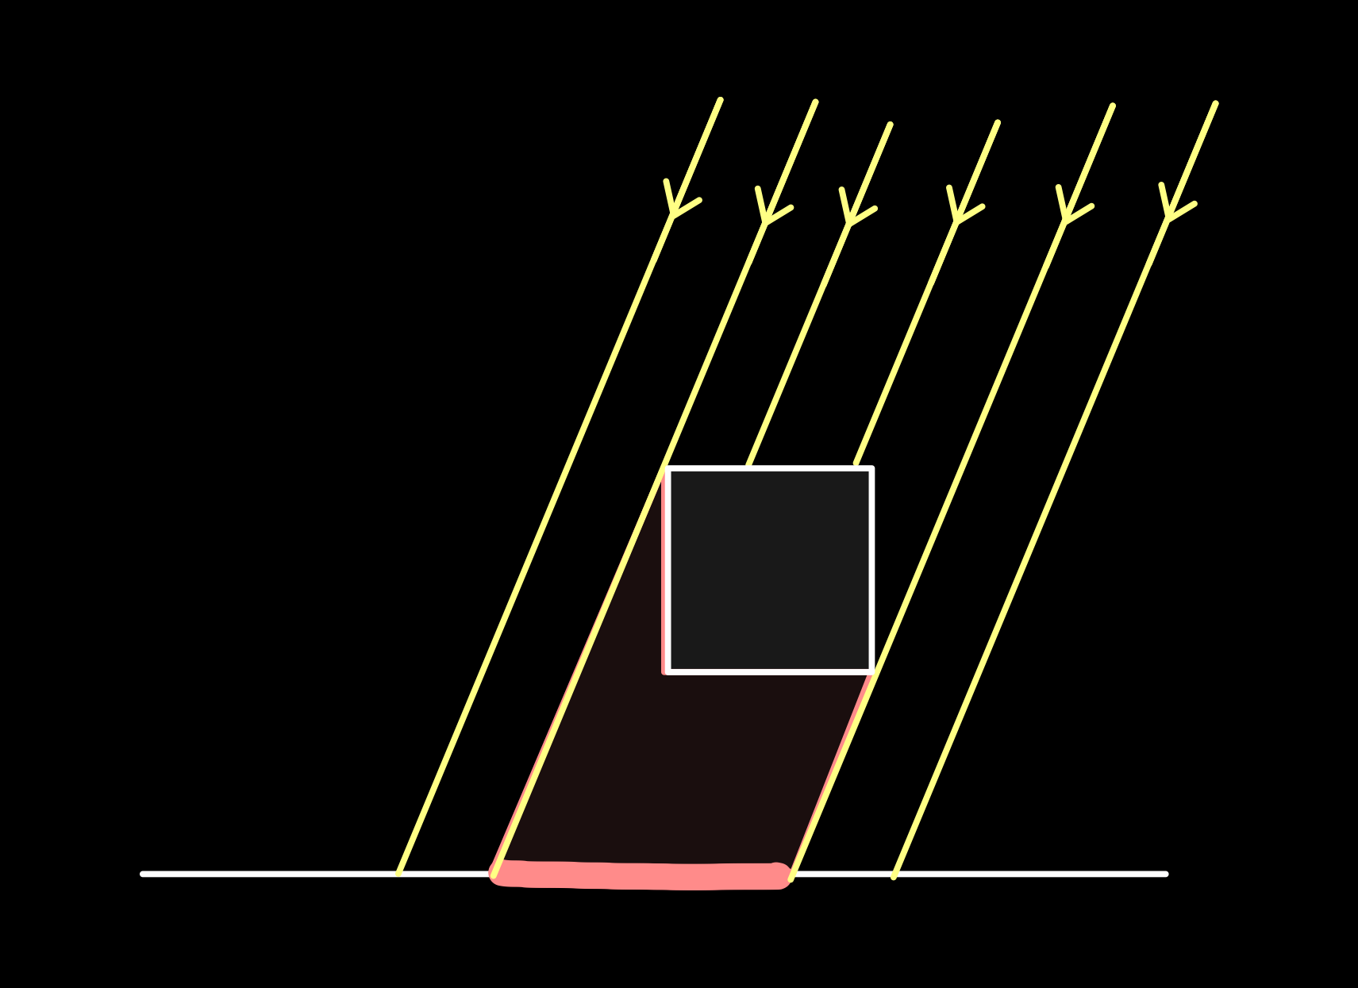
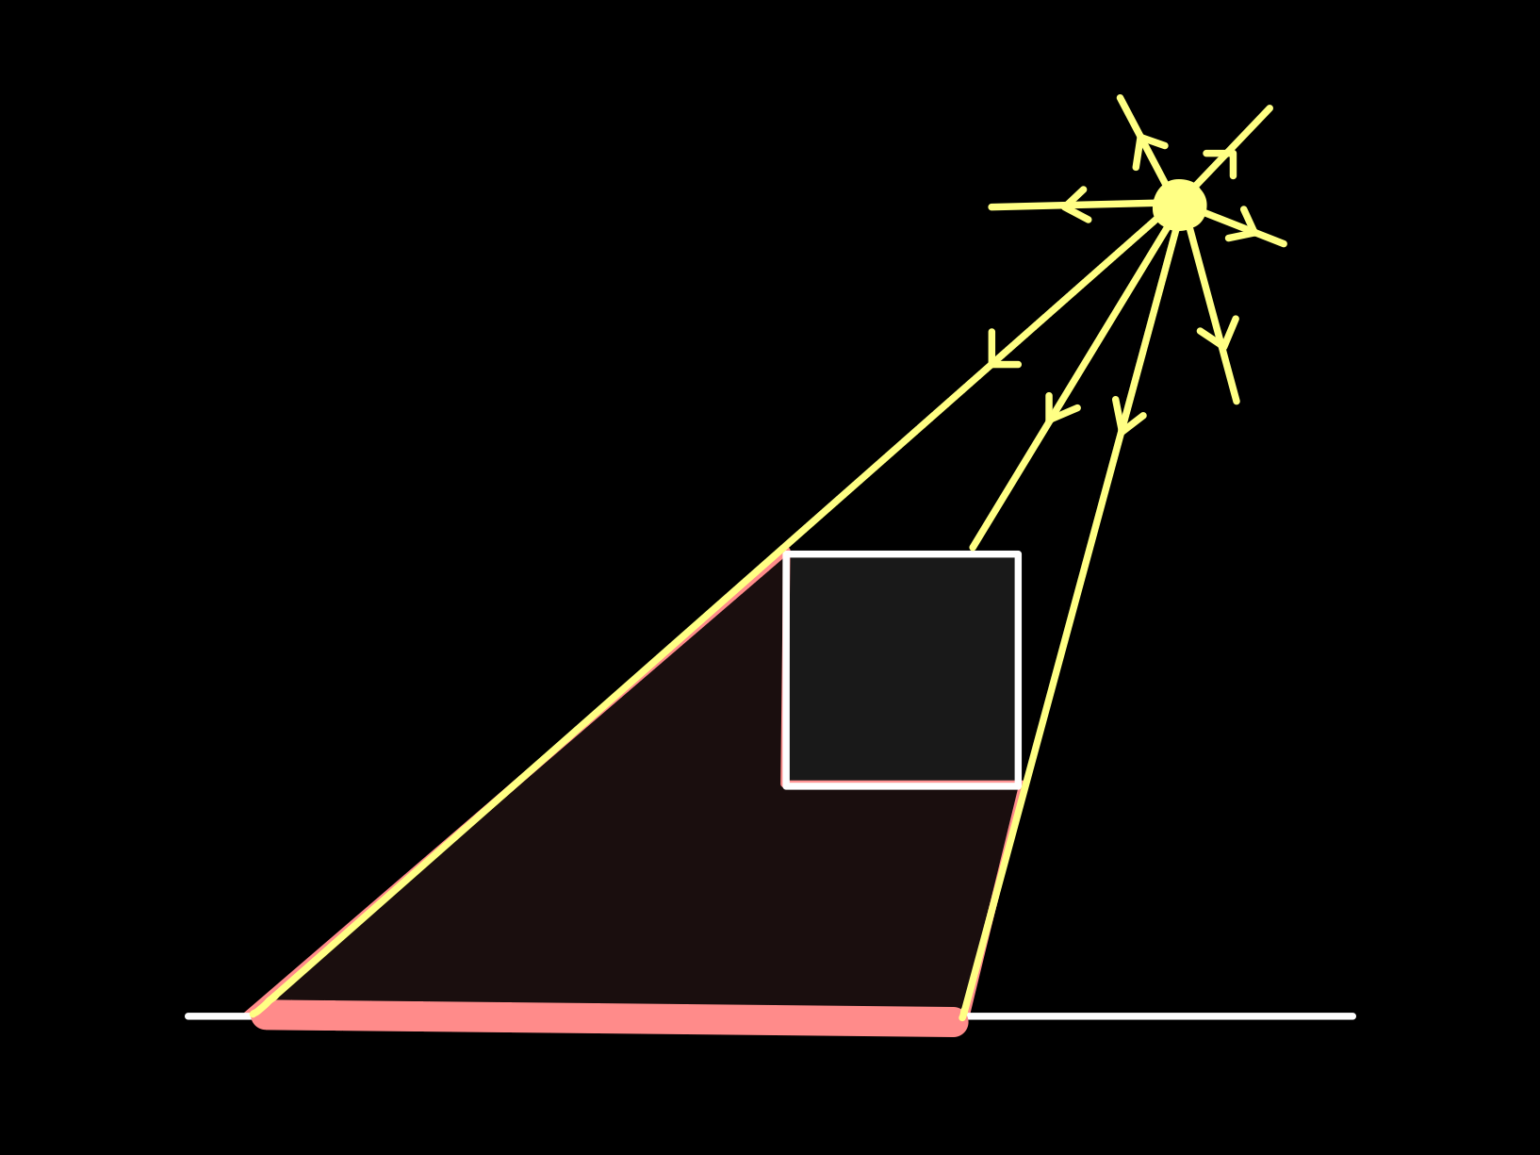
Lights & shadows
Shadows…
Add realism
Convey depth
Convey spatial relationships between objects
Different lights cast different shadows
Directional Light:
Point Light:
Orthographic Projection
Perspective Projection
Notes:
Mention that here we’ll focus on *hard* shadows only (from directional & point lights), not in soft shadows (from area lights).

Slide 4
Shadow Mapping
A technique for rendering shadows in real-time 3D graphics
2 pass algorithm:
Generate Depth Map by rendering scene from light’s POV
Render scene from camera’s POV…
…using generated Depth Map to determine if fragment is lit
or in shadow
TODO – image of shadows rendered using shadow mapping?

Slide 5
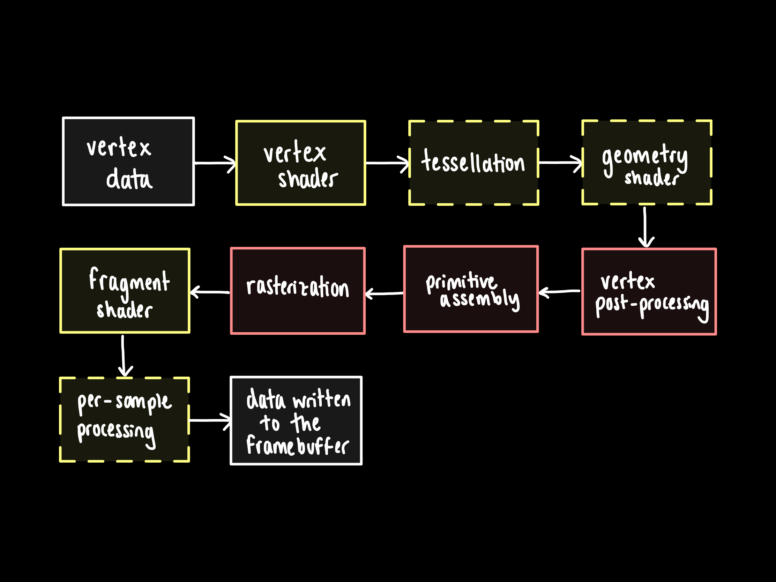
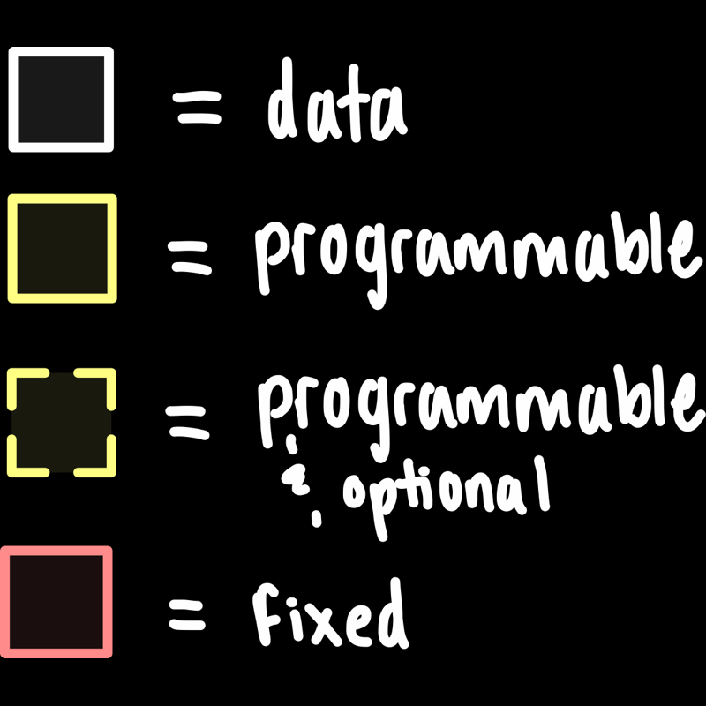
OpenGL rendering pipeline
Notes:
Consists of a set of fixed & programmable stages for processing the geometry data.
Start with the vertex data (position & other attributes such as tex cords, normal), and process it, ending up with fragment data (colour, depth & stencil) written to the currently active framebuffer -> this could be the screen buffer meaning that the image is rendered to the screen or another FBO.
We’re mainly focussed in the vertex & fragment shaders here => NEXT SLIDE

Slide 6
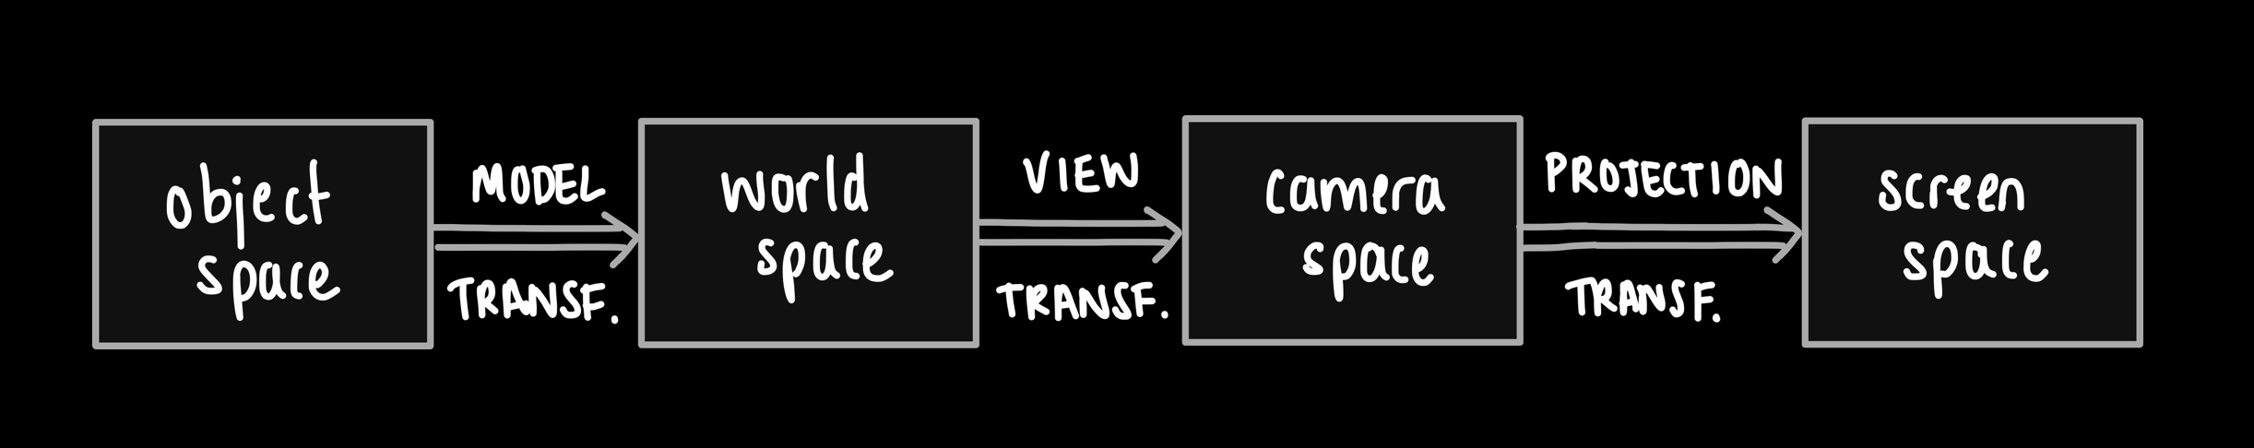
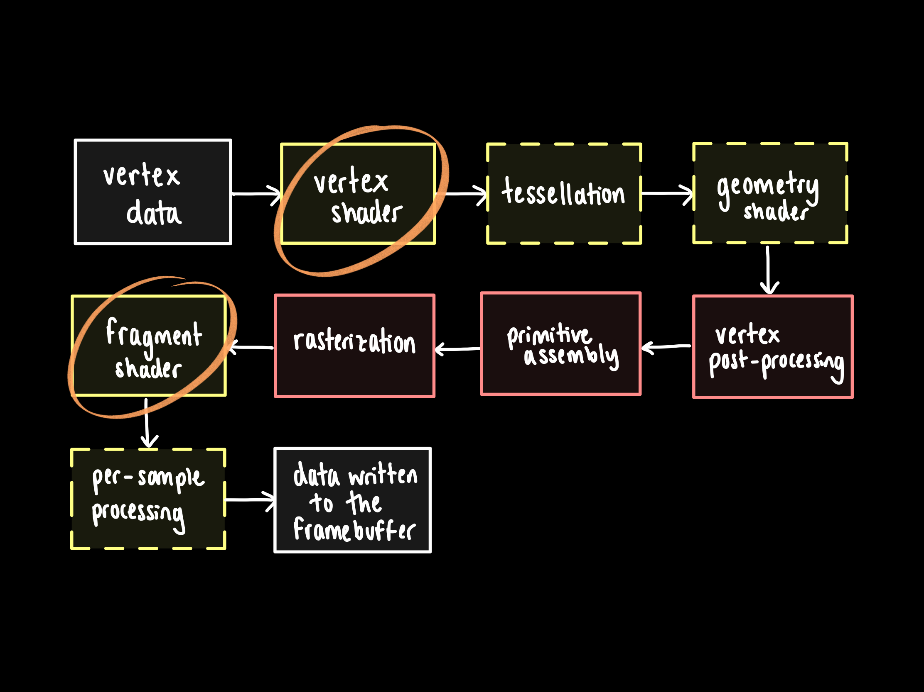

OpenGL rendering pipeline
Notes:
Vertex shader:
performs basic processing of each indiv vertex
converts each incoming vertex into a single outgoing vertex based on a user-defined program.
Here we do a series of transf to get from local object coords to screen cords (obj space -> world space -> camera space -> screen space)

Slide 7
OpenGL rendering pipeline
Notes:
Fragment shader:
data for each fragment from the rasterization stage is processed by a fragment shader.
Calculates the colour for each fragment (pixel) e.g. using the Phong illumination model.
[“fragment” = “candidate pixel”… might or not be the final pixel, depending e.g. whether there’s a closer fragment or not, e.g. any later per-sample processing (stencil test…)]
Output: a colour value, a depth value, & a stencil value.

Slide 8
Method (directional lights)

Slide 9
Artefacts

Slide 10
Demo time! :)

Slide 11
Summary – key takeaways
A technique for rendering shadows in real-time 3D graphics
Shadows add realism, convey depth & convey spatial relationships between objects
Several advantages:
Fast on modern GPUs
Relatively easy to implement
Transparent Shadows
…and some drawbacks:
Aliasing!
…but many + advanced shadow mapping techniques improve this (at the expense of resources or flexibility)
Omni-directional Shadow Mapping (for point lights) requires + renders

