Slide 1
Connecting the client and server

Slide 2
overview
This powerpoint will show you how to connect to your server as another user.
I will use the simpleServer.c program as an example.
simpleServer.c makes use of open_listenfd.c, which is from the Computer Systems textbook posted on Canvas. If you want to learn more about it and sockets, the information begins on page 900.
The server will run on Temple’s Linux network, allowing us to launch the server and be a user from the same machine.

Slide 3
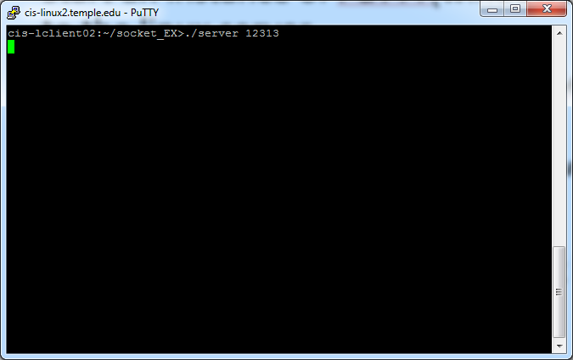
Launching the server
Start an instance of PuTTY(windows) or SSH(linux/mac) and connect to the linux server. This is the server.
Ensure that simpleServer.c, simpleServer.h, and open_listenfd.c are all on the linux server.
You can move them using winSCP on windows and scp on linux/mac.
Compile the program.
If you run the program and nothing happens, it’s working correctly. Keep it running, if you want to close it, hit ‘ctrl-c’.

Slide 4
Launching the user
Launch another instance of PuTTY or SSH and connect to the linux server again. This will be a user.
On your server instance, take note of the machine the server is running on.
On the user instance, if the machine is not the same. SSH on to the server’s machine. See next slide.

Slide 5
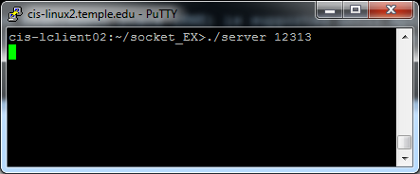
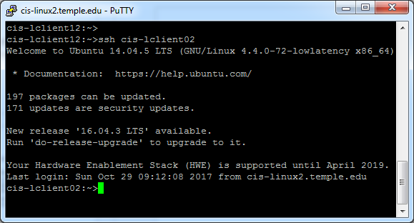
Different machines
SSH to server’s machine
Now they both match!

Slide 6
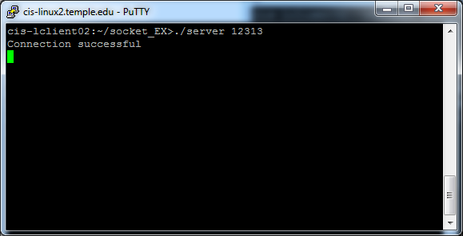
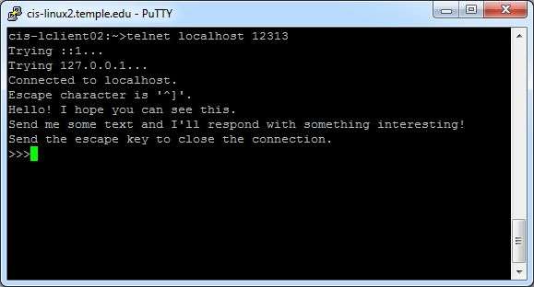
Connecting the user to the server
As the user type ‘telnet localhost PORTNUMBER’.
PORTNUMBER being the port the server is listening on.
The user can now send messages to the server.

Slide 7
Currently, the simple server only services a single user, if you try to connect to the server while another connection is active, you will have to wait until the first user quits.
However, once the user quits, the server program will also quit, dropping all pending connections.
To change this behavior to allow the server to service users after the first one quits only requires the addition of a while loop into the program.
Hopefully this helps you on your server.

