Slide 1

Fault-tolerant quantum computation with Triple Alpha
Alessandro Summer
Alban Dietrich
Leonard Logaric
Arthur Strauss

Slide 2
FTQC 101
FTQC
FT Gates
Quantum Error Correction
Decoding
Logical encoding
Clifford
Non-Clifford
Syndrome extraction
(mid-circuit measurement)
Nested subroutines
Transversal gates
Magic State Distillation
(Repeat Until Success)

Slide 3
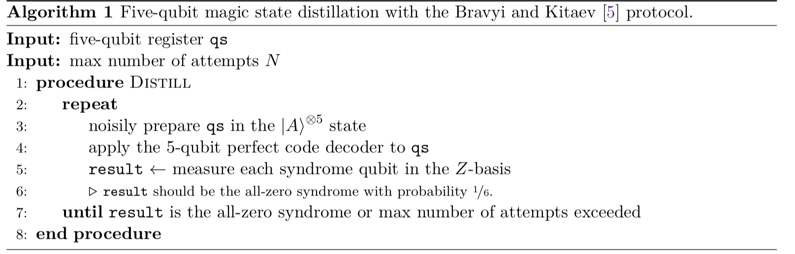




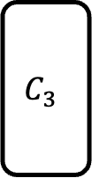

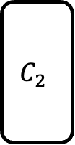

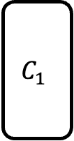
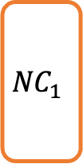
FT Circuit
$$C_{1}$$
$$QEC$$
$$C_{2}$$
$$QEC$$
$$C_{3}$$
$$QEC$$
$${NC}_{1}$$
We break down all tasks required to run a FT circuit:
Implementing a logical Clifford gate
Implement QEC (bit-flip and phase-flip codes examples)
Magic State Distillation
Implement Non-Clifford gate fault-tolerantly
$${\left|ψ\right\rangle }_{L}$$
$$|A⟩$$
Magic State Distillation
(RUS)
$$|A_{distilled}⟩$$

Slide 4
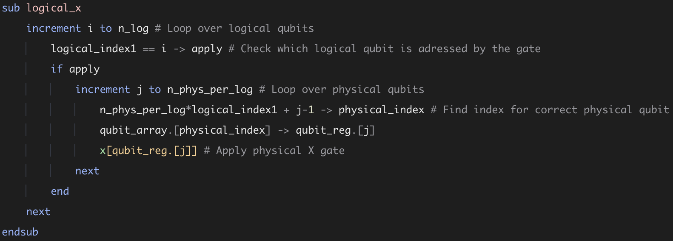





Logical Clifford gate
$$C$$
$$C$$
Clifford gates can be done fault-tolerantly in a « transversal » way
$$C$$
$$C$$
$$C$$

Slide 5
Quantum Error Correction: The Bitflip code / 5 qubit code

Slide 6
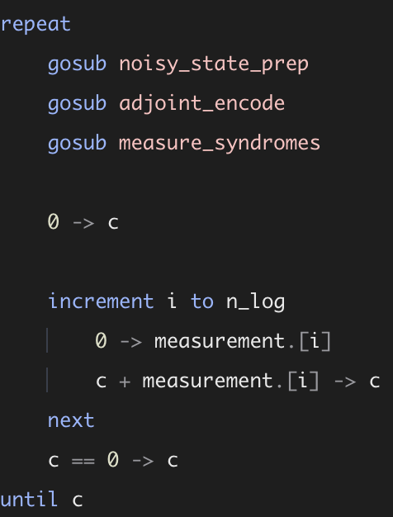
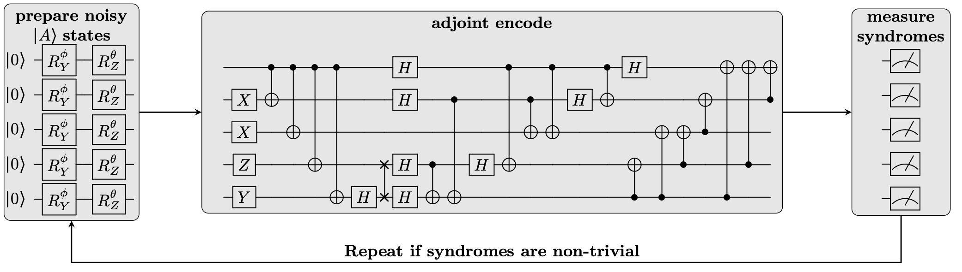
Magic State Distillation (MSD)
To be implemented fault-tolerantly, a non-Clifford gate requires Magic States
MSD requires fault-tolerant Clifford gates, and repeat-until-success procedures

Slide 7
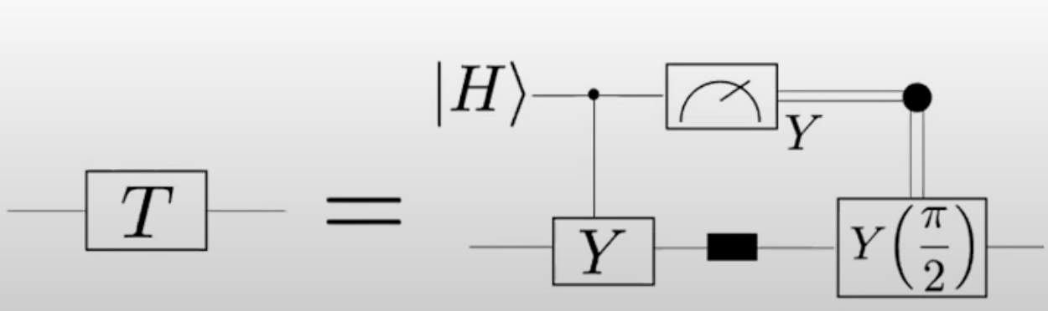
Logical Non Clifford gate (T gate)

Slide 8
Conclusion
Triple Alpha enables to write efficiently key FT subroutines at both physical and logical levels
Comments on what to improve? New directions?

