Slide 1

Fault-tolerant quantum computation with Triple Alpha
Alessandro Summer
Alban Dietrich
Leonard Logaric
Arthur Strauss

Slide 2
FTQC 101
FTQC
FT Gates
Quantum Error Correction
Decoding
Logical encoding
Clifford
Non-Clifford
Syndrome extraction
(mid-circuit measurement)
Nested subroutines
Transversal gates
Magic State Distillation
(Repeat Until Success)

Slide 3
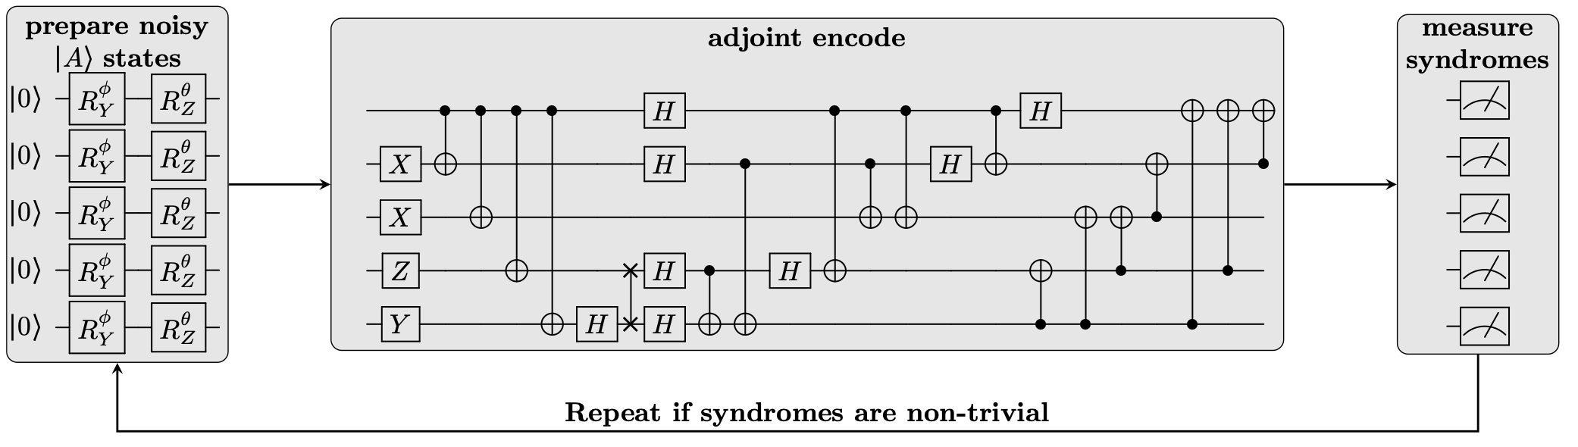

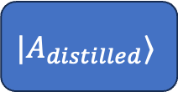




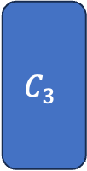
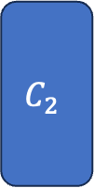



FT Circuit
$$C_{1}$$
$$QEC$$
$$C_{2}$$
$$QEC$$
$$C_{3}$$
$$QEC$$
$${NC}_{1}$$
$${\left|ψ\right\rangle }_{L}$$
$$|A⟩$$
$$RUS$$
$$|A_{distilled}⟩$$

