Slide 1

REPUBLIKA E MAQEDONISË UNIVERSITETI I EVROPËS JUGLINDORE South East European University Faculty of Contemporary Sciences and Technologies
FlaskBlog
STUDENT:
Alban Memishi
MENTOR:
Prof. Dr. Artan Luma
TETOVO, JUNE 2021

Slide 2
Topics:
Intro
Used technologies

Slide 3
Intro
What I’ve build.
Technologies used
Brief explanation

Slide 4
PyCharm and Flask
Programming language.
Web Development .

Slide 5
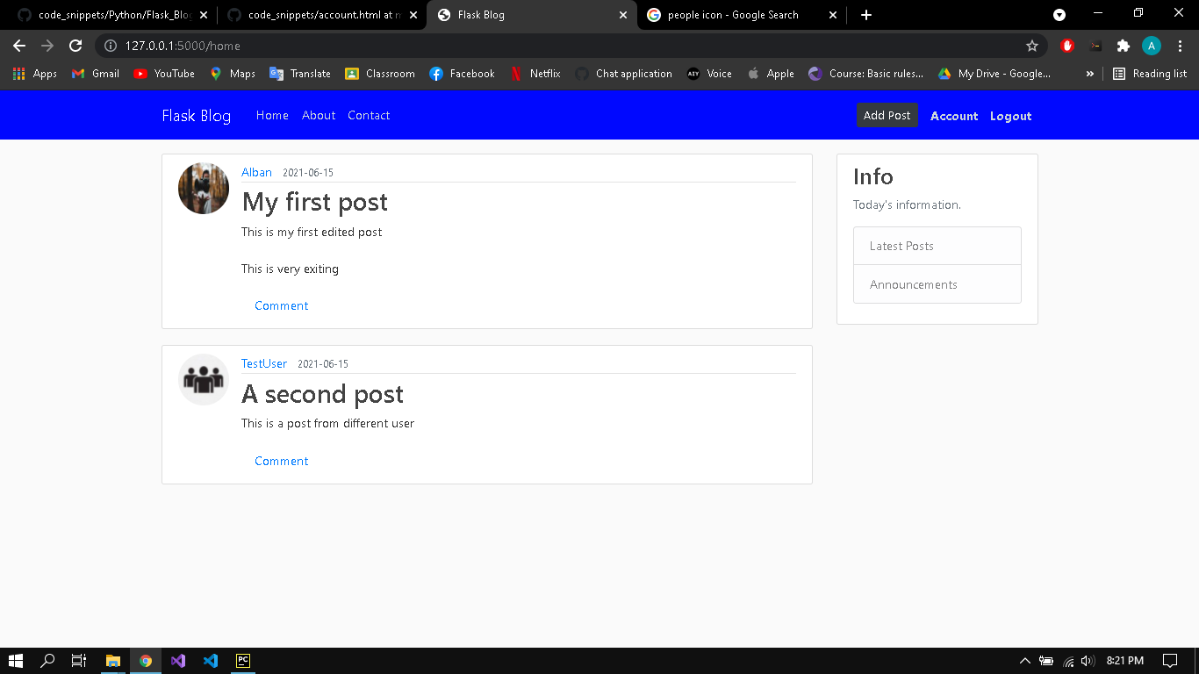
FlaskBlog
Home screen
Posts.
Login
Register

Slide 6
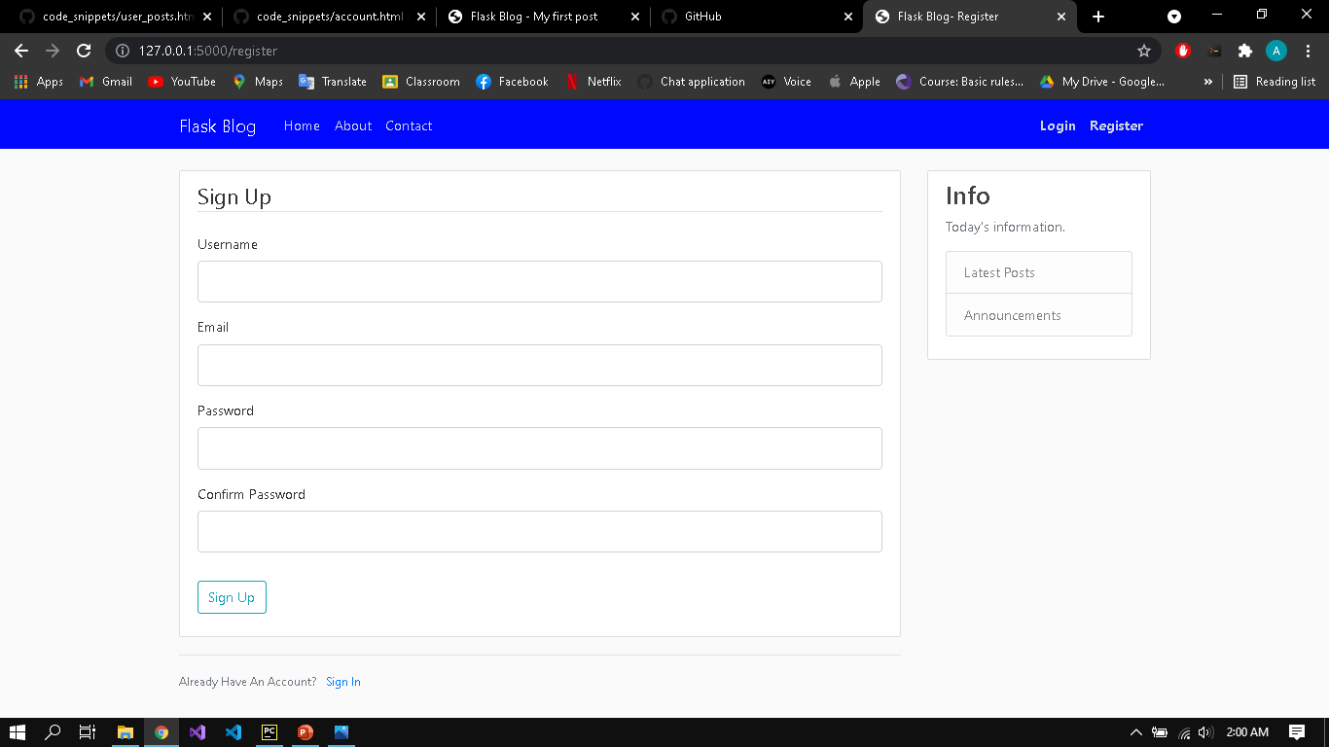
FlaskBlog
Required fields for Signing Up
Email field
Password
For login, email and password

Slide 7
FlaskBlog
Registred users can add, delete or update
Authentication is required
Pagination

Slide 8
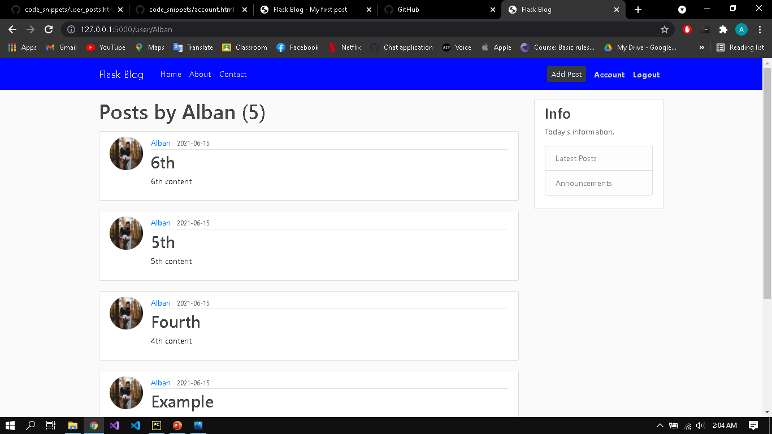
fBlog
You can see how many times has the user posted

Slide 9
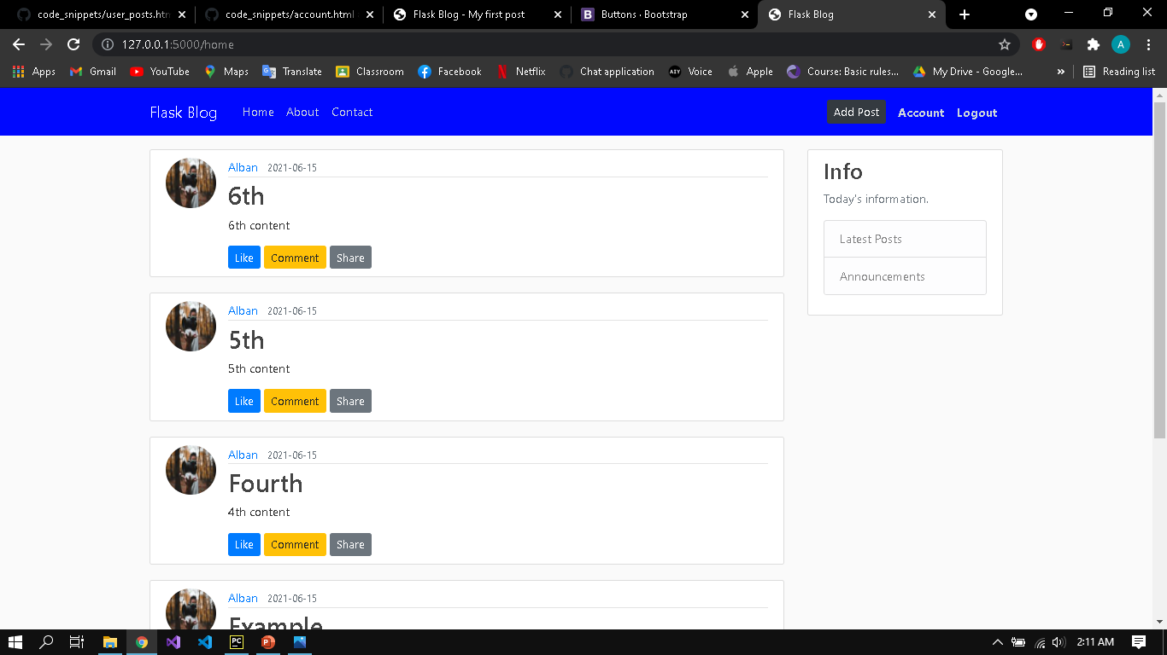
Important feature

Slide 10

Questions ?

