Slide 1

AMAZON
REVIOWS
BY ALBANDARI ALTALHI

Slide 2
Table of Contents
Introduction
Project Objectives
Data Overview
Preprocessing
Review Classification
Clustering
Summarization
Application & Deployment
Results
Challenges & Conclusion

Slide 3
Introduction
Our project aims to automate the analysis of Amazon product reviews using NLP techniques, enabling companies to better understand customer experiences faster and more accurately.

Slide 4
Project Objectives
Classify reviews as Positive, Negative, or Neutral
Group similar products using clustering
Automatically summarize key strengths and complaints
Build an interactive interface for analysis and presentation

Slide 5
Data Overview
Dataset: Amazon Reviews
Real customer reviews across various products
Contains star ratings and review texts
Cleaned and labeled for sentiment analysis

Slide 6
Preprocessing
Text cleaning: symbols, links, and irrelevant content removed
Tokenization and stop word removal
Mapping star ratings to sentiment:
1–2 stars → Negative
3 stars → Neutral
4–5 stars → Positive

Slide 7
Review Classification
We used a pre-trained BERT model (bert-base-uncased) and fine-tuned it on our dataset to classify customer reviews by sentiment.

Slide 8
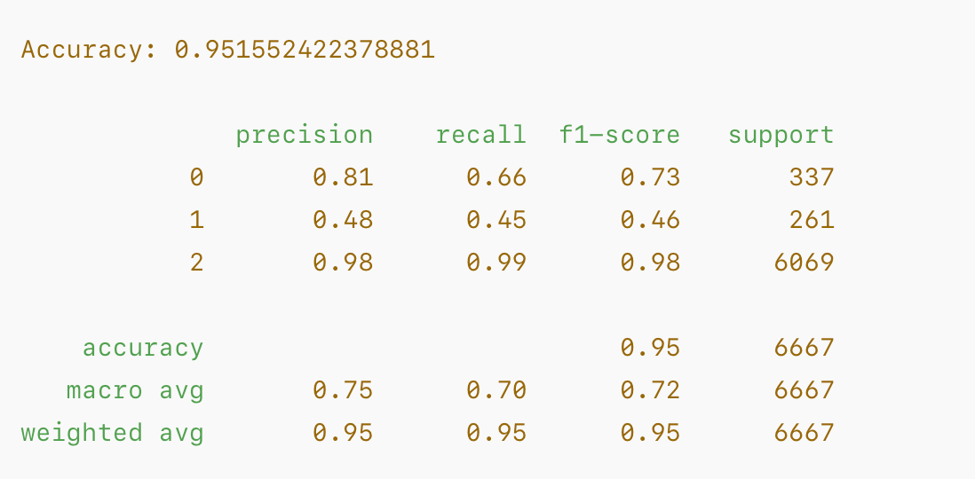
Classification Results

Slide 9
CONFUSION MATRIX
A confusion matrix was used to evaluate the model’s performance and understand misclassifications between the three sentiment classes.

Slide 10
SUMMARIZATION
T5 or BART models were used to generate automatic summaries
Extracted highlights per product: best-rated items, common issues
Example: “Top-rated product...” or “Most mentioned complaint...”

Slide 11
APPLICATION
Built an interactive UI using Gradio
Features:
Real-time sentiment analysis
Cluster visualization
Summarized insights
Successfully deployed on AWS

Slide 12
FINAL RESULTS
95% classification accuracy
5 distinct product clusters discovered
Summarized thousands of reviews using deep learning

Slide 13
CHALLENGES
Imbalanced dataset with a majority of positive reviews
Difficulty choosing the best number of clusters
Deployment on AWS involved dependency and environment issues
Slow training due to limited hardware resources

Slide 14
CONCLUSION
Demonstrated that NLP can effectively automate review sentiment analysis
The approach is scalable to other platforms like Yelp or TripAdvisor
Future work: Improve balance in data and optimize cluster tuning

Slide 15
Thank you !

