Slide 1
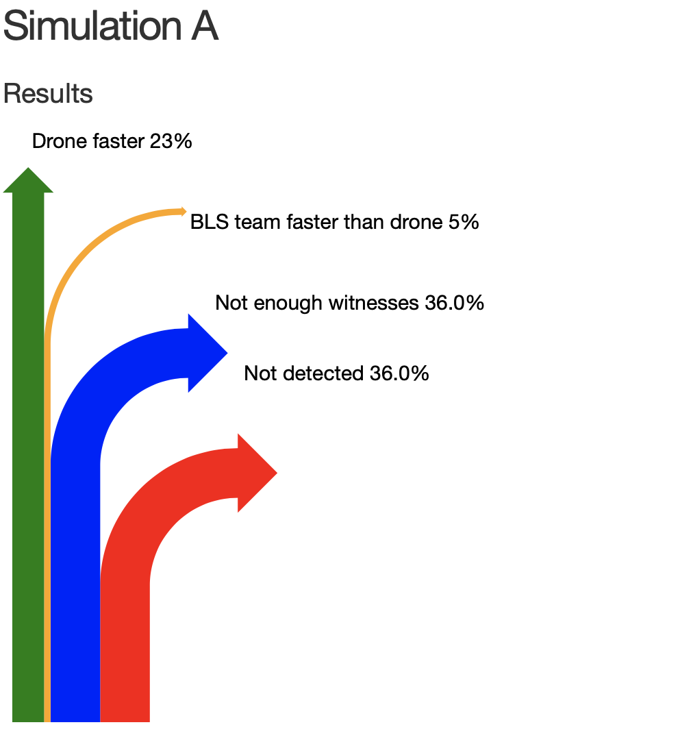
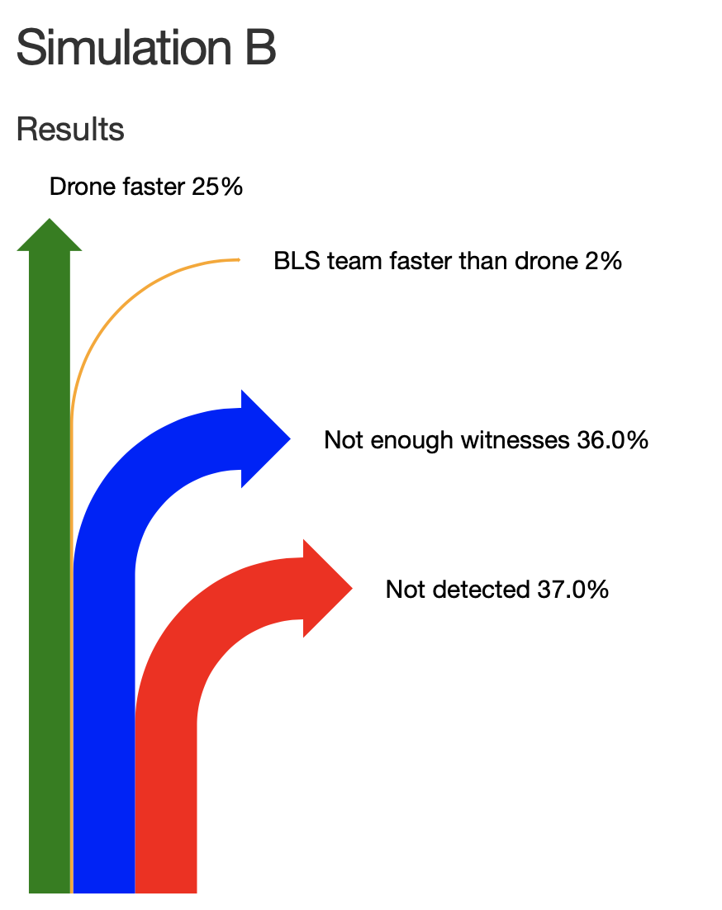

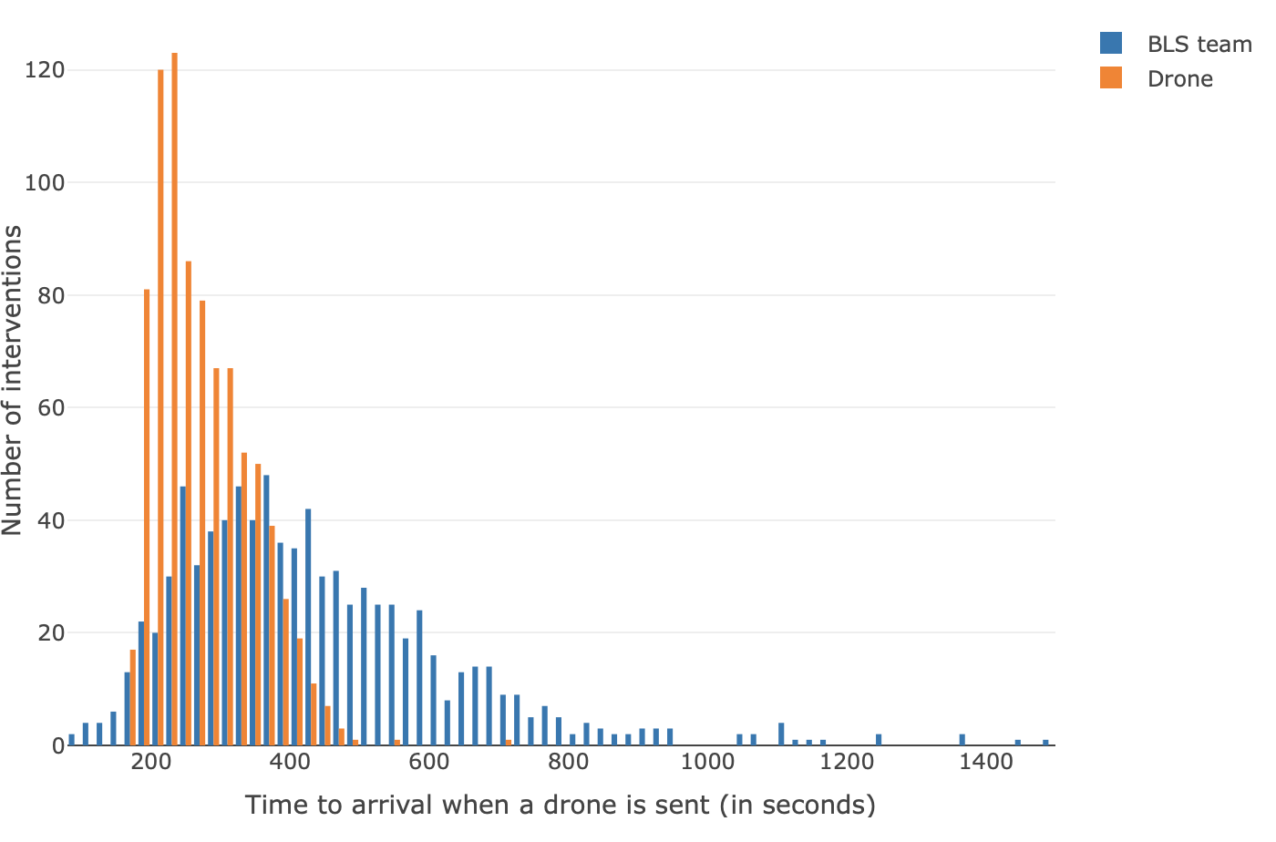
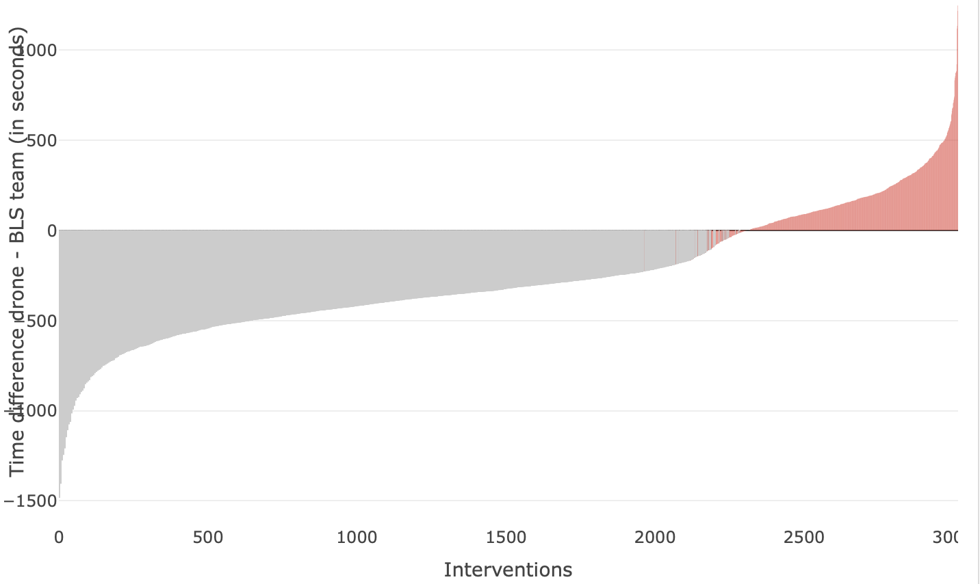
Unconsciousness detected
Detection rate : drone send for OHCA detected … % in public place
… % at home
OHCA detection sequence : drone goes … sec after BLS team
… % of OHCA at home have only one witness alone: no drone sent.
Drone can fly during aeronautical night : yes/no
Drone parameters:
Take off delay … (in s)
Drone's cruise altitude ... (in m)
Max drone speed … (in km/h)
Drone's acceleration time … (in sec)
Drone's vertical speed … (in m/s)
Drone’s landing delay … sec.
After a run the drone is unavailable for … h.

Slide 2
Some guidelines to read graphs
Detection rate : drone send for OHCA detected … % in public place
… % at home
OHCA detection sequence : drone goes … sec after BLS team
… % of OHCA at home have only one witness alone: no drone sent.
Drone can fly during aeronautical night : yes/no
Drone parameters:
Take off delay … (in s)
Drone's cruise altitude ... (in m)
Max drone speed … (in km/h)
Drone's acceleration time … (in sec)
Drone's vertical speed … (in m/s)
Drone’s landing delay … sec.
After a run the drone is unavailable for … h.

Slide 3
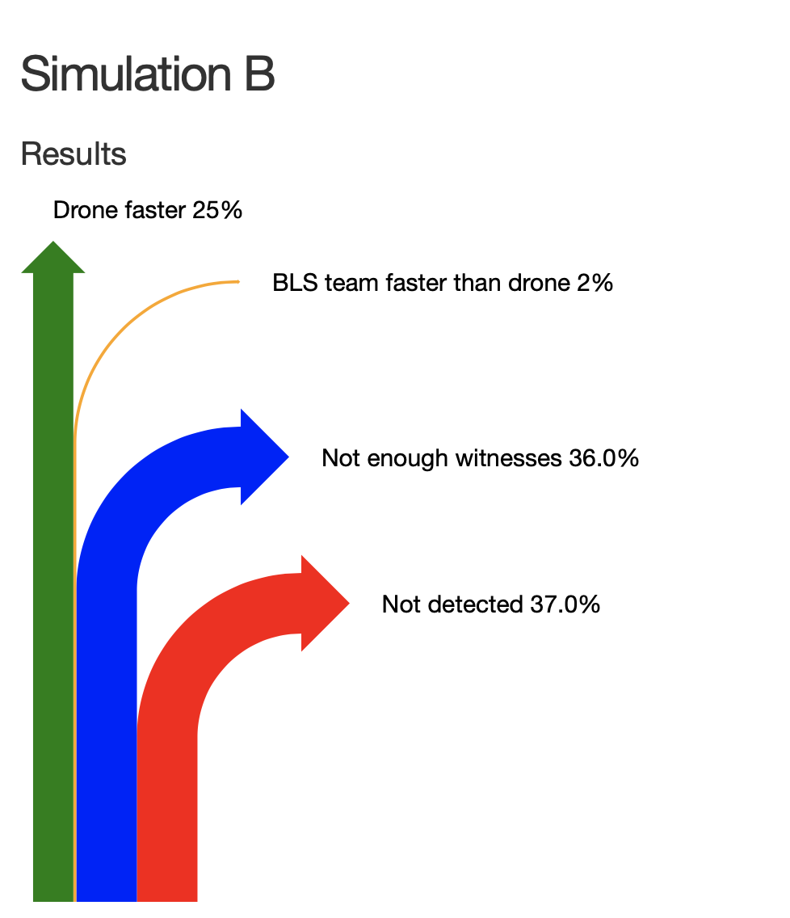
Some guidelines to read graphs
Detection rate : drone send for OHCA detected … % in public place
… % at home
OHCA detection sequence : drone goes … sec after BLS team
… % of OHCA at home have only one witness alone: no drone sent.
Drone can fly during aeronautical night : yes/no
Drone parameters:
Take off delay … (in s)
Drone's cruise altitude ... (in m)
Max drone speed … (in km/h)
Drone's acceleration time … (in sec)
Drone's vertical speed … (in m/s)
Drone’s landing delay … sec.
After a run the drone is unavailable for … h.

Slide 4
Unconsciousness detected
OHCA detection rate:
drone sent for OHCA detected
… % in public place
… % at home
OHCA detection sequence:
drone goes … sec after BLS team
Bystanders:
… % of OHCA at home have only one witness alone: no drone sent.
Drone takes off
Take off delay … (in s)
Drone’s landing delay … (in sec).
Drone's vertical speed … (in m/s)
Drone's cruise altitude ... (in m)
Max drone speed … (in km/h)
Drone's acceleration time … (in sec)
BLS team leaves
Drone can fly during aeronautical night : yes/no
After a run the drone is unavailable for … h.

Slide 5
Unconsciousness is detected
Detection rate:
drone sent for OHCA detected
12 % in public place
80 % at home
OHCA detection sequence:
drone goes 104 sec after BLS team
Bystanders:
58 % of OHCA at home have only one witness alone: no drone sent.
Drone takes off
Take off delay 15 (in s)
Drone’s landing delay 15 (in s).
Drone's vertical speed 9 (in m/s)
Drone's cruise altitude 100 (in m)
Max drone speed 80 (in km/h)
Drone's acceleration time 5 (in s)
BLS team leaves
Drone can fly during aeronautical night : no
After a run the drone is unavailable for 6 h.

Slide 6
Unconsciousness
detected
Is the OHCA detected?
Can a drone be sent?
OHCA detection rate:
… % in public place
… % at home
If OHCA not detected: no drone sent.
Bystanders:
… % of OHCA at home have only one witness alone: no drone sent.
Drone can fly during aeronautical night : yes/no
Drone takes off
Take off delay … (in s)
Drone’s landing delay … (in sec).
Drone's vertical speed … (in m/s)
Drone's cruise altitude ... (in m)
Max drone speed … (in km/h)
Drone's acceleration time … (in sec)
BLS team leaves
OHCA detection sequence:
drone goes … sec after BLS team
After a run the drone is unavailable for … h.

Slide 7
Unconsciousness
detected
Is the OHCA detected?
Can a drone be sent?
OHCA detection rate:
12 % in public place
80 % at home
If OHCA not detected: no drone sent.
Bystanders:
58 % of OHCA at home have only one witness alone: no drone sent.
Drone can fly during aeronautical night: no
Drone takes off
Take off delay 15 (in s)
Drone’s landing delay 15 (in sec).
Drone's vertical speed 9 (in m/s)
Drone's cruise altitude 100 (in m)
Max drone speed 80 (in km/h)
Drone's acceleration time 5 (in sec)
BLS team leaves
OHCA detection sequence:
drone goes 104 sec after BLS team
After a run the drone is unavailable for 6 h.

