Slide 1
WeB sementic – VElo
Par :
Soumaya SABRY – Alban STEFF

Slide 2

Sommaire
Data
Ontologie
@Context
Java
Import
Queries
Temps-réel
Functions
RDF
Interface Console

Slide 3

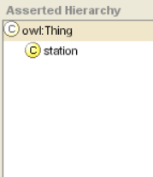

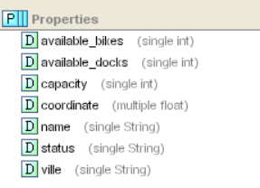
Ontologie
Sur Protège
ns:station rdf:type rdfs:Class .
ns:available_bike rdf:type rdf:Property .
ns: available_bike rdfs:domain ns:station .
ns: available_bike rdfs:range xsd:integer
……
xsd: integer
available_bike
Domain OF
xsd: integer
available_dockers
Station
capacity
xsd: integer
coordinate
xsd:float
name
status
xsd:string
ville
xsd:string
xsd:string

Slide 4
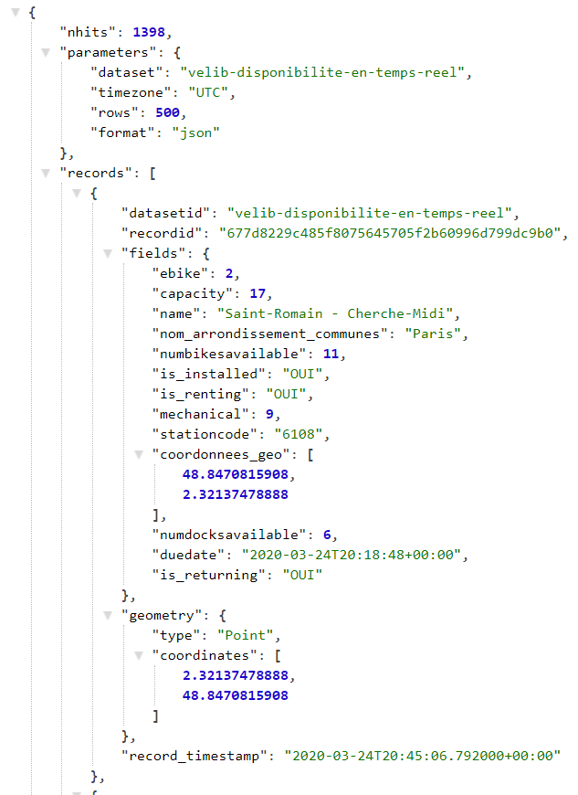
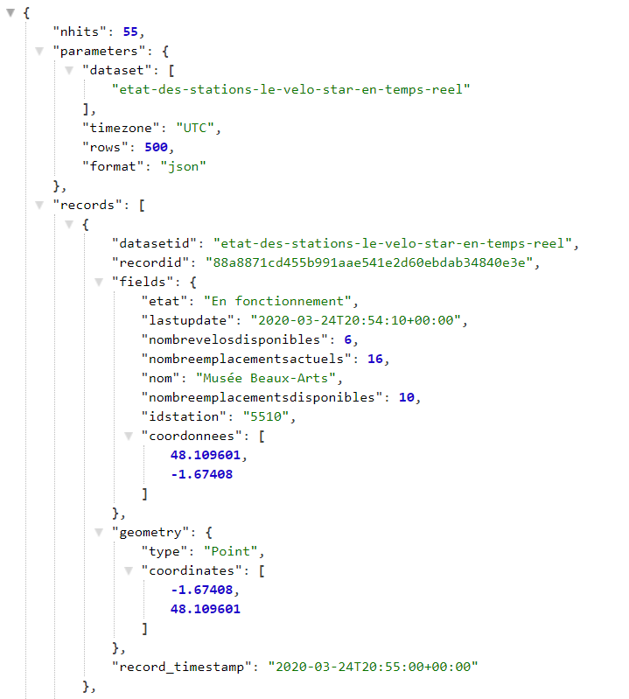
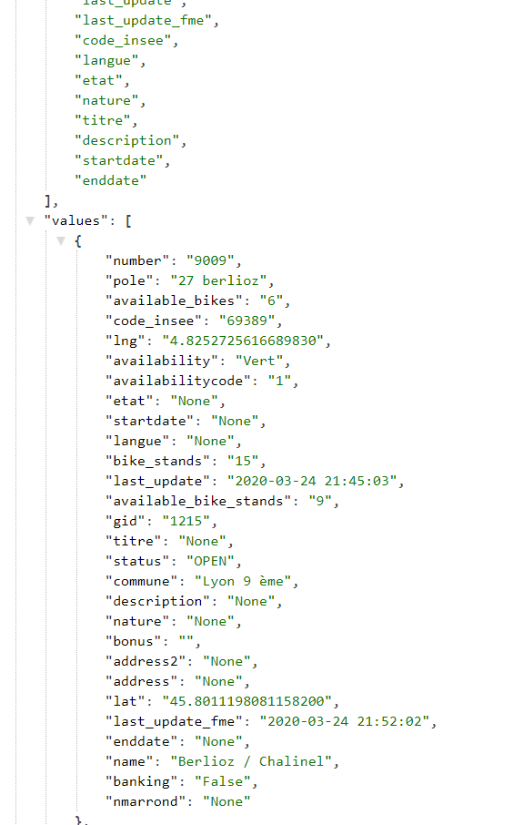
JSON ➔ ROWS MAX =500
PAris
LyoN
Rennes
Sans Ville

Slide 5
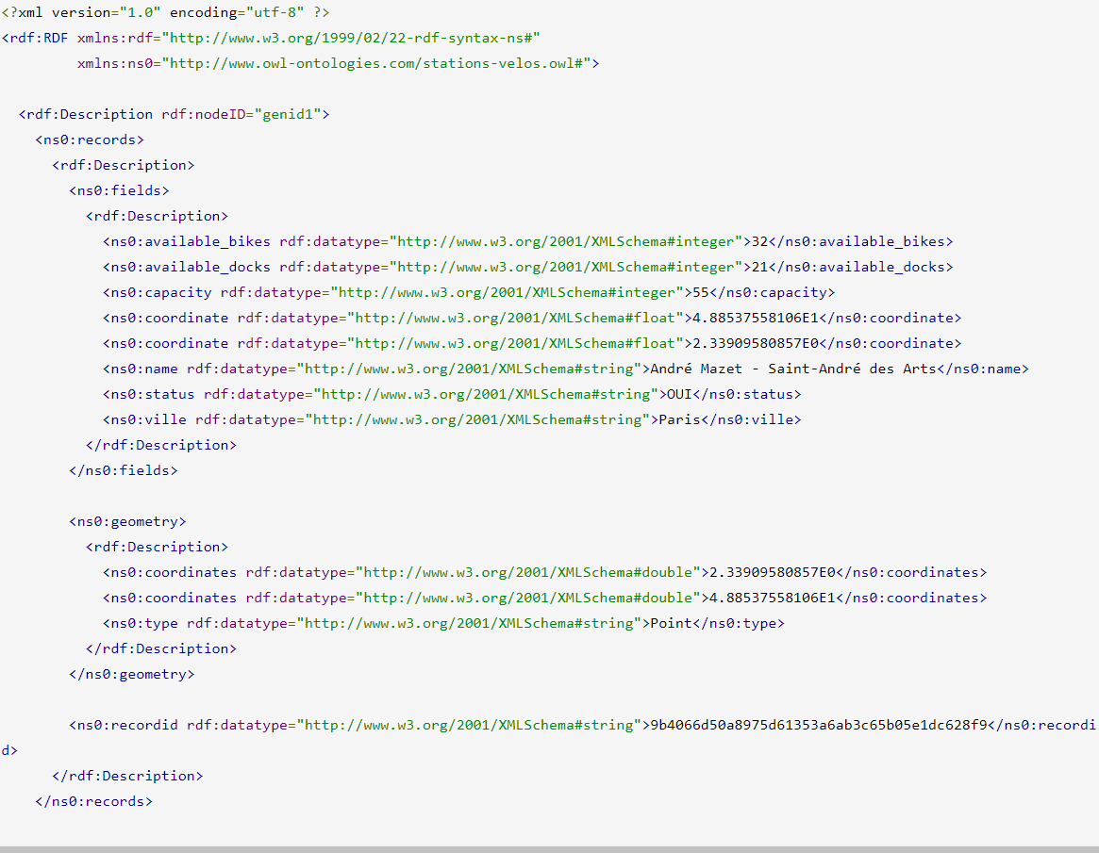
@context
"@context": {
"@vocab":"http://www.owl-ontologies.com/stations-velos.owl#",
"capacity":"capacity",
"numbikesavailable":"available_bikes",
"coordonnees_geo" ": "coordinate", "is_installed":"status",
"numdocksavailable":"available_docks",
"nom_arrondissement_communes":"ville",
"datasetid":null, "nhits":null,
"is_renting":null,"is_returning":null,
"ebike":null,"duedate":null,
"mechanical":null,"record_timestamp":null,
"stationcode":null,"parameters":null
}
id1
capacity
55

Slide 6
@context
id1
capacity
55
"@context": {
"@version":1.1
"@vocab":"http://www.owl-ontologies.com/stations-velos.owl#",
" fields " : "@nest",
"capacity":"capacity",
"numbikesavailable":"available_bikes",
"coordonnees_geo" ": "coordinate", "is_installed":"status",
"numdocksavailable":"available_docks",
"nom_arrondissement_communes":"ville",
}
"@context": {
"@vocab":"http://www.owl- ontologies.com/stations-velos.owl#",
" fields " : { "@id": "_:fields", "@container": "@set"}
"capacity":"capacity",
"numbikesavailable":"available_bikes",
"coordonnees_geo" ": "coordinate", "is_installed":"status",
"numdocksavailable":"available_docks",
"nom_arrondissement_communes":"ville",
}

Slide 7
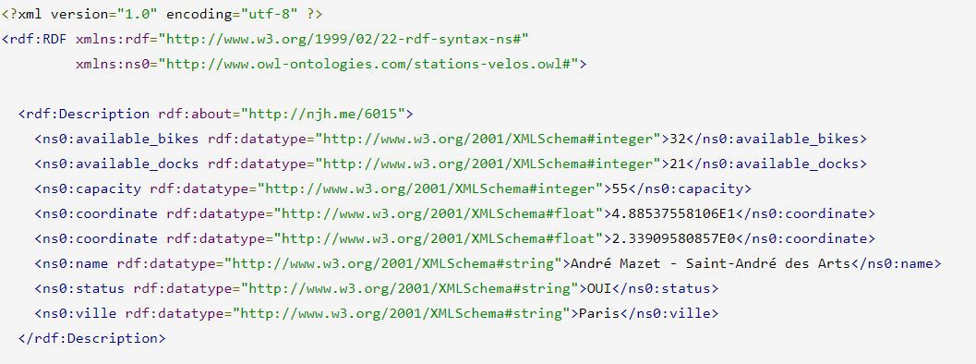
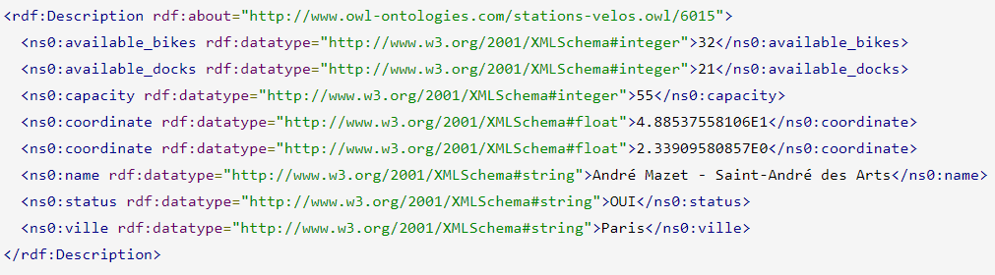
@context
"@context": {
"@vocab":
"http://www.owl-ontologies.com/stations-velos.owl#",
"stationcode":"@id",
"capacity":"capacity",
"numbikesavailable":"available_bikes",
"coordonnees_geo":"coordinate",
"is_installed":"status",
"numdocksavailable":"available_docks",
"nom_arrondissement_communes":"ville",
"fields": { "@id": "_:fields", "@container": "@set"} ,
"datasetid":null, "is_renting":null,"is_returning":null,
"geometry":null,"ebike":null,"duedate":null,
"mechanical":null,"record_timestamp":null,
"records": { "@id": "_:records", "@container": "@list" },
"recordid":null,"parameters":null,"nhits":null
}
"@base": "http://www.owl-ontologies.com/stations-velos.owl/"

Slide 8
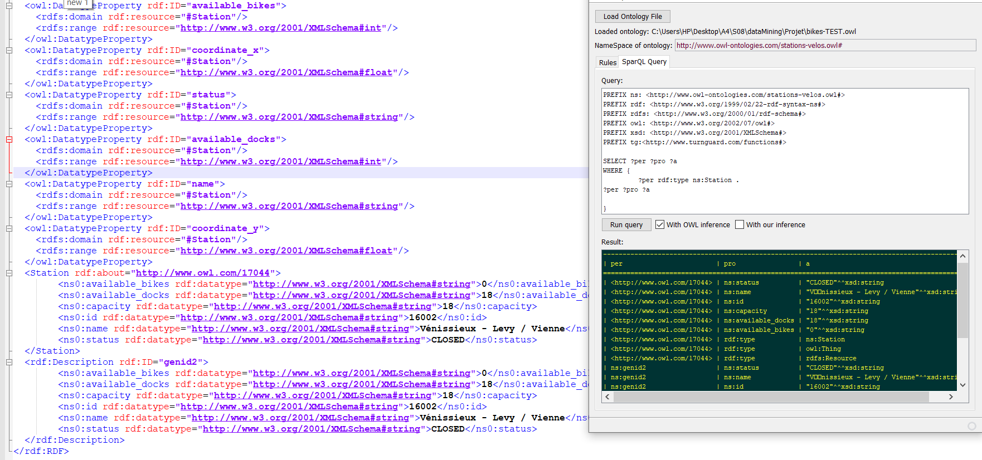
RDF
idéal
Notre resultat

Slide 9
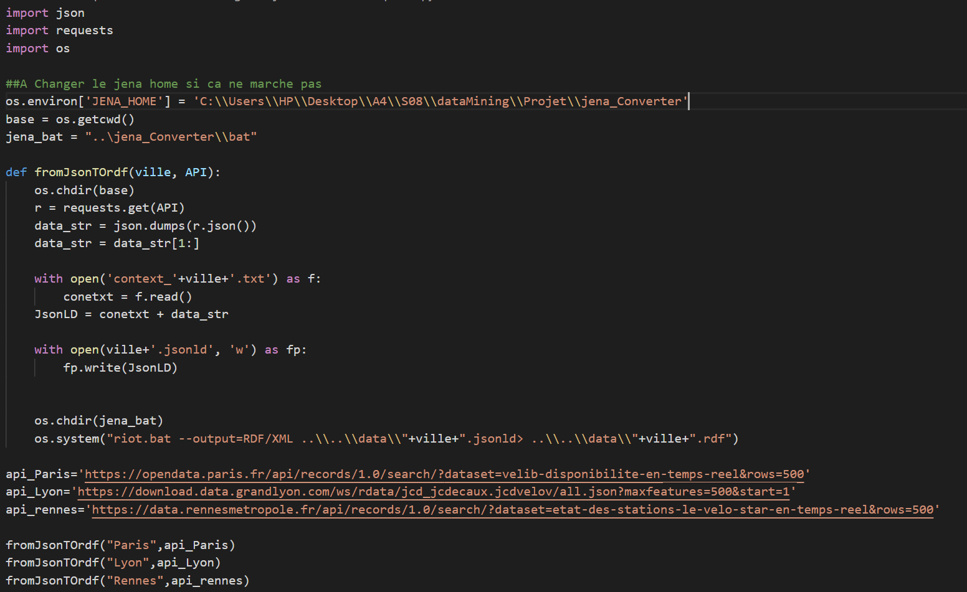
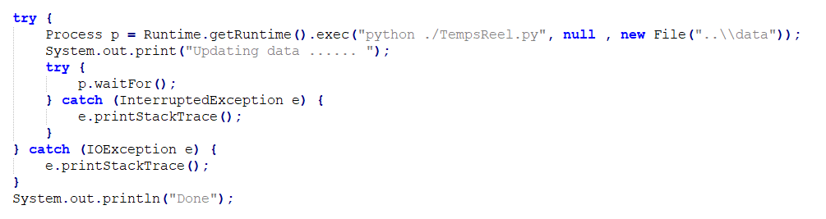
Temps-réel
Set the envi
JSON
JSON-LD
To RDF
Exécution 3 api

Slide 10
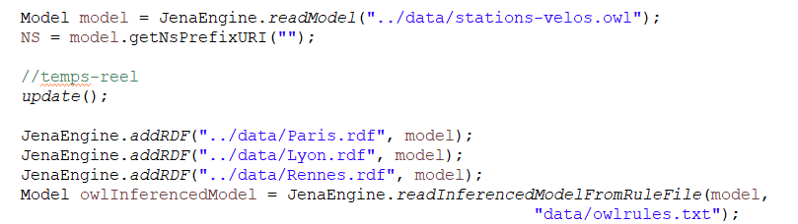
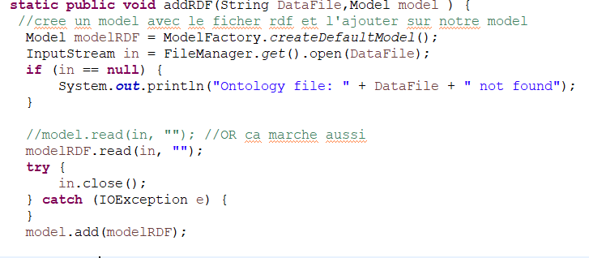
Java Import
Data
 | Station-velo.owl
 | Paris.rdf
 | Lyon.rdf
 | Rennes.rdf
Jena_Project
 | scr
 | data (rule & query)

Slide 11
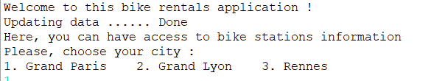
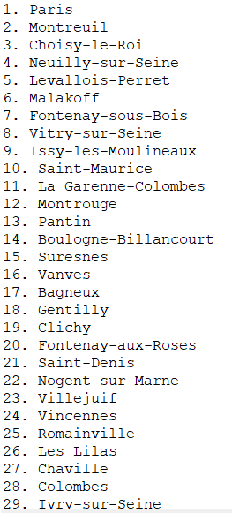
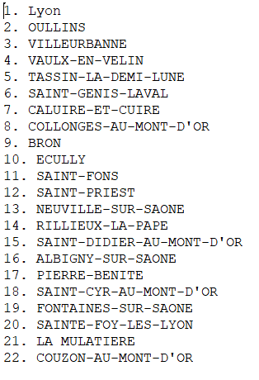
Interface Console
Bouns :
Demander les corrdonnées
Sans Ville

Slide 12
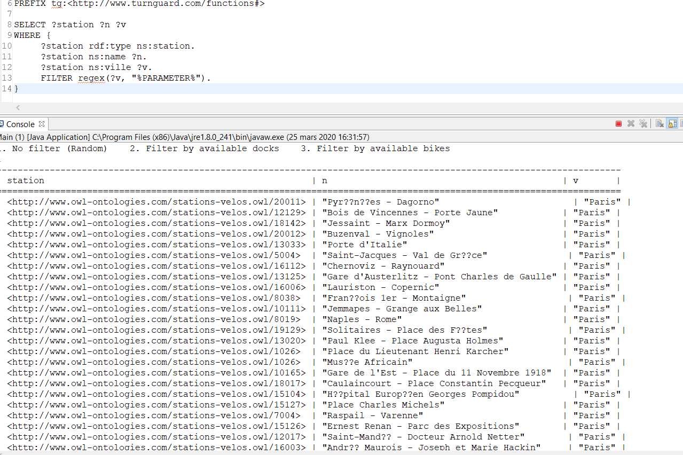
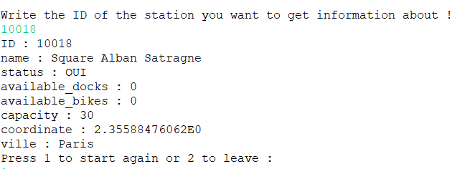
Interface Console
1.
Pour Paris

Slide 13
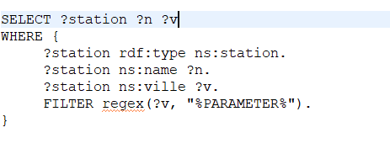
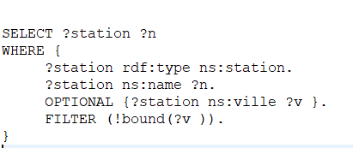
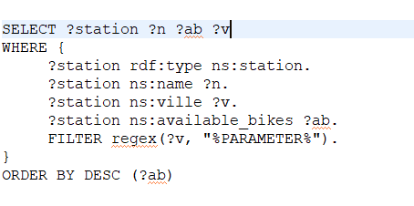
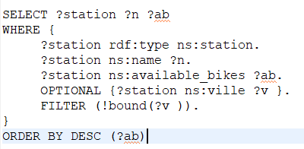
Queries
Pour Paris & Lyon
Pour Rennes

Slide 14
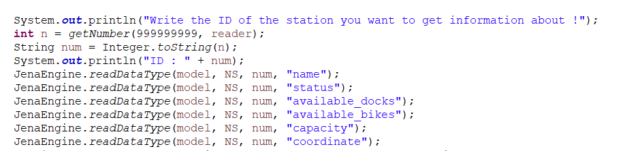
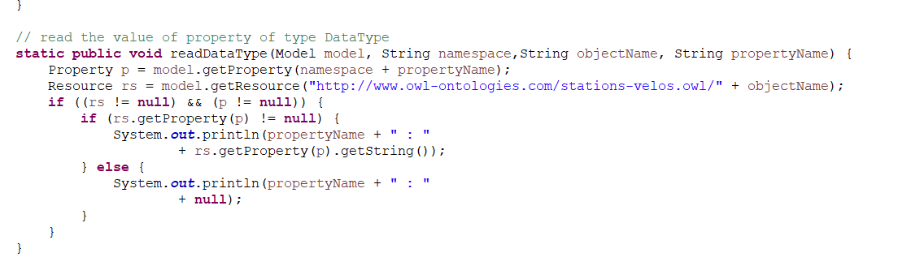
Fonctions

Slide 15


Une Demo

