Slide 1



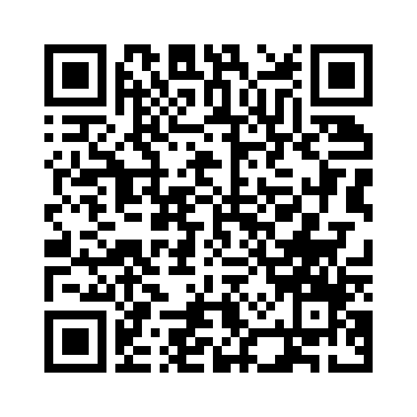
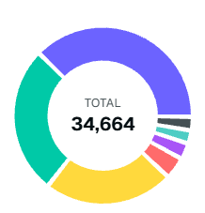
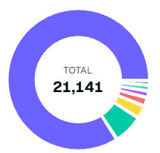
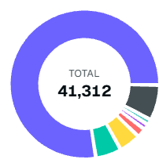
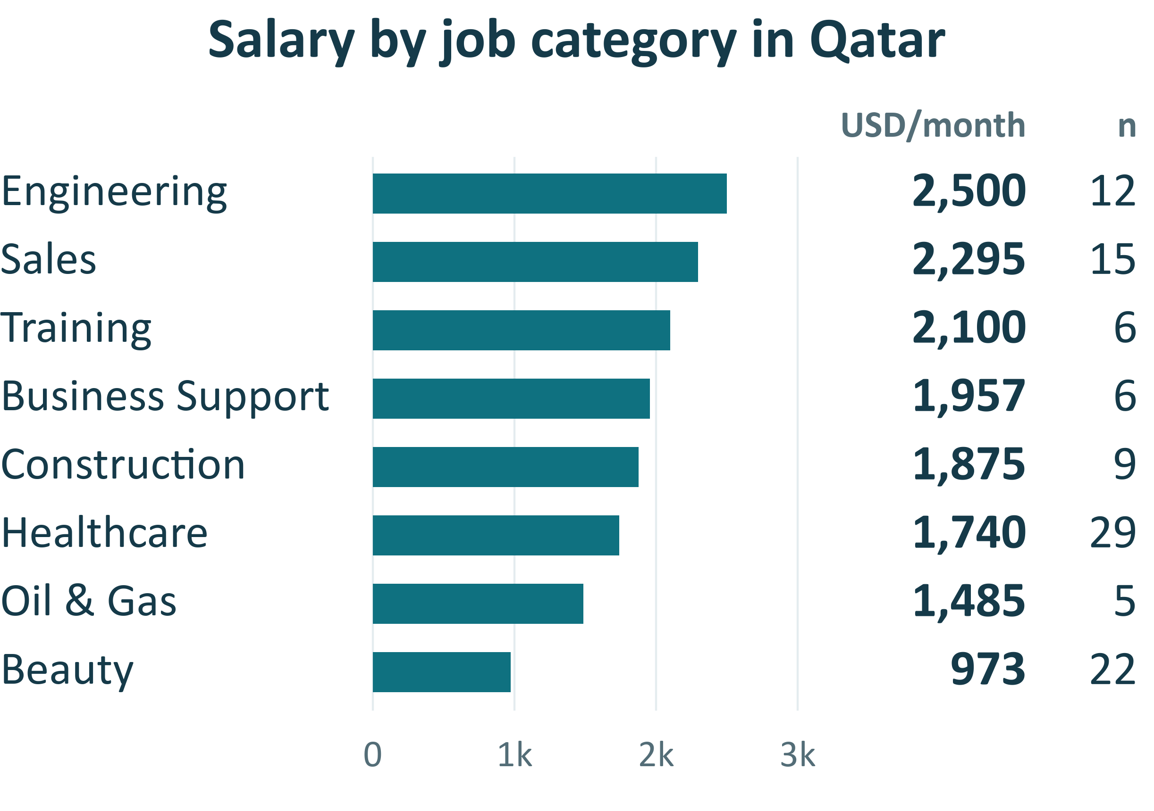









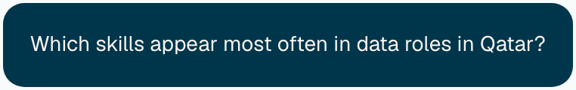
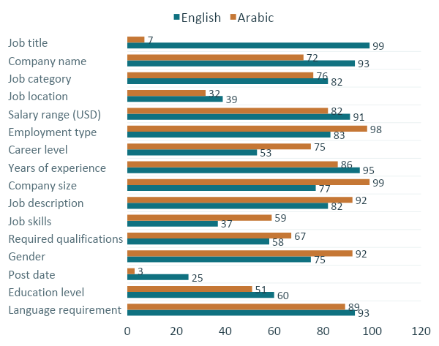





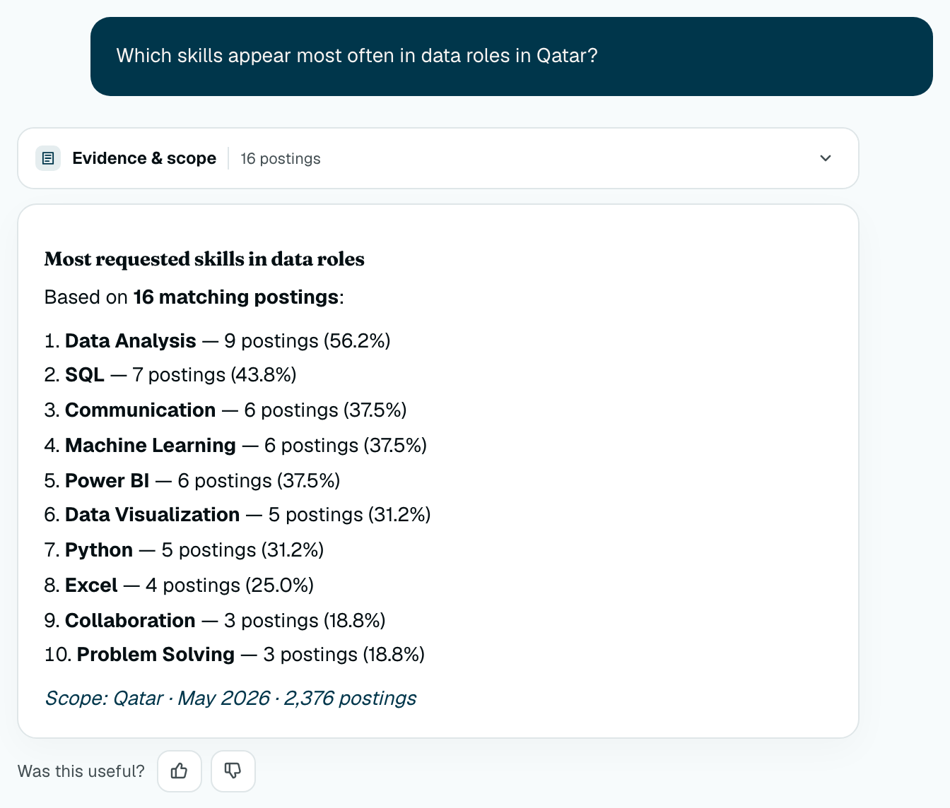





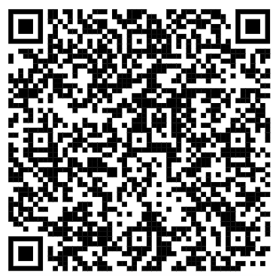
Mihna
AI-Powered Job Market Intelligence
Mohammad Faiz Jabir · Albaraa Aloush · Yahya Taha
Mentors: Dr. Hamdy Mubarak, Eng. Ummar Abbas, Abubakr Mohamed
Project code
QCRI Summer Internship Program 2026
Motivation & aim
Dashboard exploration: Per-country and aggregated
Job ads can inform education, career decisions and workforce planning. Inconsistent terminology, different formats and missing fields make them hard to analyze.
Career level
Employment type
Education requirements
55.6k
postings
2
platforms
3
countries
Bayt + LinkedIn; all available dates
Qatar; Bayt, May 2026
Mihna structures postings into evidence of demand that students, employers and policymakers can explore through dashboards and bilingual questions.
Senior
13.4K
39%
Full-Time
18.3K
86%
Bachelor
32.9K
80%
Data collection & preparation
Mid-Level
9.4K
27%
Contract
1.4K
6.6%
High School
2.2K
5.3%
Entry-Level
8.3K
24%
Internship
560
2.6%
Diploma
1.8K
4.4%
Manager
1.3K
3.7%
Part-Time
343
1.6%
Master
672
1.6%
Custom scraping pipeline
not applicable
904
2.6%
Remote
238
1.1%
Bachelor’s degree /
higher diploma
343
0.8%
JobSpy collection
Director
702
2.0%
Freelance
207
1.0%
PhD
330
0.8%
Top 5 sectors overall; share of country postings.
Median disclosed salary; n = postings per category.
Dashboard snapshot coverage
Bilingual RAG methodology
Experiments & results
Source / snapshot | Qatar | Saudi Arabia | UAE
Bayt | 10,131 | 16,101 | 19,124
LinkedIn | 2,041 | 4,441 | 3,778
System overview
Benchmark: Automated scenario evaluation
26 English + 26 Arabic
PREPARATION & INDEXING
QUESTION ANSWERING
51/52
34/34
1
2
3
4
5
6
7
55,616 records across 11 dated datasets
Scenario checks
Evidence availability
Standardized metadata and remove duplicates. Used an LLM with a structured output schema to extract fields from job descriptions.
Validated
dataset
Job
document
Multilingual
embeddings
Qdrant
vector DB
Query
understanding
Evidence
retrieval
Grounded
answer
52/52
3/4
Extraction accuracy by field
Online query answering
Output language checks
Safe abstention
GPT-5.1 vs human annotations · Bayt
150 English + 150 Arabic postings
Retrieval and analytics are restricted to the selected source, country, period and dashboard filters.
Platform conversation · Cropped excerpt
THREE EVIDENCE PATHS
User
question
Query
understanding
Statistical
analytics
Pandas
analytics
Semantic
retrieval
Counts & rankings
Filtered aggregations
Relevant job postings
Scoped evidence context
…
Dataset summaries · Computed statistics
Retrieved postings · Source metadata
Fanar LLM
Generation
Validation
Arabic / English
response with citations
Future work
Accuracy (%)
Check citations and numbers
Automate monthly collection, validation, cleaning and dashboard/index refreshes.
References
Insufficient evidence
or failed checks
Safe abstention
[1] Nguyen et al. (2024). Rethinking Skill Extraction in the Job Market Domain using Large Language Models. NLP4HR.
[2] Myung et al. (2025). HyST: LLM-Powered Hybrid Retrieval over Semi-Structured Tabular Data. arXiv:2508.18048.
State that the selected data
cannot support an answer
Expand coverage across job sources, countries and comparable time periods.
Explore demand forecasting and market reports as longitudinal coverage improves.
Reference library

