Slide 1

OBE ASSIGNMENT ON
COMPUTER
AIDED DESIGN
AND
DRAFTING

Slide 2
Presented by,

Slide 3
INTRODUCTION
What is AutoCAD ?
AUTOCAD is a computer aided design drafting software program. It is used for creating blueprints for buildings, bridges, computer chips, electric design etc.
Though auto cad is used mainly by drafters, but often time the usage of this program software is common with engineers, surveyors and architects.
As its name implies AutoCAD stands for AUTOMATED COMPUTER AIDED DESIGN. A program developed and owed by Autodesk incorporation.

Slide 4
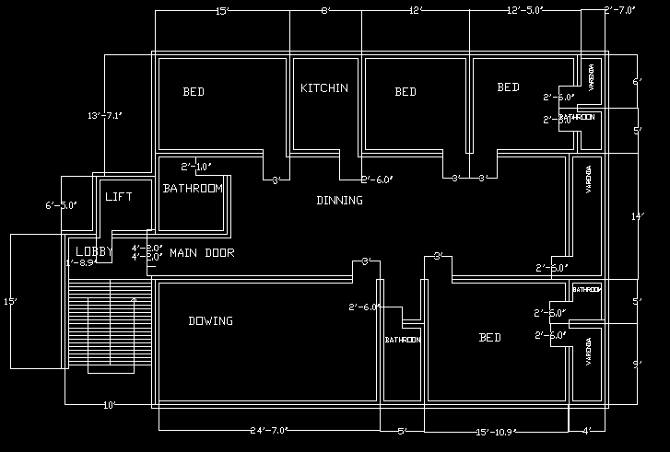
Planning Design
UNIT - B

Slide 5
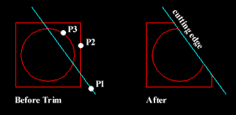
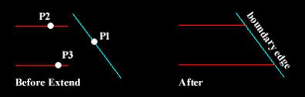
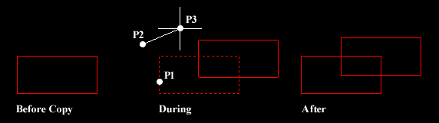
Some AutoCAD commands
Trim command - Type “Tr” than double enter in command prompt :
Trim command modify the edge of the shapes or trimmed,
Trim command apply the enter-
set objects which boundary are trim.
Extend command - Type “Ex” than double enter in command promote:
Extend command to use the any one line to extend, first select
a line and define the source and boundary edge.
Multiple copy command - Type “Co Or Cp” than enter in command prompt:
If I want the multiple objects so I can select the copy command
and click the objects and
give a base point and create a objects

Slide 6
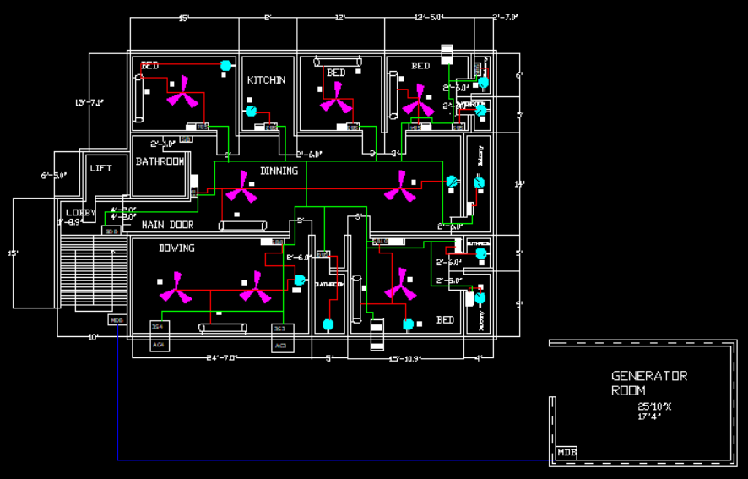
Final Design:
Final Design:

Slide 7
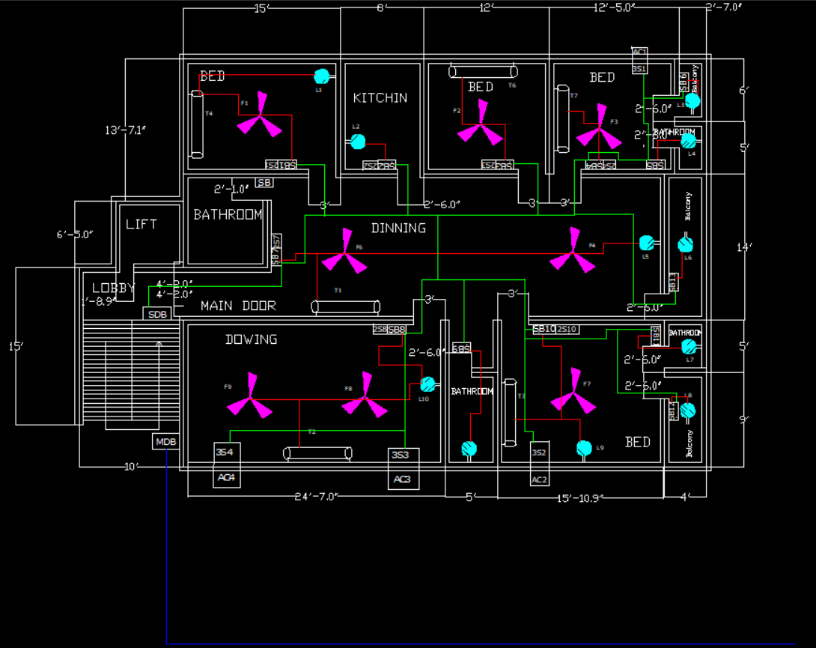
Waring
Conduct layout
Red- light load
Blue- medium load
Yellow- heavy load

Slide 8

Power distribution :

Slide 9
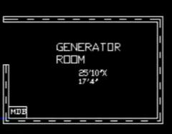
Generator
Total power consumption ......kilowatt
Generator ....... kilowatt

Slide 10
Load calculation

Slide 11
Research on topic
https://www.firstfloorplan.com/2020/02/house-plans-two-units-1500-to-2000-3-4-5-decimal.html#gsc.tab=0
First Floor Plan
Design Basis LLC

Slide 12
Some Uses Of Auto cad
Engineering Drafting Tool. AutoCAD has the possibility to produce very accurate designs.
Architectural Planning Tool.
3D Printing.
Fashion Industry.
Mechanical Industry.

Slide 13
Conclusion
AutoCAD is a computer-aided design software developed by the company Autodesk . It allows you to draw and edit digital 2D and 3D designs more quickly and easily than you could by hand. The files can also be easily saved and stored in the cloud, so they be accessed anywhere at any time .

Slide 14
Thank You

