Slide 1


Slide 2

Economic sustainability
of indigenous people
Preservation of their culture

Slide 3

Benefits of the Handicraft Industry
It promotes our cultural heritage
Raw material producers will be encouraged to produce more
Employment is generated

Slide 4
99%
of the national economy is fuelled by
small and medium enterprises
(Department of Trade and Industry, 2017)

Slide 5
Indigenous mobile revolution
There were almost as many mobile subscriptions as people in the world (International Telecommunication Union, 2014)

Slide 6
129.4
million phone lines used in the Philippines
(We Are Social Singapore, 2017)

Slide 7

Integration of education
into e-commerce

Slide 8
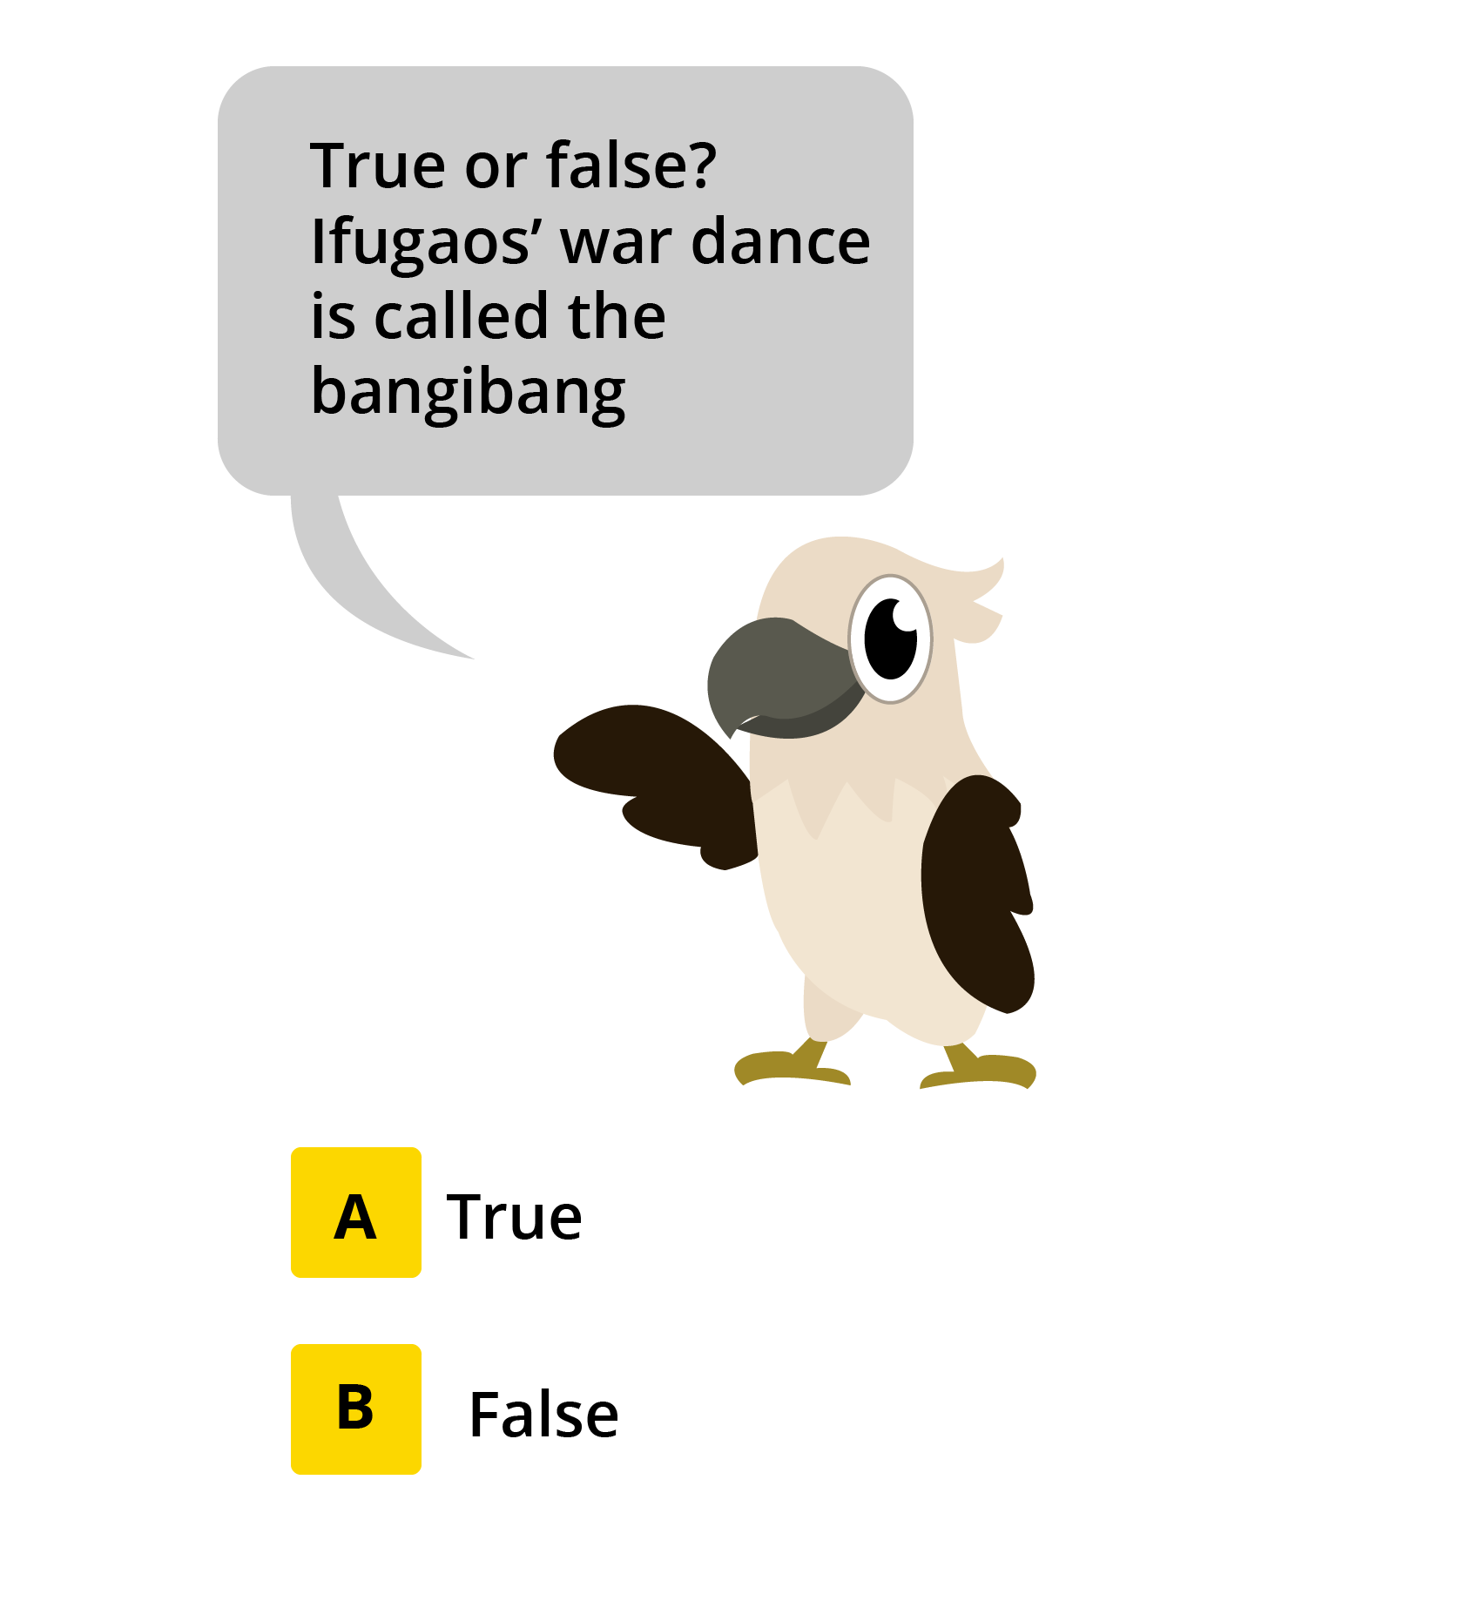


Slide 9
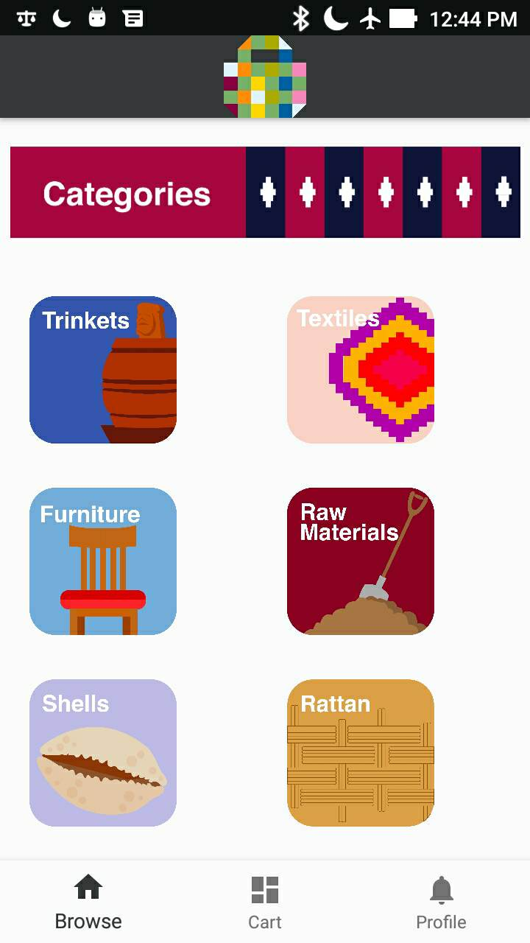
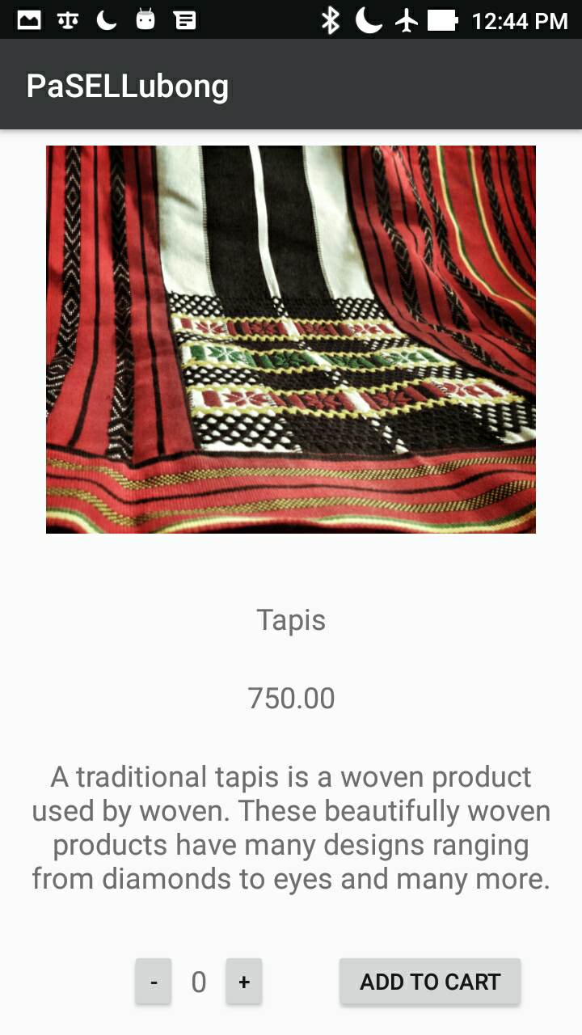

Slide 10
Creating a bridge between
the producers and the consumers

Slide 11



Slide 12
Future plans

