Slide 1
CS 161
An Analysis of the Dynamic Average Burst CPU Scheduling Algorithm
Constantino, Cu, Yumang

Slide 2
CS 161 | Cu, Constantino, Yumang
How does it work?

Slide 3
CS 161 | Cu, Constantino, Yumang
Round 1
Average : 9
Ready | 0 | 1 | 2 | 3 | 4 | 5 | 6 | 7 | 8 | 9 | 10 | 11 | 12 | 13 | 14 | 15
p2
p1
p5
p4
p3

Slide 4
CS 161 | Cu, Constantino, Yumang
Round 1
Average : 9
16 | 17 | 18 | 19 | 20 | 21 | 22 | 23 | 24 | 25 | 26 | 27 | 28 | 29 | 30 | 31 | 32 | 33

Slide 5
CS 161 | Cu, Constantino, Yumang
Round 2 & 3
Average : 4
Ready | 37 | 35 | 36 | 37 | 38 | 39 | 40 | 41 | 42 | Ready | 43 | 44 | 45 | 46
p5 |  |  |  |  |  |  |  |  |  | p3
p4
p3

Slide 6
CS 161 | Cu, Constantino, Yumang
Difficulties and Issues

Slide 7
CS 161 | Cu, Constantino, Yumang
Difficulties and issues
No Priority
X
No Response Time
Same CPU bursts
X
=

Slide 8
CS 161 | Cu, Constantino, Yumang
Approaches used to test the algorithm

Slide 9
CS 161 | Cu, Constantino, Yumang
Deterministic model
Case 1. Zero arrival time with ascending order of processes
Case 2. Zero arrival time with descending order of processes
Case 3. Zero arrival time with Random order of processes
Case 4. Without zero arrival time with ascending order of processes.
Case 5. Without zero arrival time with descending order of processes.
Case 6. Without zero arrival time with random order of processes
Number of context switch
Average waiting time
Average turnaround time

Slide 10
CS 161 | Cu, Constantino, Yumang
Performance vs Classic algorithms

Slide 11
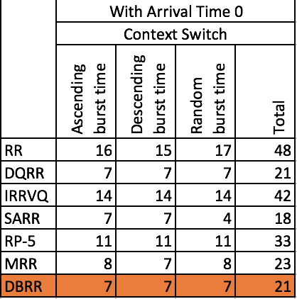
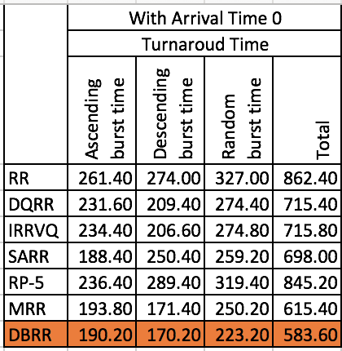
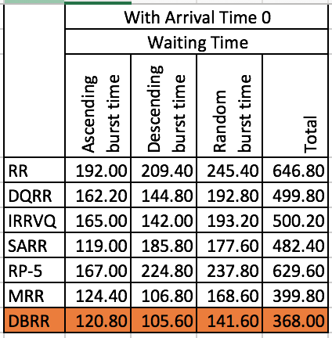
CS 161 | Cu, Constantino, Yumang
Results
Case 1
Case 2
Case 3

Slide 12
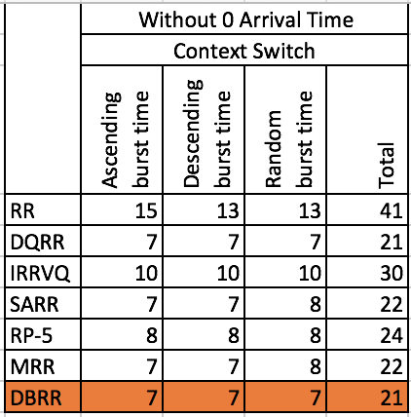
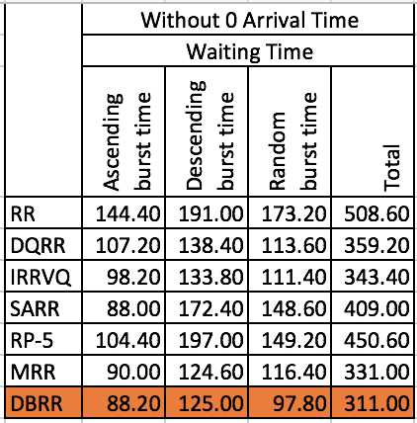
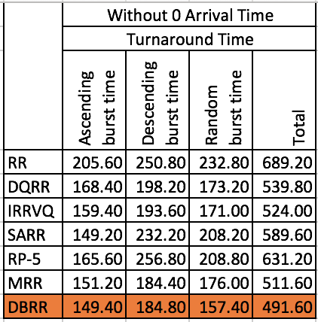
CS 161 | Cu, Constantino, Yumang
Results
Case 4
Case 5
Case 6

Slide 13
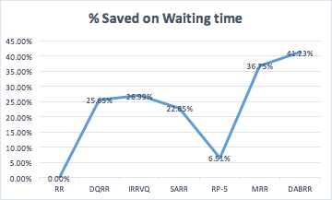
CS 161 | Cu, Constantino, Yumang
Results

Slide 14
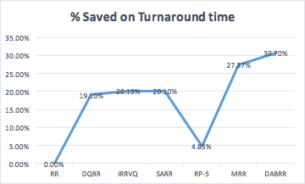
CS 161 | Cu, Constantino, Yumang
Results

Slide 15
CS 161 | Cu, Constantino, Yumang
Advantages and Disadvantages

Slide 16
CS 161 | Cu, Constantino, Yumang
Results
Advantages
Disadvantages
Context switches
Priority not addressed
X
Average Waiting Time
Possibility of starvation
!
Average Turnaround Time

Slide 17
CS 161 | Cu, Constantino, Yumang
Application in Uni- and Multiprocessor threads

Slide 18
CS 161 | Cu, Constantino, Yumang
Application in Uni- and Multiprocessor Threads
Uniprocessor
The application is round robin and if a process is still not done, it goes to the next round
Multiprocessor
Complicated to apply because of multiple job schedulers
Different quantum times are to be calculated for each CPU
In heterogeneous system, the CPU's have communicate to each other
In homogenous system, the CPU's can perform load sharing

Slide 19
CS 161 | Cu, Constantino, Yumang
MIS application

Slide 20
CS 161 | Cu, Constantino, Yumang
Network Packet Scheduling
The network scheduler is an arbiter program in the packet switching communication network which manages the sequence of network packets both in receive and transmit queues. It is the network scheduler who decides which network packet to forward to, next, from the buffer.
Network Throughput
Latency
Delay
Notes:
The network scheduler is an arbiter program in the packet switching communication network which manages the sequence of network packets both in receive and transmit queues. It is the network scheduler who decides which network packet to forward to, next, from the buffer.

Slide 21
CS 161 | Cu, Constantino, Yumang
End

