Slide 1



Report
View in Power BI
Last data refresh:
2/21/2023 10:40:43 AM UTC
Downloaded at:
2/21/2023 10:59:15 AM UTC

Slide 2
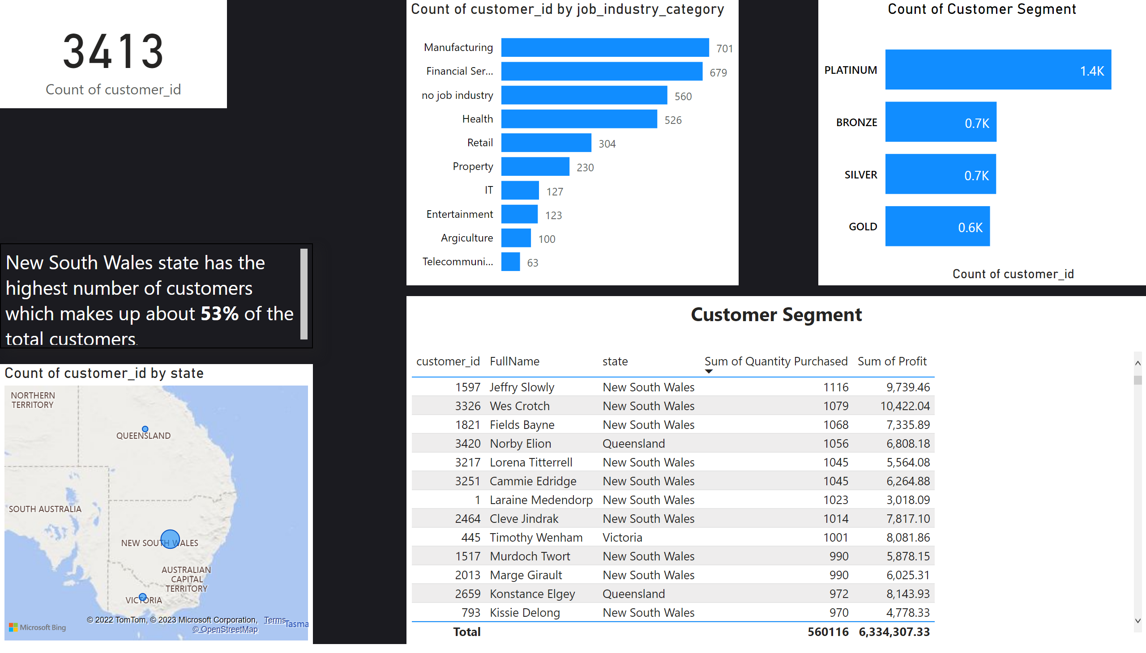
Customer Analysis
Notes:
textbox
No alt text provided
map
No alt text provided
Count of Customer Segment
No alt text provided
tableEx
No alt text provided
textbox
No alt text provided
clusteredBarChart
No alt text provided
card
No alt text provided

Slide 3
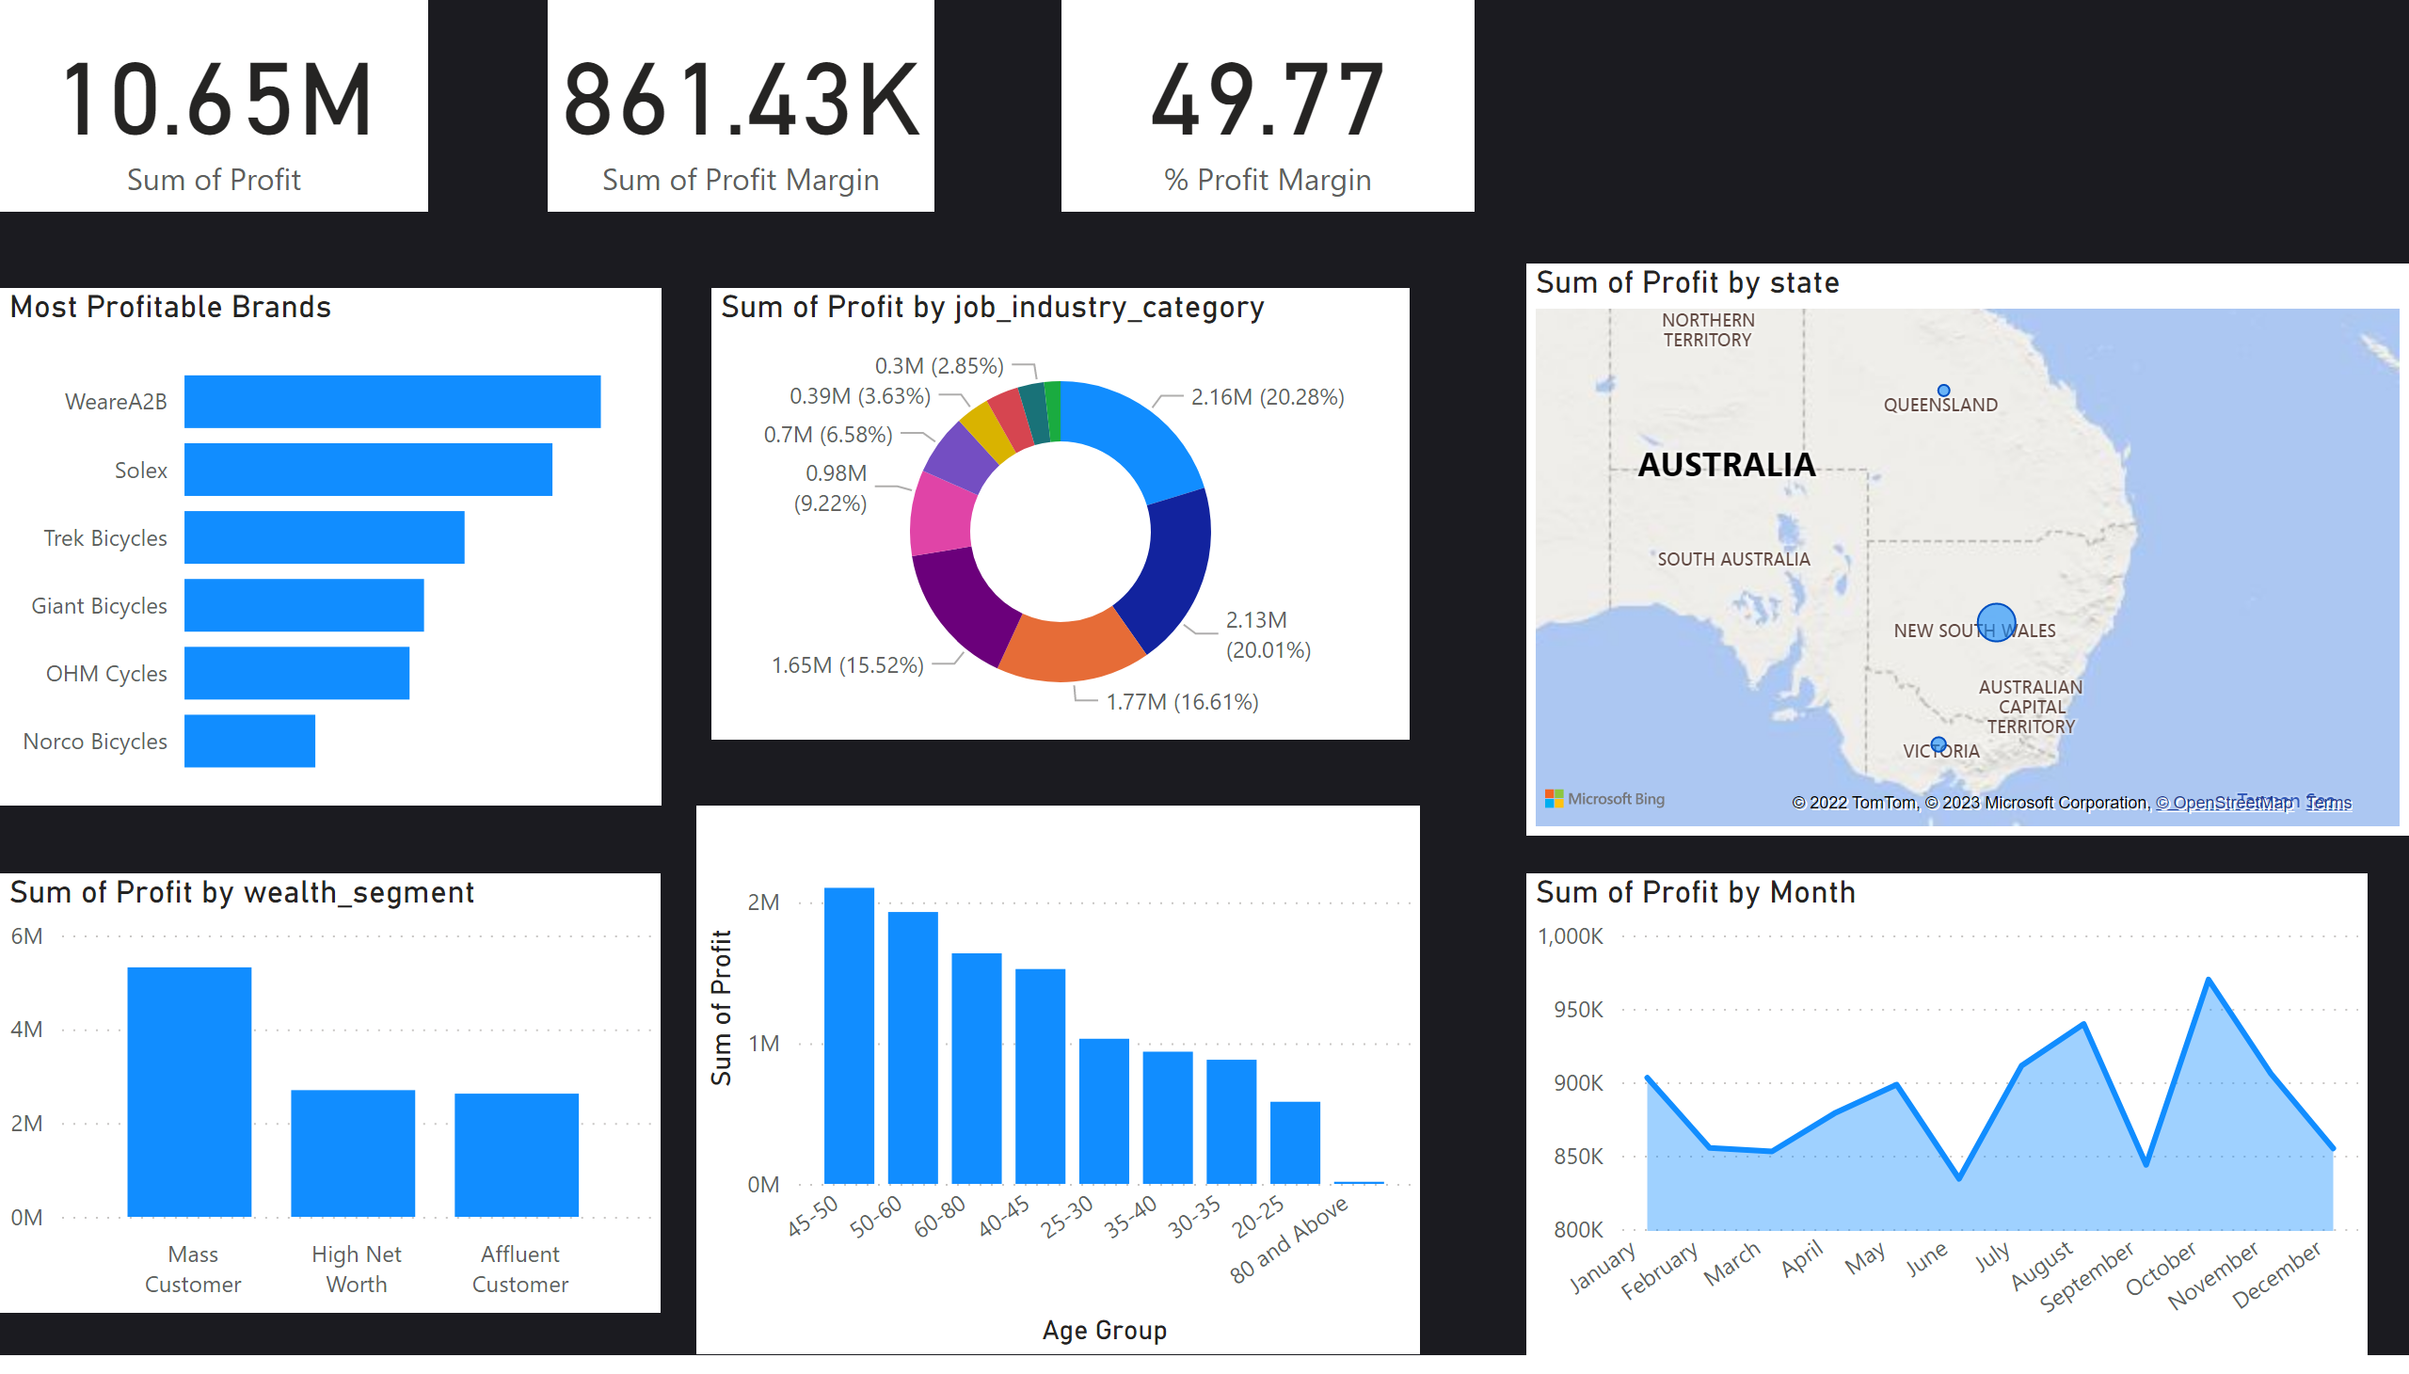
Profit Analysis
Notes:
card
No alt text provided
clusteredColumnChart
No alt text provided
card
No alt text provided
card
No alt text provided
map
No alt text provided
Most Profitable Brands
No alt text provided
clusteredColumnChart
No alt text provided
areaChart
No alt text provided
donutChart
No alt text provided

Slide 4
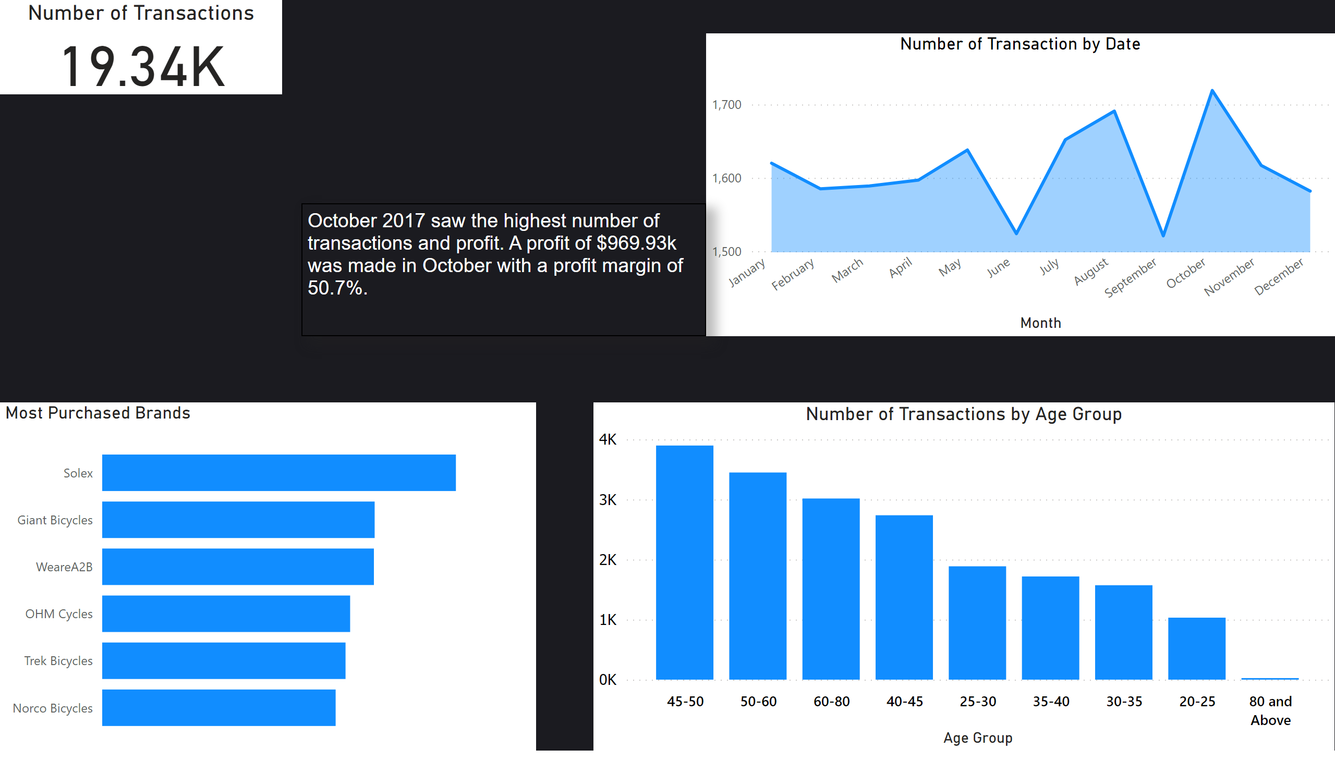
Transactions Analysis
Notes:
Number of Transactions
No alt text provided
Number of Transaction by Date
No alt text provided
textbox
No alt text provided
Most Purchased Brands
No alt text provided
Number of Transactions by Age Group
No alt text provided

Slide 5
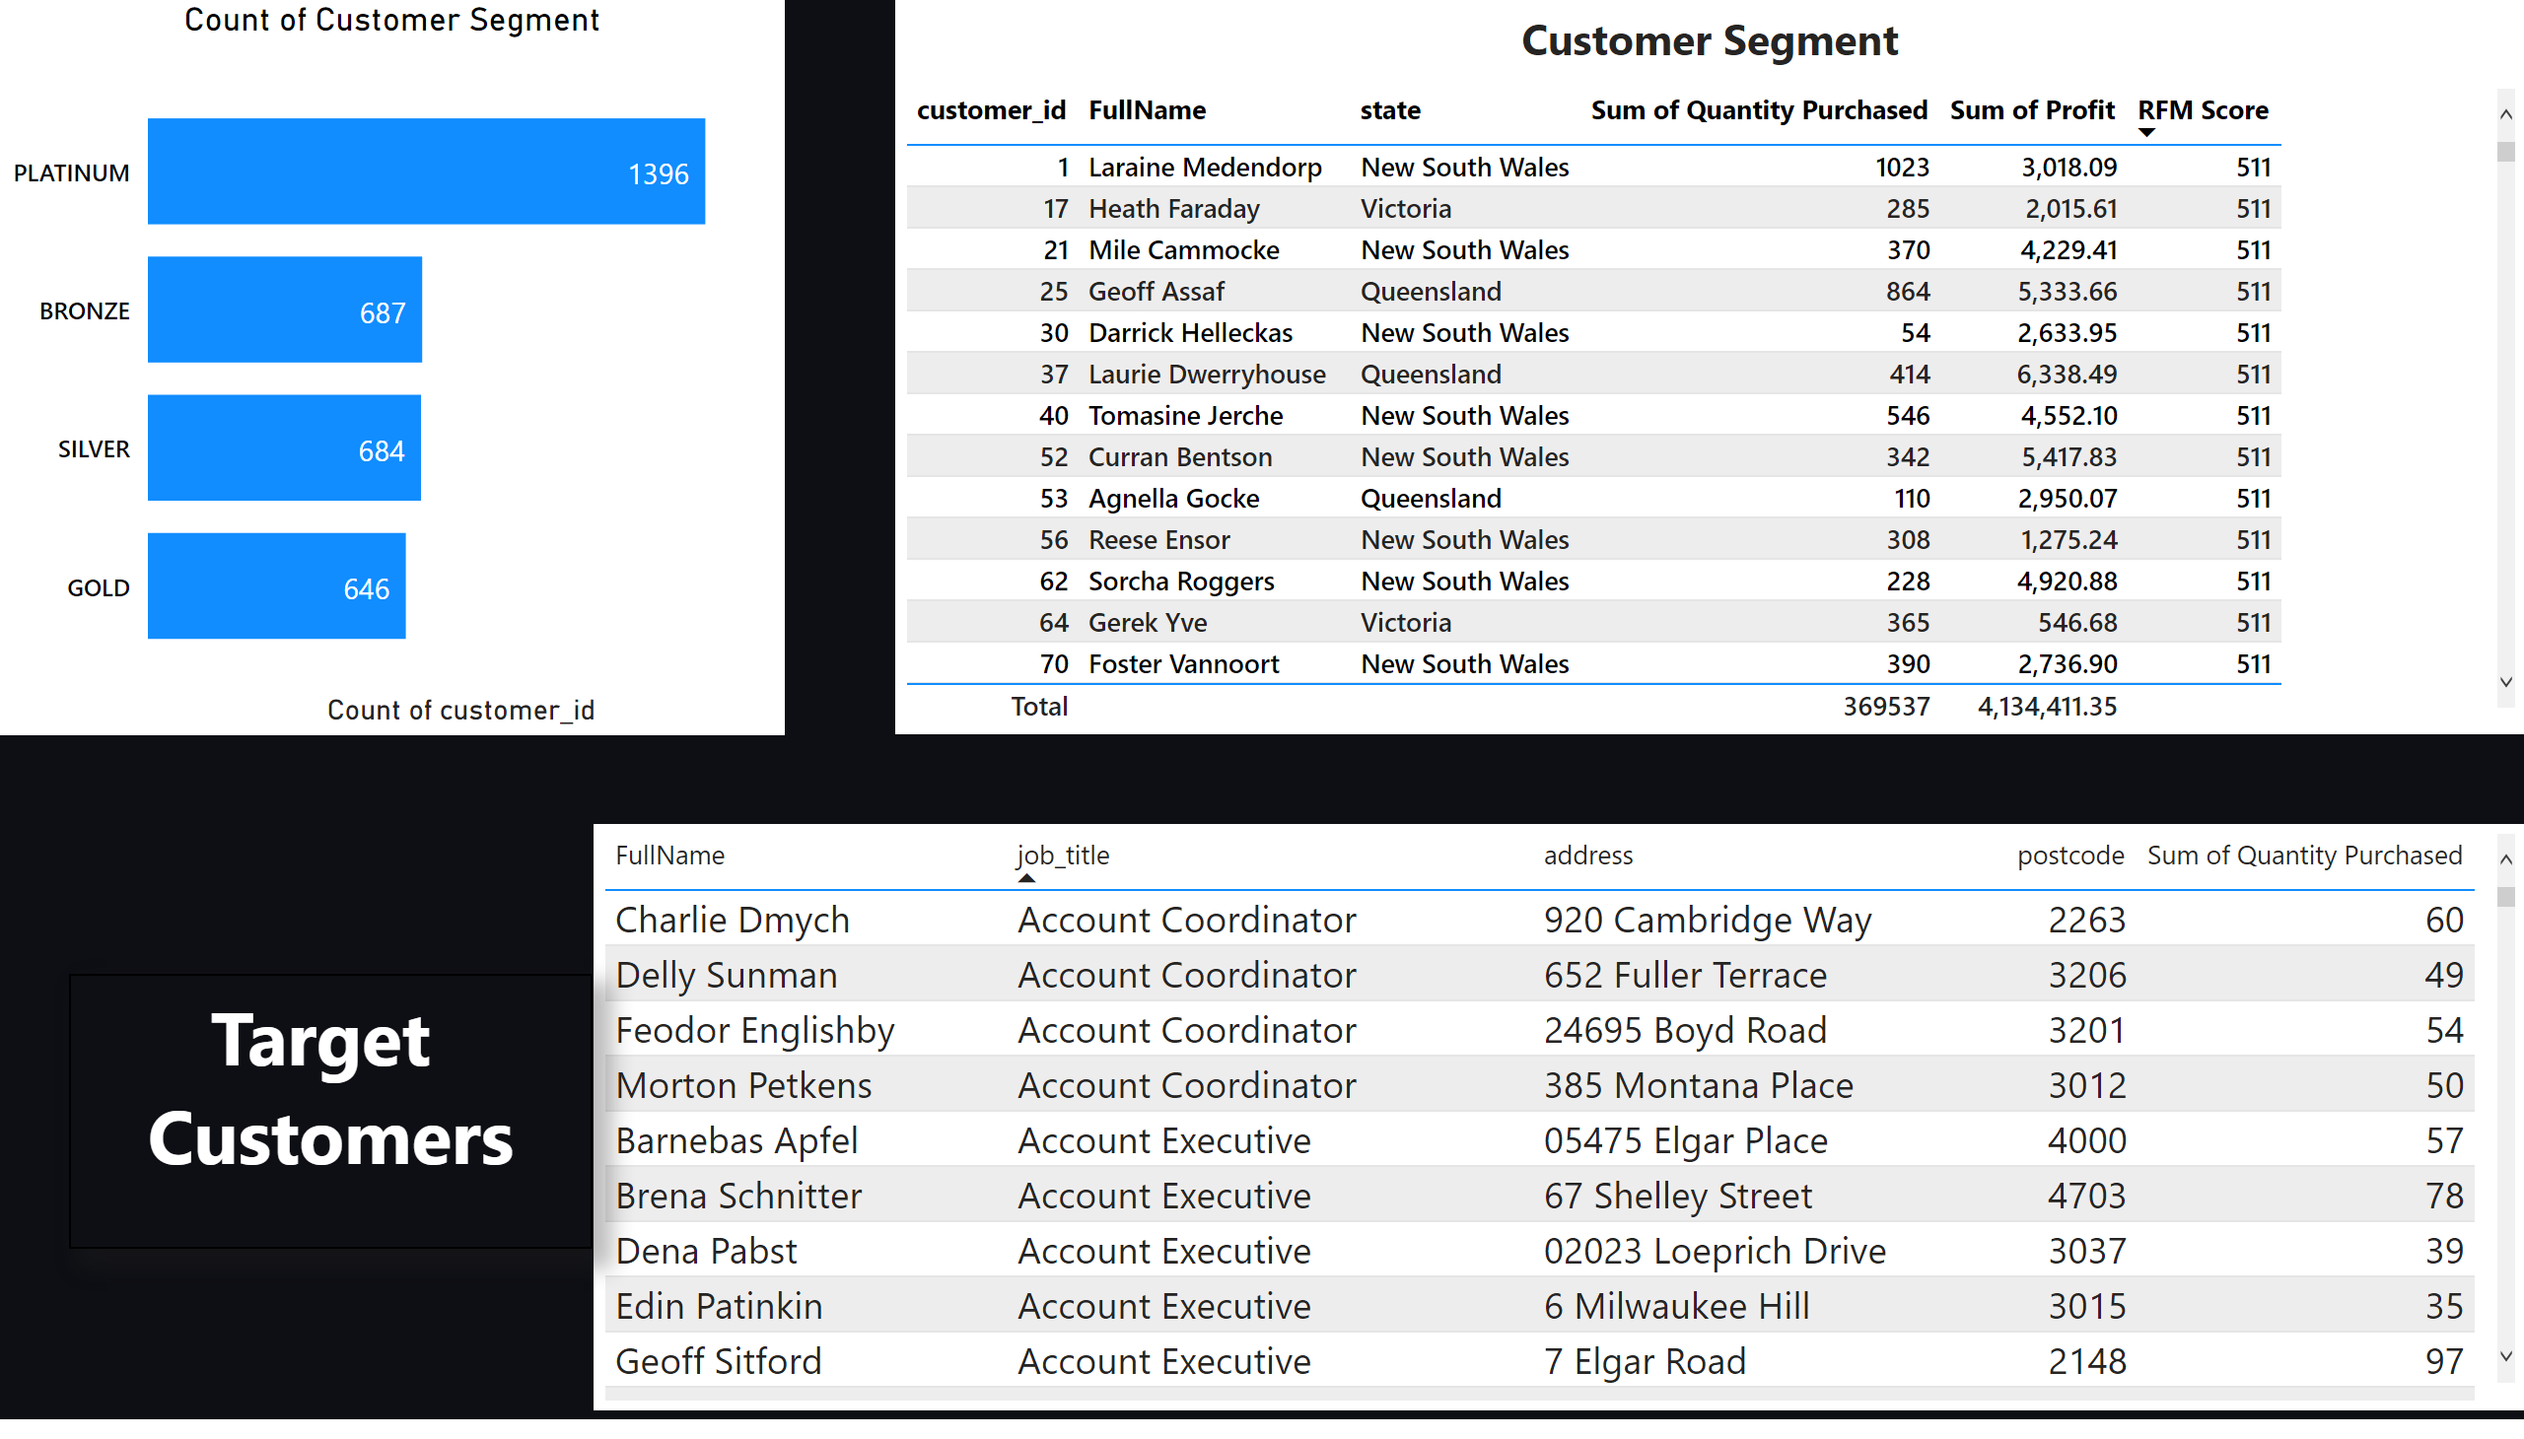
Customer Segment
Notes:
Count of Customer Segment
No alt text provided
tableEx
No alt text provided
Target Customers
No alt text provided
textbox
No alt text provided
textbox
No alt text provided

Slide 6
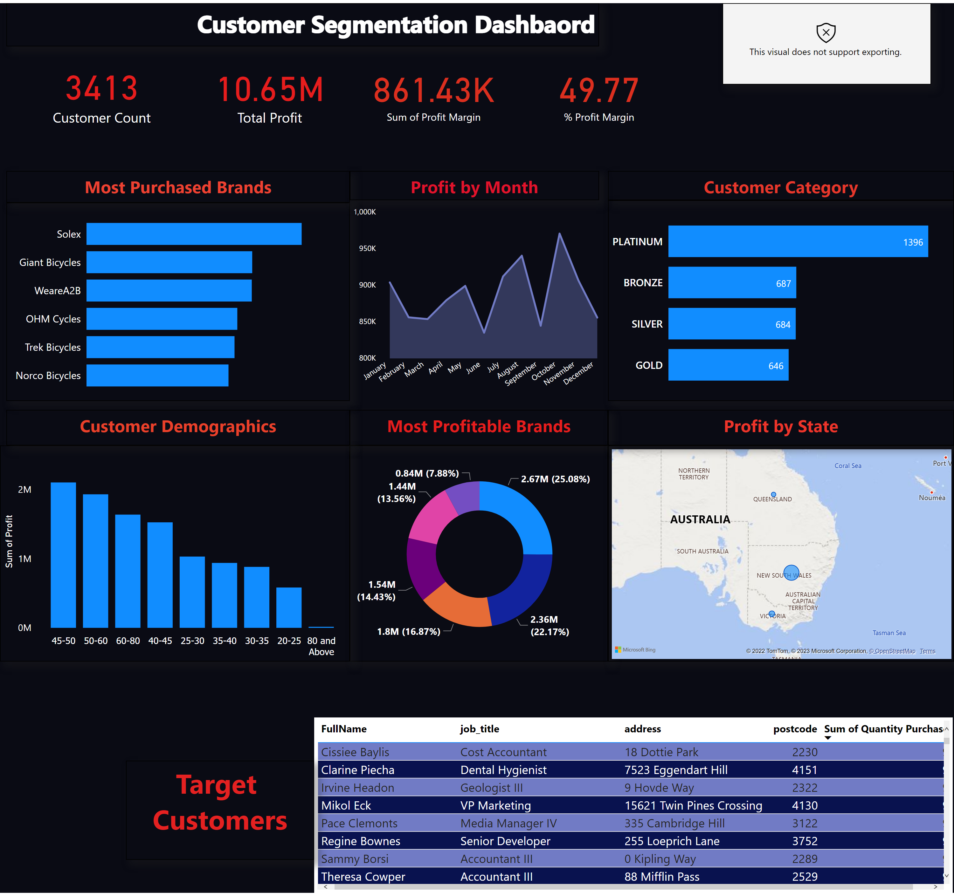
Dashboard
Notes:
Count of Customer Segment
No alt text provided
Target Customers
No alt text provided
textbox
No alt text provided
textbox
No alt text provided
card
No alt text provided
card
No alt text provided
Most Purchased Brands
No alt text provided
textbox
No alt text provided
Most Profitable Brands
No alt text provided
areaChart
No alt text provided
simpleImageEBC4593F96F1425FB3D84C5BF02B5075
No alt text provided
textbox
No alt text provided
textbox
No alt text provided
card
No alt text provided
card
No alt text provided
textbox
No alt text provided
textbox
No alt text provided
map
No alt text provided
textbox
No alt text provided
textbox
No alt text provided
clusteredColumnChart
No alt text provided
textbox
No alt text provided

